Slide 1
Dynamic Thresholds for Channel Bonding
Date: 2019-11-10
Authors:

Slide 2
Abstract
Currently, the CCA levels on the secondary channels have fixed levels, i.e. -62dBm for 11n and -72dBm for (11ac/ax). Both values are not optimal.
It is well established that optimal secondary CCA levels depend on the network scenario (STA density, QoS requirements, etc.) [1]
To achieve extreme high throughputs, we propose that the secondary channel CCA levels for 802.11be be made dynamic.

Slide 3
Current State of Secondary Channel CCA levels
Secondary Channel BW | 11n | 11ac | 11ax (without OBSS_PD) | 11be
20 | -62 | -72 | -72
40 | - | -72 | -72
80 | - | -69 | -69
We propose
dynamic levels
Based on primary CCA-ED threshold
Chosen as a “reasonable compromise” [1]
Inherited from 11ac

Slide 4
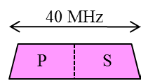
Problem with static secondary CCA levels
Low SINR
BSS-1
High SINR
BSS-1
BSS-2
BSS-2
With current secondary CCA level, the BSS cannot take advantage of dynamic OBSS interference
When OBSS interference is low, we should encourage high BW transmissions → Use low secondary CCA level
When OBSS interference is high, we should encourage high BW transmissions → Use high secondary CCA level

Slide 5
System Simulation Scenario
3 BSS network, 10 associated STAs per BSS
BSS-2
BSS-1
BSS-1
R
r
BSS-3
R
R
BSS-2
frequency
R- InterBSS distance
r- BSS radius
BSS-3

Slide 6
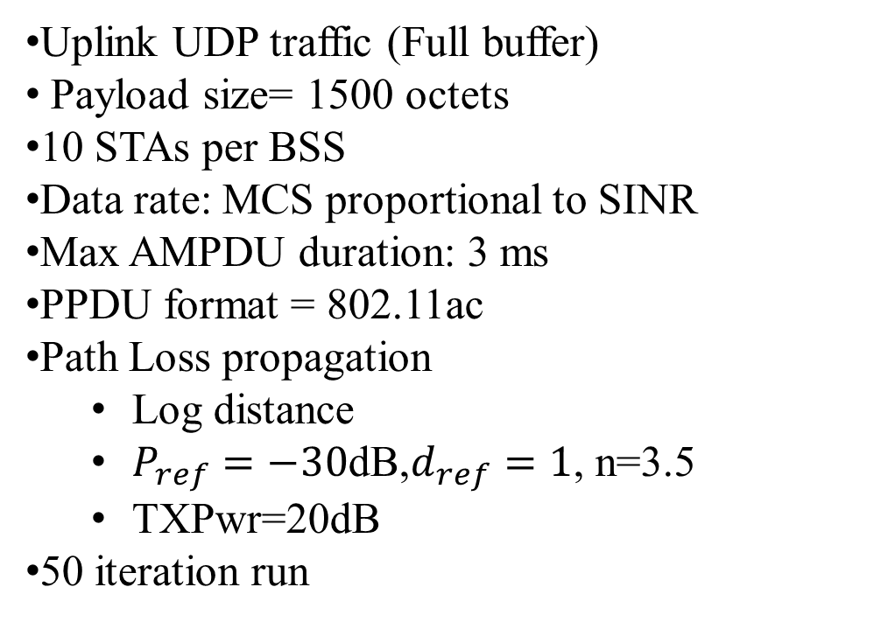
Simulation Parameters (NS-3*)
Uplink UDP traffic (Full buffer)
Payload size= 1500 octets
10 STAs per BSS
Data rate: MCS proportional to SINR
Max AMPDU duration: 3 ms
PPDU format = 802.11ac
Path Loss propagation
  Log distance
  $P_{ref}=−30$dB,$d_{ref}=1$, n=3.5
  TXPwr=20dB
50 iteration run
BSS-1
  80MHz
  36(Primary),40,44,48
BSS-2
  20MHz
  Channel 40
BSS-3
  20MHz
  Channel 48
* Codes available at repository:https://gitlab.com/sderonne/ns-3-dev/tree/channel_bonding_models_extended

Slide 7
InterBSS distance =10m
25% increase
Default

Slide 8
InterBSS distance =20m
65% increase
Default

Slide 9
InterBSS distance =40m
3% improvement
Default

Slide 10
Discussion of Results
When OBSS interference on secondary channels is high → Low Secondary CCA levels are optimal
When OBSS interference on secondary channels is low →High Secondary CCA levels are optimal
Having the secondary CCA level fixed at the default value of -72dBm can hinder improvement of as much as 65%.

Slide 11
Additional Thoughts
Due to dynamic primary channel CCA levels already implemented in 11ax, a dynamic CCA level mechanism on the secondary should be straightforward.
The secondary CCA levels could be implemented as a beacon parameter whose value is adapted by the AP/multi-AP master or could be implemented as an extension of 11ax OBSS_PD algorithm.
Hardware implementation for -62dBm and -82dBm levels are feasible [3].

Slide 12
Conclusion
We present simulation results showing that significant throughput gains are achieved when dynamic secondary CCA levels are enabled.
We believe this is one of the simplest way we can achieve the extremely high throughput requirements of 11be.

Slide 13
Strawpoll
Do you support to have dynamic secondary CCA thresholds in 11be. Actual implementation is TBD
Y/N/A

Slide 14
References
[1] CCA Threshold Levels, IEEE 792,11-11/0061r0
[2] Enhanced CCA for Non-Primary Channels
Using Guard Interval, IEEE 792,11-10/0012r0
[3] M. Park, "IEEE 802.11ac: Dynamic Bandwidth Channel Access," 2011 IEEE International Conference on Communications (ICC), Kyoto, 2011

