Slide 1
Revisiting HARQ Complexity
Date: 2019-01-06
Authors:

Slide 2
Background
Various contributions on Hybrid Automatic Repeat Request (HARQ) have been presented in previous meetings [1-7]
In [8], HARQ complexity was addressed, with focus on 3 major aspects:
  Receiver LLR Memory requirements
  PHY LDPC codeword processing
  MAC layer processing
This is an updated revision based on comments received during the conf-call; in particular, the following were updated/added:
  Updated the memory area estimation (28nm→7nm conversion)
  Added discussion about the general considerations with HARQ
  Added more details on LDPC codeword processing

Slide 3
HARQ: General Considerations
HARQ can be used to significantly improve the performance, as shown in various contributions; in order to support HARQ, both transmitter and receiver need to accommodate it
  At transmitter side, HARQ can be accommodated with minor design and spec changes, as suggested for example in [10]
  At receiver side, the major cost associated with HARQ is the memory required; we show in this contribution that the impact on memory size is not very significant
HARQ support should be signaled via capability exchange; if either transmitter or receiver do not support it, it will not be used – no harm done
  A transmission scheme that is backward compatible (e.g. no changes to encoder design) is hence preferred
  Receiver should be able to indicate its memory size; both sides can then use this information to dynamically adapt the retransmissions (requesting/selecting HARQ or ARQ mode)

Slide 4
Receiver LLR Memory Requirements
We start out with similar assumptions as in [8]:
  An HARQ sequence (defined here as a block of data, e.g. PSDU, that is contained in the initial transmission and any subsequent HARQ retransmission) completes within a TXOP
  A single HARQ sequence is active at any time
  Memory is allocated for the LLRs for all code bits in the codeword
  Focus on Chase Combining
  5 bits are allocated for an LLR
In the next slides, we compute the memory size respective to various scenarios, just like [8]

Slide 5
Receiver LLR Memory Requirements – Rough Estimate of LLR Memory Size
Let us begin with a discussion of the memory size required for the LLRs
We will reuse the same scenarios of data rates and durations given
in the table below, and then compute the corresponding LLR memory size
Data Rate (Gb/s) | Duration of Data Field (ms)
1 | 1
5 | 1
10 | 1
1 | 5
5 | 5
10 | 5

Slide 6
Receiver LLR Memory Requirements – Rough Estimate of LLR Memory Size
Let us look at how many codewords fail, on average, within a failed MPDU, where we assume 20% PER
We look at three different
MCS – each with a different
coding rate - for a 1500B MPDU
The results are shown in the
figure on the right; the average
number of failed codewords is:
  MCS 1 = 5.68 out of 13, ~43%
  MCS 4 = 6.11 out of 9, ~67%
  MCS 7 = 5.55 out of 8, ~69%

Slide 7
Receiver LLR Memory Requirements – Rough Estimate of LLR Memory Size
Some things to consider before we compute the memory size:
  Rate of 1Gbps corresponds to 1Mbit transmitted within 1msec, which means
  which is a rather large aggregation; similarly, 10Gbps transmitted within 1msec corresponds to ~833 MPDUs…
    We assume packets of size 1500B are used for such high data rates
    These are far from being typical scenarios; nevertheless, we will adopt them
  Typical MCS selection/link adaptation works around 10% PER, however with HARQ we may aim for a higher, pre-combining PER, so let’s assume we operate around 20% PER
  On average, as shown in previous slide, roughly half the codewords fail within a failed MPDU, for practical PER; let’s assume 66% of codewords fail on average
  We need to store only LLRs corresponding to incorrectly decoded codewords
Based on the above, ~0.2*0.66= ~13% of transmitted codewords need to be stored (on average); the memory required for storing LLRs is the same irrespective of the HARQ feedback scheme, since only failed codewords are stored

Slide 8
Receiver LLR Memory Requirements – Rough Estimate of LLR Memory Size
Based on the previous slide, we update the table with the respective LLR memory size, where we slightly modify the memory size computation from [8]:
where D is the data rate in
Gb/sec, T is the data field
duration in msec, and
C is the ratio of codewords
that needs to be stored
We assume both C=13%
and C=26%
Code rate 5/6 is assumed
Data Rate (Gb/s) | Duration of Data Field (ms) | Codeword Storage Ratio | LLR Memory Size (MB)
1 | 1 | 0.13 | 0.09
5 | 1 | 0.13 | 0.46
10 | 1 | 0.13 | 0.93
1 | 5 | 0.26 | 0.93
5 | 5 | 0.26 | 4.65
10 | 5 | 0.26 | 9.3

Slide 9
Receiver LLR Memory Requirements – Required memory at STA (DL example)
We will assume, similar to [8], MCS 11 with 2 SS, and Chase Combining
Since there are 11ax chipsets fabricated at 14nm process [9] in the market, we expect 11be to be fabricated at 7nm or below
Given an area ratio of 4.5:1 (28nm→7nm process) and re-using the value of 0.155mm²/Mb from [8], the memory die size at 7nm is 0.034mm²/Mb for memory
cells
The resulting
required
memory area
is relatively
small
Bandwidth (MHz) | Data Rate (Gb/s) | Duration of Data Field (ms) | Codeword Storage Ratio | LLR Memory Size (MB) | SRAM Area (7nm) (mm²)
80 | 1.2 | 1 | 0.13 | 0.11 | 0.029
160 | 2.4 | 1 | 0.13 | 0.22 | 0.059
320 | 4.8 | 1 | 0.13 | 0.45 | 0.12
80 | 1.2 | 5 | 0.26 | 1.11 | 0.3
160 | 2.4 | 5 | 0.26 | 2.23 | 0.6
320 | 4.8 | 5 | 0.26 | 4.47 | 1.21

Slide 10
LDPC Codeword Processing
As indicated in [8], with HARQ – depending on the retransmission scheme – less time may be required to transmit the code bits respective to an LDPC codeword
This means that more codewords may be transmitted in a given period of time; for example, as shown below, if 50% of the coded bits are retransmitted, then within any given time twice as many codewords are transmitted within a reTx
It appears as if codeword processing rate may need to be doubled in this case; let us see if this is indeed true
1st Tx
100% of the code bits from the k-th LDPC Codeword
Time
2nd Tx
50% of the code bits from the k-th LDPC Codeword
50% of the code bits from the k+1th LDPC Codeword

Slide 11
LDPC Codeword Processing
The LDPC decoder processing rate is mainly dictated by the number of decoding iterations
We now compare the number of iterations required for the 1st Tx (no combining) and the 2nd Tx (after combining), where we use one of two HARQ combining schemes:
  Chase combining (retransmission of all bits)
  Info bit retransmission (as per [10]); for this analysis we assume coding rate ½, hence 50% of coded bits are retransmitted
Maximum number of iterations is set to 8
We chose an operating SNR, such that the PER after combining using the ‘Info Retransmission’ and ‘Chase’ HARQ schemes is ~8% and ~0.5%, respectively

Slide 12
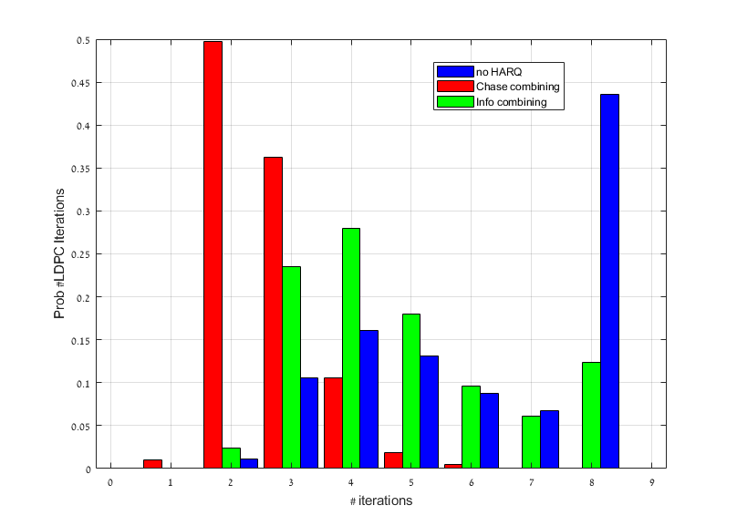
LDPC Codeword Processing
The figure below shows the distribution of #LDPC iterations for all three cases
The average number of iterations
required for the ‘No HARQ’, ‘Chase’
and ‘Info’ HARQ schemes is 6.2,
2.65 and 4.4, respectively
This means within the retransmission
(for this specific operating SNR),
where only 50% of the coded bits are
transmitted, the LDPC decoder needs to
‘work’ only ~70% of the time as well,
so the increase in LDPC codeword
processing requirement is small (far from being doubled)
This all assumes CW retransmission; with MPDU retransmission (e.g. [10]), the processing is further relaxed

Slide 13
Conclusions
We looked at two aspects related to HARQ – the required memory, and the LDPC processing rate
We’ve shown that the impact of HARQ on the memory size and LDPC decoder processing is not as significant as previously thought
A later contribution will discuss the MAC processing rate aspect

Slide 14
References
11-18-1587: HARQ for EHT, Sep. 2018
11-18-1955: HARQ for EHT – Further Information, Nov. 2018
11-18-1963: Discussion on HARQ for EHT, Nov. 2018
11-19-1992: HARQ Feasibility, Jan. 2019
11-19-2029: HARQ in EHT, Jan. 2019
11-19-1979: HARQ performance analysis, Jan. 2019
11-19-780: Consideration on HARQ, May 2019
11-19-1080r0: HARQ Complexity, Sep. 2019
https://www.qualcomm.com/news/releases/2019/01/07/qualcomm-demonstrates-continued-leadership-industry-transitions-wi-fi-6
11-19-1578: An HARQ Transmission Scheme for 11be, Nov. 2019

