Slide 1
Considerations for Multi-link Channel Access
Without Simultaneous TX/RX Capability
Date: 2019-11-11
Authors:
Name | Affiliation | Address | Phone | Email
Insun Jang | LG Electronics | 19, Yangjae-daero 11gil, Seocho-gu, Seoul 137-130, Korea |  | insun.jang@lge.com
Jinsoo Choi |  |  |  | js.choi@lge.com
Jeongki Kim |  |  |  | jeongki.kim@lge.com
Suhwook Kim |  |  |  | suhwook.kim@lge.com
Sungjin Park |  |  |  | allean.park@lge.com
Taewon Song |  |  |  | taewon.song@lge.com

Slide 2
Introduction
Many contributions have addressed operation of STAs belonging to a multi-link device (MLD) which don’t have simultaneous TX/RX (STR) capability [1], [2]
  In this contribution, “STR” means the transmission and the reception simultaneously in a TXOP can be allowed over multiple links
  Also, we call the constraints to support STR “non-STR” for simplicity
Specifically,
  Capability [1], [2]
  Operation [3]-[6]
  Performance [7]-[9]
  Impact on legacy (or single-link) STAs [10],[11]
In this contribution, we first consider operation for the most constrained case that two or more APs with non-STR on their operating links

Slide 3
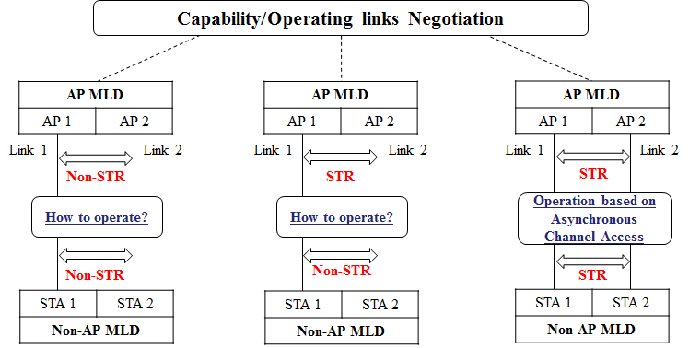
STR Capability and Operation
STAs of MLD can support STR or not on their operating links depending on several constraints (e.g., frequency separation)
For a pair of links, we can consider the following cases:
We start with the most constrained case that two or more APs with non-STR on their operating links

Slide 4
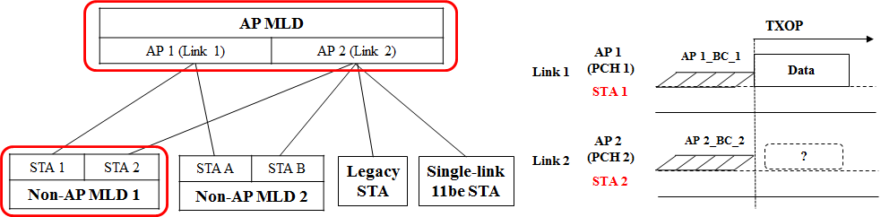
Example of Scenario for DL
We assume the following topology and scenario
  AP MLD is transmitting a frame to non-AP MLD 1 on link 1
  Non-AP MLD 2 can know the transmission through link 1
  Single-link 11be and Legacy STA cannot know the transmission
  MLDs have the constraints to support STR (i.e., non-STR)
For each, we describe its behavior on link 2 during the DL transmission on link 1 in the following slides

Slide 5
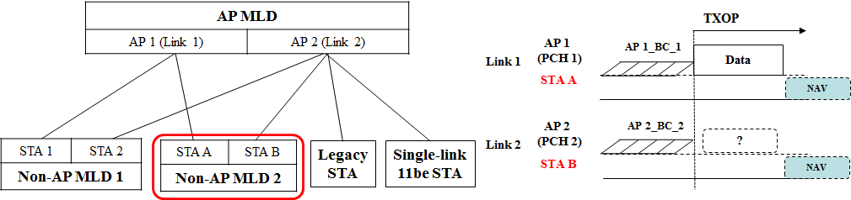
Example: Behavior for Non-AP MLD 2
It can know the transmission of AP MLD and its TXOP
  Therefore, it may defer over link 2 during the time estimated based on the TXOP information from link 1 without performing back-off
However, if a non-AP MLD doesn’t support a link on which an AP is transmitting a frame, it can’t know the transmission of AP
  For example, if there is link 3 and another non-AP MLD operates on link 2 and link 3, it can’t know the transmission of AP 1
    Therefore, an STA of the non-AP MLD would transmit a UL frame to an AP on link 2 or link 3 when obtaining a TXOP; however, the AP cannot receive the UL frame

Slide 6
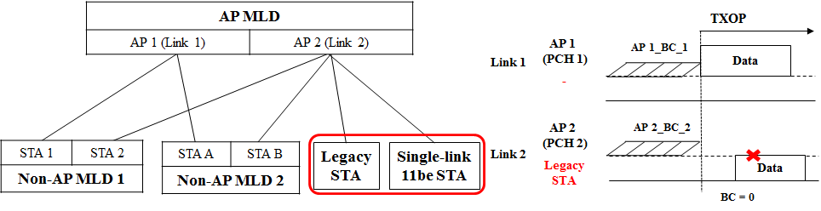
Example: Behavior for Single-link 11be STA and Legacy STA
They also cannot know the transmission of AP MLD and its TXOP
  Therefore, they would transmit a UL frame to AP 2 when obtaining a TXOP; however, AP 2 cannot receive the UL frame
Even for UL case, AP MLD cannot control them normally because each STA performs the random access on its operating link and doesn’t recognize the transmission on the other link(s)

Slide 7
Analysis and Proposal
Consequently, AP MLD with non-STR has to be able to handle legacy or single-link STAs before obtaining a TXOP
  Even for a non-AP MLD which doesn’t support a link on which an AP is transmitting a frame
When AP MLD obtains a TXOP on one or more link(s), it cannot receive UL frames correctly on the other link(s) (not applied to TXOP)
To resolve the issue, we propose the concept of primary link where legacy or single-link STAs always stay to exchange frames

Slide 8
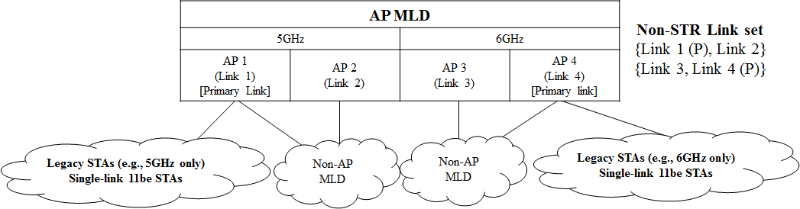
Overview of Proposal
Non-STR link Set and Primary link
  Non-STR link set means a set of links on which APs of AP MLD with constraints to support STR operate
  Non-STR link set would have a Primary link including a Primary channel (PCH)
  AP MLD can have multiple non-STR link sets where they each have a primary link depending on STR capability across all links supported
    STR is possible between Primary links
    One or more non-primary link(s) may be included in multiple non-STR link sets in common
  Example

Slide 9
Proposed Behavior of STA and MLD
All Legacy STAs and All Single-link 11be STAs operate on the primary link
All MLDs transmit a frame on one or more links including the primary link (in a Non-STR link set)
  It prevents the legacy or single-link 11be STAs from transmitting during MLD’s transmission

Slide 10
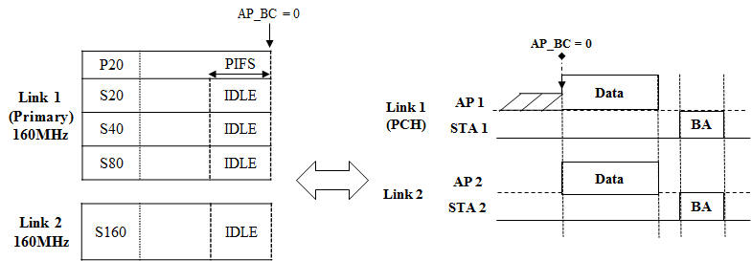
Channel Access in Non-STR Link Set
One PCH in Primary link
  All STAs will discover an AP through the primary link(s)
In terms of the existing channel access, it is almost same to the channel access (e.g., 80 + 80 in 11ax)
  However, the existing method would be inefficient for multi-link because
    It’s not likely that channels on non-primary link is used for transmission
    Ambiguous combinations of bandwidth depending on the multi-link capability (e.g., P80-S80-S80-S160, P80-S80-S160-S80)

Slide 11
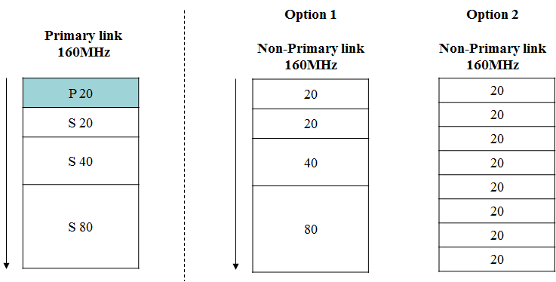
CCA rule for improving efficiency
To improve the link utilization, we can have several options for rules applied to non-primary link(s)
  It is independent of rules for primary link
  Option 1: CCA like existing dynamic bandwidth operation
  Option 2: CCA per xMHz (e.g., 20MHz as in preamble puncturing case)
    Option 2 is more efficient than Option 1

Slide 12
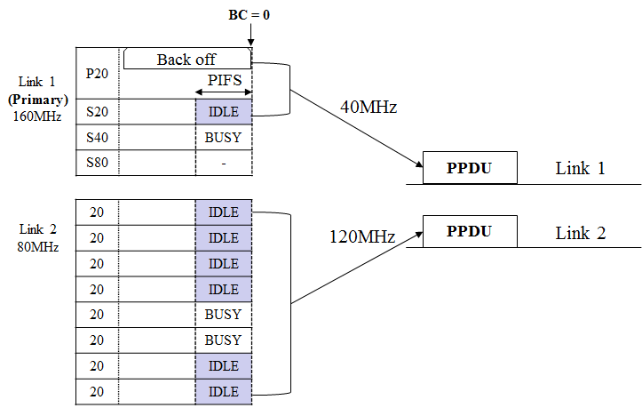
Example: Option 2
PIFS based example

Slide 13
Summary
Considering the most constrained case that two or more APs of AP MLD don’t have STR capability on their operating links, we analyzed the behaviors of single-link STAs and MLDs
To handle the behavior issues, we proposed the concept of primary link
  A Primary link is set in a non-STR link set
    Non-STR link set means a set of links APs of AP MLD with constraints to support STR operate on
  All legacy and single-link 11be STAs operate on the primary link
  All MLDs transmit a frame on one or more links including the primary link
We also discussed the channel access in the non-STR link set to improve efficiency

Slide 14
SP #1
Do you agree that 11be defines mechanism(s) that enables the following:
  Operation to manage the transmission of APs of AP MLD with constraints to simultaneously transmit and receive (STR) on a non-STR link set*
    Non-STR link set means a set of links on which APs of AP MLD with constraints to STR operate
    *NOTE: the exact name can be changed
Y/N/A

Slide 15
SP #2
Do you support that 11be defines the following mechanisms
  A Primary link* is set in a non-STR link set
    Primary link means a link including primary 20MHz channel
  All MLDs transmit a frame on one or more links including the primary link set in the non-STR link set
  *NOTE: Exact name can be changed
Y/N/A

Slide 16
SP #3
Do you support that 11be defines the following mechanisms
  AP MLD can have multiple non-STR link sets where they each have a primary link
    Transmission and reception simultaneously are possible over the primary links
    One or more non-primary link(s) may be included in multiple non-STR link sets in common
Y/N/A

Slide 17
SP #4
Do you agree that 11be defines method(s) of CCA to improve the utilization of links which are included in a non-STR link set?
Y/N/A

Slide 18
SP #5
Do you support 11be defines the following mechanism for a non-STR link set?
  In a non-primary link, states of 20MHz sub-channels are checked
  When obtaining a TXOP on a primary link, an STA of MLD on a non-primary link can transmit a PPDU on 20MHz sub-channels which are IDLE
Y/N/A

Slide 19
References
[1] 802.11-19/1550r1 Simultaneous Tx/Rx Capability Indication
for Multi-link Operation
[2] 802.11-19/1159r5 Multiple Link Operation Capability Announcement
[3] 802.11-19/1144r6 Channel Access for Multi-link Operation
[4] 802.11-19/1116r4 Channel Access in Multi-band Operation
[5] 802.11-19/1405r3 Multi-link Channel Access Discussion
[6] 802.11-19/1548r0 Channel Access Design for Synchronized Multi-Links
[7] 802.11-19/0979r2 EHT Multi-Link Operation Follow-up
[8] 802.11-19/0764r1 Multi-Link Aggregation - Gain Analysis
[9] 802.11-19/1291r3 Performance aspects of Multi-link operations
[10] 802.11-19/1546r0 Legacy Performance Impact on Multi-Link Operation
[11] 802.11-19/1505r2 Multi-link Aggregation Considerations

