Slide 1
Considerations for Multi-link Channel Access Without Simultaneous TX/RX Capability
Date: 2019-11-11
Authors:
Name | Affiliation | Address | Phone | Email
Insun Jang | LG Electronics | 19, Yangjae-daero 11gil, Seocho-gu, Seoul 137-130, Korea |  | insun.jang@lge.com
Jinsoo Choi |  |  |  | js.choi@lge.com
Jeongki Kim |  |  |  | jeongki.kim@lge.com
Suhwook Kim |  |  |  | suhwook.kim@lge.com
Sungjin Park |  |  |  | allean.park@lge.com
Taewon Song |  |  |  | taewon.song@lge.com

Slide 2
Introduction
Many contributions have addressed a multi-link (ML) operation between STAs which don’t have simultaneous TX/RX (STR) capability [1], [2]
In this contribution, STR capability means the transmission and the reception simultaneously in a TXOP over multiple links can be allowed due to in-device interference by out-of-band (OOB) emission
Specifically,
Capability [1], [2]
Basic Operation [3], [4]
Performance [5]-[7]
How to improve channel utilization [8],[9]
Impact on legacy (or single-link) STAs [10],[11]
First of all, we need to consider the most constrained case that two or more APs and STAs don’t have STR capability on their operating links

Slide 3
STR Capability
Basically, STAs of multi-link logical entity (MLLE) have STR capability or don’t have STR capability on their operating links, depending on several constraints (e.g., frequency separation)
We call STR capability “STR” for simplicity
APs with STR and STAs with STR would perform a channel access independently
However, if either STAs or APs don’t have STR capability, several issues [8] have to be resolved
Especially, we start with the most constrained case that two or more APs and STAs don’t have STR capability on their operating links
In other words, they cannot receive a frame on a link while transmitting a frame on the other link(s)

Slide 4
Example of Scenario for DL
We assume the following topology and scenario
AP MLLE is transmitting a frame to non-AP MLLE 1 on link 1 and link 2
Non-AP MLLE 2 can know the transmission through link 2
Single-link 11be and Legacy STA cannot know the transmission
For each, we describe its behavior during the TXOP in the following slides

Slide 5
Example: Behavior for AP MLLE
While DL frames are transmitted on link 1 and link 2, a DL frame could be transmitted on link 3
However, it cannot know which signal (e.g., in-device interference, any UL transmission, or mixed) is detected on link 3
Therefore, AP MLLE itself cannot use link 3 in the TXOP, additionally

Slide 6
Example: Behavior for Non-AP MLLE
It can know the transmission of AP MLLE and its TXOP
Therefore, it does not transmit any frame on link 3 during TXOP
Therefore, it can defer over link 2 and link 3 during the time estimated based on the TXOP information from link 2 (e.g., NAV)

Slide 7
Example: Behavior for Single-link 11be STA and Legacy STA
They cannot know the transmission of AP MLLE and its TXOP
Moreover, they may transmit a UL frame to AP 3; however, AP 3 cannot receive the UL frame

Slide 8
Example of Scenario for UL
When legacy or single-link STAs are operating on each link, the AP MLLE cannot control them because each STA performs the random access on its operating link and doesn’t know the length of PPDU being transmitted on the other link(s)
Trigger frames are only for 11ax STAs

Slide 9
Analysis and Proposal
Consequently, AP MLLE without STR has to handle legacy or single-link STAs before obtaining a TXOP or ignore them
Assuming a general topology in which such STAs are associated with any link
Whether or not to choose either, single-link STAs cannot transmit a UL frame correctly on link(s) where frame is not being transmitted, during the length of TXOP of AP MLLE
To resolve the issue, we propose the concept of primary link where legacy or single-link STAs stay to exchange frames

Slide 10
Overview of Proposal
Non-STR link Set and Primary link
Non-STR link set means a set of links where STR isn’t possible
It mainly would happen in one band
Non-STR link set would have at least a single Primary channel (PCH); In other words, it may have multiple PCHs in the set
A Primary link is set in non-STR link set
AP MLLE may have multiple Primary links depending on STR capability

Slide 11
Proposed Behavior of STAs
All Legacy STAs shall operate on the primary link
All Single-link 11be STAs may operate on the primary link
However, if they operate on non-primary link, RTS-CTS-like mechanisms are necessary
All MLLEs shall transmit a frame on one or more links including the primary link
It prevents the legacy or single-link 11be STAs from transmitting during MLLE’s transmission

Slide 12
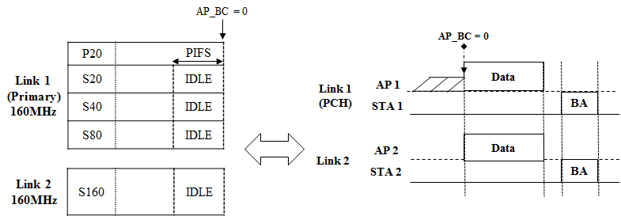
Single PCH in Non-STR Link Set
One PCH in Primary link
All STAs will discover an AP through the primary link
In terms of channel access, it is very similar to the channel access in single link in legacy systems (e.g., 80 + 80 in 11ax)

Slide 13
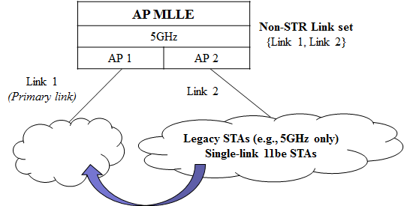
Multiple PCHs in Non-STR Link Set: Setup
Each PCH on each link in non-STR link set
Some legacy or single-link 1be STAs may discover an AP through non-primary link
The AP switches the STAs from the non-primary link to the primary link
Single-link 11be STAs may move to the primary link based on the operation information from AP 2

Slide 14
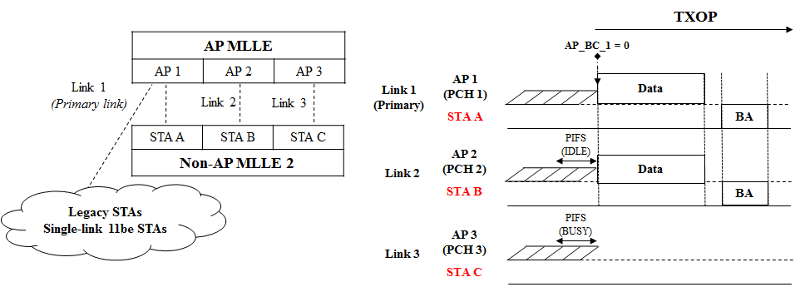
Multiple PCHs in Non-STR Link Set: Channel Access
When the BC of primary link becomes 0, PCH states of other links are IDLE during PIFS immediately preceding time BC = 0, a frame is transmitted by aggregating the links
It is fair to legacy or single-link STAs in the primary link; however, the channel load in the primary link could be high
It can improve channel utilization by aggregating links quickly

Slide 15
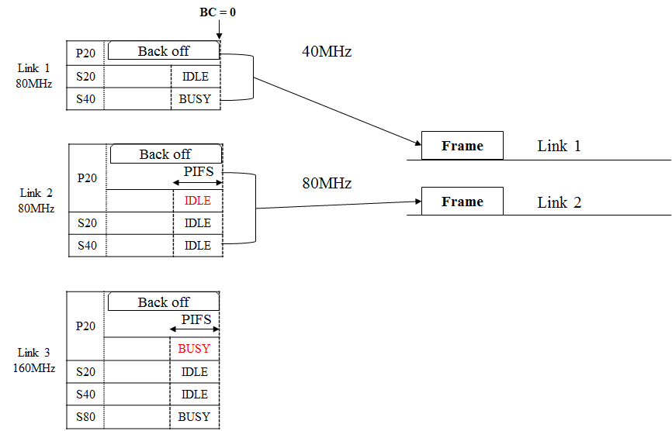
Example

Slide 16
Opportunistic UL Transmission of Non-AP MLLE
An Non-AP MLLE knows the transmission of another non-AP MLLE and there is no transmission on any link, it can transmit a frame on the link by aligning the end of frame transmission [9]
It can improve channel utilization by reducing the waste of resources

Slide 17
Summary
Considering the most constrained case that two or more APs and STAs don’t have STR capability on their operating links, we analyzed the behaviors of single-link STAs and MLLEs
To handle single-link STAs, we proposed the concept of primary link
Primary link is set in non-STR link set
All legacy or single-link 11be STAs operate on the primary link
All MLLEs shall transmit a frame on one or more links including the primary link
We discussed the setup and the channel access in case of single PCH or multiple PCHs in Non-STR Link Set

Slide 18
SP #1
Do you support 11be defines mechanism(s) for multi-link operation that enables the following:
Operations of APs of AP MLLE and STAs of non-AP MLLE on links in the same non-STR link set
Non-STR link set means a set of links where simultaneous transmission and reception (STR) aren’t possible over the links
Y/N/A

Slide 19
References
[1] 802.11-19/1550r0 Simultaneous Tx/Rx Capability Indication for Multi-link Operation
[2] 802.11-19/1159r2 Multiple Link Operation Capability Announcement
[3] 802.11-19/1144r4 Channel Access for Multi-link Operation
[4] 802.11-19/1116 r1 Channel Access in Multi-band Operation
[5] 802.11-19/0979r2 EHT Multi-Link Operation Follow-up
[6] 802.11-19/0764r1 Multi-Link Aggregation - Gain Analysis
[7] 802.11-19/1294r3 Performance aspects of Multi-link operations
[8] 802.11-19/1405r3 Multi-link Channel Access Discussion
[9] 802.11-19/1548r0 Channel Access Design for Synchronized Multi-Links
[10] 802.11-19/1546r0 Legacy Performance Impact on Multi-Link Operation
[11] 802.11-19/1505r0 Multi-link Aggregation Considerations

