Slide 1
MC-OOK symbols with low autocorrelation
Date: 2019-11-09
Authors:

Slide 2
Abstract
We propose a new LDR symbol for the examples in Annex AD. The new symbol complies with the autocorrelation requirement introduced in Section 30.3.12.5 of IEEE 802.11ba/D4.0, and is intended to replace example 2 in Table AD-2

Slide 3

Symbol definition
$S^{LDR}=\frac{\text{[1+}\text{j}\text{,}\text{−1+}\text{j}\text{,−}\text{1+}\text{j}\text{,}\text{1+}\text{j}\text{,}\text{−1+}\text{j}\text{,}\text{1−}\text{j}\text{,0,}\text{1+}\text{j}\text{,}\text{1+}\text{j}\text{,}\text{1−}\text{j}\text{,}\text{1+}\text{j}\text{,}\text{−1−}\text{j}\text{,}\text{−1+}\text{j}\text{]}}{\sqrt{2}}$
This symbol should be used with the CSD values corresponding to example 2 of Table AD-4.

Slide 4
Autocorrelation properties
The WUR PPDU has been formatted according to IEEE 802.11ba/D4.0
200 PPDUs with random data have been generated, and the maximum value of the metric is shown in the table below
The autocorrelation metric has also been checked for TX diversity (4 TX), and it has been verified that all the signals in all TX branches comply with the requirement
Maximum value of autocorrelation metric
Symbol | Sync field only | Data field only | Sync and data
Example 2 (old) | 0.398 | 0.746 | 0.746
New symbol | 0.398 | 0.317 | 0.398

Slide 5
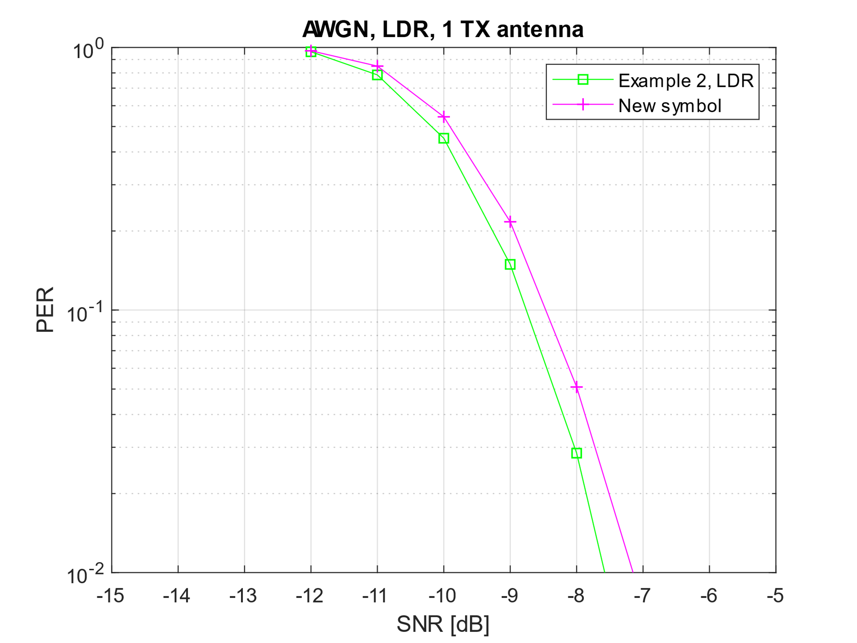
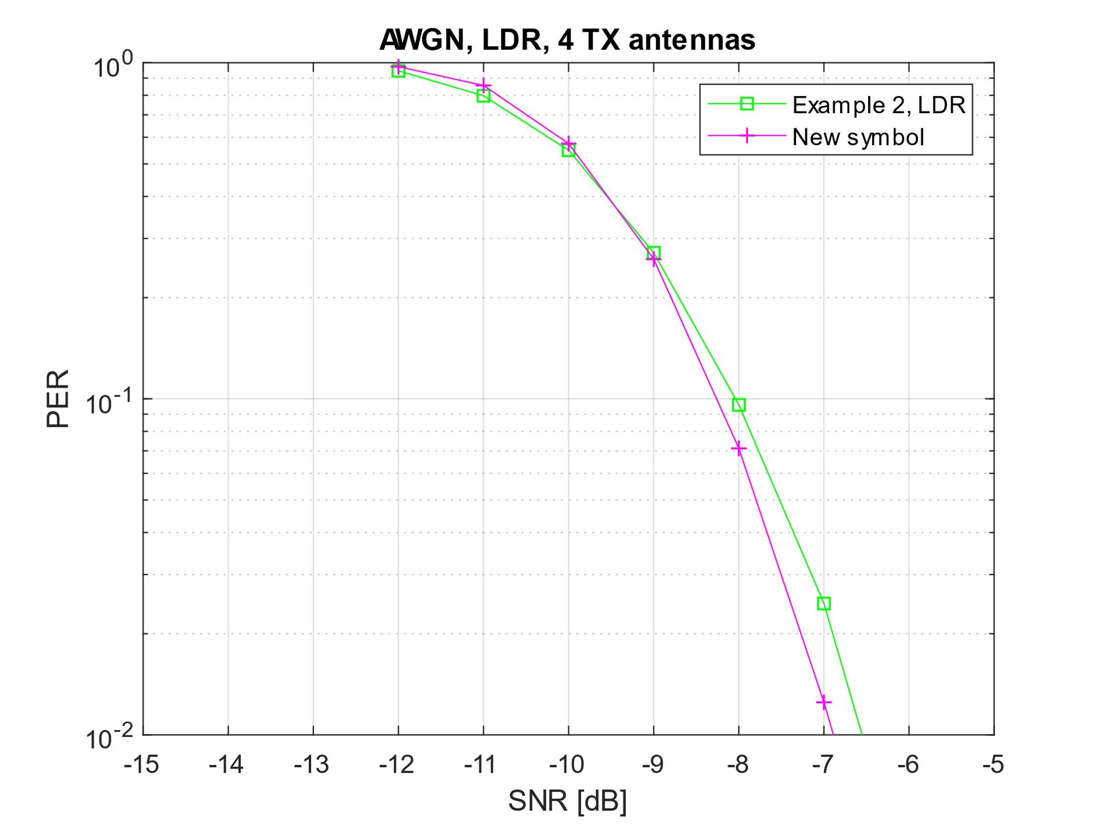
Performance of the new symbol in AWGN
Ideal synchronization

Slide 6
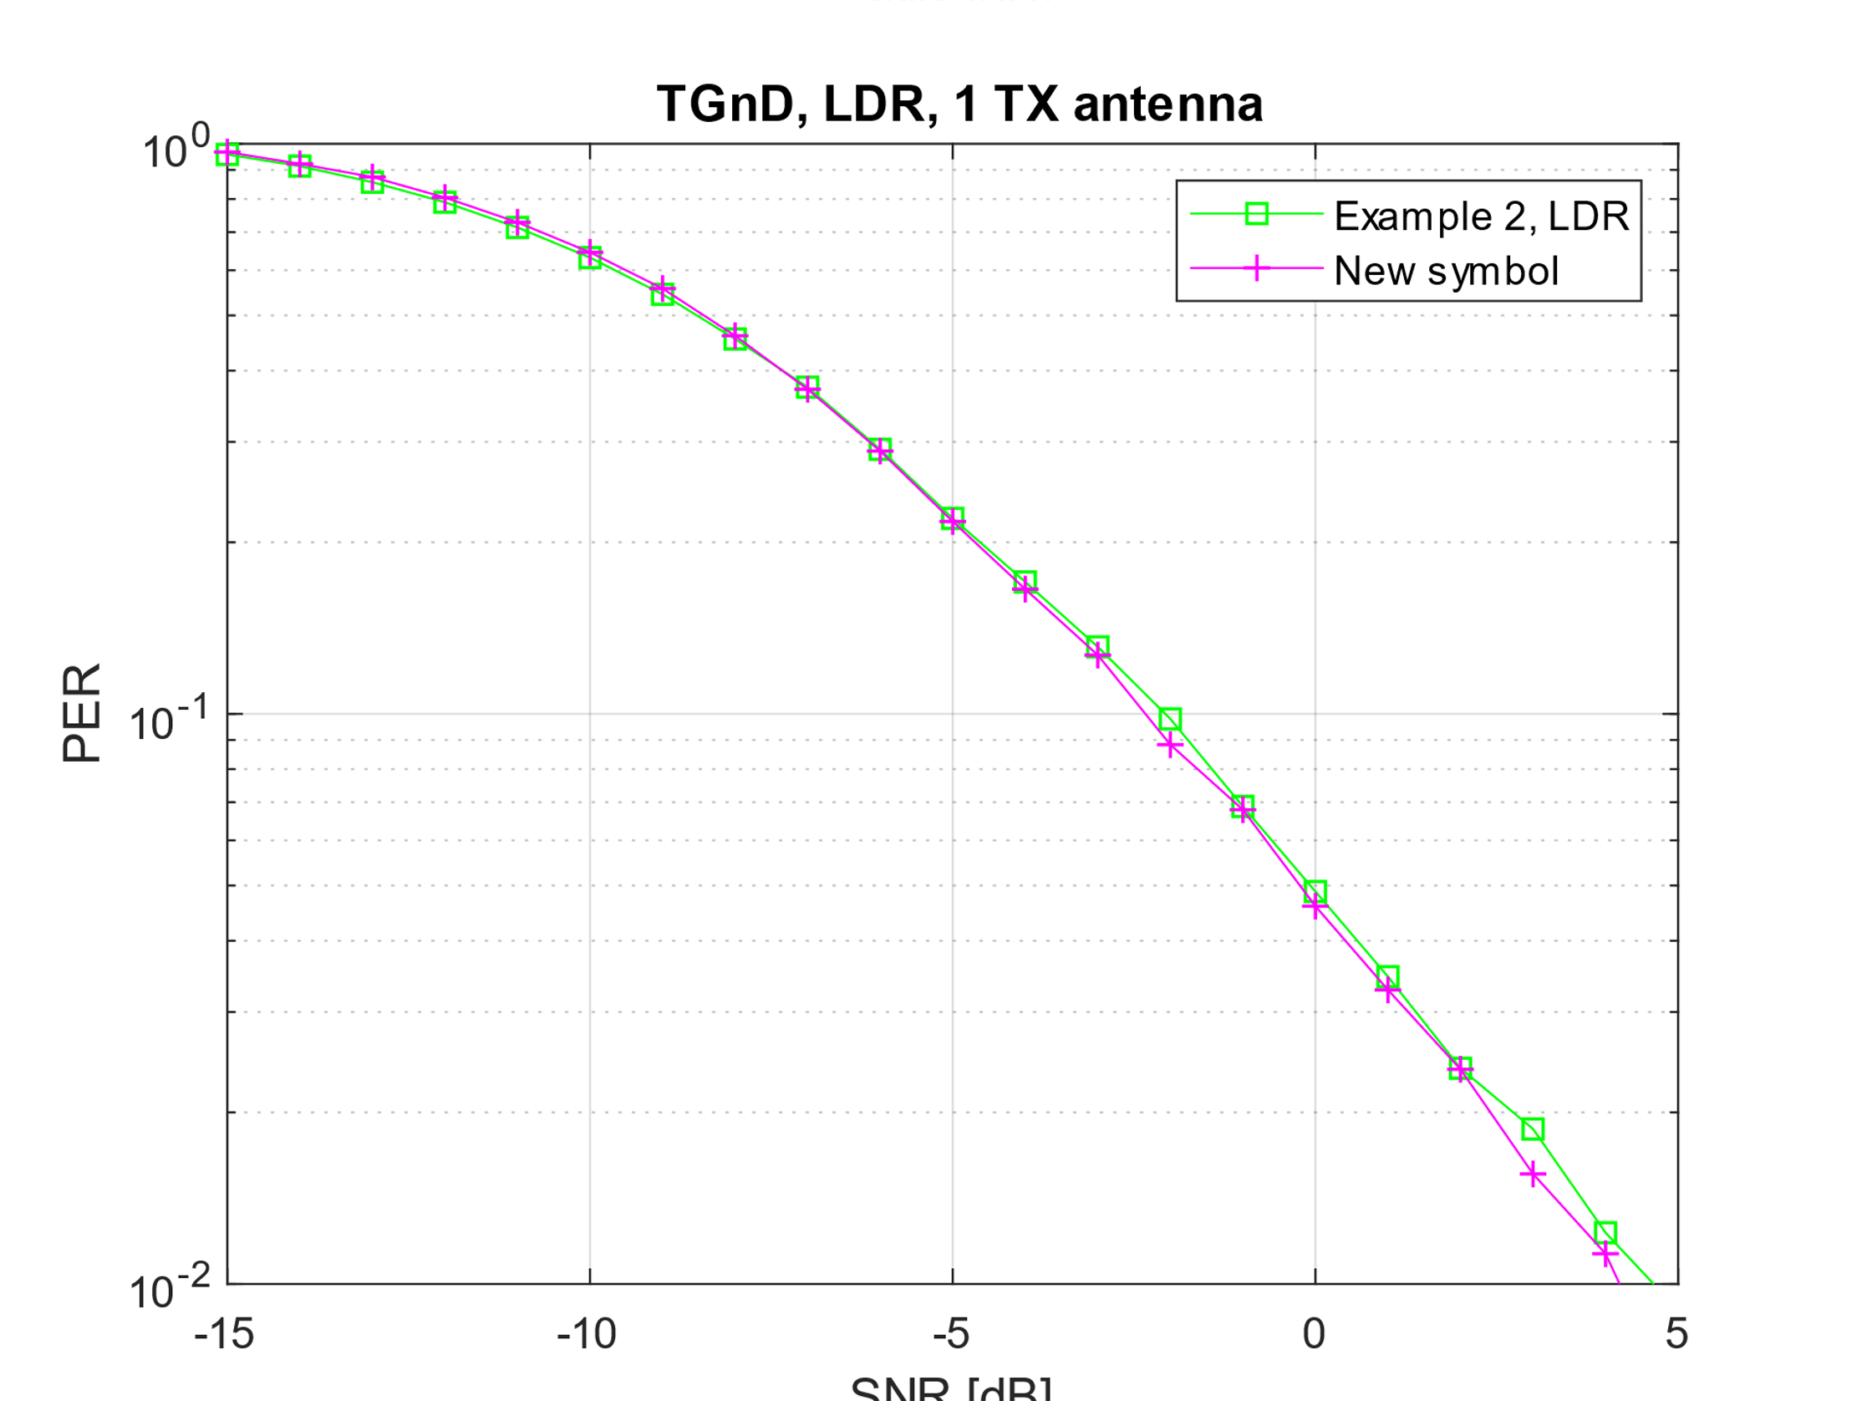
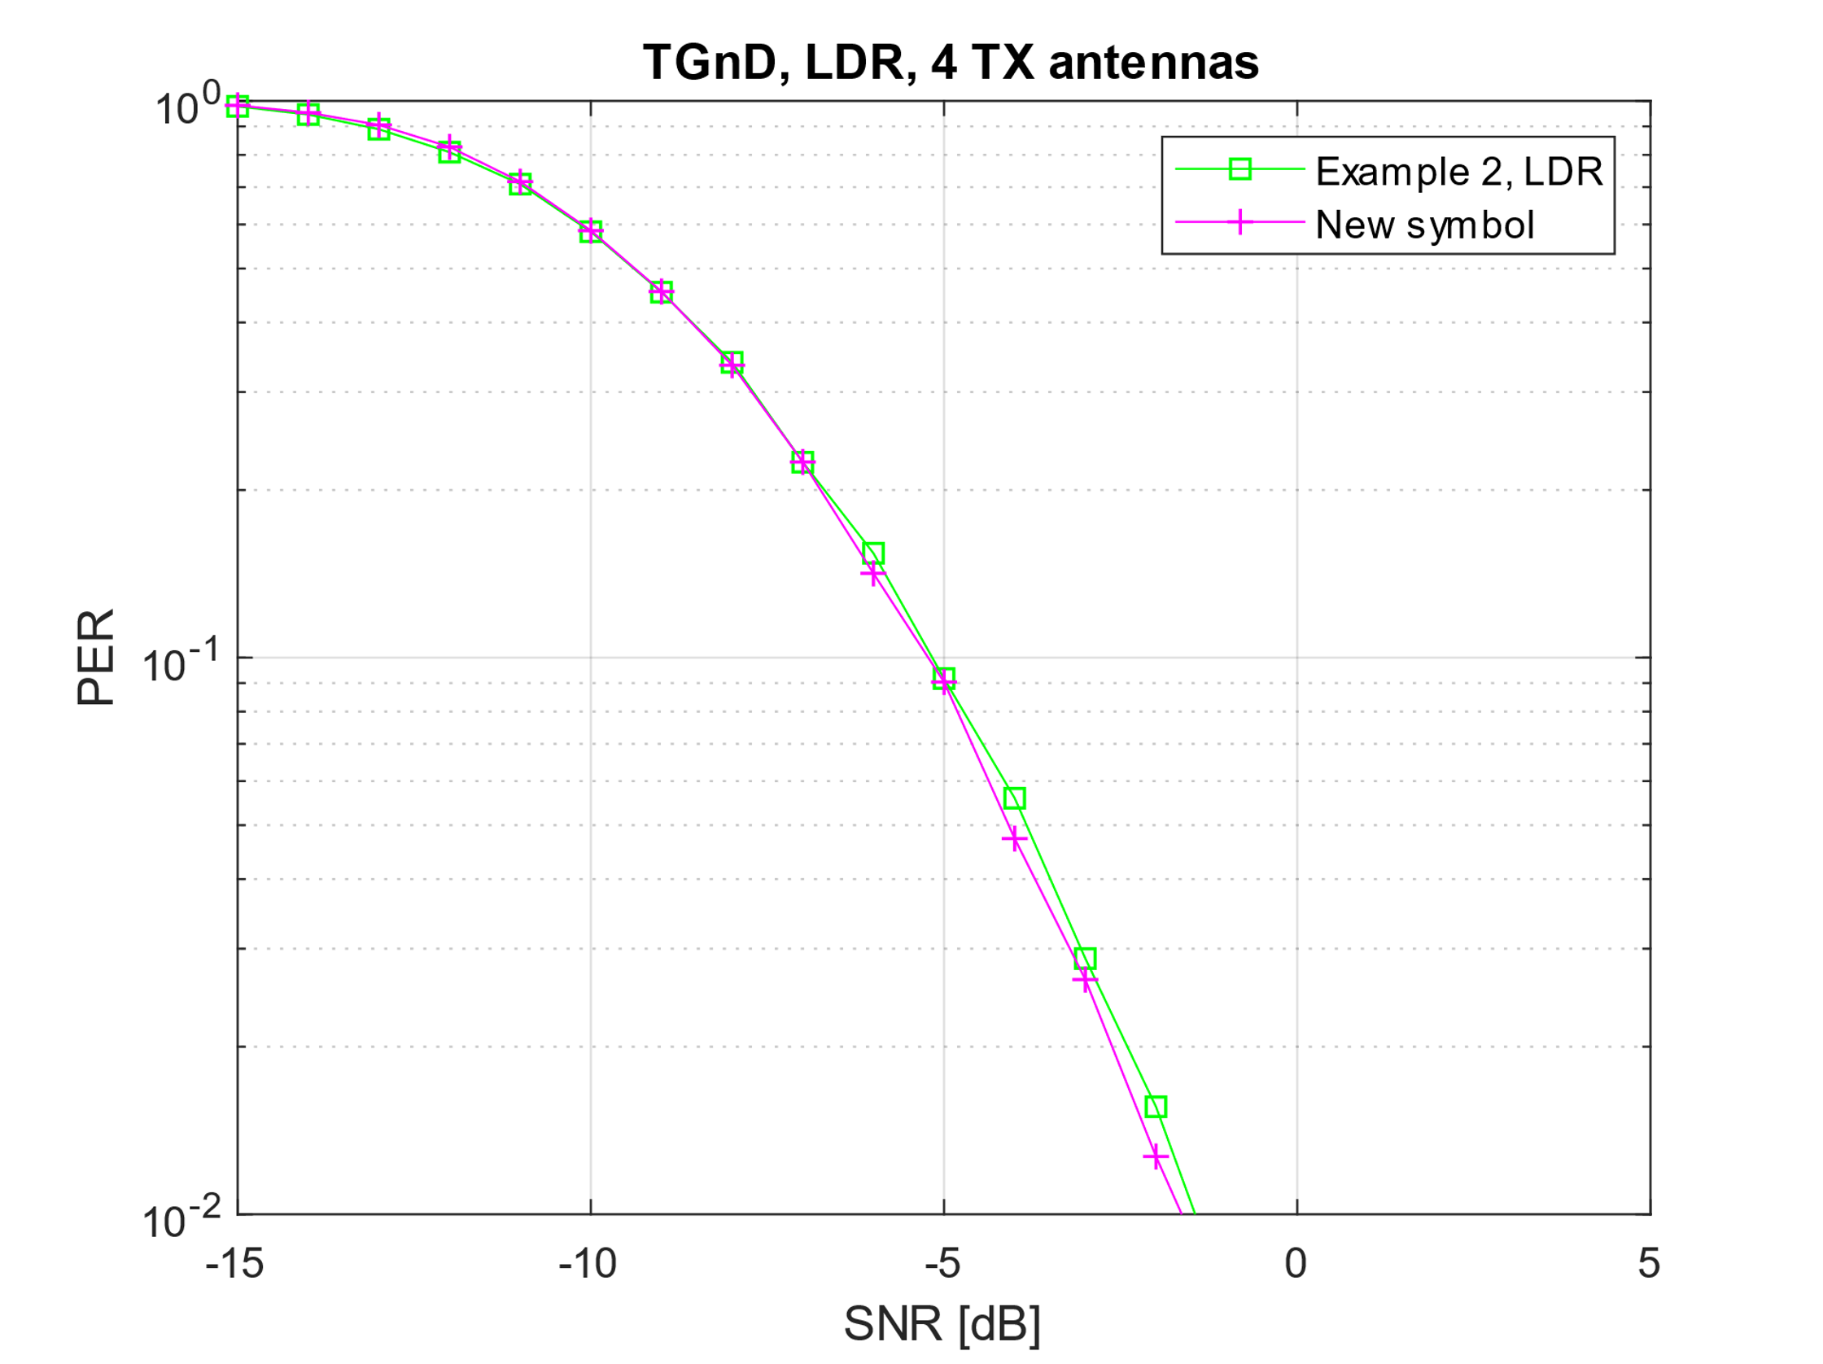
Performance of the new symbol in fading channel
Ideal synchronization

Slide 7
Conclusions
It is proposed to use the new symbol shown in slide 3 as a replacement for example 2, Table AD-2 in draft 4.0

Slide 8
References

