Slide 1
11be Channelization discussion
Date: 2019-11-10
Authors:
Name | Affiliation | Address | Phone | Email
Si-Chan Noh | Newratek |  |  | sc.noh at newratek.com
Yujin Noh | Newracom |  |  | yujin.noh at newracom.com

Slide 2
Introduction
11be channelization is under discussion in [1], [2]
New BW modes
320MHz, 240MHz and 160+160MHz
Tone plan
Reuse 11ax 996-tone RU or 11ax 996$×$2-tone RU block units
Define new tone plans on 240MHz and 320MHz (e.g for SU PPDU format)
Restriction of “one RU per user” in 11ax has been discussed in [3]
To lift this restriction may increase spectral efficiency for some scenarios
Preamble puncture cases in 80MHz (or 160MHz) channel with radar signals detected in the secondary 20MHz channel
This presentation will discuss the segment parser to be applied to 320MHz channelization and multiple RUs assigned to a STA by using the existing BCC interleaver and LDPC tone mapper designed in 11ax

Slide 3
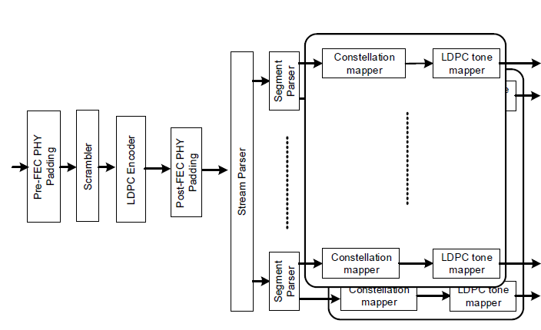
Segment Parser 1/2
In 11ax, segment parser is applied only for a 160MHz and 80+80MHz transmission with a 2$×$996-tone RU
Use the LDPC encoder for 2$×$996-tone RU
Use two LDPC tone mappers for 996-tone RU
It could be reused with simple extension to support 320MHz channelization in 11be in case no additional tone plans supported
…

Slide 4
Segment Parser 2/2
With the 11ax OFDMA numerology reused in 11be
Similar concept of segment parser could be applied
E.g. 1) 106-tone RU assigned to one user, 106-tone RU and 26-tone RU assigned to the other user in 20MHz channel
106
26
106
20MHz channel
E.g. 2) 242-tone RU and 484-tone RU assigned to one user in 80MHz channel
242
242
26
484
80MHz channel

Slide 5
Summary
We can reuse the segment parser applied in 11ax to support 320MHz channelization in 11be with simple extension
Multiple RUs assigned to a STA reduce spectral efficiency degradation by using similar concept with segment parser
Parsing and signaling process of multiple RUs is TBD

Slide 6
Reference
[1] 802.11-19/0797r1 320MHz Channelization and Tone Plan
[2] 802.11-19/1066r0 Tone Plan Discussion
[3] 802.11-19/1126r0 Enhanced Resource Allocation Schemes for 11be

Slide 7
APPENDIX

Slide 8
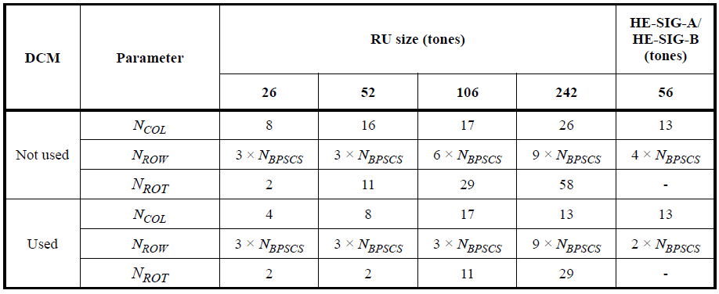
BCC interleaver in 11ax
BCC interleaver parameter depend on the RU size and whether or not DCM is used

Slide 9
LDPC Tone Mapper in 11ax
LDPC tone mapping distance for each RU size and whether or not the DCM is used
Note- The LDPC tone mapping parameters are applied for each frequency subblock

