Slide 1
P matrices to support more than 8 TX chains
Date: 2019-11-07
Authors:

Slide 2
Abstract
This contribution discusses the use of P-matrices containing zero entries. It is shown that it is advantageous to consider these matrices in EHT

Slide 3
Recap
During the standardization of 802.11ax it was shown that support for both 4x-LTF and 1x-LTF is beneficial
The use of 4x-LTF is gainful when employing higher order modulations [1]
The use of 1x-LTF is advantageous for UL-MU-MIMO [2]
It has been argued in TGbe that joint channel sounding is beneficial to support multi-AP joint transmission [3]
It has been proposed to use sub-carrier interleaved LTFs [3] to support a global number of antennas exceeding 8
During the question period following the presentation of the contribution [4] it was pointed out that subcarrier interleaved LTFs can also be used to support MIMO with up to 16 spatial streams.

Slide 4
Remarks on subcarrier interleaved LTFs
The contributions [1], [2], [3] indicate that subcarrier interleaved LTFs is a potentially useful technique when two APs are coordinated (RX estimates frequency domain channels coefficients spaced 156.25 kHz)
Subcarrier interleaved LTFs may not be enough to support all relevant use cases
There may be under-sampling of the channel in the frequency domain, which may adversely impact performance for time dispersive channels such as TGnD, or when high order modulations (e.g. 256/1024/4096 QAM) are used, as shown in [1]
Subcarrier interleaved LTFs may not support some multi-AP configurations when the global number of TX antennas is large. For example 3 APs with 16 TX each would require the RX to estimate frequency domain channel coefficients spaced 468.75 kHz and interpolate.

Slide 5
P-matrices with zeros
In this contribution we discuss P-matrices with zeros (i.e. some of the entries are zero)
P-matrices with zeros, having orders > 8, or even > 16, can be easily constructed from smaller matrices
The already standardized P matrices can be re-used as basic building blocks
These P-matrices can be used for joint sounding when the global number of antennas is too large for subcarrier interleaved LTFs
These P-matrices can be used in the cases where full resolution is needed in the frequency domain (e.g. when 4x-LTFs are the best choice)
These P matrices give reduced complexity at the receiver, compared to P-matrices with only non-zero entries
P-matrices with zeros can be used together with subcarrier interleaved LTFs

Slide 6
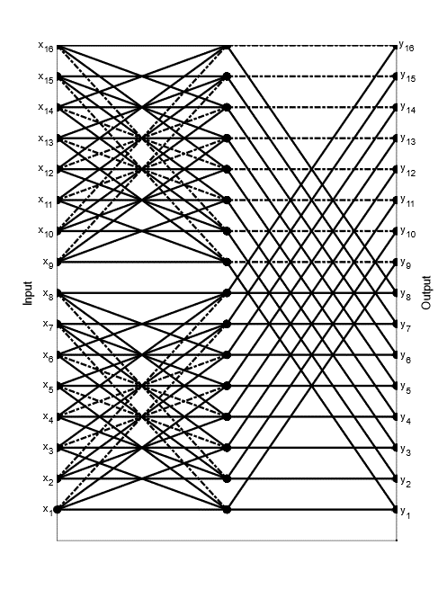
P-matrices with zeros: An example
Butterfly of $M_{16}^{e}$
There are many different ways to generate P-matrices with zeros. We illustrate one procedure by means of a relevant example.
802.11 has standardized a P-matrix $P_{8}$ of order 8. If $I_{2}$ is the identity matrix of order 2 then the matrix ${M_{16}^{e}=P}_{8}⊗I_{2}$ has order 16, and half of its entries are zeros (here $⊗$ denotes the Kronecker product)
The matrix $M_{16}^{e}$ is orthogonal
Multiplication of a vector by $M_{16}^{e}$ can be performed more efficiently than Hadamard/Walsh Transforms or FFT of order 16
minus
plus

Slide 7
Problem of P-matrices with zeros
One problem inherent to the use of the matrix $M_{16}^{e}$ described in slide 6 is that the presence of each zero implies that one TX chain will be silent during the transmission of one LTF → In this example, there is a loss of TX power of up to 3 dB relative to P-matrices with only unit amplitude entries .

Slide 8
Solving the power loss problem of P-matrices with zeros
An easy solution to this problem, for the example in slide 6, is to use one matrix for the even subcarriers and a different matrix for the odd subcarriers.
Subcarrier interleaved LTFs are a special case → The use of P matrices with zeros as described in this contribution is a generalization of the technique used in subcarrier interleaved LTFs
Variants of the procedure can be used for all orders (e.g. 8, 10, 12, 14, 16, 32, 48 etc)
The method is easy to generalize if it is desired/needed to use a different P matrix every 3rd/4th/5th/6th/... subcarrier

Slide 9
Solving the power loss problem of P-matrices with zeros
Going back to the example in slide 6: Generate a second matrix $M_{16}^{o}$ by flipping the rows of $M_{16}^{e}$upside down, so that row $n$ in $M_{16}^{o}$ is equal to row $17−n$ of $M_{16}^{e} (1≤n≤16)$. In the Matlab programming language $M_{16}^{o}$=flipud($M_{16}^{e}$)
Odd subcarrier → apply $\sqrt{2}∙M_{16}^{o}$
Even subcarrier → apply $\sqrt{2}∙M_{16}^{e}$
There’s no need to implement multiplication by $M_{16}^{o}$ at the RX. Instead perform multiplication by $M_{16}^{e}$ and read the result backwards
Note: There are many alternative ways to generate P matrices similar to $M_{16}^{e}$ and $M_{16}^{o}$ from smaller matrices. For example ${M_{16}^{o}=P}_{8}⊗\left[\begin{matrix}0 & 1 \\ 1 & 0\end{matrix}\right]$ also works

Slide 10
Remarks
Since both $M_{16}^{e}$ and $M_{16}^{o}$ have full rank, the RX can estimate the channel at both even and odd subcarriers
RX complexity is reduced when compared to the use of P matrices of the same order and without zero elements
We have given one example to illustrate the proposal. It is straightforward to generate many more examples to fit the requirements of different use cases regarding number of TX antennas, complexity reduction at RX and/or resolution of the channel estimates in the frequency domain
The P-matrices are applied only to non-pilot subcarriers

Slide 11
Summary
It has been pointed out that
P matrices with zeros of any order can be generated from smaller matrices and thus allow the re-use of the already standardized P matrices
P matrices with zeros can be used to reduce the complexity of RX processing. History shows that 802.11 PHYs have a very long life and what used to be top of the line a few years ago is today heavily optimized for use in IoT and other applications that require power efficiency and low cost (e.g. 802.11n)
P matrices with zeros can give the maximum possible resolution for frequency domain channel estimation

Slide 12
Straw poll
Do you agree that EHT should support the estimation of frequency domain channel coefficients with a resolution of 78.125 kHz when the global number of antennas exceeds 8?
Y/N/A

Slide 13
References
[1] Kome Oteri et al., “Performance of 1x 2x and 4x HE LTF” IEEE 802.11-15-0569-01-00ax, May 2015
[2] Hongyuan Zhang et al., “1x HE LTF for UL MU MIMO” IEEE 802.11-16-0033-00-00ax, Jan 2016
[3] Jianhan Liu et al. “Joint sounding for multi-AP systems”, IEEE 802.11-19-1593-00-00be, Sep 2019
[4] Miguel López et al., “Remarks on P matrices”, IEEE 802.11-19-1555-00-00be, Sep 2019

