Slide 1
Performance of JT with Wireless Backhaul
Date: 2019-11-08
Authors:
Name | Affiliations | Address | Phone | email
Ron Porat | Broadcom |  |  | ron.porat@broadcom.com
Srinath Puducheri | Broadcom

Slide 2
Abstract
In our previous contribution ([1]), we looked at JT performance on the fronthaul, which provides a true indication of JT performance gains when the backhaul is wired [4] (e.g, enterprise deployments).
In this contribution we provide results on system-level performance of JT assuming wireless backhaul ([2], [3]) and compare it with a baseline mesh deployment.
Note that both JT and mesh use backhaul with differences explained in the following slides

Slide 3
System model (1)
We assume a wireless mesh model comprising a master AP and one or more slave APs.
  Master AP communicates with slave APs over wireless backhaul.
  Master and slave APs communicate with STAs over wireless fronthaul.
Backhaul operation:
  Backhaul assumed on different channel from fronthaul, as typical of current mesh deployments.
  Mesh: Master AP forwards each STA’s data to corresponding slave AP.
  JT: Master AP broadcasts all STAs’ data to all slave APs.
    JT incurs higher backhaul-overhead than mesh:
      2x for 2AP, 1.5x for 3AP and 1.33x for 4AP, assuming symmetric distribution of STAs.
  Backhaul BW:
    Mesh: same BW for fronthaul and backhaul
    JT: backhaul BW either same or 2x that of fronthaul

Slide 4
System model (2)
  Backhaul MCS and Nss assumed to be the same for both JT and mesh.
Fronthaul operation as in [1]:
  Mesh: Master and slave APs share the medium in a TDMA fashion, with each AP transmitting to only its STAs.
  JT: Master and slave APs jointly transmit to all STAs
    Simulation results assume 80MHz for fronthaul and 80/160MHz for JT backhaul.
      Gains expected to be same with BW scaled up proportionally for both fronthaul and backhaul.
Overhead due to sounding and AP-AP coordination is ignored.

Slide 5
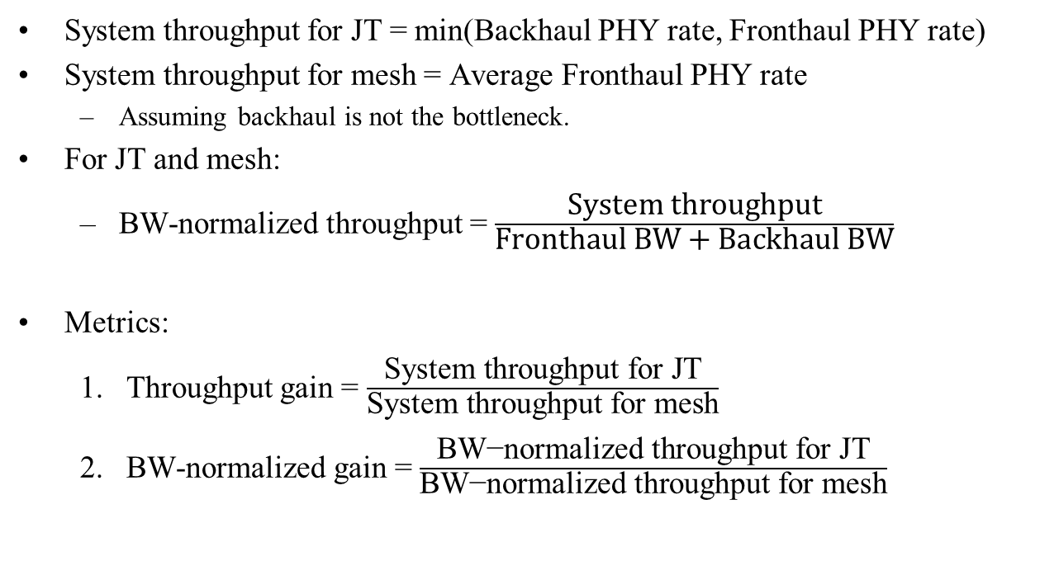
Performance Metrics
System throughput for JT = min(Backhaul PHY rate, Fronthaul PHY rate)
System throughput for mesh = Average Fronthaul PHY rate
  Assuming backhaul is not the bottleneck.
For JT and mesh:
  BW-normalized throughput = $\frac{\text{System} \text{throughput}}{\text{Fronthaul} \text{BW}\text{ + }\text{Backhaul} \text{BW}}$
Metrics:
  Throughput gain = $\frac{\text{System} \text{throughput} \text{for} \text{JT}}{\text{System} \text{throughput} \text{for} \text{mesh}}$
  BW-normalized gain = $\frac{\text{BW}\text{−}\text{normalized} \text{throughput} \text{for} \text{JT}}{\text{BW}\text{−}\text{normalized} \text{throughput} \text{for} \text{mesh}}$

Slide 6
Fronthaul simulation model (1)
Channel: 11nD, 80MHz, -30dBc channel aging
Mesh: TDMA across different BSS, each with AP =4 ant., STA = 2 ant., Nss = 2.
JT:
  Per-AP tx power = 1.0;
  2AP: AP = [4 4] ant., STA = [2 2] ant., Nss = [2 2]
    Total tx power boosted by 3dB
  3AP: AP = [4 4 4] ant., STA = [2 2 2] ant., Nss = [2 2 2]
    Total tx power boosted by 5dB
  4AP: AP = [4 4 4 4] ant., STA = [2 2 2 2] ant., Nss = [2 2 2 2]
    Total tx power boosted by 6dB
Cross-BSS path-loss: each STA sees 0dB from own-BSS AP and X=10 dB from remaining APs
  AP-STA SNR in all plots (x-axis) refers to own-BSS SNR

Slide 7
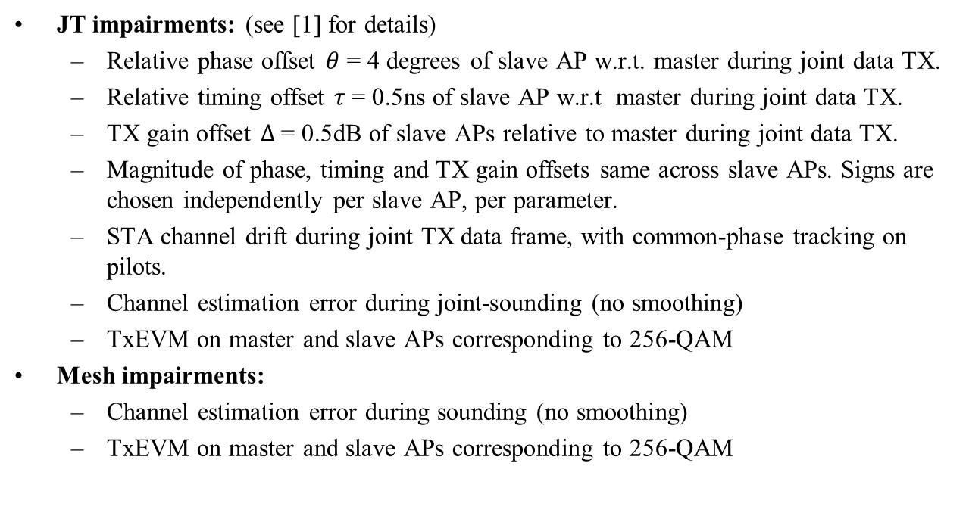
Fronthaul simulation model (2)
JT impairments: (see [1] for details)
  Relative phase offset $θ$ = 4 degrees of slave AP w.r.t. master during joint data TX.
  Relative timing offset $τ$= 0.5ns of slave AP w.r.t master during joint data TX.
  TX gain offset $Δ$= 0.5dB of slave APs relative to master during joint data TX.
  Magnitude of phase, timing and TX gain offsets same across slave APs. Signs are chosen independently per slave AP, per parameter.
  STA channel drift during joint TX data frame, with common-phase tracking on pilots.
  Channel estimation error during joint-sounding (no smoothing)
  TxEVM on master and slave APs corresponding to 256-QAM
Mesh impairments:
  Channel estimation error during sounding (no smoothing)
  TxEVM on master and slave APs corresponding to 256-QAM

Slide 8
Simulation results: infinite backhaul
For reference, assuming backhaul has infinite rate or wired
Config | Throughput gain @ different AP-STA SNR
 | 20dB | 25dB | 30dB
AP = 4,4,4,4 STA = 2,2,2,2 | 3.19 | 3.47 | 3.12
AP = 4,4,4 STA = 2,2,2 | 2.51 | 2.72 | 2.39
AP = 4,4 STA = 2,2 | 1.69 | 1.87 | 1.65

Slide 9
Simulation results: finite backhaul (1)
JT backhaul BW = 80MHz
  BW-normalized gain = throughput gain, since JT and mesh both use same fronthaul and backhaul BW = 80MHz
  Some cases are bottlenecked by backhaul (vs infinite backhaul)
Config | Backhaul MCS, Nss | Throughput gain @ different AP-STA SNR
 |  | 20dB | 25dB | 30dB
AP = 4,4,4,4 STA = 2,2,2,2 | 9, 4 | 3.19 | 2.70 | 2.13
 | 9, 3 | 2.68 | 2.03 | 1.60
AP = 4,4,4 STA = 2,2,2 | 9, 4 | 2.51 | 2.70 | 2.13
 | 9, 3 | 2.51 | 2.03 | 1.60
AP = 4,4 STA = 2,2 | 9, 4 | 1.69 | 1.87 | 1.65
 | 9, 3 | 1.69 | 1.87 | 1.60

Slide 10
Simulation results: finite backhaul (2)
JT backhaul BW = 160MHz, Throughput Gain
  None of the cases considered here are bottlenecked by backhaul.
Config | Backhaul MCS, Nss | Throughput gain @ different AP-STA SNR |  |  | Gain vs 80MHz backhaul
 |  | 20dB | 25dB | 30dB
AP = 4,4,4,4 STA = 2,2,2,2 | 9, 4 | 3.19 | 3.47 | 3.12 | Mid-high SNR
 | 9, 3 | 3.19 | 3.47 | 3.12 | All SNR
AP = 4,4,4 STA = 2,2,2 | 9, 4 | 2.51 | 2.72 | 2.39 | High SNR
 | 9, 3 | 2.51 | 2.72 | 2.39 | Mid-high SNR
AP = 4,4 STA = 2,2 | 9, 4 | 1.69 | 1.87 | 1.65 | No
 | 9, 3 | 1.69 | 1.87 | 1.65 | No

Slide 11
Simulation results: finite backhaul (3)
JT backhaul BW = 160MHz, BW-normalized Gain
  BW-normalized gain is lower than throughput gain since we assume mesh backhaul is still 80MHz.
  However, for practical mesh deployments, this may be a less relevant metric than throughput gain.
Config | Backhaul MCS, Nss | BW-normalized gain @ different AP-STA SNR
 |  | 20dB | 25dB | 30dB
AP = 4,4,4,4 STA = 2,2,2,2 | 9, 4 | 2.13 | 2.31 | 2.08
 | 9, 3 | 2.13 | 2.31 | 2.08
AP = 4,4,4 STA = 2,2,2 | 9, 4 | 1.67 | 1.81 | 1.59
 | 9, 3 | 1.67 | 1.81 | 1.59
AP = 4,4 STA = 2,2 | 9, 4 | 1.12 | 1.24 | 1.10
 | 9, 3 | 1.12 | 1.24 | 1.10

Slide 12
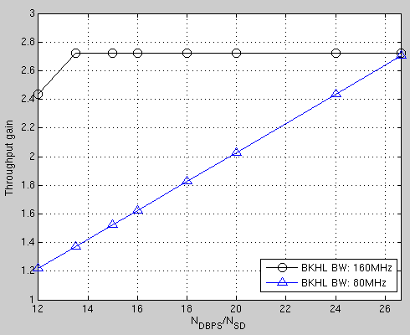

JT gains vs backhaul spectral efficiency
Looked at one example case: 3AP case, 25dB fronthaul AP-STA SNR
Backhaul spectral efficiency = number of data bits per sub-carrier = $\frac{N_{DBPS}}{N_{SD}}$
{MCS, Nss} | Backhaul spectral efficiency
{9,4} | 26.67
{8,4} | 24
{9,3}, {7,4} | 20
{8,3}, {6,4} | 18
{5,4} | 16
{7,3} | 15
{6,3} | 13.5
{5,3}, {4,4} | 12

Slide 13
Conclusions
We have shown that, in various deployment configurations and different figures of merit, JT with wireless backhaul does have gains compared to typical mesh deployments.
This is true even in cases where JT is backhaul-limited since the backhaul rate is still much higher than fronthaul mesh rates.
Choice of JT backhaul BW depends on fronthaul configuration and SNR.
  160MHz backhaul is not always necessary.

Slide 14
References
“JT performance with Multiple Impairments,” IEEE 802.11-19/1597
“Joint Transmissions: Backhaul and Gain State Issues,” IEEE 802.11-19/1089
“Multi-AP backhaul analysis,” IEEE 802.11-19/1588
“Consideration on Joint Transmission,” IEEE 802.11-19/1595

