Slide 1
Multiple RU Combinations for EHT
Date: 2019-11-12
Authors:
Name | Affiliations | Address | Phone | Email
Jianhan Liu | Mediatek |  |  | jianhan.liu@mediatek.com
Shengquan Hu

Slide 2
Introduction
11be task group has approved the following motion [1]:
  11be shall allow more than one RUs to be assigned to a single STA
    Coding and interleaving schemes for multiple RUs assigned to a single STA are TBD.
    Maximum number of RUs (>1) assigned to a single STA is also TBD.
11be task group has also approved the following motion [1]:
  11be uses the same subcarrier spacing for the data portion of EHT PPDU as 11ax data portion.
  This means that up to 160/80+80 MHz, the tone plan shall be same as 11ax.
In this contribution, we consider the possible multiple RU combinations for PPDU BW is less or equal to 160MHz.

Slide 3
Multiple RU Combination Design Principle
To avoid the design and testing complexity, to balance the complexity and spectrum efficiency, we think the following principles are reasonable.
  Limit the number of RUs that can be combined
    Allowing combine large number of RUs causes the exponential growth of possible RU combinations.
  Reduce the multiple RU combinations, only the useful and reasonable combinations should be introduced.
    Allowing all the possible RU combinations increases the difficulty of scheduling.
  Main focus is to enhance the spectrum use, not frequency diversity.
    Compared to spectrum use enhancement, diversity provides limited gain.

Slide 4
Useful Scenarios of Small-size RU Combinations
In 2.4GHz band, only 20MHz and 40MHz BW are allowed. So the small-size RU combinations within 20MHz and 40MHz should be considered.
  For 20MHz BW, RU26 is over 10% of the spectrum. For 2 user OFDMA transmissions, center 26 tone RU is always wasted if multiple RU combination for 20MHz BW is not allowed.
For preamble puncture cases in 80MHz and above, to meet the spectral mask (reduce the interference to the punctured adjacent 20MHz channels), edge 26 RU (#9 RU in the figure) should not be assigned to any user. So the combination of RU52 and the RU26 adjacent to the edge RU26 is useful (#3 RU52+#8 RU26 in the figure).

Slide 5
Considerations on RU Combination
It is not reasonable to combine a small-size RU with a large-size RU, for example, combine a RU26 with a RU484 do not increase the spectrum use much.
Based on 802.11 tradition on 20MHz channelization, we can separate RUs into large-size RUs and small-size RUs.
  RUs with equal to or more than 242 tones are called as large-size RUs
    RU242, RU484, RU 996 and RU 996x2 are regarded as large size RUs
  RUs with less than 242 tones as small-size RUs
    RU26, RU52 and RU106 are regarded small-size RUs
General RU Combination considerations:
  Do not combine small-size RUs with large-size RUs
    Small-size RUs combine with small-size RUs
    Large-size RUs combine with large-size RUs

Slide 6
Considerations on Small-size RU Combination
It is not reasonable to combine small-size RUs across 20MHz boundary.
  It only provides diversity gain, not enhancing spectral efficiency much.
  It will significantly increase the number of RU combinations.
To reduce the number of RU combinations, for small-size RU combinations, only the combinations of contiguous small-size RUs should be introduced.
  Allowing non-contiguous small-size RU combinations only provides diversity gain, not spectral efficiency enhancement.
RU combinations of RU26+RU26 and RU52+RU52 are not useful because
  Instead of allocating two RU26 to one STA, AP can allocate one RU52 to that station.
  Instead of allocating two RU52 to one STA, AP can can allocate one RU106 to that station.

Slide 7
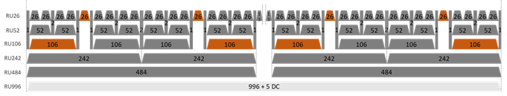
Proposal on RU106 and RU26 combinations
    For 20 and 40 MHz, within 20MHz boundary, any contiguous RU26 and RU106 can be combined.
    For 80MHz, to reduce the combination mode, within each 20MHz, only one combination RU126+RU26 is introduced (as colored in orange).
      These combinations enhance the spectral efficiency for OFDMA cases with 8 users.
    For 160MHz BW, each 80MHz segment allows the same the combinations of RU126+RU26 as in 80MHz BW.

Slide 8
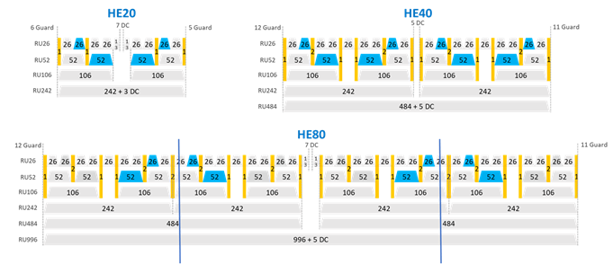
Proposal on RU52 and RU26 combinations
For 20MHz and 40MHz BW, the combination of contiguous inner RU52 with RU26 are introduced (as colored in blue).
For 80MHz BW, to reduced the number of combinations, only the combinations helpful for punctured cases are introduced (as colored in Blue).
    For 160MHz BW, each 80MHz segment allows the same the combinations of RU52+RU26 as in 80MHz BW.

Slide 9
Diversity Gain Evaluation for non-contiguous small RU combinations
M-RU Assignment Mode: (e.g. assume with BW20, only two RUs aggregated)
  Mode-0: non-adaptive for RU106+RU26; adaptively switched between two RU52+RU26 combinations; continous
  Mode-1: semi-adaptive: i.e. only larger RU (e.g. RU52) is adaptively selected; RU26 is selected adjacent with selected RU26; continuous
  Mode-2: full-adaptive: i.e. both RUs are adaptively selected with BW20; may non-continuous
Mode-1
Mode-2
RU52
RU26
RU52
RU26

Slide 10
RU52+RU26: MCS4, BF/4x1
MCS4, 4x1

Slide 11
RU52+RU26: MCS7, BF/4x1
MCS7, 4x1

Slide 12
RU52+RU26: MCS4, BF/4x2
MCS4, 4x2

Slide 13
RU52+RU26: MCS7, BF/4x2
MCS7, 4x2

Slide 14
RU106+RU26: MCS4, BF/4x1
MCS4, 4x1

Slide 15
RU106+RU26: MCS7, BF/4x1
MCS7, 4x1

Slide 16
RU106+RU26: MCS4, BF/4x2
MCS4, 4x2

Slide 17
RU106+RU26: MCS7,BF/4x2
MCS7, 4x2

Slide 18
Considerations on large-size RU combinations
For combinations of large-size RUs (RU242, RU484, RU 996 and RU 996x2), the main idea is to enhance the spectral efficiency in the preamble punctured cases for DFS channel and incumbent signals.
To reduce the number of combinations, we propose the following combinations
  For 80MHz BW, introducing RU combination RU242+RU484 (both contiguous and non-contiguous)
    It is not useful to introduce RU combinations of RU242+RU242 because a single RU484 has the same spectral efficiency as combinations of RU242+RU242.
    Maybe non-contiguous combination of RU242+RU242 is useful in preamble punctured cases for SU.

Slide 19
Considerations on large-size RU combinations (cont’s)
For BW>=160MHz
  Within each 80MHz segment
    RU combination RU242+RU484 (both contiguous and non-contiguous)
  Crossing 80MHz
    RU combinations of RU484+RU996
    RU combinations of RU242+484+RU242+484
    RU combinations of RU242+484+RU996

Slide 20
Straw Poll #1
Do you agree that small-size RUs can only combine with small-size RUs and large-size RUs can only combine with large-size RUs?
  RUs with equal to or more than 242 tones are called as large-size RUs
  RUs with less than 242 tones as small-size RUs

Slide 21
Straw Poll #2
Do you agree that combination of small-size RUs shall not cross 20MHz channel boundary?

Slide 22
Straw Poll #3
Do you agree that only allowed small-RU combinations are RU126+RU26 and RU52+RU26?

Slide 23
Straw Poll #4
    Do you agree that for 20 and 40 MHz PPDU, within 20MHz boundary, any contiguous RU26 and RU106 can be combined?

Slide 24
Straw Poll #5
    Do you agree that for 80MHz BW, only the orange colored RU combinations are allowed?

Slide 25
Straw Poll #6
    Do you agree that for 20 and 40 MHz PPDU, the blue colored combination of RU52 and RU26 are allowed?

Slide 26
Straw Poll #7
Do you agree that for 80MHz PPDU, the blue colored combination of RU52 and RU26 are allowed?

Slide 27
Straw Poll #8
Do you agree that for 80MHe PPDU, large-size RU combinations of RU242+RU484 (contiguous and non-contiguous) are allowed?

Slide 28
Straw Poll #9
Do you agree the following large-size RU combinations for 160MHz PPDU?
  Within each 80MHz segment
    RU combination RU242+RU484 (both contiguous and non-contiguous)
  Crossing 80MHz
    RU combinations of RU484+RU996
    RU combinations of RU242+484+RU242+484
    RU combinations of RU242+484+RU996

