Slide 1
Uplink Coordinated Multi-AP
Date: 2019-11-11

Slide 2


Introduction
Coordinated Multi-AP in Uplink (UL)
  Enabling simultaneous transmission from multiple devices to multiple APs in the same frequency channel
  Coordination between multiple non-collocated APs
  Each AP not only receives signals from the desired STAs but also from the co-channel interferers in the neighboring cells
Anticipated gains:
  Increasing Uplink (UL) Throughput in Managed Wi-Fi Networks
  Facilitate Reliable Reception in UL/ Improve Cell Edge’s performance
  Reducing Latency as a result of Multi-AP operation
$${AP}_{1}$$
$${AP}_{2}$$
Int.

Slide 3
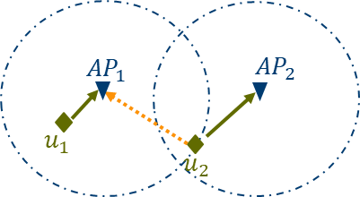
Introduction
Multi-AP cooperation is expected to be easier to implement in UL than in the downlink (DL)
  OBSS Channel information is available in the network without resource-consuming feedback transmissions.
  Synchronization requirements between APs may be less restricted
There are other constraints, such as the UL processing time and consequently time to send acknowledgement feedback as well as processing load across APs.
Different levels of coordination may be realized based on the deployment and backhauling capabilities.
Level of coordination may range from very limited information (scheduling) to significant amount of information (received samples for joint processing) exchange.

Slide 4
Introduction
In this contribution we evaluate different schemes, which represent different level of coordination between APs, Compare simulation results, and analyze some implementation complexities:
  Diversity Reception
  Per-AP Interference Cancellation
    Similar concept/requirement as collaborative BF in DL.
  Distributed SIC (DSIC)
  Joint Reception (JR)
    Joint Multi-AP processing

Slide 5

Uplink Coordinated Multi-AP Schemes: Diversity Reception
Diversity Reception (light coordination):
  No joint processing across APs
  Cell edge STA ($u_{2}$) may be detected by each single AP (individually) and either APs who successfully receive data ($u_{2}$) will send ACK. This provides extra route for reliability.
  Use Case: Cell Edge or Mission critical device with higher reliability requirement.
  The STA may send UL data and trigger multi-APs for collaborative reception in UL and ACK.
Slide 5

Slide 6
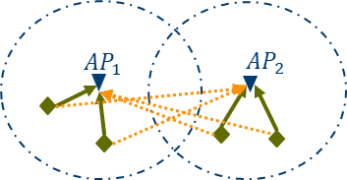
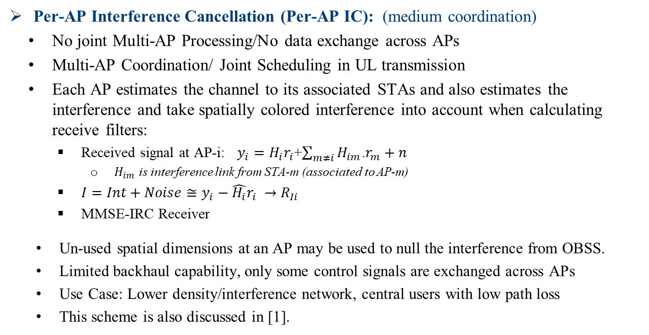
UL Coordinated Multi-AP Schemes: Per-AP IC
Per-AP Interference Cancellation (Per-AP IC): (medium coordination)
  No joint Multi-AP Processing/No data exchange across APs
  Multi-AP Coordination/ Joint Scheduling in UL transmission
  Each AP estimates the channel to its associated STAs and also estimates the interference and take spatially colored interference into account when calculating receive filters:
    Received signal at AP-i: $y_{i}=H_{i}r_{i}$+$\sum_{m≠i}{H_{im}}$.$r_{m}+n$
      $H_{im}$ is interference link from STA-m (associated to AP-m)
    ${I=Int+Noise≅y}_{i}−\hat{H_{i}}r_{i} →R_{Ii}$
    MMSE-IRC Receiver
  Un-used spatial dimensions at an AP may be used to null the interference from OBSS.
  Limited backhaul capability, only some control signals are exchanged across APs
  Use Case: Lower density/interference network, central users with low path loss
  This scheme is also discussed in [1].

Slide 7


UL Coordinated Multi-AP Schemes: DSIC
Distributed Interference Cancellation (DSIC): (Medium+ coordination)
  Single-AP decoding with successive interference cancellation (SIC)
  Data exchange is required across multiple APs
    No joint Multi-AP processing
  Stage-1: Each AP decodes data from in-cell STAs and forward to other APs for interference subtraction
    Channel estimation for in-cell and OBSS STAs
    Receiver: MMSE, ML, …
  Stage-2: Each AP performs second stage equalization
    Removing interference data received from other APs
  High Speed Backhaul capability
  Use Case: Medium/high density, central/mixed users
AP-1
AP-2
Stage-1
$${\text{[}\text{STAs}\text{]}}_{1}$$
$${\text{[}\text{STAs}\text{]}}_{2}$$
AP-1
AP-2
Stage-2
Cancel Int. from ${\text{[}\text{STAs}\text{]}}_{2}$
Cancel Int. from ${\text{[}\text{STAs}\text{]}}_{1}$
$${\text{[}\text{STAs}\text{]}}_{1}$$
$${\text{[}\text{STAs}\text{]}}_{2}$$

Slide 8


Uplink Coordinated Multi-AP Schemes: JR
Joint Reception: (tight coordination)
  Received data from all STAs in OBSS are jointly processed
  Synchronization is required across APs
  Single-user (cell edge) / Multi-user
  Maximized Multi-AP Gain through joint array processing
  Higher front-haul rate, and stringent latency requirements, from participating nodes to central processor where the joint decoding takes place
  Use cases: Non-uniform distribution of STAs, High Interference
    Higher Implementation Complexity
$${AP}_{1}$$
$${AP}_{2}$$
Slide 8

Slide 9





Uplink Coordinated Multi-AP: Design Considerations
Uplink Control Sequence for MU (High Level)
  The initiator AP will send a trigger frame to initiate the coordination. The APs IDs for all participating APs and STAs info may be identified in this trigger frame.
  After a SIFS time, all coordinated APs will send the exact same trigger frame (simultaneously) for UL MU transmission, identifying coordinated APs IDs, all the STAs (OBSS) info, etc. This will trigger data transmission in uplink from all STAs.
    Alternatively one trigger frame may be sent from initiator AP, assuming all STAs can hear the initiator AP
UL MU Trigger
Multiplexed in
Time/ Frequency
AP-1
SIFS
SIFS
SIFS
$${\text{[}\text{BA}\text{]}}_{1}$$
UL MU Trigger
AP-2
$${\text{[}\text{BA}\text{]}}_{2}$$
$${\text{[}\text{STAs}\text{]}}_{1}$$
HE MU TB PPDU
$${\text{[}\text{STAs}\text{]}}_{2}$$
HE MU TB PPDU

Slide 10
Uplink Coordinated Multi-AP: Design Considerations
Acknowledgement (ACK):
  Block ACK (BA) from all APs in coordinated set may be multiplexed in time or frequency
  In Per-AP IC and DSIC, each AP should send BA for its associated STAs
  In Diversity reception, if STA receives BA from any of the APs, that would be sufficient.
  In JR, one BA could be sent from master AP
  In JR, and DSIC, since some data exchange is required across APs, UL processing time should be taken into account.
    If the backhaul speed is not high enough, Delayed BA may be required.
  BA policy may be indicated in UL trigger frame.
Channel/ Interference estimation in UL:
  STAs in collaborative set (OBSS) will send orthogonal training signals for channel estimation

Slide 11
Uplink Coordinated Multi-AP
Summary
Scheme | Data Exchange across APs | Backhaul Support | Data transmission always initiated by a trigger from AP side | Processing Time Concern/ (Delayed ACK/BA) | Use Case
SU Diversity | No | No | No | No | Cell Edge/ Device with High Reliability Requirement
Per-AP IC | No | No | Yes | No | Un-used receive spatial dimension/ Interference from OBSS STAs
DSIC | Detected Symbols | High Capacity/ Low latency | Yes | Likely | Dense network/High interference
JR/ SU | Received samples after FFT | High Capacity/ Low latency | No | Likely | Cell Edge/ High Reliability Requirement
JR/MU | Received samples after FFT | High Capacity/ Low latency | Yes | Very likely | Dense network/High interference Non-uniform distribution of STAs

Slide 12
Simulation Results

Slide 13
Simulation Set Up
MATLAB Simulator
Path Loss Model: IEEE Channel model D
BW=20 MHz
AP: 4 Tx/Rx antennas
STA: Transmitting one spatial stream
Noise floor: -89.9 dBm
Receiver: MMSE
Slide 13

Slide 14
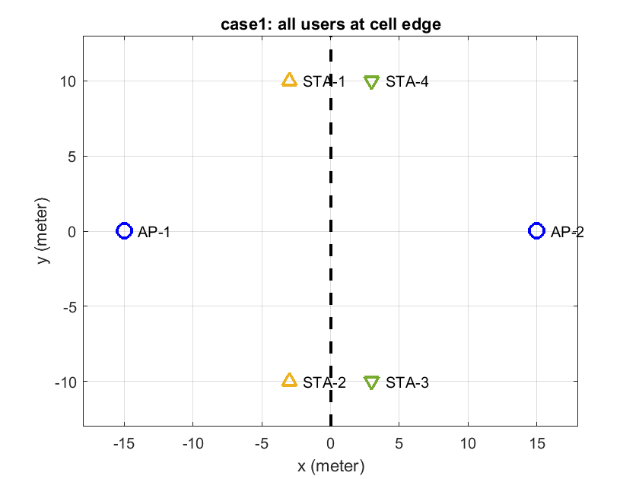
Simulation Results, Example for 2 APs: Area Throughput
STAs are moved vertically (1:41 m)
If number of interfering STAs is lower than spatial degrees of freedom at each AP, per-AP IC performs the same as DSIC.
In 2 APs case, JR and Per-AP IC provide ~2.5× and ~1.8× throughput gain compared to single-AP respectively.
y=1:41
x=14

Slide 15
PER Performance: 2 APs
High interference/ Cell Edge

Slide 16
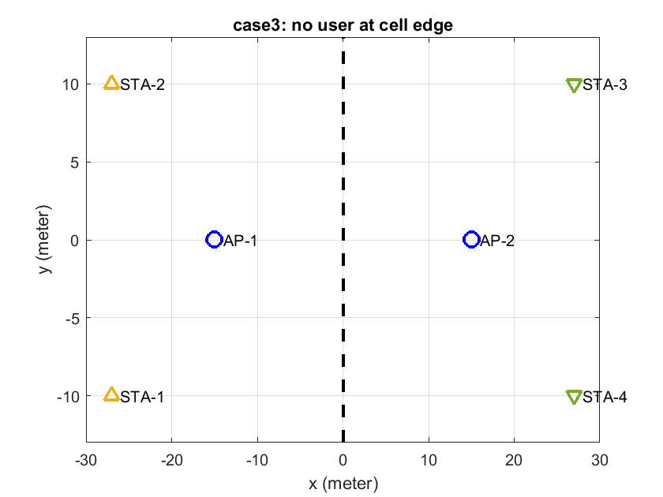
Simulation Results, Example for 2 APs: Area Throughput
JR performs the same as per-AP IC because of power imbalance of STAs at receiving nodes.
y=1:41
x=14
Slide 16

Slide 17
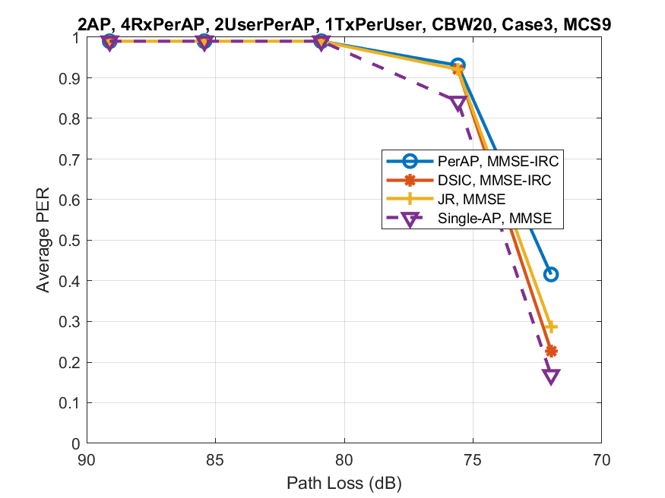
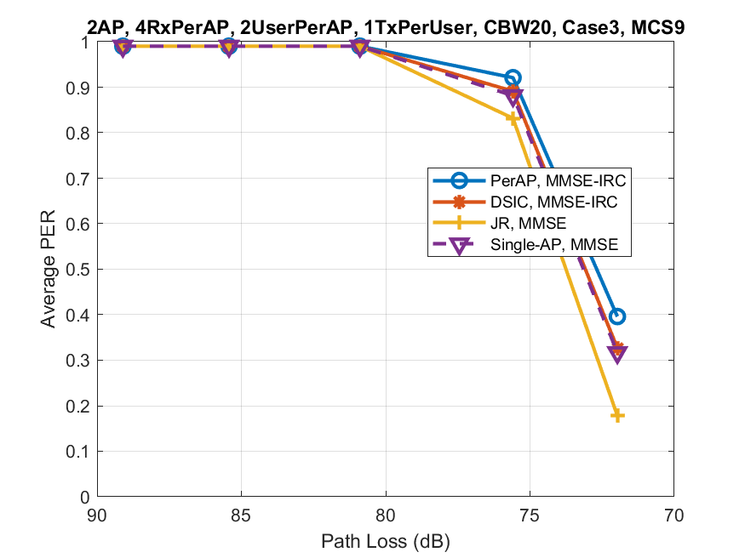
PER Performance: 2 APs
STA3
STA1
Slide 17

Slide 18
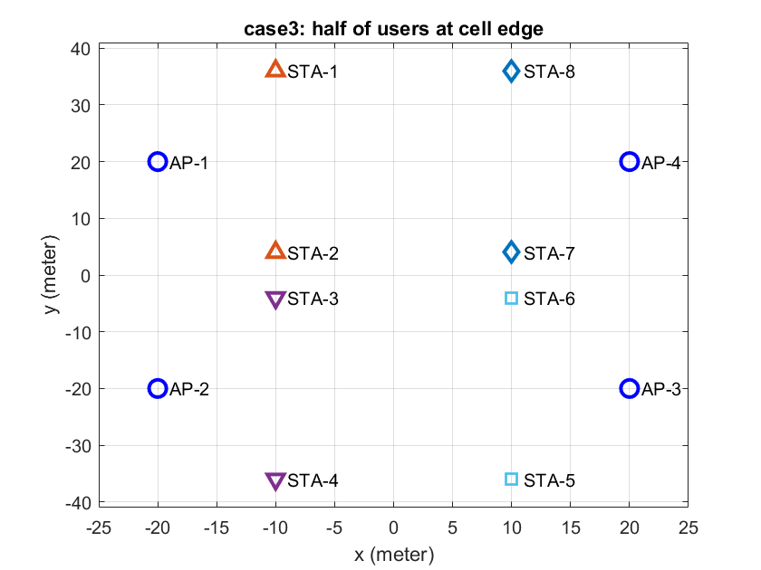
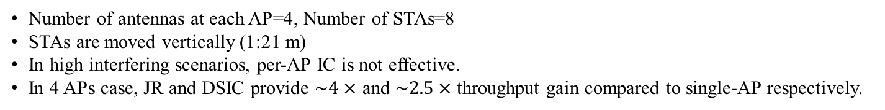
Simulation Results: Example for 4 APs: Area Throughput /Packet Error Rate (PER)
Number of antennas at each AP=4, Number of STAs=8
STAs are moved vertically (1:21 m)
In high interfering scenarios, per-AP IC is not effective.
In 4 APs case, JR and DSIC provide $\sim 4×$ and $\sim 2.5×$throughput gain compared to single-AP respectively.
y=1:21
x=10
Slide 18

Slide 19
PER Multi-AP Diversity
Single-AP PER for 4 APs where STA is located in the cell edge.
No joint processing/ No combining gain
The packet from single STA is received by all 4 APs.
PER will behave as the minimum among all APs.

Slide 20
Conclusion
This contribution is for evaluation of Coordinated Multi-AP in Uplink whether the scheme is attractive and feasible.
Analyzed different possible schemes and compared simulation results.
JR provides the highest performance gain of multiple AP array processing/ interference cancellation but with the high cost of high speed backhaul requirement.
Delayed BA may be required for JR.
In Low-interference scenarios, Per-AP IC results close performance gains as JR
For 2 APs, Per-AP IC results (1.5-2)x throughput gain depends on use case scenarios and path loss.
In high-interference scenarios, Per-AP IC is not effective.
In Single-user case with high reliability requirement, joint diversity reception may provide an additional path for data reception which improves reliability.
Slide 20

Slide 21
References
[1]: IEEE802.11-19/1594r2, “Coordinated Beamforming/Null Steering Protocol in 802.11be”.

Slide 22
Back up

Slide 23
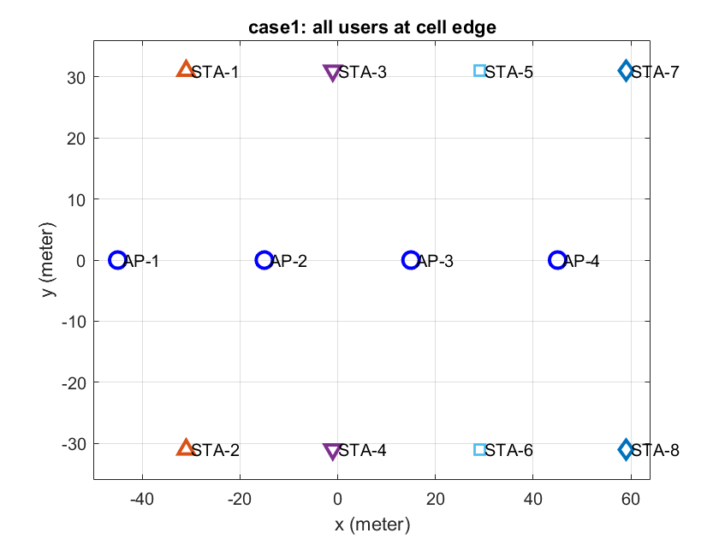
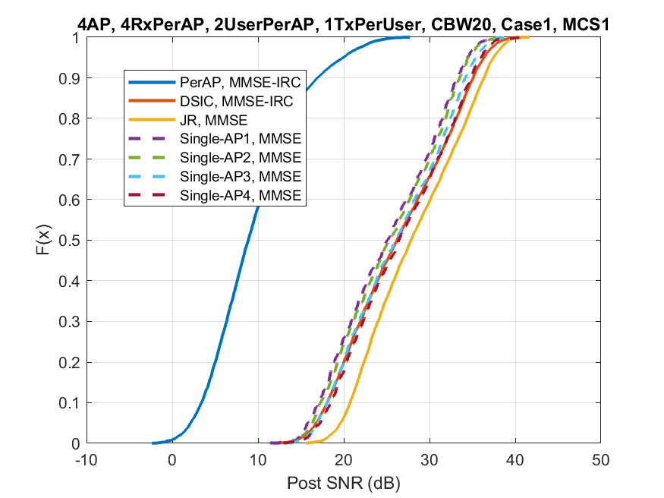
Simulation Results, Example for 4 APs: Packet Error Rate (PER)/ Area Throughput
y=1:41
x=14
Slide 23

