Slide 1
Wi-Fi Sensing with Doppler measurement in 60GHz band
Date: November 11, 2019
Authors:

Slide 2
Abstract
mmWave Radar can measure the target(s) velocity by measuring the Doppler frequency.
The target velocity information is very useful for almost all use-cases.
Wi-Fi Sensing should include means to allow efficient Doppler measurement.

Slide 3
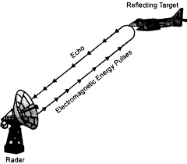
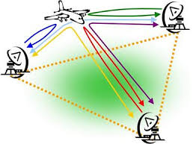
Radar introduction
Monostatic Radar
Multi-Static Radar

Slide 4
Doppler measurement
The target velocity (relative to the Radar device) can be computed from the Radar signal Doppler (frequency shift)
The Doppler frequency shift can be measured by processing two or more short time measurements
  Doppler resolution = Lambda/2/ObservationTime.
  Note that the factor 2 is needed since the Doppler effect doubled due to the round trip.
  In our case Lambda=5mm.
  Hence for 5msec observation time the resolution is 0.5m/sec.
  The Max Doppler that can be measured without wrap is PRI*Lambda/4
Typically, a Radar will perform N evenly spaced measurements and use FFT to produce the Doppler map
  In Wi-Fi, evenly spaced measurements is very difficult
  Alternatively, non-uniform spaced measurements can be used
Alecsander Eitan (Qualcomm)

Slide 5
Benefits of Doppler information
Enables detection of non-static targets (e.g. people, pets,…)
(Doppler can be used to characterize targets – humans move differently than other objects)
Enables targets identification and tracking, when the other parameters (Az/El/Range) are same or similar
Enables micro-movements detection
High resolution Doppler measurement can be achieved by increasing the measurement time
Alecsander Eitan (Qualcomm)

Slide 6
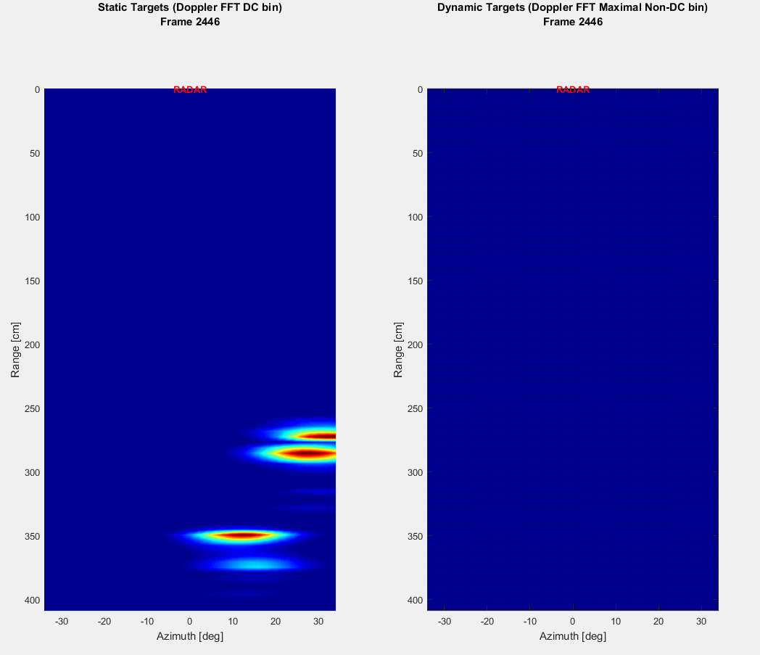
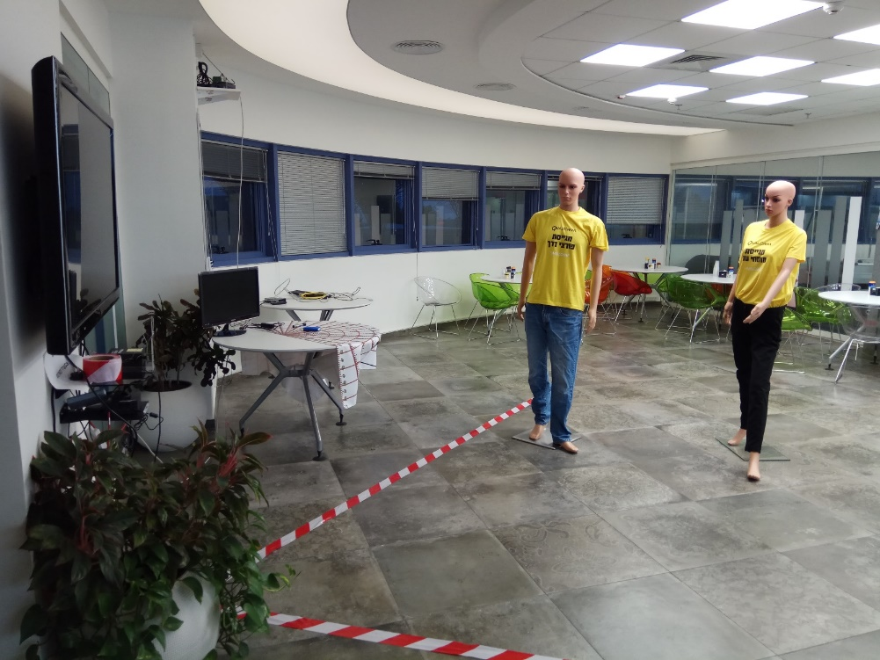
Mono-static 60GHz Radar demo
Alecsander Eitan (Qualcomm)

Slide 7
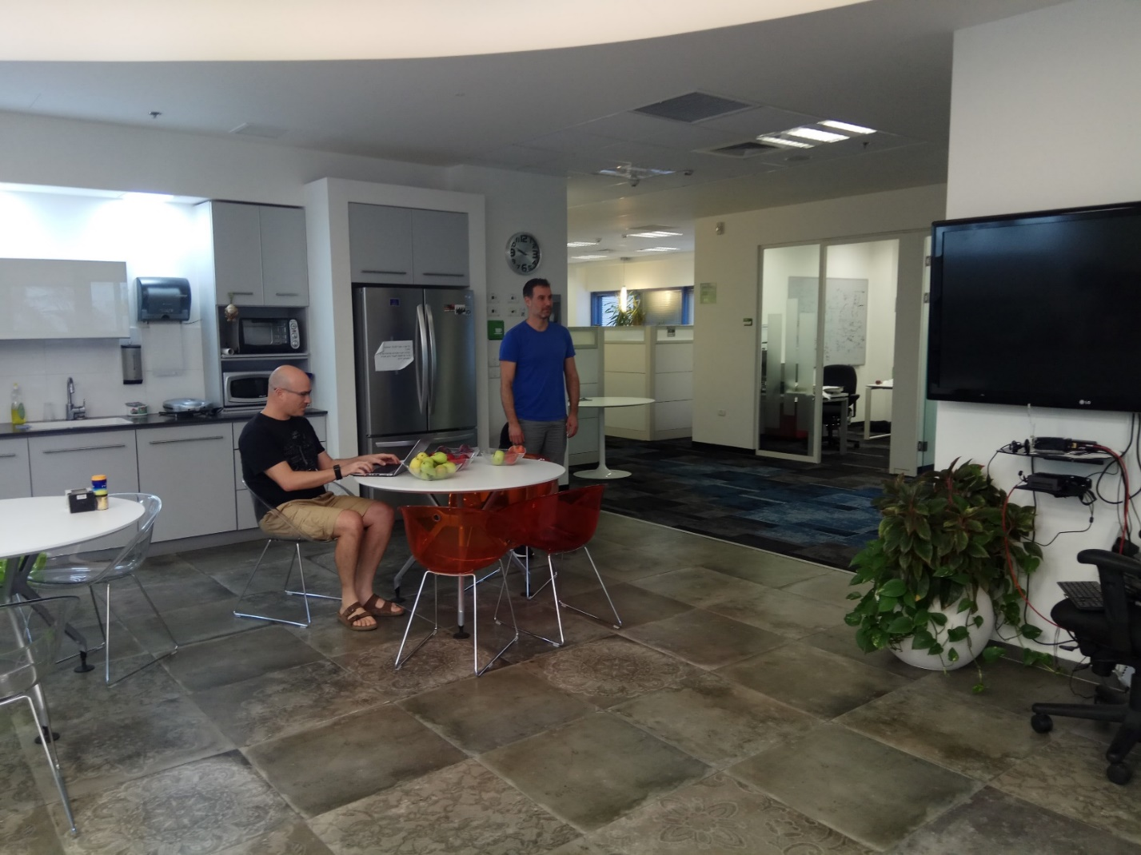
Mono-static 60GHz Radar demo
Alecsander Eitan (Qualcomm)

Slide 8
Benefits of Doppler information – Use-case examples
Room sensing
  Identify humans and pets vs static objects in the room
  Assist objects movement classification
  Allow objects separation
Liveness
  Micro-movements are typical of living creatures
Healthcare
  Micro-movements allow breathing measurement
  Activity level identification (walk, sit, sleep,…)
Alecsander Eitan (Qualcomm)

Slide 9
4-D Radar Measurements
A generic Radar measurement result is a 4-D map –> Az-El-Range-Doppler.
In most cases, after some processing this map is sparse.
(Examples for the processing can be found by looking for automotive Radar)
The sparse 4-D map is (generally) processed by algorithms such as: CFAR, clustering, tracking and target extraction.
Alecsander Eitan (Qualcomm)

Slide 10
Non-Uniform Spaced Measurements
Doppler measurement is simple from evenly spaced samples, by performing FFT per same Az, El and CIR bin (Range).
However, in WiFi evenly spaced samples cannot be efficiently measured.
Fortunately, there are many methods developed and available in the literature for Fourier Transform of Non-Uniform Spaced Measurements.
The computation is more complex than the well known FFT but still practical.
The upper bound for the computation complexity is DFT
(NxK where N is number of samples and K number of FT bins)
Alecsander Eitan (Qualcomm)

Slide 11
Spec Requirements
Doppler measurements require uniform spaced measurements (best) or
close to uniform spaced measurements.
The .11 spec shall allow and make easy to achieve this with high efficiency.
Data sharing between STAs shall allow for exchanging the 4-D Radar measurements (Az-El-Range-Doppler) efficiently (meaning: compressed data) and reduced maps (e.g. 3-D and 2-D).
Alecsander Eitan (Qualcomm)

Slide 12
Summary
The Doppler information is very useful for almost all use-cases. It allows
distinction between living targets and static surrounding as well as enables
micro-movements measuring.
The Doppler is measured by “periodic” measurements.
The .11 spec shall allow and make easy to achieve efficient Doppler
measurement.
The .11 spec shall allow efficient (4-D, 3-D and 2-D) measurements sharing
between stations.
Alecsander Eitan (Qualcomm)

Slide 13

Alecsander Eitan (Qualcomm)

Slide 14
60GHz Radar Performance
Monostatic radar can achieve the following:
Angular resolution of 4°with 32 elements in a row/column (raw)
Range resolution of 9cm (raw @1.76Gsps)
Doppler resolution of 0.5m/sec for 5msec measurement
(depends on no of repetitions)
Micromovement differential resolution of 0.1mm (raw)
Alecsander Eitan (Qualcomm)

Slide 15
60GHz Radar Performance Numbers
Angular resolution of 4°with 32 elements in a row/column (raw)
Assuming 32 elements in a row, the theoretical beamwidth is 2/Nel [rad],
which are 2/32*180/pi = 3.6 deg.
Range resolution of 9cm (raw @1.76Gsps)
The raw resolution is the light speed divided by the sampling rate and divided by 2 since
it is forward & back travel.
The chip rate of DMG is 1.76Gsps (with basic Golay correlator). This gives 8.5cm.
Doppler resolution of 0.5m/sec for 5msec measurement (depends on no of repetitions)
Doppler resolution: achieved by multiple repetition and FFT on results. The resolution is only a function of the repetitions (aka sampling duration).
Doppler resolution = Lambda/2/ObservationTime. In our case Lambda=5mm. Hence for 5msec observation time the resolution is 0.5m/sec.
Micromovement differential resolution of 0.1mm (raw)
Resolution: is derived from the correlations phase and it can be seen as the range resolution when the sampling frequency is replaced by the RF frequency.
One wavelength is 5mm, hence 0.1mm requires to measure phase (of the Golay
correlation) with resolution of lower than 14 deg, which is not an issue.
Alecsander Eitan (Qualcomm)

Slide 16
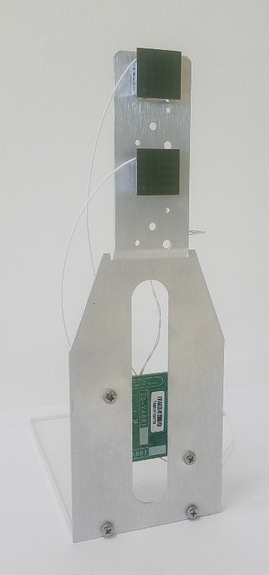
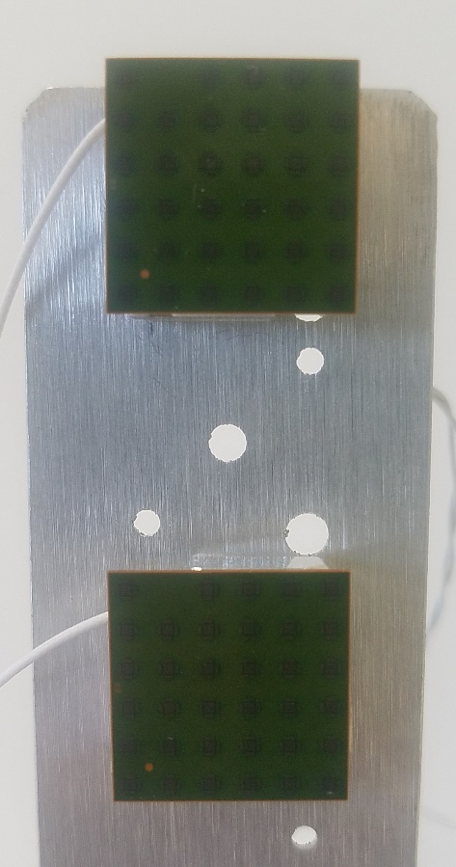
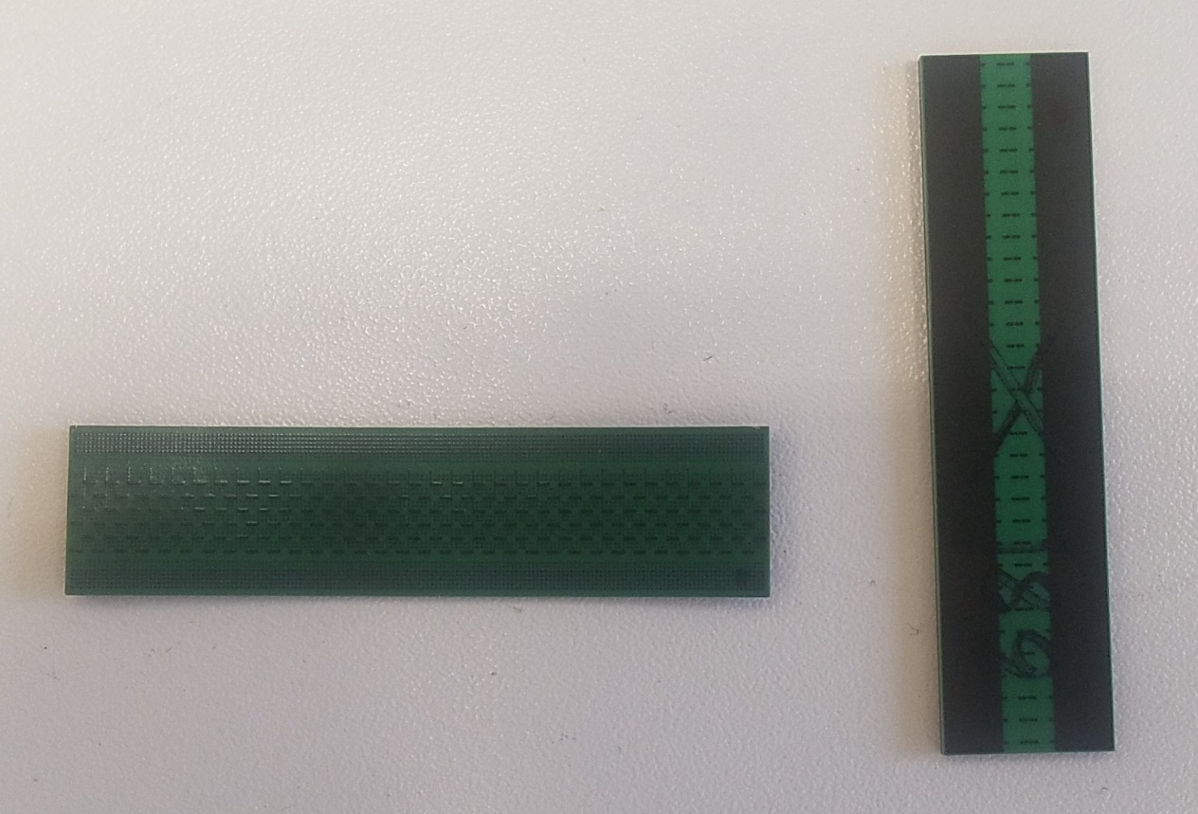
Mono-static 60GHz Radar demo
Alecsander Eitan (Qualcomm)

