Slide 1
On ranging methods for NGV
Date: 2019-11-11
Authors:

Slide 2
Abstract
This contribution discusses some possibilities for 1-dimensional ranging. The objective is to initiate a discussion on the different methods which may be adopted in 802.11bd. Thus, the presentation is aimed at a high-level “brainstorming” discussion rather than promoting a specific method into the standard.

Slide 3
Introduction
The NGV PAR specifies that “this amendment defines procedures for at least one form of positioning in conjunction with V2X communications”
Identifying “positioning” methods for V2X is probably outside the scope of a PHY / MAC specification
However, 802.11bd may define 1-dimensional ranging methods for enabling or improving the estimation of position at a system level
As we move towards automated driving, this capability may be the decisive factor in the success of a next-generation V2X technology

Slide 4
Ranging with 802.11
Various methods already exist and either use proprietary (eg RSSI measurements) or standardized (11v TM / 11mc FTM) technologies
There are a few important differences between how these can be applied in the context of 802.11bd (i.e. in V2X scenarios):
Challenges
High mobility (up to 500 km/h)
OCB operation (no central coordination)
Narrow bandwidth (commonly 10 MHz compared to up to 160 MHz of .11ac/ax)
Duty cycle restrictions combined with large number of nodes
Strengths
A tightly integrated GNSS is commonly deployed with the V2X modem

Slide 5
Ranging Methods
One-way ranging
Two-way ranging
Fine Timing Measurement
Non-Trigger Based ranging

Slide 6
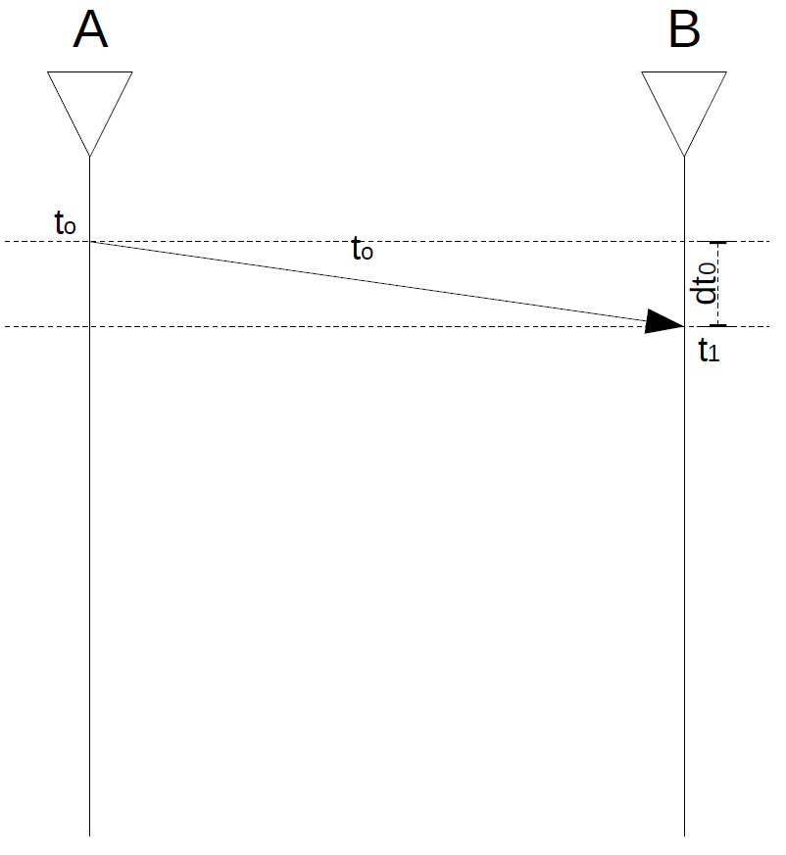
One-way ranging
Procedure
Device A sends a packet containing information on t₀
Measurement method
Device B acquires t₀ from packet and measures t₁
dt₀ = t₁ – t₀
Challenges
Accurate absolute timing is needed in A & B
Exact timing of actual packet transmission (at ns-level) is not scheduled in advance. Inserting this information into the packet is challenging
Need to find an appropriate place (PHY? / MAC? / higher layers?) for the t₀ information

Slide 7
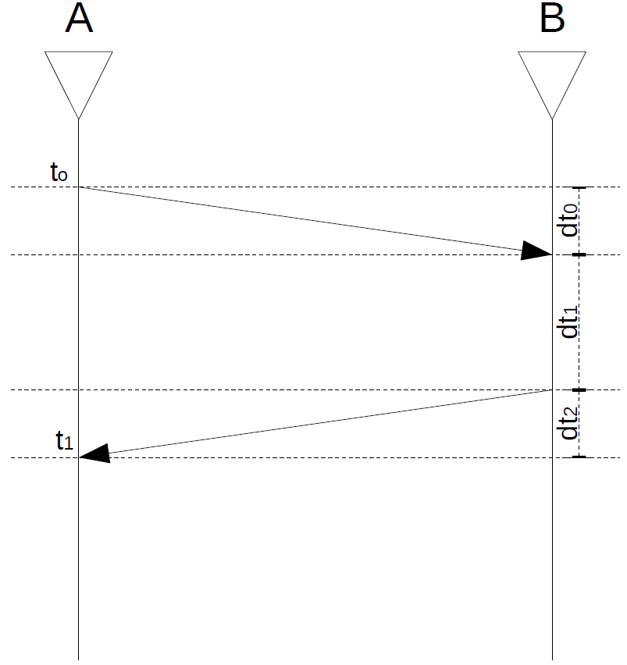
Two-way ranging
Procedure
Device A sends a unicast or RTS packet
Device B responds with ACK or CTS
Measurement method
Device A knows t₀ and t₁
dt₁ = 32 us (±1.3 us*) *10% aSlotTime at 10 MHz
dt₀ == dt₂
dt₀ = (t₁ – t₀ – 32us) / 2
Challenges
Tolerance on response timing is too high (390m distance)
Accurate relative timing is needed in A & B
Only limited to unicast messages

Slide 8
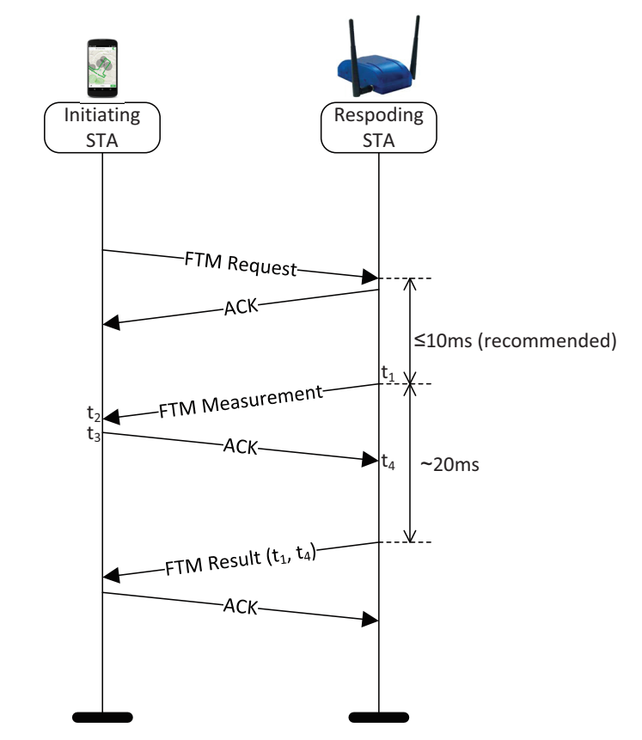
Fine Timing Measurement
Propagation delay from round trip time (RTT) ranging measurements:
Time to obtain RTT range ~ 30 ms (minimum 6 messages)
Position: 3 ranges needed => 18 messages (90 – 120 ms)
FTM creates high channel load
Passive ranging is also possible:
Parameters recorded by Observing STA when monitoring FTM message exchange
Observer needs in addition to t₁ and t₄ also TOF = RTT/2. Could be transmitted with Ack
RTT$=\frac{\left(t_{4}−t_{1}\right)−\left(t_{3}−t_{2}\right)}{2}$

Slide 9
Non-Trigger Based ranging
SIFS = 16 μs,
NDP = 56 μs to (44+16*n) μs < 1 ms
Minimum 4 messages needed
Position: 3 ranges needed => 12 messages (3–4 ms)
Passive ranging is also possible:
Observer needs in addition to t₂ and t₃ also t₁ and t₄
Need to be transmitted with additional message

Slide 10
Ranging constrains
European regulation (ECC Decision 08/01) defines duty cycle restrictions:
Long term: 1% measured over an hour, typical CAM/BSM use in average 0.5%
Short term: Up to 3% for a second, used for event-driven messages like DENM
Raging operation need to respect these restrictions
Communication congestion:
ITS communication is restricted by channel congestion
Congestion control is required to guarantee proper operation of C-ITS systems
All ranging operations have to take that into account
Whenever possible ranging operation should be combined with data communication

Slide 11
Conclusion
Various 1-dimensional ranging methods already exist for 802.11, however these need to be adapted in order to address the challenges and harness the strengths of V2X
Providing support for high-accuracy (dm-level) measurements might be the selling point of 11bd as a next-generation V2X technology
Restrictions need to be followed and unnecessary overhead should be avoided. Whenever possible, ranging should come with minimal or no overhead to “normal” data exchange

