Slide 1
On a new 20 MHz Class-C Spectrum Mask
Date: 2019-11-11
Authors:

Slide 2
Introduction
The use of a more stringent spectrum mask for 20 MHz transmissions (compared to 802.11p – Class C) is desirable to reduce Adjacent Channel Interference
Compliance with the new mask needs to be validated using common DSRC Power Amplifiers (PAs)
Any measurements shall target the high end of transmit power (i.e. >= 25 dBm) where meeting the mask is most challenging

Slide 3
Measurement set-up
-20 dB
Signal generator (VSG)
Keysight EXG
Output power: -6 dBm
Frequency: 5890 MHz
Waveform: 802.11p 20 MHz
  MATLAB-generated
Power amplifier
Skyworks DSRC
32 dB fixed gain
Spectrum analyzer
R&S FSV
WLAN add-on

Slide 4
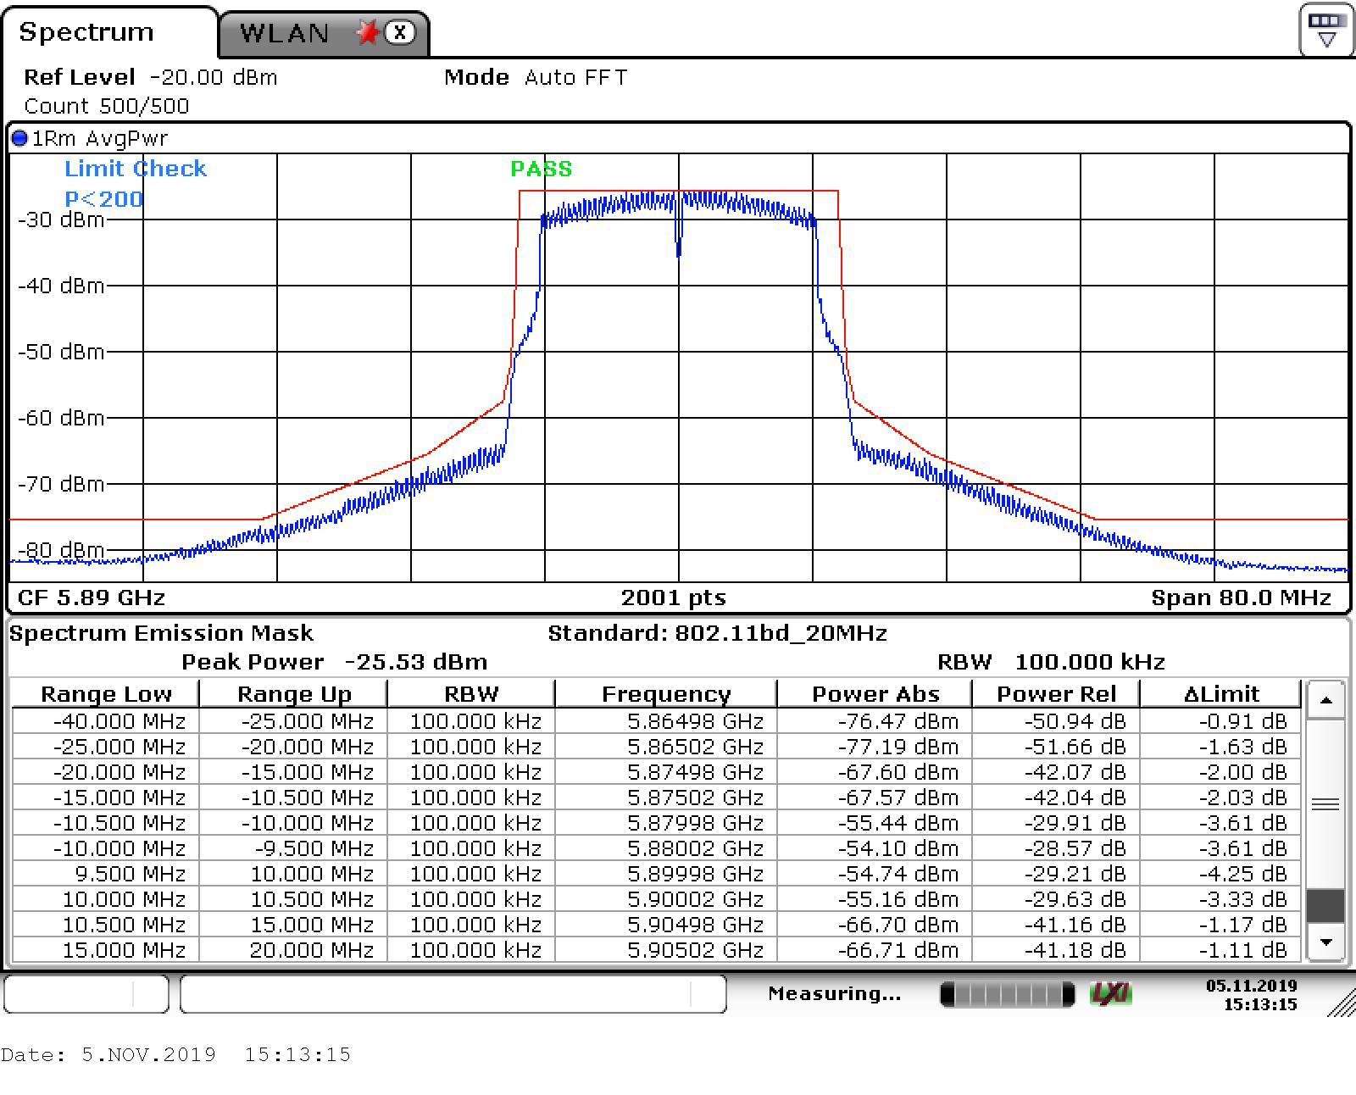
Issue with specific waveform, can be fixed with proper windowing
From f±15 MHz up to f±25 MHz mask is linear
Note 1: Measurement at room temperature (~23 C)
Note 2: Results are optimistic due to good phase and thermal noise characteristics of VSG
0 dB
-26 dB
-32 dB
-40 dB
-45 dB
-50 dB

Slide 5
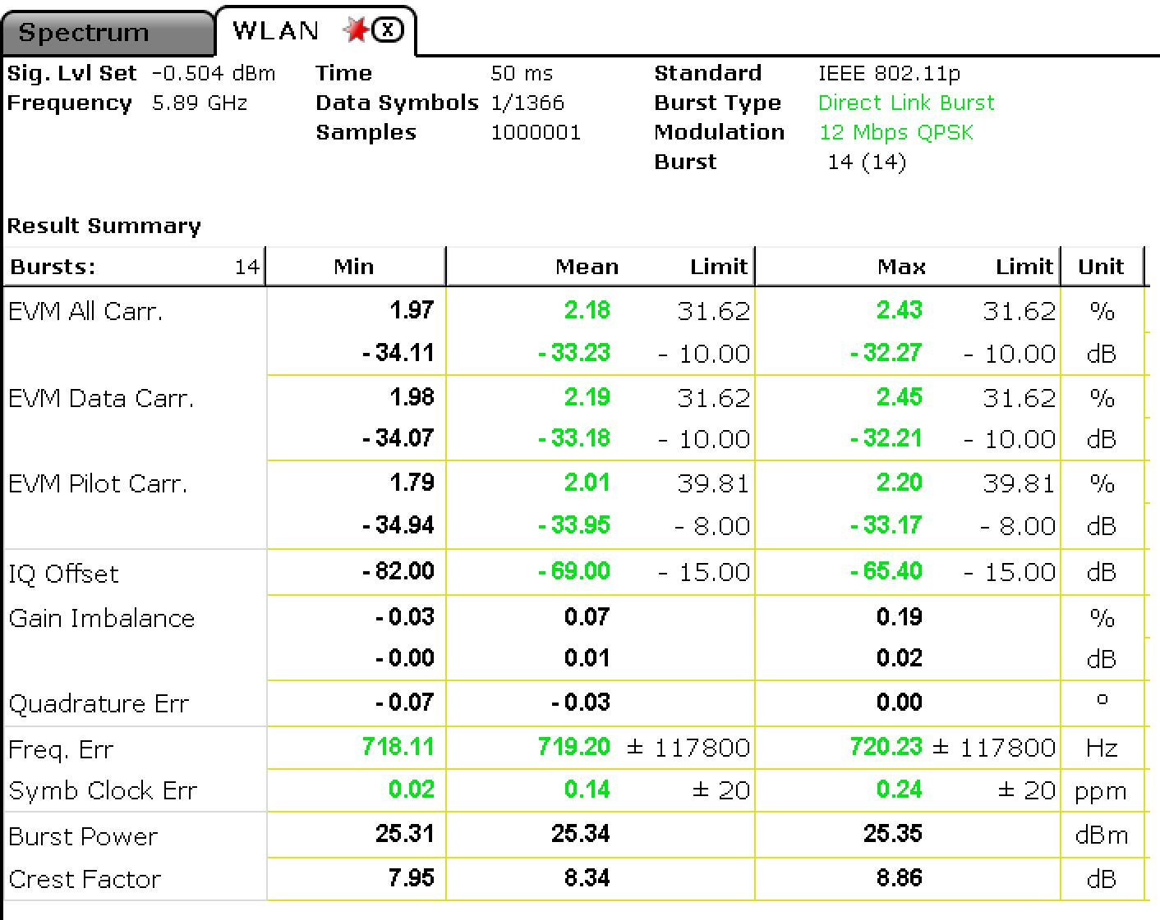
Tx EVM:
-33 dBm
Increasing the Tx power further violates compliance with spectrum mask and reduces EVM (~3dB loss for 1dB more Tx power)
Tx power (losses and attenuation are de-embedded):
25.3 dBm

Slide 6
20MHz Spectrum Mask: Class C
 | Permitted power spectral density, dBr
 | +/-4.5 MHz offset (+/-f1) | +/-5 MHz offset (+/-f2) | +/-5.5MHz offset (+/-f3) | +/-10MHz offset (+/-f4) | +/-15MHz offset (+/-f5)
11p 10MHz | 0 | -26 | -32 | -40 | -50
 | +/-9 MHz offset (+/-f1) | +/-10 MHz offset (+/-f2) | +/-11MHz offset (+/-f3) | +/-20MHz offset (+/-f4) | +/-30MHz offset (+/-f5)
11p 20MHz | 0 | -26 | -32 | -40 | -50
Definition is redundant
 | Permitted power spectral density, dBr
 | +/-9.5 MHz offset (+/-f1) | +/-10 MHz offset (+/-f2) | +/-10.5MHz offset (+/-f3) | +/-15MHz offset (+/-f4) | +/-20MHz offset (+/-f5) | +/-25MHz offset (+/-f6)
Class-C2 20MHz | 0 | -26 | -32 | -40 | -45 | -50

Slide 7
Conclusion
A more stringent mask than 20 MHz Class C is achievable @ P_{Tx} =25 dBm
Increasing the power further not only violates mask compliance but reduces Tx EVM to levels where 256-QAM will not be achievable (< 32 dB)
Proposed spectrum mask
 | Permitted power spectral density, dBr
 | +/-9.5 MHz offset (+/-f1) | +/-10 MHz offset (+/-f2) | +/-10.5MHz offset (+/-f3) | +/-15MHz offset (+/-f4) | +/-25MHz offset (+/-f6)
Class-C2 20MHz | 0 | -26 | -32 | -40 | -50

Slide 8
References
[1] Rui Cao and etc., “NGV 20MHz Spectrum Mask and OFDM Numerology: Followup”, IEEE 802.11-19/1473r1

Slide 9
Straw poll
Do you agree with the following definition of a 20 MHz Class C2 mask?
Y:
N:
A:
 | Permitted power spectral density, dBr
 | +/-9.5 MHz offset (+/-f1) | +/-10 MHz offset (+/-f2) | +/-10.5MHz offset (+/-f3) | +/-15MHz offset (+/-f4) | +/-25MHz offset (+/-f6)
Class-C2 20MHz | 0 | -26 | -32 | -40 | -50

Slide 10
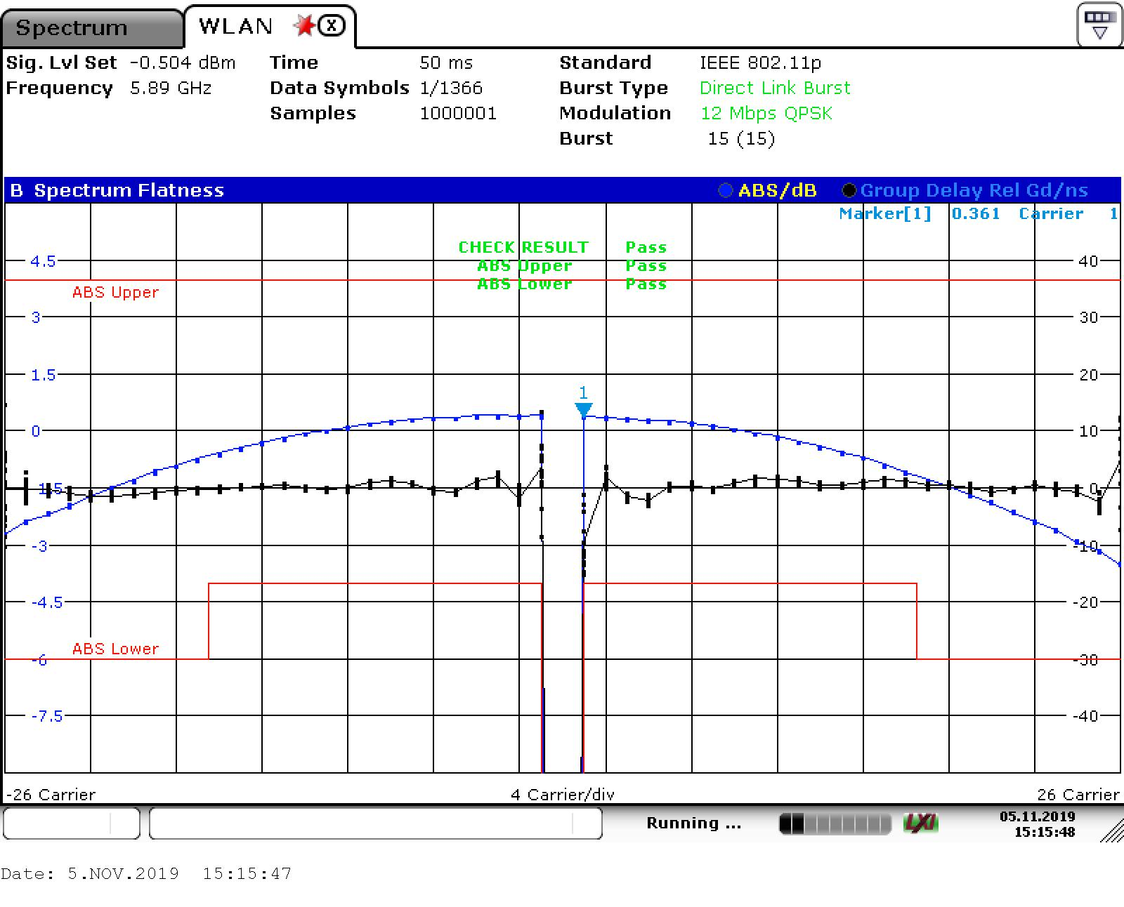
BACKUP
Spectral shaping & compliance with spectrum flatness limits

