Slide 1
Performance evaluation of deterministic service for EHT - Follow up
Date: 2019-11-11
Authors:
Name | Affiliation | Address | Phone | Email
Suhwook Kim | LG Electronics | 19, Yangjae-daero 11gil, Seocho-gu, Seoul 137-130, Korea |  | suhwook.kim@lge.com
Jinsoo Choi |  |  |  | js.choi@lge.com
Jeongki Kim |  |  |  | jeongki.kim@lge.com
Insun Jang |  |  |  | insun.jang@lge.com
Taewon Song |  |  |  | taewon.song@lge.co
Sungjin Park |  |  |  | allean.park@lge.com

Slide 2
Introduction
We have addressed the simulation results for latency traffic in 11ax OFDMA system [1]
  We have adopted OFDMA only system for simulation
  We have implemented real time streaming and cloud gaming traffic in OBSS environment
  We found that supporting deterministic service (especially UL transmission) can be challengeable in OBSS environment regardless of the data rate
We will evaluate that OFDMA with EDCA can support deterministic service
  We will be interested in how to improve UL latency performance

Slide 3
Recap: Simulation Topology
Revised Residential scenario (from 11ax SS document [2])
  Blue: Acting with time-sensitive traffic
    We are focusing on this apartment
  Yellow: Acting as interference (Non time-sensitive traffic)
    They are hearable from Blue apartment
  White: Empty apartment (or acting in different channel)

Slide 4
Recap: Simulation Topology
Blue Apartment
  Traffic: Cloud gaming
  Number of STA
    2 or 4 STAs
  Location: Fixed (1 meter from AP)
Yellow Apartment
  Traffic: Constant Bit Rate
  Number of STA: 2 STAs
  Location: Random

Slide 5
Recap: Traffic details and others
Traffic model: Cloud Gaming [3][4]
  Data rate: 20 Mbps (DL), 100 kbps (UL)
  Latency bound: 10 msec
  Frame rate: 60 Hz (16.7 msec, DL), 15 Hz (66.7 msec, UL)
  UDP, Near-lossless
Interference: Constant Bit Rate
  DL and UL mixed: 2, 4 Mbps per link
  Trigger frame duration: 8 msec
Other parameters for all apartment
  MCS is fixed (MCS 7)
  RU sizes: 484 tones(* 2) and 242 tones(* 4) RU are used

Slide 6
Recap: Simulation Scenario
SS1: Real Time Streaming (omitted)
SS2: Cloud gaming
  2 STAs
  Interference level: 0 Mbps, 2 Mbps, 4 Mbps
  Trigger frame duration: 4 msec, 8 msec
SS3: Cloud gaming
  4 STAs
  Interference level: 0 Mbps, 2 Mbps, 4 Mbps
  Trigger frame duration: 4 msec, 8 msec

Slide 7
New Items
OFDMA with EDCA
  There are two EDCA parameter set (AIFSn, CWmin, CWmax)
    EDCA set (2, 15, 1023): Only for Latency traffic
    MU-EDCA set (17, 255, 1023): For all or non-latency traffic
Smart Triggering
  Assumed that frame arrival time at STA-side is reported to the AP by Genie (No cost, No delay)
  When the frame is buffered at STA-side, the AP attempts to transmit the trigger frame as soon as possible
  Trigger frame is also transmitted for the UL retransmission

Slide 8
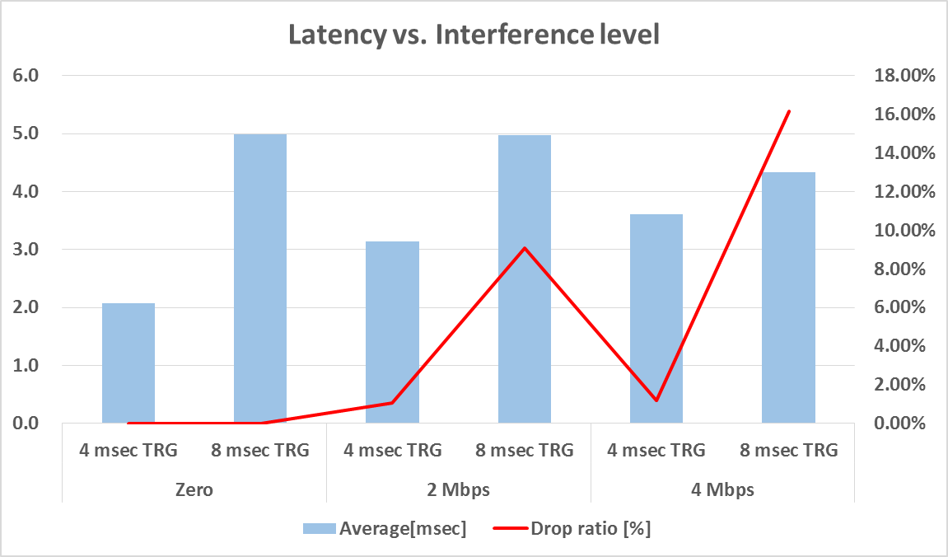
Recap: Simulation Result for SS2
Cloud Gaming (2 STAs): Uplink performance
When the period of trigger frame is set to 8 msec, UL performance is very poor under OBSS interference. We will focus on this case (yellow box), and see how the results will change when the OFDMA with EDCA is applied

Slide 9
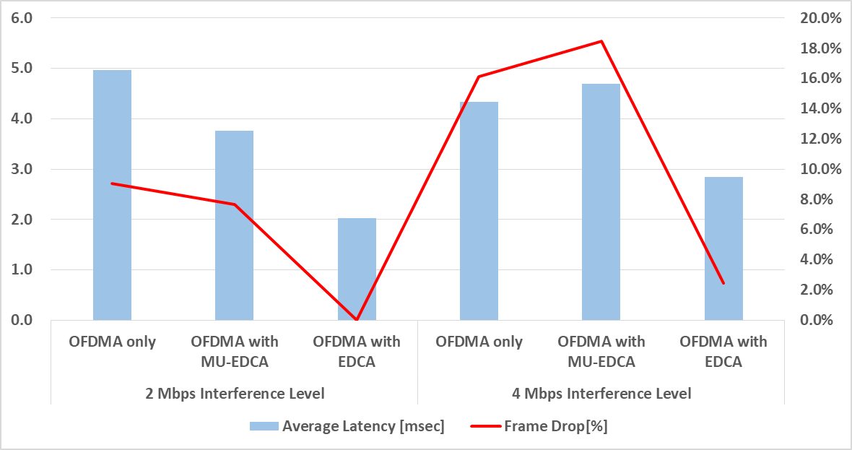
Simulation Result for SS2 (New)
Uplink performance of OFDMA with EDCA

Slide 10
Observation
OFDMA with MU EDCA parameter (larger parameter set) couldn’t improve latency performance compared to OFDMA only
If the STA use shorter EDCA parameter than other STAs in OFDMA with EDCA, latency performance has been improved and the latency traffic can be supported enough
  However, there can be some inconvenience at user-side in situations where interference is high
  So, we will see how the inconvenience can be solved when the smart triggering is applied

Slide 11
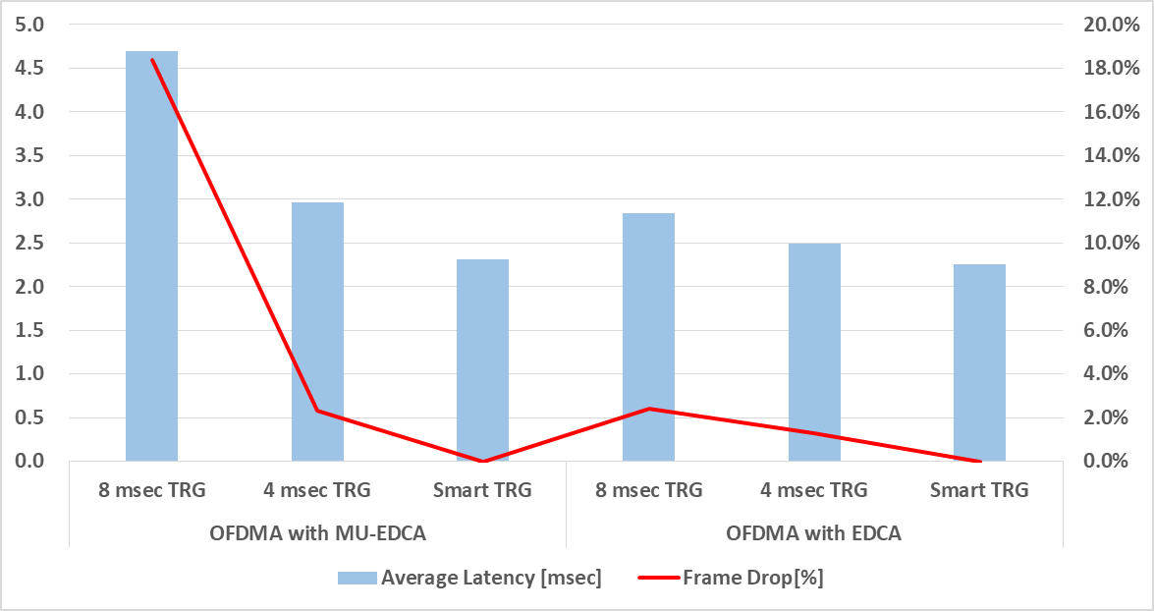
Simulation Result for SS2 (New)
UL performance of Smart Triggering

Slide 12
Observation
If the AP transmits the trigger frames at proper time, UL latency performance can be fully guaranteed whatever parameter the STAs uses
  However, since this smart triggering is difficult in reality, it is obvious that the STA can improve UL latency performance using the shorter EDCA parameter

Slide 13
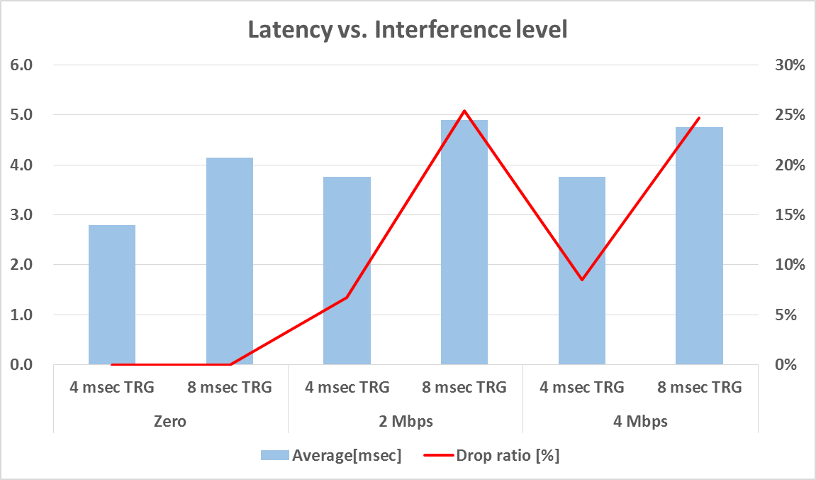
Recap: Simulation Result for SS3
Cloud Gaming (4 STAs): Uplink performance
UL performance of 4 STAs is also very poor in OBSS interference. We will focus on 2 Mbps interference case (yellow box), and see how the results will change when the OFDMA with EDCA is applied

Slide 14
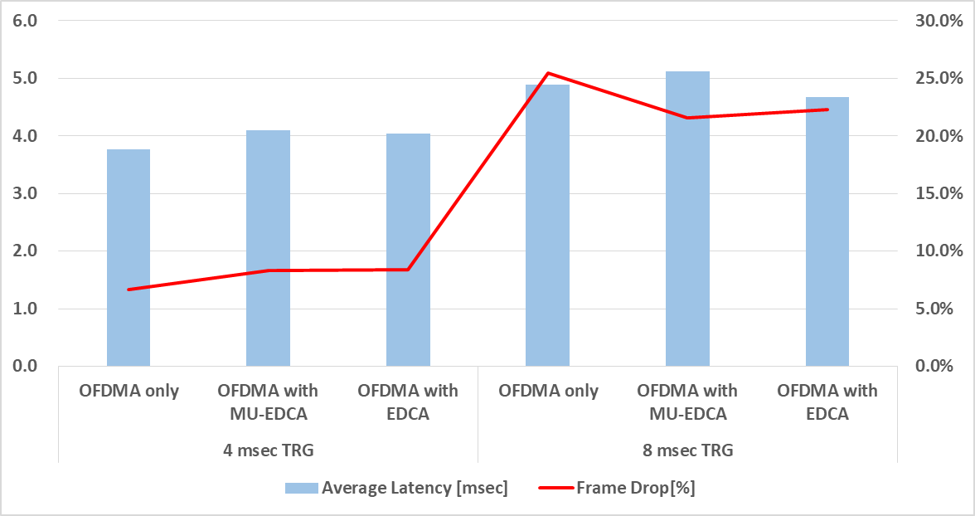
Simulation Result for SS3 (New)
UL performance of OFDMA with EDCA

Slide 15
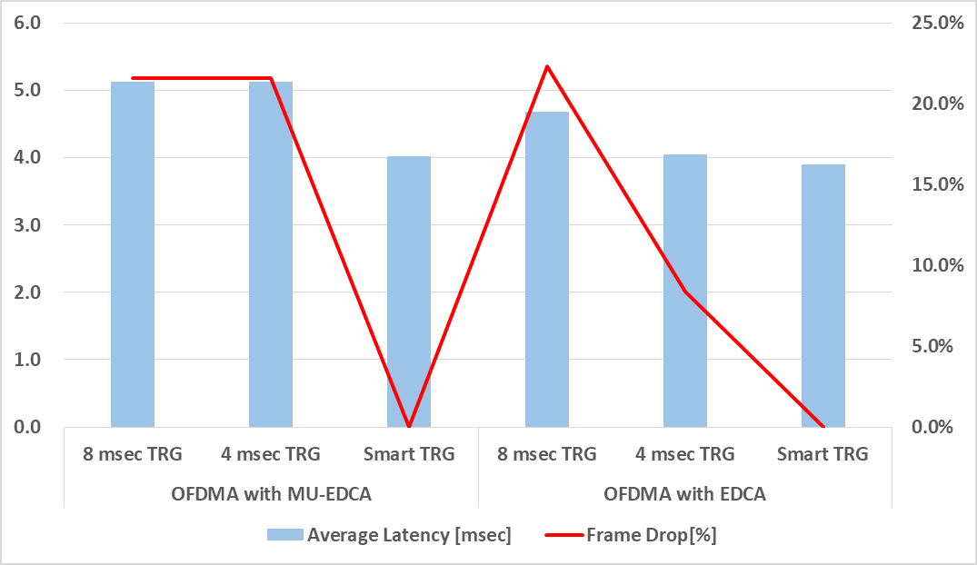
Simulation Result for SS3 (New)
UL performance of Smart Triggering

Slide 16
Observation
Unlike previous case, even though the STA use shorter EDCA parameter than other STAs in OFDMA with EDCA, it is difficult to expect improved UL latency performance in 4 STAs case
  The STA couldn’t have enough TXOP for transmitting latency traffic within latency bound where the BSS load and OBSS interference is high
The solution seems to be the transmission of trigger frames at the right time
  DL latency performance is not significantly affected (see appendix)

Slide 17
Time information reporting
For supporting smart triggering, time information should be delivered to AP
However current BSR/Queue Size Control subfields include size information only, and there isn’t a subfield for reporting time information of traffic in baseline spec
So we propose that defining a mechanism for report traffic stream information
  Traffic stream information: Frame arrival time, remaining time until frame drop, inter arrival time, etc..

Slide 18
Summary
We have evaluated that OFDMA with EDCA can support deterministic service
  If the STA use shorter EDCA parameter than other STAs in OFDMA with EDCA, latency performance has been improved
  Also, latency performance has been improved if the trigger frames can be transmitted at the right time
    The STA should be able to report traffic stream information to the AP

Slide 19
Straw poll
Do you agree to add the following into the TGbe SFD?
An EHT non-AP STA can report traffic stream information for supporting the traffic requiring low latency to the associated AP
  Detail of traffic stream information and signaling are TBD (e.g. frame arrival time, remaining time until frame drop, etc …)

Slide 20
References
[1] 11-19-1523-00-00be-performance-evaluation-of-deterministic-service-for-EHT
[2] 11-14-0980-14-00ax-simulation-scenarios.docx
[3] 11-18-2009-06-0rta-rta-report-draft.docx
[4] 11-18-1973-03-0rta-old-and-new-latency-requirements.pptx

Slide 21
Appendix

Slide 22
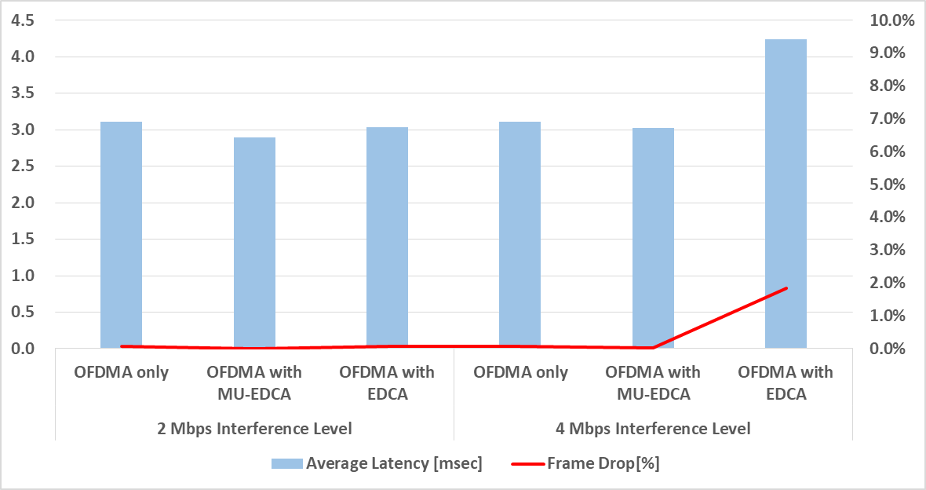
Simulation Result for SS2 (New)
DL performance of OFDMA with EDCA

Slide 23
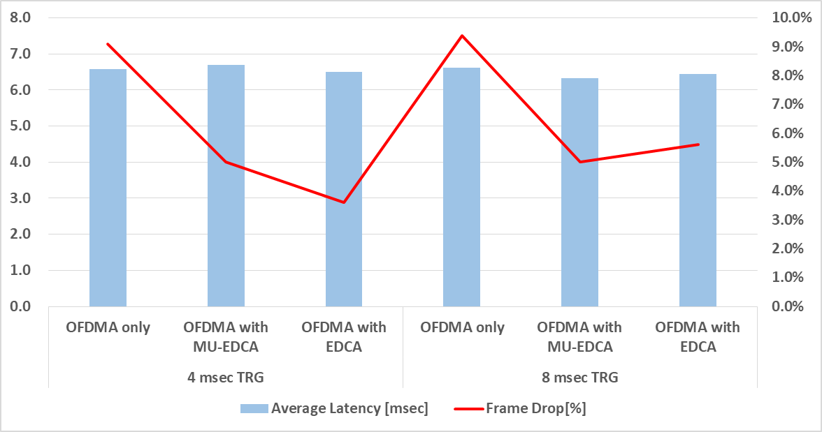
Simulation Result for SS3 (New)
DL performance of OFDMA with EDCA

Slide 24
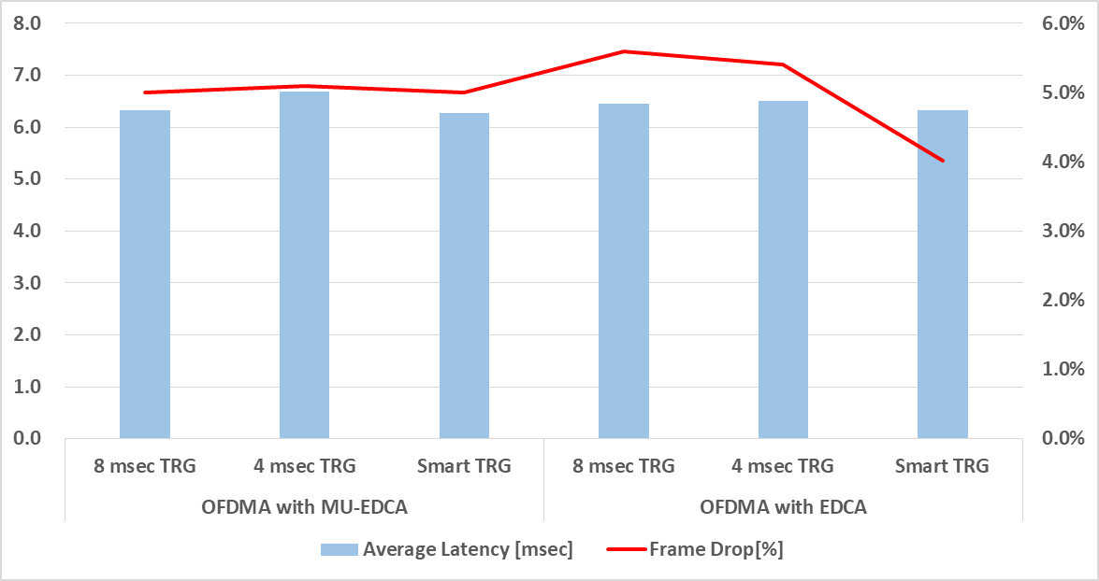
Simulation Result for SS3 (New)
DL performance of Smart Triggering

