Slide 1
Indoor sensing with FMCW radar
Date: 2019-11-11
Authors:
Name | Affiliation | Address | Phone | Email
Xiaohui Peng | Huawei Technologies Co. Ltd | F3, Huawei Base, Shenzhen, China |  | pengxiaohui5@huawei.com
Rui Du |  |  |  | Ray.du@Huawei.com
Chenchen Liu |  |  |  | liuchenchen1@Huawei.com
Baojian Zhou
Zhichao Rong
Ping Zhang
Yizheng Tang
Meihong Zhang
Jiajin Luo
Danny Tan Kai Pin
Tony Xiao Han
David Xun Yang

Slide 2
Outline
Abstract
Basic knowledge of FMCW radar
Experimental measurement
  Measurement configurations
  Evaluation platforms
  Detection analysis
  Measurement results
Potential impacts on WLAN standards
Summary

Slide 3
Abstract
Many contributions on WLAN sensing have been discussed during the last IEEE 802.11 meeting in September and the SENS TIG had been formed [1-5].
Radar has been regarded as a candidate technology for WLAN sensing and some measurement results of 60 GHz band have been presented in September [6-7].
This contribution focus on the experimental results of FMCW radar in 5 GHz band.
Xiaohui Peng, et al. (Huawei)

Slide 4





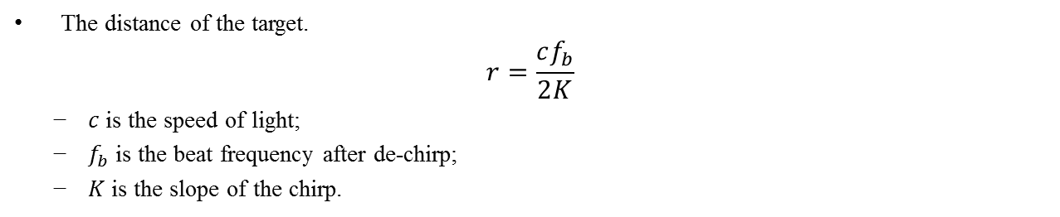




1 Principles of FMCW radar
Frequency
Transmitting signal
Receiving signal
$$B$$
$$f_{b}$$
Time
$$τ$$
$$T$$
$$2T$$
De-chirp
Frequency
$$f_{b}$$
$$f_{b}$$
Time
$$τ$$
$$T$$
$$2T$$
The distance of the target.
$$r=\frac{cf_{b}}{2K}$$
  $c$ is the speed of light;
  $f_{b}$ is the beat frequency after de-chirp;
  $K$ is the slope of the chirp.
Xiaohui Peng, et al. (Huawei)

Slide 5
2.1 Measurement configurations
Measurement Configurations:
  Location: F3-5-A19R @ Huawei, Shenzhen Campus
  Measurement area: 2m×3m
  Two measurement platforms (platform details could be found in the next slide):
    FMCW Radar-based platform: 2 mono-static FMCW Radar nodes, each node with 1 Tx antenna and 1 Rx antenna, placed in position A, and B, respectively (as shown in the figure, the height of both radar is 0.7m).
  Sweep frequency: 5.1-5.42GHz (Node A); 5.2-5.52GHz (Node B)
  Bandwidth: 320MHz
  Range resolution: 0.47m (c/2B)
  Sweep duration: 2.35 ms
  Antenna pattern: V-32°, H-32°
  Antennas polarization: V-V
  EIRP: 15dBm
z
B
y
A
Measurement Area
x
Xiaohui Peng, et al. (Huawei)

Slide 6
2.2 Evaluation platforms
The chirp signal from 800-1120MHz is generated with AWT and up-converted to 5.1-5.42GHz. Then, the signal is passed through a splitter to create two copies, one for transmission and the other one as the input of the mixer to be mixed with the receiving signal.
The receiver receives the RF signal reflected from the target and is translated to baseband using a mixer. The baseband signal is passed through LPF, and then sampled by the ADCs.
Xiaohui Peng, et al. (Huawei)

Slide 7
2.3 Detection analysis
The range resolution is 0.47m (c/2B) which is good enough for human detection.
Since the beamwidths are 32°both vertically and horizontally. The actual horizontal beamwidth is 2.87 meters at 5 meters away from radar.
In order to localize the target within a single beam, additional information is needed, e.g.
  Information from another station
  Angle of arrival of target
  …
2.87m
32°
5m
Radar
Xiaohui Peng, et al. (Huawei)

Slide 8
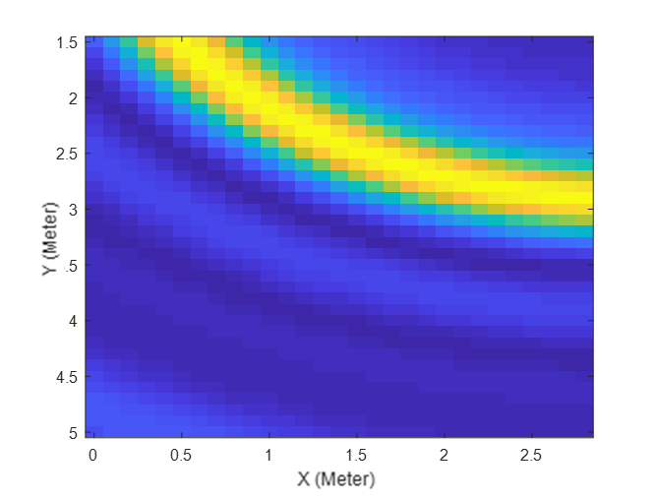
2.4.1 Results with single radar node
Node A
Node B
The detection result of a single target is an arc of constant range within the beam, and it’s not possible for an individual node to localize the target without additional information.
Xiaohui Peng, et al. (Huawei)

Slide 9
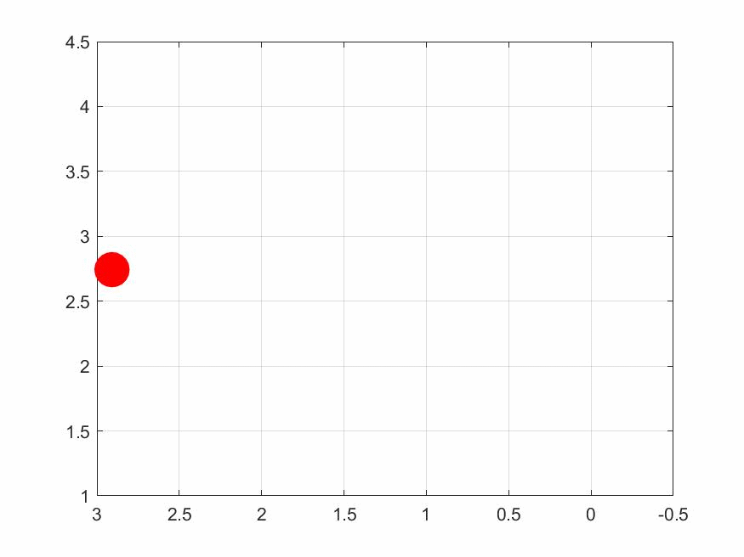
2.4.2 Results with two radar nodes
With the knowledge from two nodes, it is possible for us to localize the target within the beam.
The target’s location is indicated by the intersection point of two arcs.
An example of real time localization result of a moving pedestrian is shown in the right figure.
Xiaohui Peng, et al. (Huawei)

Slide 10
4 Potential impacts on WLAN standards
New waveforms (chirp signal).
Chirp signal could be a potential waveform adopted by WLAN devices in the future.
Cooperation between different nodes.
Information from multiple (two or more) nodes, using triangulation techniques, are needed for more accurate target localization.
Others
Xiaohui Peng, et al. (Huawei)

Slide 11
Summary
Measurement results of FMCW radar at 5 GHz have been shown and discussed.
The feasibility of localizing the target within a single beam with two radar nodes at 5 GHz is validated.
The potential impacts on WLAN standards are discussed.
Xiaohui Peng, et al. (Huawei)

Slide 12
References
[1] 11-19-1164-00-0wng-wi-fi-sensing.pptx
[2] 11-19-1293-00-0wng-wi-fi-sensing-usages-requirements-technical-feasibility and standards gaps.pptx
[3] 11-19-1416-00-0wng-wi-fi-sensing-cooperation-and-standard-support.pptx
[4] 11-19-1580-00-0wng-wi-fi-sensing-application-multipath-enhanced-device-free-localization.pptx
[5] 11-19-1626-01-0wng-802-11-sensing-applications-feasibility-standardization.pptx
[6] 11-19-1500-00-0wng-wi-fi-sensing-follow-up.pptx
[7] 11-19-1551-00-0wng-wi-fi-sensing-in-60ghz-band.pptx
Xiaohui Peng, et al. (Huawei)

