Slide 1
Passive radar: a potential solution for WLAN sensing
Date: 2019-11-11
Authors:
Name | Affiliation | Address | Phone | Email
Rui Du | Huawei Technologies Co. Ltd | F3, Huawei Base, Shenzhen, China |  | ray.du@Huawei.com
Danny Tan Kai Pin |  |  |  | dannyt.pin@huawei.com
Chenchen Liu |  |  |  | liuchenchen1@huawei.com
Xiaohui Peng
Baojian Zhou
Zhichao Rong
Ping Zhang
Meihong Zhang
Yizheng Tang
Jiajin Luo
Tony Xiao Han
David Xun Yang

Slide 2
Outline
Abstract
Definition of passive radar
Signal processing for passive radar
Range/Doppler resolution of bistatic radar
Experimental measurement
  Measurement configurations
  Evaluation platforms
  Measurement results
Potential impacts on WLAN standards
Summary
Rui Du, et al. (Huawei)

Slide 3
Abstract
Radar and CSI had been proposed as two main potential techniques for WLAN sensing [1-2].
Measurement results of active radar for indoor scenarios at 60 GHz had been presented in September IEEE 802.11 meeting[3].
This contribution focus on WLAN passive radar at 5 GHz in indoor scenarios, relevant passive radar background and experimental results will be shown and discussed.
Rui Du, et al. (Huawei)

Slide 4
1 Definition of passive radar
Different from active radar systems, passive radar has no dedicated transmitter. Instead, the receiver uses non-cooperative source in the environment and measures the time/Doppler difference between the signal arriving directly from the transmitter and the signal arriving via reflection from the object.
Rui Du, et al. (Huawei)

Slide 5
2 Signal processing of passive radar
Surveillance channel signal
Clutter cancellation
Matched
filter
Time-frequency analysis
Reference channel signal
The main passive radar signal processing techniques are described as follows:
  The direct path and static clutter signals are to be suppressed from the surveillance signal;
  The matched filter is used to process the “clean” surveillance signal and reference signal ;
  Time-frequency analysis is used to analyze the micro-Doppler of the target.
Rui Du, et al. (Huawei)

Slide 6

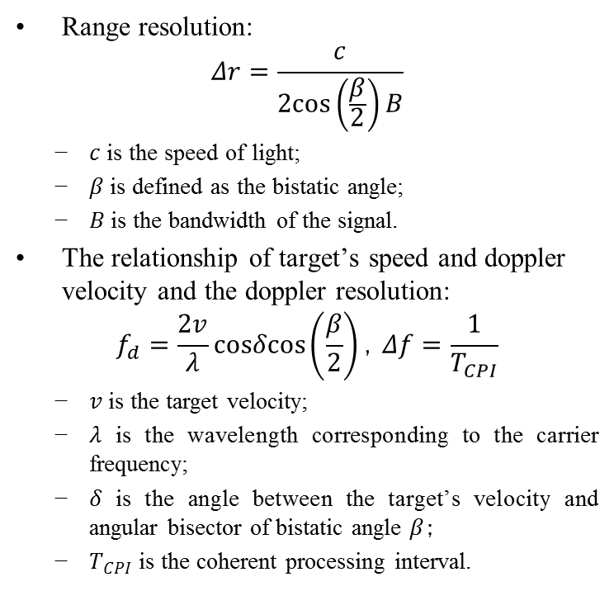







3 Range/Doppler resolution of passive (bistatic) radar
Range resolution:
$$Δr=\frac{c}{2cos\left(\frac{β}{2}\right)B}$$
  $c$ is the speed of light;
  $β$ is defined as the bistatic angle;
  $B$ is the bandwidth of the signal.
The relationship of target’s speed and doppler velocity and the doppler resolution:
$$f_{d}=\frac{2v}{λ}cosδcos\left(\frac{β}{2}\right)，Δf=\frac{1}{T_{CPI}}$$
  $v$ is the target velocity;
  $λ$ is the wavelength corresponding to the carrier frequency;
  $δ$ is the angle between the target’s velocity and angular bisector of bistatic angle $β$；
  $T_{CPI}$ is the coherent processing interval.
Target
$$δ$$
$$β$$
$$β/2$$
$$R_{T}$$
$$R_{R}$$
$$θ_{r}$$
$$θ_{t}$$
Tx
Rx
$$D$$
Baseline
Dual channel passive radar
* Please note that when $β=0$, the analysis above on could be applied for monostatic radar.
Rui Du, et al. (Huawei)

Slide 7
4.1 Measurement configurations
Measurement configurations:
  Location: F3-5-A19R @ Huawei, Shenzhen Campus
  Measurement area: 3m×4m
  Transmitter
  Signal format: 802.11ax
  Carrier frequency: 5.35GHz
  Bandwidth: 20 MHz
  Range resolution: 7.5m (for monostatic radar)
  Antenna pattern: Omnidirectional
  EIRP: 20 dBm
  Receiver
  Number of channels: 1 reference channel and 1 surveillance channel
  Antenna pattern: V-16°, H-16°
  Antennas polarization: V-V
z
Transmitter
Reference channel
y
Receiver
Surveillance channel
Measurement Area
x
Rui Du, et al. (Huawei)

Slide 8
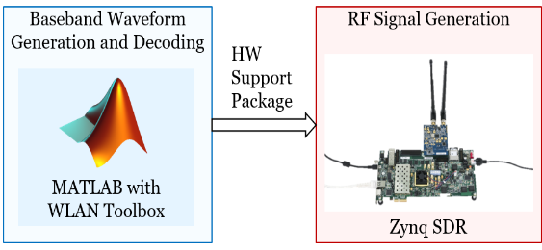


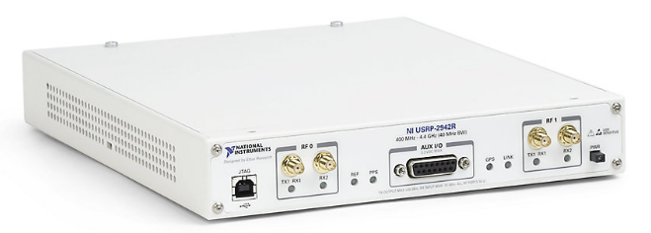
4.2 Evaluation platforms
Transmitter
  The transmitter platform is based on WLAN Toolbox in MATLAB and Zynq SDR.
  IEEE 802.11ax WLAN waveforms are generated by the WLAN Toolbox, and passed to the Zynq SDR for transmission via hardware support package.
Receiver
  The receiver platform is based on Ettus USRP X310 SDR.
  The signal is received via USRP Hardware Drive(UHD), and the received signal is processed offline in matlab.
Transmitter
1 omnidirectional antenna
Reference channel
USRP X310
UHD
Offline signal processing
Surveillance channel
Receiver
1 Reference channel
1 surveillance channel
Rui Du, et al. (Huawei)

Slide 9

4.3.1 Measurement results
Walking
http://www.clipartpanda.com/clipart_images/walk-clipart-black-and-white-38665509
A human target walking towards the passive radar, making a U-turn and walking away from the radar and so on.
Rui Du, et al. (Huawei)

Slide 10

4.3.2 Measurement results
Hand push
https://www.shutterstock.com/zh/search/pushing+hand+vector?image_type=illustration
A human target doing a hand push and retracting at approximately 3 meters away from the passive radar.
Rui Du, et al. (Huawei)

Slide 11

4.3.3 Measurement results
Squat
https://ya-webdesign.com/explore/squat-vector-deadlift/
A human target squatting and standing up at approximately 3 meters away from the passive radar.
Rui Du, et al. (Huawei)

Slide 12

4.3.4 Measurement results
Falling
https://hearinghealthmatters.org/dizzinessdepot/2018/automatic-fall-detection-a-step-in-the-right-direction/
A human target mimicking a fall and standing up at approximately 3 meters away from the passive radar.
Rui Du, et al. (Huawei)

Slide 13
5 Potential impacts on WLAN standards
Sensing result feedback
Multiple Beams
  Two beams (reference channel and surveillance channel);
  Multi beams (one reference channel and multiple surveillance channels);
  …
Multiple devices
  Idle devices (AP/STA) could participate passive sensing, the cooperation between different nodes could be discussed;
  …
Others
Rui Du, et al. (Huawei)

Slide 14
Summary
The definition of passive radar and relevant range/Doppler resolutions are discussed.
The feasibility of detecting target with WLAN passive radar operating at 5 GHz is validated, and more tests could be conducted in the future.
The potential impacts on WLAN standards are discussed.
Rui Du, et al. (Huawei)

Slide 15
References
[1] 11-19-1164-00-0wng-wi-fi-sensing.pptx
[2] 11-19-1500-00-0wng-wi-fi-sensing-follow-up.pptx
[3] 11-19-1551-00-0wng-wi-fi-sensing-in-60ghz-band.pptx
Rui Du, et al. (Huawei)

