Slide 1
Discussion on RTA retransmission
Date: 2019-11-12
Authors:
Name | Company | Address | Phone | Email
Liangxiao Xin | Sony Corporation |  |  | Liangxiao.Xin@sony.com
Mohamed Abouelseoud |  |  |  | Mohamed.Abouelseoud@sony.com
Kazuyuki Sakoda |  |  |  | Kazuyuki.Sakoda@sony.com
Yusuke Tanaka |  |  |  | Yusuke.YT.Tanaka@sony.com
Thomas Handte |  |  |  | thomas.handte@sony.com
Akira Kishida | NTT |  |  | akira.kishida.fs@hco.ntt.co.jp
Kengo Nagata
Suhwook Kim | LG Electronics |  |  | suhwook.kim@lge.com

Slide 2
Objective
Discuss how retransmission time affects the worst case latency
  Investigate if/how the retransmission is critical to the latency
  Show measurement experiment results of expected retransmission delay
Discuss potential solutions to minimize retransmissions delay

Slide 3
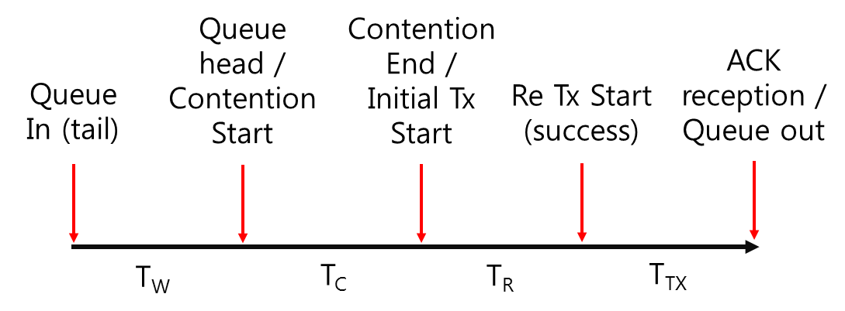
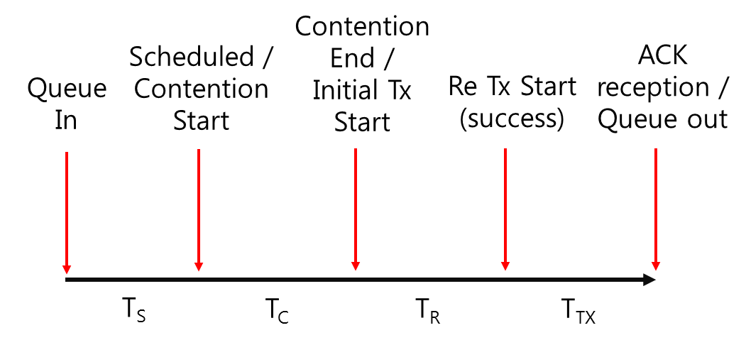
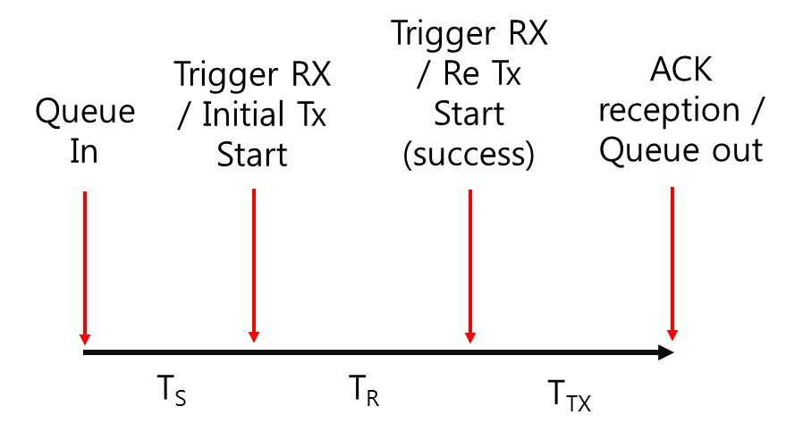
Introduction
One of the challenges of 802.11be is to address the worst-case latency [1].
Deterministic service [2] requires data to be transmitted within a bounded latency [3].
It is expected that 802.11be STA would be able to deliver data to a peer STA within a predefined time almost all time.
It is important to understand what actually causes unexpected large latency with 802.11 data transfer
[4] proposed to break down the latency component to several portions.
  Considered latency portions in EDCA, DL/UL OFDMA scenarios
EDCA
DL OFDMA
UL OFDMA

Slide 4
Latency portions affecting worst-case latency
Queuing time
  Time waiting in the transmitter’s queue
  The queuing time starts when the data arrives at the MAC-SAP
  The queuing time ends when the data triggers contention or scheduling
Contention time
  Time to gain initial channel access
  The contention time starts when the data triggers contention
  The contention time ends when the data is transmitted over the air
Retransmission time
  Time to recover from a transmission failure
  Time between the initial attempt of the frame delivery to the start of the last retransmission
Focus of this presentation

Slide 5
How retransmission time affects the latency
Retransmission time could contain multiple attempts of frame delivery.
Assuming RTA packets are small in size and not using frame aggregation:
  At each attempt of frame delivery, STA needs to wait a random period of re-contention time to gain retransmission channel access.
    Backoff time is randomly chosen according to the contention window size
    The contention window size increases as retransmission occurs
      Double-size the contention window every retransmission until reach CW_max
    The larger the random backoff time, more chances that the channel to be preempted by other STAs
    Once channel busy is report by its PHY, the backoff time countdown is suspended
      Max TXOP of AC_VI: 3.008 ms, which is not marginal wait time for real time traffic
It seems that 802.11 retransmission makes negative effect to the worst case latency
  Let us assess the issue with experiment

Slide 6
Latency measurement
Experiment setup:
  Use case: Real-time mobile gaming [5]
  Topology: One AP and three STAs
  Channel: 20 MHz 11g at Channel 1
  Tx power: 20 dBm
  Venue: office building
  Wi-Fi card brands: from multiple vendors
  Traffic:
    STA1 (DUT) →AP: Packet size (500 bytes) VI UDP at 1Mb/s
    STA2 (interferer) →AP: Packet size (1500 bytes) VI UDP interference
    STA3 (interferer) →AP: Packet size(1500 bytes) VI UDP interference
    The traffic load at STA2 and STA3 vary to simulate different channel occupancy levels
  Experiment time: 1000s

Slide 7
Latency measurement at STA 1 (DUT)
Interference traffic load | STA2: 10Mb/s VI STA3: 10Mb/s VI | STA2: 15Mb/s VI STA3: 15Mb/s VI | STA2: 20Mb/s VI STA3: 20Mb/s VI
# retransmitted frames | 10237 | 11935 | 11873
Max retransmission time | 21.87 ms | 80.47 ms | 208.11 ms
Pr(retransmission time ≥ 10 ms) | 0.19% | 0.94% | 11.18%
# retransmission attempts | 10679 | 12617 | 13194
Max re-contention time | 18.3 ms | 80.35 ms | 208.00 ms
Average re-contention time | 0.93 ms | 1.61 ms | 3.86 ms
Pr(re-contention time ≥ 5 ms) | 0.73% | 4.91% | 26.14%
Pr(re-contention time ≥ 10 ms) | 0.14% | 0.65% | 9.41%
Duration of data frame* | 0.108 ~ 0.148 ms | 0.108 ~ 0.148 ms | 0.108 ~ 0.212 ms
* The duration of data frame is 0.108 ms at 54 Mb/s bit rate
The average RSSI at AP from STA1 is -49 dBm.
Re-contention time: time to gain channel access for a retransmission attempt.
Retransmission time: time to recover from a tx failure.

Slide 8
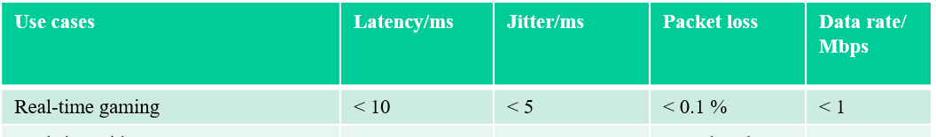
Discussion of measurement results
The result in the worst case (STA2: 20Mb/s VI, STA3: 20Mb/s VI) shows
  STA 1 (DUT) has 11873 retransmitted frames, among which
    Pr(retransmission time ≥ 10 ms) = 11.18%
    Max retransmission time = 208.11 ms
  STA 1 (DUT) generates 250000 VI frames during the experiment
    0.53% of VI frames does not meet the latency requirement (< 10 ms) due to retransmission alone.
    If using the deterministic service, those 0.53% of VI frames will be dropped, which violates the frame (packet) loss requirement (< 0.1%).
Retransmission time by itself does not satisfy the worst-case latency requirement.
Latency requirement of real-time gaming [2]

Slide 9
What can be done to minimize retransmission time?
Goal: minimize the re-contention time for retransmission
No backoff time is needed if the channel is kept occupied by STA
  If the transmission failure is not caused by the contention collision, it is meaningless to have extra backoff time
Backoff time is needed when retransmission occurs due to contention collision

Slide 10
Potential solutions
Retransmission scenario 1 for RTA traffic : the transmission fails due to poor SNR.
  If STA can keep occupying the channel, it could retransmit the frame without extra backoff time.
    STA knows it keeps occupying the channel by receiving negative feedback such as
      Single user scenario (small traffic/no aggregation): consider ACK/NACK
      MU/OFDMA transmission (UL/DL): improve MU cascading transmission (previous proposals [6][7])
    STA retransmits the frame right after receiving the negative feedback
  If the latency budget is very limited, it could retransmit the frame multiple times in a single TXOP.
    Feedback may not be needed, i.e., no ACK or BA.

Slide 11
Potential solutions
Retransmission scenario 2 for RTA traffic: when re-contention is needed for retransmission
  When STA re-contends the channel for retransmission, the size of contention window matters.
  It is possible to decrease the contention window size according to the channel condition

Slide 12
Summary
Latency measurement results is showing retransmission time impact on worst case latency for RTA
Measurement results show that current retransmission scheme does not satisfy the latency requirement of RTA traffic
  Retransmission delay can be significant when re-contention happens.
Potential solutions to minimize the contention time for RTA retransmissions
  Scenario 1: the transmission fails due to poor SNR
    STA should use proper retransmission policy to keep channel access and avoid re-contention
    STA retransmits frames multiple time in one TXOP without feedback
  Scenario 2: when re-contention is needed for retransmission
    STA adjusts the contention window size to re-contend the channel

Slide 13
Straw Poll #1
Do you think the retransmission delay has a critical impact on worst case latency?
Y/N/A

Slide 14
Straw Poll #2
Should we solve the problem of worst case latency caused by retransmission time and consider new retransmission procedures for RTA traffic?
Y/N/A

Slide 15
References
[1] 11-19/0065r6: RTA report summary
[2] 11-19/1298r1: IEEE 802.1 TSN – An Introduction
[3] 11-19/1523r0: Performance evaluation of deterministic service for EHT
[4] 11-19/0762r1: Latency analysis for EHT
[5] 11-18/2009r6: IEEE 802.11 Real Time Application TIG Report
[6] 11-19/1118r1: Enhancements for Time-Critical Data Transmission
[7] 11-19/1538r1: Use of Uplink Persistent Allocation for RTA

Slide 16
Appendix
Retransmission time for one retransmitted frame
Contention End / Initial Tx starts
1st Re-Tx attempt starts
1st Re-Tx attempt ends
2nd Re-Tx attempt starts
2nd Re-Tx attempt ends
Last Re-Tx attempt starts
Initial Tx ends
…
Frame
Frame
Frame
Frame
Time
Duration of a data frame
Re-contention time
Retransmitted frame: data frame that fails the initial transmission attempt.
Retransmission attempt: attempt to retransmit data frame.
Re-contention time: time to gain channel access for a retransmission attempt
Contention time: time to gain initial channel access

