Slide 1
Gain Analysis of Coordinated AP Time/Frequency Sharing in a Transmit Opportunity in 11be
Date: Nov 2019
Name | Affiliation | Address | Phone | Email
Lochan Verma | Qualcomm Inc. |  |  | lverma@qti.qualcomm.com
Menzo Wentink
George Cherian

Slide 2
Introduction
Multiple APs in vicinity of each other can coordinate and share between themselves their time/frequency resource within a TXOP (transmit Opportunity)
Frequency resource sharing (CAP (Coordinated AP) OFDMA) and Time resource sharing (CAP TDMA) for the duration of the TXOP introduced in [1]
Here we show through simulations that these schemes offer significant worst-case latency improvement in the network

Slide 3
Recap: An example of CAP TX Phases [1]
TXOP Owner orchestrates the time/frequency sharing in a TXOP
TX Ind & Req (Indication and Request)
  Neighboring APs learn of TXOP gained by TXOP Owner (Indication)
  TXOP Owner learns of neighboring AP’s intent to participate in a CAP TX (Request)
Schedule Allocation
  TXOP Owner tells participating APs their allocated subchannels, allocated TXOP duration, and TX start time
  Participating APs can tell their clients the allocated subchannels, allocated TXOP duration, and TX start time
Data TX
  Participating APs transmit on their respective allocated subchannels for the allocated TXOP duration beginning at the TX start time

Slide 4
Schemes Compared
Basic EDCA (legacy mode) [EDCA]
  Each AP contend using EDCA, uses the TXOP for its own transmission
Coordinated AP Transmission using frequency/time sharing [CAP OFDMA / CAP TDMA]
  Each AP contend using EDCA. TXOP Owner shares sub-channels/time-slots with neighboring APs
  Coordination between APs on a TXOP by TXOP basis [1]
      No global, long-term synchronization
      TXOP Owner AP sends a broadcast CTI frame to neighboring APs
      Neighboring APs respond to the CTI frame with CTR frame and hence may get included in the TXOP for CAP TX

Slide 5
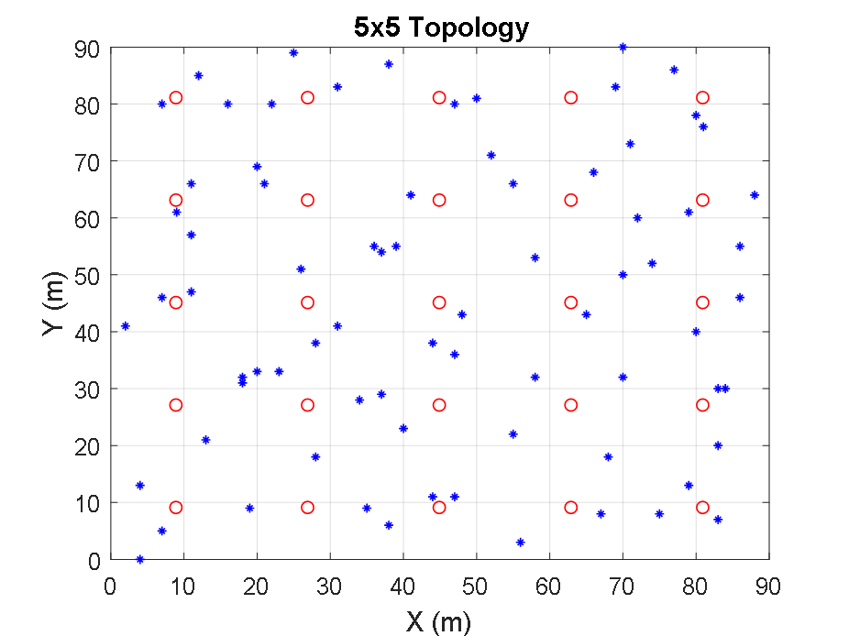
Simulation Setup
Parameter | Configuration
BW | 11ax SU 80 MHz
AP/STA | 4x4; 2x2
AP/STA TxPwr(Total) | 26/21dBm
Channel | CHD
Rate Adaptation | Genie
Max Retry | 4
EDCA TXOP | 4ms
CAP Max Participants | 4
Traffic | Full Buffer DL
Metrics
  Access Wait: Time to successfully transmit a packet

Slide 6
Maximum Access Wait (AW)
CAP improves worst case latency
CCA condition at participant APs may change from alloc phase to data phase
  Hence, CAP TDMA has larger max AW than CAP OFDMA
3x reduction*
3.5x reduction*
Lower is better
*reduction relative to EDCA

Slide 7
References
[1] Lochan Verma et al., ‘Coordinated AP Time/Frequency Sharing in a Transmit Opportunity in 11be”, DCN 802.11-19/1582r0

