Slide 1
11be Preamble Autodetection Follow-up
Date: 2019-11-10
Authors:
Name | Company | Address | Phone | Email
Lei Huang | Panasonic Corporation |  |  | lei.huang@sg.panasonic.com
Yanyi Ding
Urabe Yoshio
Rojan Chitrakar

Slide 2
Background
We presented a 11be preamble autodetection scheme [1] at the September meeting.
The following comments were received during or after our presentation.
  In terms of L-SIG error rate, since only a half of data tones of L-SIG are repeated in SYM following L-SIG, the proposed scheme has a 1.5 dB loss compared to 11ax in AWGN channel, which may disadvantage range extension.
  Performance of 12-bit signaling field carried in the SYM’s Group 2 data tones need to be evaluated.
This contribution addresses the above comments.

Slide 3
Update on the Proposed Scheme
Original scheme in [1]
  Data tones of SYM are divided into two groups:
    24 Group 1 data tones carry information for assisting in the identification of a post-HE PPDU
      24 Group 1 data tones are selected such that they are uniformly distributed over frequency domain for better frequency diversity
      The value of a Group 1 data tone is inverted from the value of the corresponding data tone in L-SIG.
    24 Group 2 data tones carry a 12-bit signaling field to indicate the version of the identified post-HE PPDU and other information.
Enhanced scheme
  To improve the error rate of L-SIG and 12-bit signaling field for range extension, 3dB power boost is applied to 24 Group 2 data tones of L-SIG and 24 Group 2 data tones of SYM.

Slide 4
Simulation Setting
f_{c} = 5 GHz
20 MHz bandwidth
1/2 Tx antennas and 1 Rx antenna
D-NLOS channels (unnormalized)
CSD values per antenna
  [0, -50]ns as in 11ax/11ac
Actual 40ppm CFO and phase/CFO tracking
Actual timing
Frequency domain repetition check based on the HD of coded bits with a threshold of 8 for 11ax and 4 for the proposed scheme

Slide 5
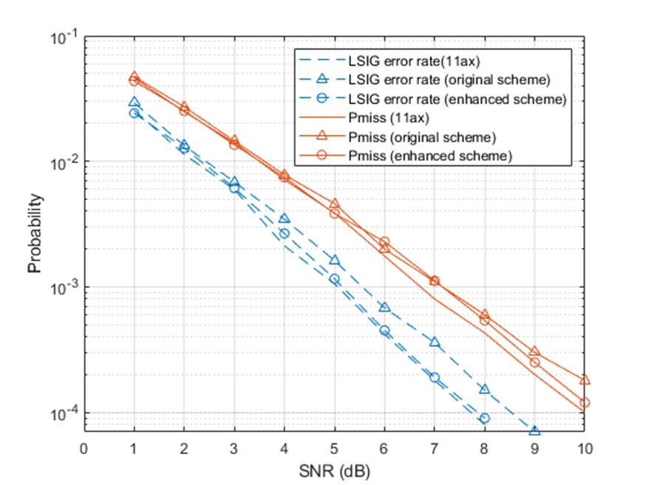
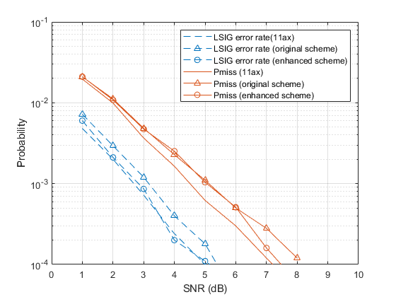
Simulation Results on L-SIG Error Rate and Miss Detection Probability
1×1
2×1
The enhanced scheme has similar L-SIG error rate as 11ax, which helps narrow down the gap between them in terms of miss detection probability.

Slide 6
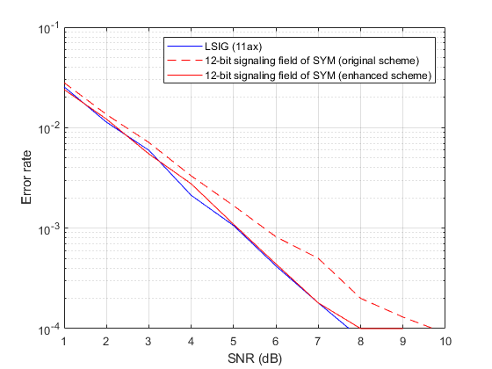
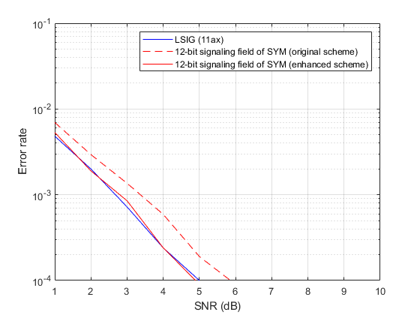
Simulation Results on 12-bit Signaling Field
1×1
2×1
12-bit signaling field of the enhanced scheme has similar error rate to L-SIG of 11ax.

Slide 7
Summary
The proposed scheme is backward compatible and has similar complexity to 11ax.
The proposed scheme enables earlier detection of PHY/PPDU version.
The performance gap between 11ax and the proposed scheme is not significant in both indoor and outdoor channels.

Slide 8
Reference
11-19-1511-00-00be-preamble autodetection for 11be

