Slide 1
Joint-MU Performance With Impairments
Date: 12/18/2019
Authors:
Name | Affiliations | Address | Phone | email
Sudhir Srinivasa | NXP |  |  | sudhir.srinivasas@nxp.com
Hongyuan Zhang | NXP |  |  | hongyuan.zhang@nxp.com

Slide 2
Joint Transmission with Multiple Clients
In [1] we studied Joint-BF and simulated the effect of CFO and delay
Phase buildup from residual CFO was one of the main factors limiting Joint-BF performance
One solution was to add midambles to obtain a more up-to-date channel estimate
In this presentation, we will examine Joint-MU in the presence of different impairments
Apart from CFO and non-ideal timing sync, we also consider the following additional non-idealities [2, 3]:
PA gain uncertainty (at secondary AP) between NDP and DATA packets
Phase uncertainty (at secondary AP) between NDP and DATA packets

Slide 3
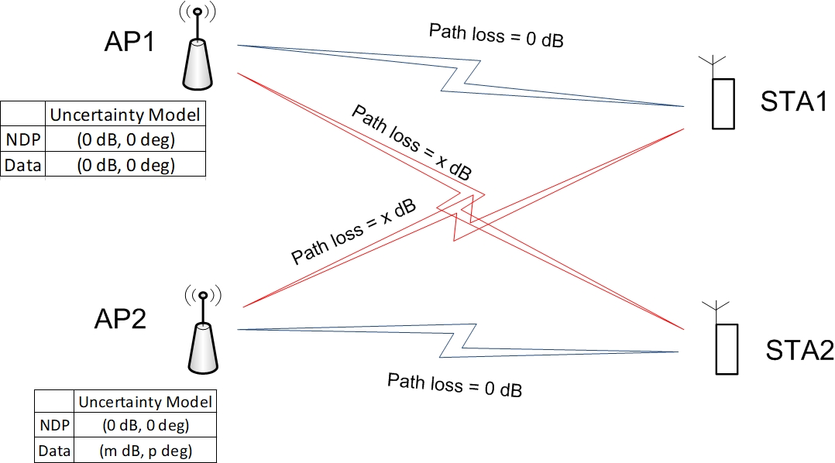
Joint-MU: Model
Path loss from each STA to its own AP is XdB higher than that to other AP(s).
Uncertainties are modeled only on the DATA portion of the secondary AP transmission.
Secondary AP’s PA applies an additional gain of m_{r} dB during data transmission
Modeling for gain is m_{r} = U[-m, m]dB.
Further, secondary AP’s signal also has a random phase component (p_{r} deg) between NDP and data
This phase is modeled as p_{r} = U[-p, p].
Note: This is different model from LO initial phase which is being corrected during trigger packet
The residual initial phase error is modeled as in [1].

Slide 4
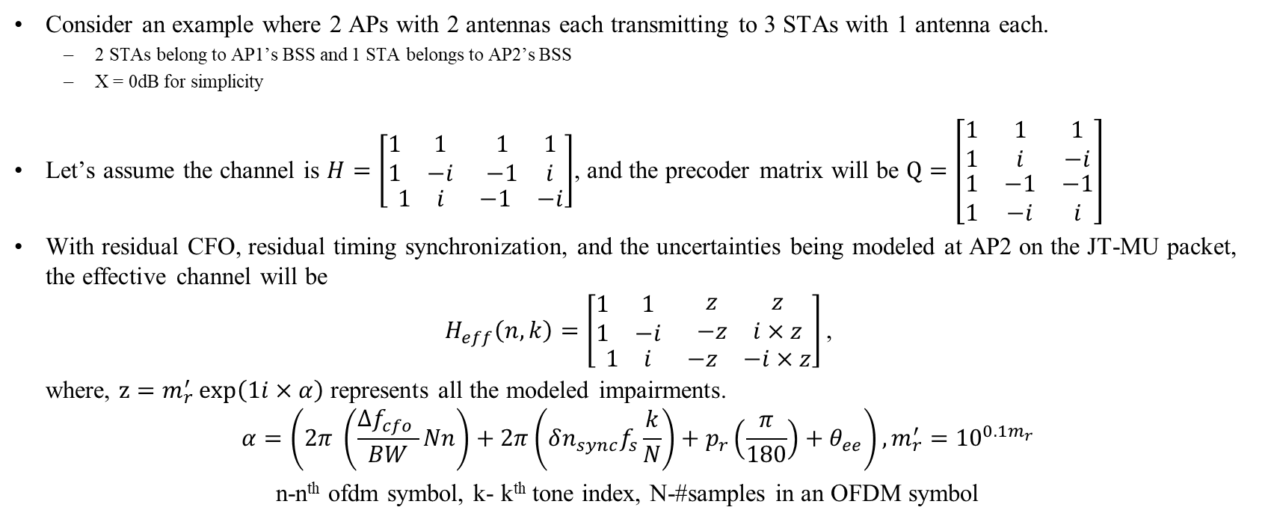
Example 1 (1)
Consider an example where 2 APs with 2 antennas each transmitting to 3 STAs with 1 antenna each.
2 STAs belong to AP1’s BSS and 1 STA belongs to AP2’s BSS
X = 0dB for simplicity
Let’s assume the channel is $H=\left[\begin{matrix}\begin{matrix}1 & 1 \\ 1 & −i\end{matrix} & \begin{matrix}1 & 1 \\ −1 & i\end{matrix} \\ \begin{matrix}1 & i\end{matrix} & \begin{matrix}−1 & −i\end{matrix}\end{matrix}\right]$, and the precoder matrix will be $Q=\left[\begin{matrix}\begin{matrix}\begin{matrix}1 \\ 1\end{matrix} \\ \begin{matrix}1 \\ 1\end{matrix}\end{matrix} & \begin{matrix}\begin{matrix}1 \\ i\end{matrix} \\ \begin{matrix}−1 \\ −i\end{matrix}\end{matrix} & \begin{matrix}\begin{matrix}1 \\ −i\end{matrix} \\ \begin{matrix}−1 \\ i\end{matrix}\end{matrix}\end{matrix}\right]$
With residual CFO, residual timing synchronization, and the uncertainties being modeled at AP2 on the JT-MU packet, the effective channel will be
$$H_{eff}\left(n, k\right)=\left[\begin{matrix}\begin{matrix}1 & 1 \\ 1 & −i\end{matrix} & \begin{matrix}z & z \\ −z & i×z\end{matrix} \\ \begin{matrix}1 & i\end{matrix} & \begin{matrix}−z & −i×z\end{matrix}\end{matrix}\right]\text{,}$$
where, $z=m_{r}^{′}\exp\left(1i×α\right)$ represents all the modeled impairments.
$$α=\left(2π \left(\frac{Δf_{cfo} }{BW}Nn\right)+2π\left(δn_{sync}f_{s}\frac{k}{N}\right)+p_{r}\left(\frac{π}{180}\right)+θ_{ee}\right), m_{r}^{′}={10}^{0.1m_{r}}$$
n-n^{th} ofdm symbol, k- k^{th} tone index, N-#samples in an OFDM symbol

Slide 5
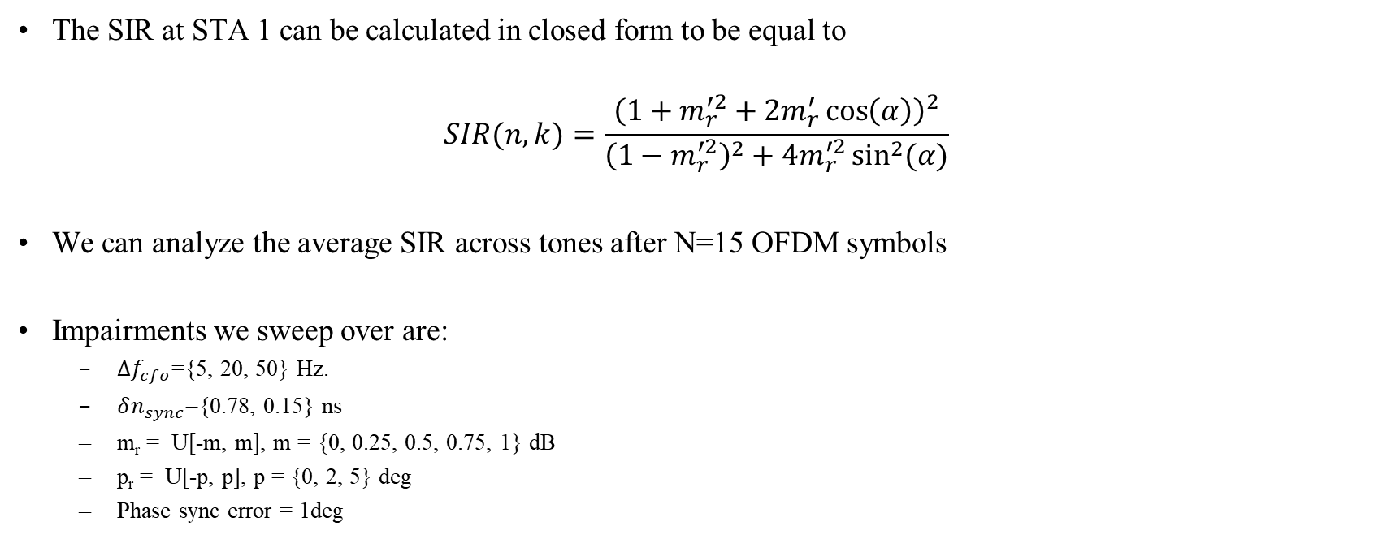
Example 1 (2)
The SIR at STA 1 can be calculated in closed form to be equal to
$$SIR(n, k)=\frac{{\left(1+m_{r}^{′2}+2m_{r}^{′}\cos\left(α\right)\right)}^{2}}{{\left(1−m_{r}^{′2}\right)}^{2}+4m_{r}^{′2}\sin^{2}{(α)}}$$
We can analyze the average SIR across tones after N=15 OFDM symbols
Impairments we sweep over are:
$Δf_{cfo}$={5, 20, 50} Hz.
$δn_{sync}$={0.78, 0.15} ns
m_{r} = U[-m, m], m = {0, 0.25, 0.5, 0.75, 1} dB
p_{r} = U[-p, p], p = {0, 2, 5} deg
Phase sync error = 1deg

Slide 6
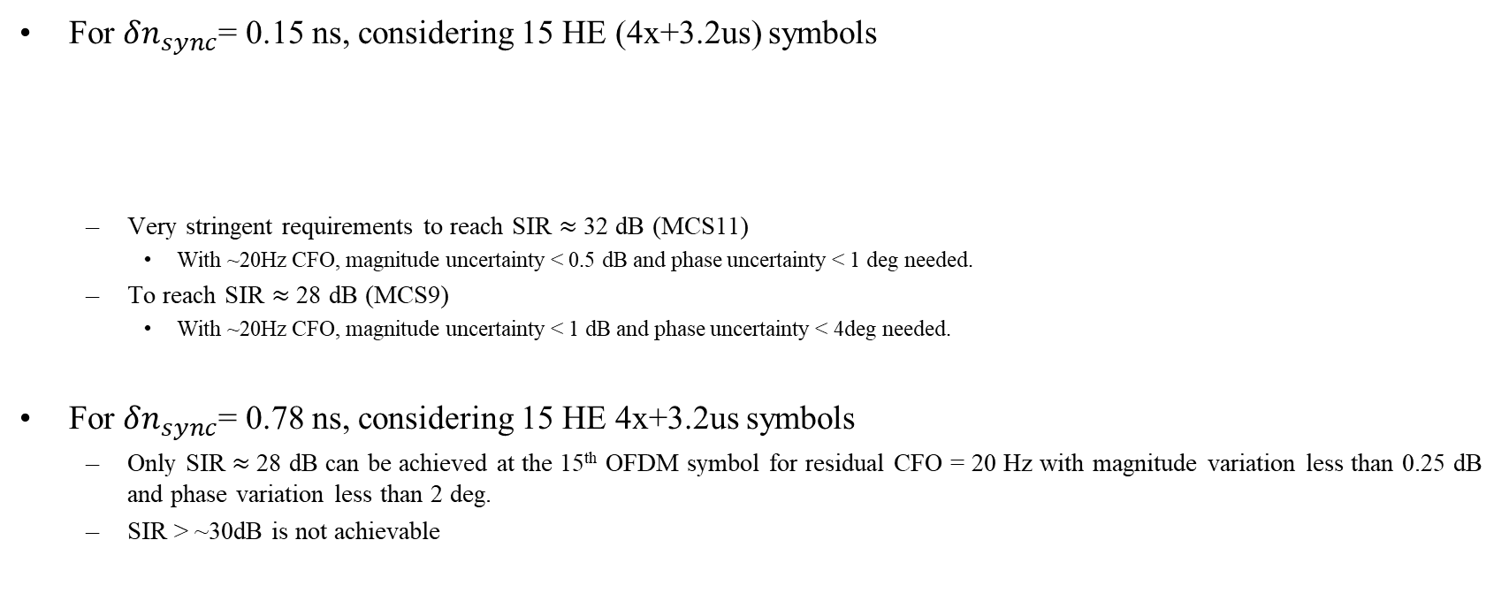
Example 1 Analysis
For $δn_{sync}$= 0.15 ns, considering 15 HE (4x+3.2us) symbols
Very stringent requirements to reach SIR $≈$32 dB (MCS11)
With ~20Hz CFO, magnitude uncertainty < 0.5 dB and phase uncertainty < 1 deg needed.
To reach SIR $≈$ 28 dB (MCS9)
With ~20Hz CFO, magnitude uncertainty < 1 dB and phase uncertainty < 4deg needed.
For $δn_{sync}$= 0.78 ns, considering 15 HE 4x+3.2us symbols
Only SIR $≈$28 dB can be achieved at the 15th OFDM symbol for residual CFO = 20 Hz with magnitude variation less than 0.25 dB and phase variation less than 2 deg.
SIR > ~30dB is not achievable
 | SIR supported = 25 dB | 28 dB | 32 dB
CFO = 5 Hz | (m (dB), p(deg)) = (1.75 dB, 6 deg) | (1dB, 4 deg) | (0.75 dB, 1 deg)
20Hz | (1.75, 4) or (1.5, 6) | (1, 4) | (0.5, 1)
50 Hz | (1.5, 4) | (0.25, 4) | (0, 1)

Slide 7
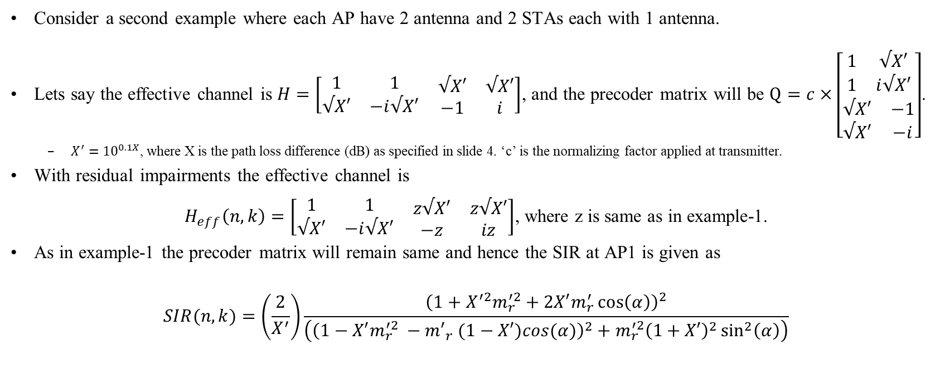
Example 2
Consider a second example where each AP have 2 antenna and 2 STAs each with 1 antenna.
Lets say the effective channel is $H=\left[\begin{matrix}\begin{matrix}1 & 1 \\ √X′ & −i√X′\end{matrix} & \begin{matrix}√X′ & √X′ \\ −1 & i\end{matrix}\end{matrix}\right]$, and the precoder matrix will be $Q=c×\left[\begin{matrix}\begin{matrix}1 & √X′ \\ 1 & i√X′\end{matrix} \\ \begin{matrix}√X′ & −1 \\ √X′ & −i\end{matrix}\end{matrix}\right]$.
$X^{′}={10}^{0.1X}$, where X is the path loss difference (dB) as specified in slide 4. ‘c’ is the normalizing factor applied at transmitter.
With residual impairments the effective channel is
$H_{eff}\left(n, k\right)=\left[\begin{matrix}\begin{matrix}1 & 1 \\ √X′ & −i√X′\end{matrix} & \begin{matrix}z√X′ & z√X′ \\ −z & iz\end{matrix}\end{matrix}\right]$, where z is same as in example-1.
As in example-1 the precoder matrix will remain same and hence the SIR at AP1 is given as
$$SIR(n, k)=\left(\frac{2}{X^{′}}\right)\frac{{\left(1+{X^{′2}m}_{r}^{′2}+2X′m_{r}^{′}\cos\left(α\right)\right)}^{2}}{\left({\left(1−X′m_{r}^{′2} −{m′}_{r} (1−X′)cos(α)\right)}^{2}+m_{r}^{′2}{\left(1+X′\right)}^{2}\sin^{2}\left(α\right)\right)}$$

Slide 8
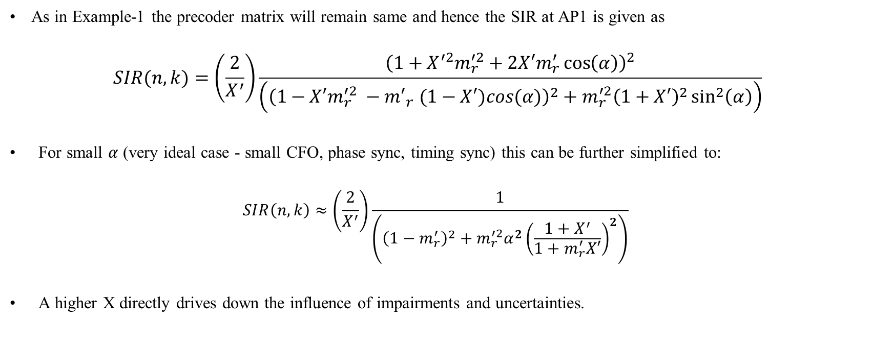
Example 2 (2)
As in Example-1 the precoder matrix will remain same and hence the SIR at AP1 is given as
$$SIR(n, k)=\left(\frac{2}{X^{′}}\right)\frac{{\left(1+{X^{′2}m}_{r}^{′2}+2X′m_{r}^{′}\cos\left(α\right)\right)}^{2}}{\left({\left(1−X′m_{r}^{′2} −{m′}_{r} (1−X′)cos(α)\right)}^{2}+m_{r}^{′2}{\left(1+X′\right)}^{2}\sin^{2}\left(α\right)\right)}$$
For small $α$ (very ideal case - small CFO, phase sync, timing sync) this can be further simplified to:
$$SIR\left(n, k\right)≈\left(\frac{2}{X^{′}}\right)\frac{1}{\left({\left(1−m_{r}^{′}\right)}^{2}+m_{r}^{′2}α^{2}{\left(\frac{1+X^{′}}{1+m_{r}^{′}X′}\right)}^{2}\right)}$$
A higher X directly drives down the influence of impairments and uncertainties.

Slide 9
Performance analysis: Simulation Setup
Familiar case of two APs each with 4 antennas and serving single client each with 2 receive antennas
Only residual timing/frequency offsets between master – slave APs are modeled
IEEE Channel D
Ng=1 feedback without any quantization (no compression/decompression)
15 Data OFDM symbols HEW LDPC packet is considered with 4x+3.2 LTF
Midambles are NOT modeled.
Uncertainty values considered (symmetric uniform distribution U[-x, x])
Magnitude: m = {0, 1} dB
Phase: p = {0, 2, 5} deg
Pathloss difference component: x = {0, -3, -6, -10} dB
 | Residual CFO at AP2 | Carrier drift at AP1 | Propagation Delay (us) | Timing synchronization error (ns) | Phase synchronization error (deg)
NDP | 20 Hz | 0 Hz | 0.2 us | 0 ns | 0 deg
Data packet | 20 Hz | 10 kHz | 0.2 us | 0.78 ns | 0.58 deg

Slide 10
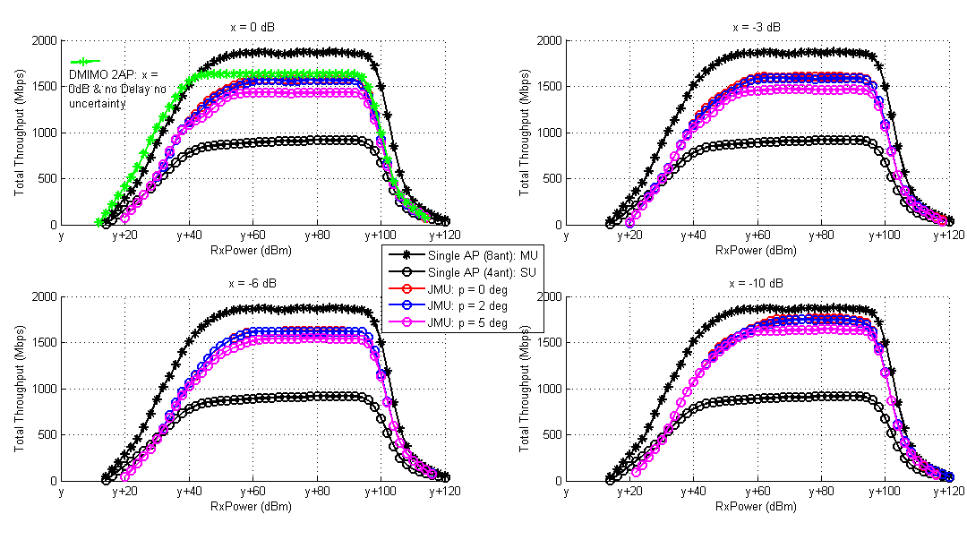
Magnitude Uncertainty: m = 0 dB
Around 1.7-1.9x improvement without any magnitude/phase uncertainty.
Around 1.5-1.8x improvement with 5deg of phase uncertainty
Delay reduces the throughput in low SNR region.

Slide 11
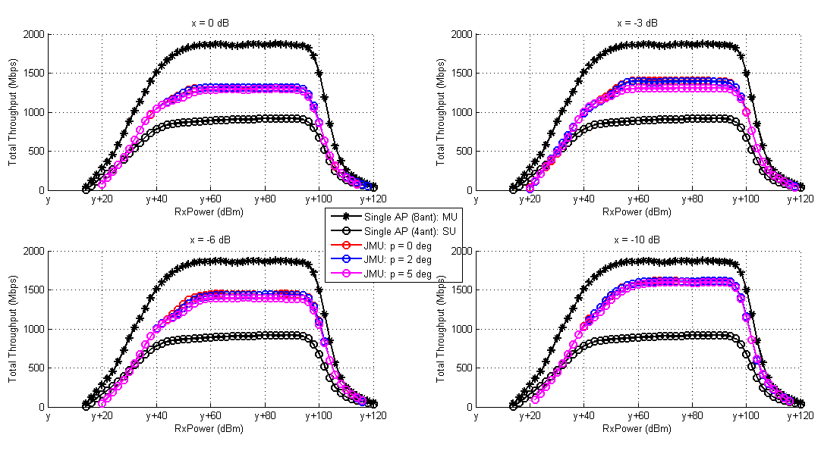
Magnitude Uncertainty: m = 1 dB
Around (1.4-1.7)x improvement with 1dB magnitude uncertainty
Marginal degradation is observed with 5 deg of phase uncertainty. Magnitude difference of 1 dB dominates the performance degradation.
Good improvement observed when the secondary AP has 10dB pathloss difference component.

Slide 12
Inferences
Up to 1.9x improvement can be achieved in a 2 AP serving 2 user scenario
Even in the presence of different impairments and uncertainties.
Design Requirements:
Tight Timing synchronization typically needed for higher rates
Accurate CFO estimation, together with periodic midambles to reset the channel estimate
Highly accurate Tx power calibration required at each AP between NDP & Steered packet transmission.
Necessitates tighter phase control, may need smaller gain steps
User selection for joint transmissions is crucial (choice of X)
Further investigation needed for:
Higher user loading/Longer packets
Quantization effects (tone grouping, compression-decompression)
Efficiency comparison

Slide 13
References
IEEE 802.11-19/1094r0
IEEE 802/11-10/1089r0
IEEE 802.11-19/1597r0

