Slide 1
Preamble Puncturing and RU Aggregation
Date: 2019-11-11
Authors:
Name | Affiliations | Address | Phone | Email
Bin Tian | Qualcomm
Lin Yang
Youhan Kim
Notes:
September 2012

Slide 2
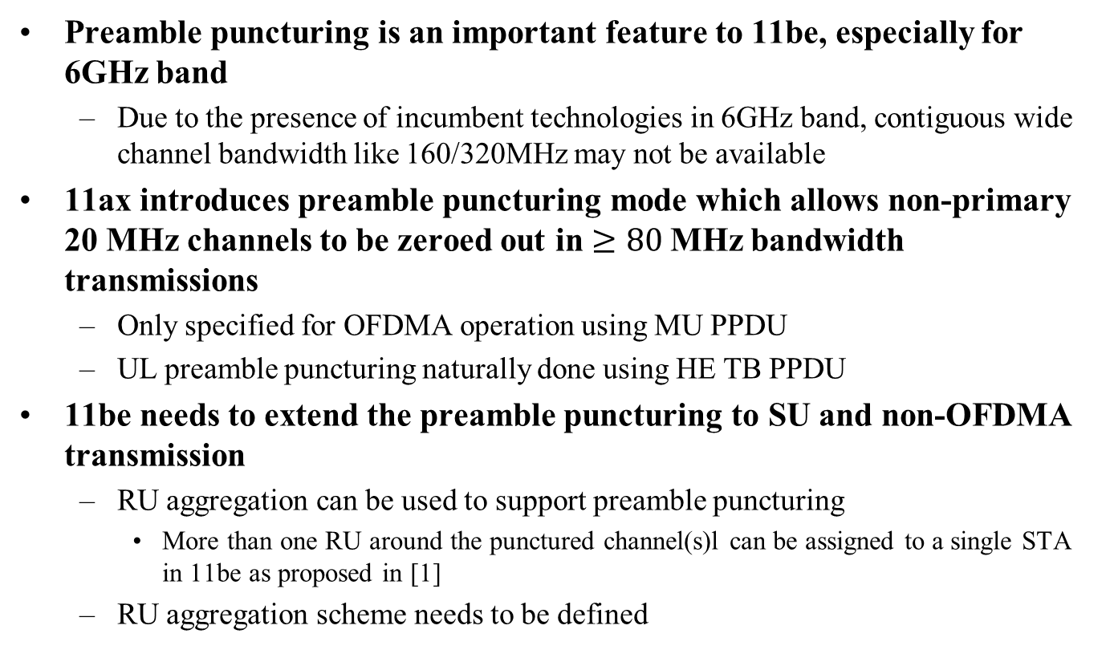
Introduction
Preamble puncturing is an important feature to 11be, especially for 6GHz band
  Due to the presence of incumbent technologies in 6GHz band, contiguous wide channel bandwidth like 160/320MHz may not be available
11ax introduces preamble puncturing mode which allows non-primary 20 MHz channels to be zeroed out in $≥80$MHz bandwidth transmissions
  Only specified for OFDMA operation using MU PPDU
  UL preamble puncturing naturally done using HE TB PPDU
11be needs to extend the preamble puncturing to SU and non-OFDMA transmission
  RU aggregation can be used to support preamble puncturing
    More than one RU around the punctured channel(s)l can be assigned to a single STA in 11be as proposed in [1]
  RU aggregation scheme needs to be defined

Slide 3
Preamble Puncturing Resolution
Two factors determines the preamble puncture resolution
  Minimum CCA BW
    Minimum 20 MHz CCA BW has been used in 11a/g/n/ac/ax
    <20MHz CCA capability requires more complexity (hardware filter etc.)
  Preamble BW
    Also 20MHz based preamble structure in 11a/g/n/ac/ax
    Introducing <20MHz preamble in 11be will have coexistence issue with legacy devices
For 11be, we suggest
  20MHz minimum CCA BW resolution
  20MHz preamble puncturing resolution
  For SU and non-OFDMA preamble puncturing, the minimum RU size assigned to a STA is RU242

Slide 4
Different RU Aggregation Options
Option 1: Multiple PSDUs
  For each single STA, MAC sends multiple PSDUs to PHY and each PSDU corresponds to one RU
  From PHY point of view, essentially the same as in DL OFDMA except one STA assigned with multiple RUs
  MAC needs to handle additional complexity
Option 2: Single PSDU + pre-encoding parsing
  For each STA, MAC sends one PSDU to PHY and PHY distributes the bits for multiple RUs before encoding
Option 3: Single PSDU + post-encoding parsing
  For each STA, MAC sends one PSDU to PHY and PHY distributes the bits for multiple RUs after encoding

Slide 5
Option 2: Single PSDU with Pre-encoding Parsing
Pre-encoding parsing plus separate encoding for each RU
  Pre-encoding parser already exists for BCC. Needs to be expanded to LDPC code and deal with different RU sizes
  One PSDU, multiple encoders
    PSDU receive performance is bottlenecked by the worst RU
    No frequency diversity among RUs due to separated encoding

Slide 6
Option 3: Single PSDU with Post-encoding Parsing
Joint encoding plus post-encoding parsing
  More align with existing PHY processing flow except to expand the segment parser to RU/Segment parser
  One PSDU one encoder
    Better performance with joint encoding

Slide 7
Discussions
Three options of RU aggregation schemes are proposed. Option 1 is mainly MAC solution while Option 2 to 3 are PHY solutions
Option 3, single PSDU with post-encoding parsing, is preferred due to its better performance from joint encoding and straightforward implementation, which is more aligned with existing structure
Some restrictions on the supported RU aggregation combinations needs to considered to balance the performance and implementation/ testing complexity

Slide 8
Straw Poll 1
Do you support in 11be
  CCA minimum BW resolution is 20MHz
  Preamble puncturing resolution is 20MHz
  Y
  N
  A

Slide 9
Straw Poll 2
Do you support one PSDU per STA for single link in 11be?

Slide 10
Straw Poll 3
For one PSDU, do you support in 11be to use one LDPC encoder?
  Note: Multiple modulations for one PSDU is TBD. This SP only applies to the single modulation per PSDU case.
  Y
  N
  A

Slide 11
Motion 1
Move to add the following text to 11be SFD
CCA minimum BW resolution is 20MHz
Preamble puncturing resolution is 20MHz
Moved by: Bin Tian
  Y
  N
  A

Slide 12
Motion 2
Move to add the following text to 11be SFD
In 11be, there is only one PSDU per STA for each link
Moved by: Bin Tian
Y/N/A

Slide 13
Motion 3
Move to add the following text to 11be SFD
In 11be, for LDPC encoding each PSDU only uses one encoder
Moved by: Bin Tian
Y/N/A

Slide 14
References
[1] Jianhan Liu, et. al., “Enhanced Resource Allocation Schemes for 11be”, IEEE 802.11-19/1126r0
[2] “Specification Framework for TGbe”, IEEE 802.11-19/1262r4

