Slide 1
Performance Comparison of LTF Designs for EHT
Date: 2019-11-11
Authors:
Name | Affiliations | Address | Phone | Email
Sameer Vermani | Qualcomm
Bin Tian
Youhan Kim
Notes:
September 2012

Slide 2
Abstract
16ss has been discussed as a candidate technology to be adopted in the EHT standard
  Substantial gains are observed using measured channels in [1]
One of the ways to reduce the LTF overhead is to use a smaller LTF symbol duration
  2x LTFs or 1x LTFs
  The channel estimation (CHE) performance of this approach is well understood
    11ax already uses it
These slides compare the CHE performance of the 2 other ways of reducing the # of LTFs
  Tone-interleaving
  Orthogonal mapping (e.g. a P-matrix) in frequency [2]

Slide 3
Tone-Interleaved vs ‘P-matrix in Freq’ for Reducing the LTFs for 16ss
In tone-interleaved approach, half of the streams are active on odd tones and half on the even tones
In frequency-domain P-matrix approach, there is an orthogonal mapping (P_{2x2}) in frequency across pairs of neighboring tones
Note: Both approaches use a P_{8x8} in time (across 8 LTFs)
Streams 1, 2, 3,…8
Streams 1, 2, 3,…16
P_{2x2}
Streams 9, 10, 11,…16
Streams 1, 2, 3,…16
Tone Interleaved Approach
Freq Domain P-matrix Approach

Slide 4
Which approach among tone-interleaved vs P-matrix in frequency is better?
Mathematical analysis for 2ss case to simplify
  Intuitions developed should apply for higher number of streams as well
S1
S1 + S2
Effect of P_{2x2}
S2
S1 – S2
S1
S2
Tone Interleaved Approach
Freq Domain P-matrix Approach

Slide 5

Mathematical analysis (for 2 stream case)
Tone-Interleaved approach suffers from interpolation errors on a per-stream basis
  E.g. stream 1 on tone 2 is just an average of tone 1 and tone 3 along with some noise averaging gain
  where subscripts are stream indices and indices in brackets are tone-indices
Observations on tone-interleaved approach
  No cross stream leakage → Very good property to have
  Interpolation Loss is mainly due to the stream 1 channel not being perfectly linearly-varying across frequency
    Moreover stream 1 has no interpolation loss on odd tones, and stream 2 has no interpolation loss on even tones
  As we reduce LTF duration
    Expect performance to stay constant at first before interpolation loss becomes greater than the noise averaging gain
  Per-stream channel boosted by sqrt(2) factor because only half the tones are active
$$\sqrt{2}.{\hat{h}}_{1}\left(2\right)=\frac{\sqrt{2}{.h}_{1} \left(1\right)+\sqrt{2.}h_{1} \left(3\right)}{2}+\frac{n\left(1\right)+n\left(3\right)}{2}$$

Slide 6
Mathematical analysis (for 2 stream case)
P-matrix approach suffers from channel variation of the own stream as well as cross stream leakage
Observations about the P-matrix approach
  More cross stream leakage terms as number of streams increases → Very undesirable
    Every other stream leaks into the stream being calculated if the channel changes from tone to tone
    May even cause a bigger problem on channel estimation MSE at high SNRs, as cross stream leakage becomes dominant
  If we go to 2x or 1x LTFs, the above process leads to even more cross stream leakage as the other stream channels vary more across the pairs of tones which are 2 or 4 tones apart
$${\hat{h}}_{1}\left(1\right)=\frac{h_{1} \left(1\right)+h_{1} \left(2\right)}{2} + \frac{h_{2} \left(1\right)−h_{2} \left(2\right)}{2} + \frac{n\left(1\right)+n \left(2\right)}{2}$$
Cross stream leakage due to
channel across other streams not staying constant on 2 tones

Slide 7
Performance Results (One MSE Sample per realization in CDF, sample averaged across tones)
‘P-matrix in freq’ approach has consistently worse performance compared to tone-interleaved approach
Reducing LTF size impacts P-matrix in freq approach lot more
Reducing LTF size in tone-interleaved approach has limited impact till 2x LTF
  Interpolation loss gets cancelled by noise averaging gain
  Effective Ng=4 should work fine for D-NLOS channel
30 dB SNR
40 dB SNR

Slide 8
Summary
For reducing the number of LTFs, “P-matrix in frequency” is not a good direction to pursue

Slide 9
References
[1] Sameer Vermani et al, “16 spatial stream support in next generation WLAN” , IEEE Document 11/18-0818r3
[2] Junghoon Suh, “Orthogonal Sequence based Reference Signal for LTF Reduction”, IEEE Document 11/19-1585r1

Slide 10
Recap: DL MU-MIMO Gains in Measured Channels [1]
Setup
  16Tx/8Tx AP to multiple 2 Rx STAs
  10th percentile of sum PHY throughput at the AP for 450 channel realizations, 20MHz
  MMSE precoding
  Perfect rate adaptation
  Effective SINR mapped to a throughput
Key observations
  By doing 16Tx MU-MIMO, we can get around 2x the throughput of 8Tx MU-MIMO
  Linear increase in throughput in going from 8 to 12 streams

Slide 11
Simulations with Reduced number of LTFs in D-NLOS Channel
16Tx AP, six 2Rx-STAs receiving 2ss each, equal pathloss to AP
Look at 10th percentile of sum-PHY-rate at the AP as a function of pathloss
D-NLOS Channel, 200 channel realizations, 40MHz
MMSE Precoding
Effective SINR to rate mapping used
Checked the impact of different NgSounding and NgCHE on performance
  Benchmark is NgSounding=1 and NgCHE=1
  Focused on tone-interleaved LTFs in these results

Slide 12
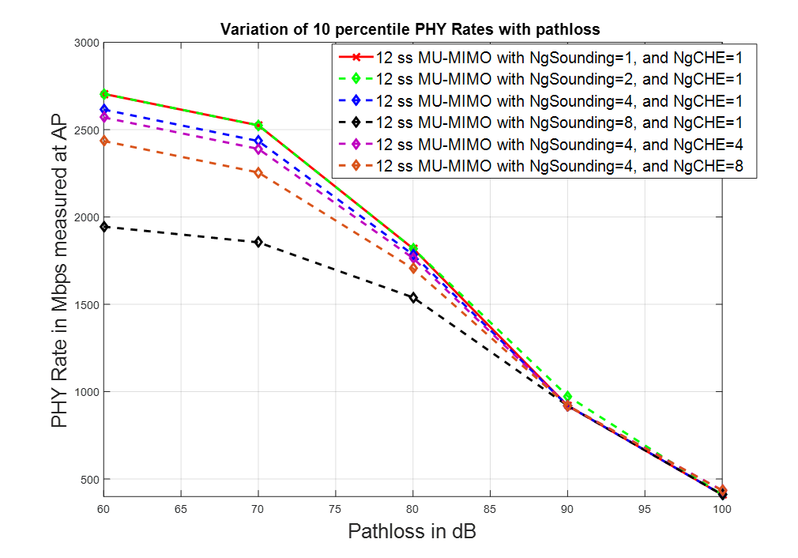
Performance Results for D-NLOS Channel
Plot shows that we can get by with doing sounding with NgSounding=4 feedback
  In line with 11ax intuition
For actual MU-MIMO transmission, NgCHE<=4 seems to be required

