Slide 1
20 MHz transmission in NGV continued
Date: 2019-11-10
Authors:
Name | Affiliation | Address | Phone | Email
Yujin Noh | Newracom |  |  | yujin.noh at newracom.com

Slide 2
Background
FRD&SFD Motion #4 passed [1]
“In 20MHz bandwidth, L-STF, L-LTF, and L-SIG for 10MHz PPDU are duplicated as shown in the figure below.”
PAPR on 20MHz transmission was discussed [2].
Two comments received
PAPR values when no phase rotation applied
Backward combability issues on 11p devices on the secondary channel of 20MHz channel.
With those comments verified, this submission is trying to decide phase rotation to be applied to each 10MHz channel.

Slide 3
PAPR (Peak-to-Average Power Ratio)
PAPR is well-known to be high when sequence is duplicated in frequency domain.
Given L-STF, L-LTF, and L-SIG for 10MHz PPDU repeated at legacy portion in 20 MHz PPDU, it is obvious that being simply repeated causes high PAPR for legacy portion of the preamble
Low PAPR value is important in reducing implementation cost of Tx Power Amplifier (PA) and Rx dynamic range related function blocks.
PAPR could be a nice guideline on actual backoff and dynamic ranges that the implementations need to consider

Slide 4
Simulation Configuration
99.9% PAPR
The max power is set to a value of top 99.9%
8x oversampled time domain signal
GI considered as part of the OFDM symbol
L-SIG PAPR
All combination of values in R1-R4 (RATE field) and R5-R16 (LENGTH field)
Data PAPR
40 MHz 11ac DC2 (downclocked by 2) based
Random values applied to more than 100,000 data OFDM symbols with MCS0, MCS2, MCS4, MCS6 and MCS8 (256QAM ¾)

Slide 5
Options
Considering no legacy devices (e.g. 11n, 11ac and 11ax) in the specially assigned channels, different options can be taken into account.
Legacy gamma vector with {1, +j}
Phase rotation in MCS0 DCM (Dual Carrier Modulation)
CSD (Cyclic Shift Delay)
etc

Slide 6
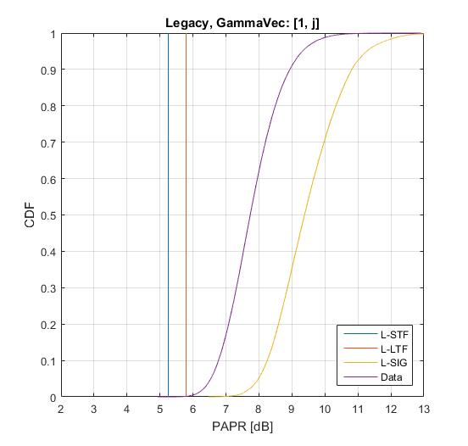
Legacy gamma vector with {1, +j}
Updated
PAPR [dB] (99.9%, 8x oversampled) in 20 MHz
Gamma Vector | L-STF | L-LTF | L-SIG (Median)
[1 1] | 5.0997 | 6.1761 | 9.0650
[1 -1] | 4.8133 | 6.1506 | 9.0354
[1 j] | 5.2497 | 5.7927 | 9.3806
[1 -j] | 5.2497 | 5.7948 | 9.3751
Simple way to reuse what we have used (11n-like approach)
+ 1 is multiplied to lower 10 MHz subchannel
+j is multiplied to upper 10 MHz subchannel
PAPR simulation shows L-SIG is identified as bottleneck of 20 MHz PPDU transmission.
PAPR of data portion is even better than PAPR of L-SIG field.
PAPR values here could be used as reference for further analysis.
1.7dB

Slide 7
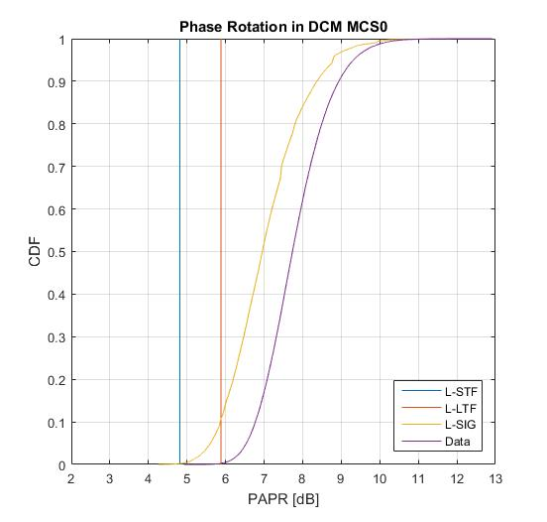
Phase rotation in MCS0 DCM
gamma vector
{1, +j}
PAPR [dB] (99.9%, 8x oversampled) in 20 MHz
L-STF | L-LTF | L-SIG (Median)
4.8133 (5.2497) | 5.8799 (5.7927) | 6.9529 (9.3806)
It is accepted to mitigate the PAPR issues for DCM MCS 0 in 11ax and 11bd [1]
+ 1 is multiplied to lower 10 MHz subchannel
(-1)^{k} is multiplied to upper 10 MHz subchannel
k: subcarrier indices
Generally providing improved PAPR over L-STF, L-LTF and L-SIG comparing to reference PAPR values
Legacy portion (especially L-SIG) is not a bottleneck anymore comparing to data portion.

Slide 8
Impact on 11p devices on the Secondary Channel
Updated
For example, assuming that phase rotation in MCS0 DCM is applied to the secondary 10 MHz channel,
L-STF consists of non-zero values described below, when 11p receiver conducts carrier sense and auto-correlation operation, there is no impact on performance.
The L-STF is given below, after rotating the tones in the upper subchannel (subcarriers 6 – 58) multiplied by -1 in alterative way.
As for L-LTF since those phase rotation would be interpreted as channel impact, no performance degradation of 11p device is expected.

Slide 9
CSD (Cyclic Shift Delay) 1/2
Cyclic delayed sequence applied to 10 MHz subchannel.
+ 1 is multiplied to lower 10 MHz subchannel
is multiplied to upper 10 MHz subchannel
k: subcarrier indices
Depending on T_{CS}, some CSD values provide improved PAPR over L-STF, L-LTF and L-SIG comparing to reference PAPR values
 | PAPR [dB] in 20 MHz (99.9%, 8x oversampled)
CSD (ns) (T_{CS}) | L-STF | L-LTF | L-SIG (Median)
-25 | 5.0489 | 5.7085 | 9.228
-50 | 4.3818 | 5.5877 | 8.5107
-75 | 3.8746 | 4.6096 | 8.0954
-100 | 3.5696 (5.2497) | 5.1641 (5.7927) | 7.3959 (9.3806)
-125 | 4.6851 | 5.3532 | 7.3918
-150 | 5.0674 | 5.8687 | 7.5948
-175 | 5.1405 | 5.6444 | 7.6878
$$e^{−j2πk∆_{F}T_{CS}^{}}$$

Slide 10
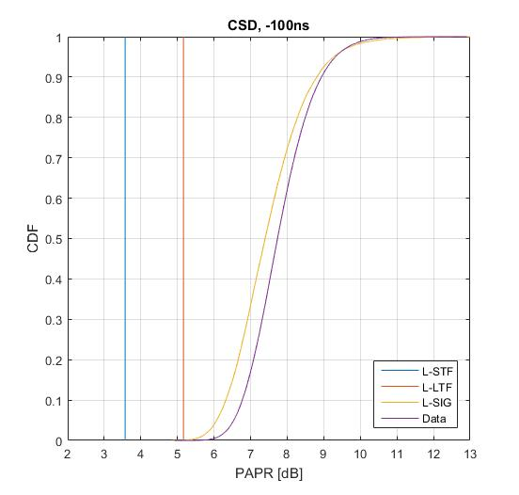
CSD (Cyclic Shift Delay) 2/2

Slide 11
PAPR bottleneck of 20 MHz NGV PPDU
PAPR [dB] (99.9%, 8x oversampled) | L-STF | L-LTF | L-SIG (Median) | 20 MHz NGV-DATA
[ 1, +j ] Phase rotation | 5.2497 | 5.7927 | 9.3806 | 7.7349
Phase rotation in DCM+MCS0 | 4.8133 | 5.8799 | 6.9529
CSD -100ns | 3.5696 | 5.1641 | 7.3959
Gamma vector [+1, +j] does not seem to give any PAPR benefits
Phase rotation in DCM+MCS0 improves PAPR of legacy portion meaningfully.
Prominently reduced PAPR of L-SIG
CSD generally provides reasonable PAPR values
-100ns picked as an example

Slide 12
Summary
Updated
20 MHz phase rotation {+1, +j} seems not to provide any benefits in terms of PAPR reduction
PAPR simulation shows L-SIG is identified as bottleneck of 20 MHz PPDU transmission.
PAPR of data portion is even better than PAPR of SIG field
PAPR barely improved comparing to no phase rotation is applied to upper 10 MHz
11bd gives the great opportunity not to have PAPR bottleneck in L-SIG of legacy portion for 20 MHz operation.
Phase rotation in DCM+MCS0 seems good.
Simple implementation
Already accepted in 11ax to reduce PAPR in DCM+MCS0 and HE-SIG-B in 11bd and 11ax
No proven performance impact to 11p device on Secondary Channel

Slide 13
SP 1
Based on so-far simulation results of PAPR, which option(s) do you prefer for 20 MHz transmission in 11bd?
Opt. 1: No phase rotation applied to upper 10MHz channel
Opt. 2: Gamma vector with {1, +j}
Opt. 3: phase rotation in DCM (Dual Carrier Modulation) + MCS0
+ 1 is multiplied to lower 10 MHz subchannel
(-1)^{k} is multiplied to upper 10 MHz subchannel
k: subcarrier indices

Slide 14
SP 2
Do you agree to add the following to section 3 in 11bd SFD?
The function $τ_{k, BW}$ is used to represent a rotation of the tones. BW in $τ_{k, BW}$ is determined by the TXVECTOR parameter CH_BANDWIDTH as defined in Table 33-xx (CH_BANDWIDTH).
Table 33-xx CH_BANDWIDTH and $τ_{k, BW}$
CH_BANDWIDTH | $$τ_{k, BW}$$
CBW10 | $$τ_{k, 10}$$
CBW20 | $$τ_{k, 20}$$
For a 10 MHz PPDU transmissions,
${ τ}_{k, 10}$ = 1
For a 20 MHz PPDU transmissions,
${ τ}_{k, 20}= \left\{\begin{aligned}1, k<0 \\ j, k ≥0, \end{aligned}\right.$
$${ τ}_{k, 20}= \left\{\begin{aligned}1, k<0 \\ \text{(−1)}\text{k} , k ≥0, \end{aligned}\right.$$

Slide 15
Reference
[1] 11-19/0514 Motion Booklet for IEEE 802.11 TGbd
[2] 11-19/1154r0 20 MHz transmission in NGV

