Slide 1
HARQ System Level Simulation Results
Date: 2019-11-05
Authors:

Slide 2
Abstract
HARQ is one of the features considered for EHT in order to enhance the performance.
This contribution provides system level simulation results of HARQ in the reference scenario “Residential” of TGax. We show that HARQ increases the throughput in this dense scenario with highly unpredictable interference.
Additionally, HARQ is extended by the multi-layer approach presented in [3]. In this configuration the throughput is further increased without the need of rate adaptation.

Slide 3
Rate Adaptation vs. HARQ
Rate adaptation tries to optimize the transmission parameters before the initial transmission
  Optimization problem: Select the transmission parameters such that
    The transmission time is minimized
    And the error probability is below a threshold
  Using (incomplete) knowledge of the channel and interference
HARQ handles transmission errors after the initial transmission
  Every (re)transmission keeps on adding information until all bits are received correctly
rate adaptation
initial transmission
retransmission
retransmission
MCS
t
HARQ Process

Slide 4
Baseline Rate Adaptation: Minstrel [1]
Typical open-loop rate adaptation
For every transmission
Every 100ms
Calculate success rates
Calculate expected throughput
Build new regular tx chain: MCSs with
  Best throughput
  2nd best throughput
  Highest success rate
  Most robust
No
Probe?
Yes
Select random MCS for transmission
Regular tx chain
1
2
3
4
Probe tx chain
Collect success / failure statistics
P
2
3
4

Slide 5
We showed the effect of combined HARQ & rate adaptation in [2]
Normal: Minstrel
HARQ using soft combining
  Modelled by adding the effective SINRs of the (re-)transmissions
  HARQ process lifetime = one TXOP
  Rate adaptation (Minstrel) for next TXOP
HARQ with aggressive lifetime
  HARQ process lifetime = (up to) 7 transmissions
  No rate adaptation for retransmissions
Simple single-link scenario
  Channel variation due to mobility
Results with mobility ~ 1m/s
Conclusion:
HARQ compensates the inability of the link adaptation to follow the varying channel

Slide 6
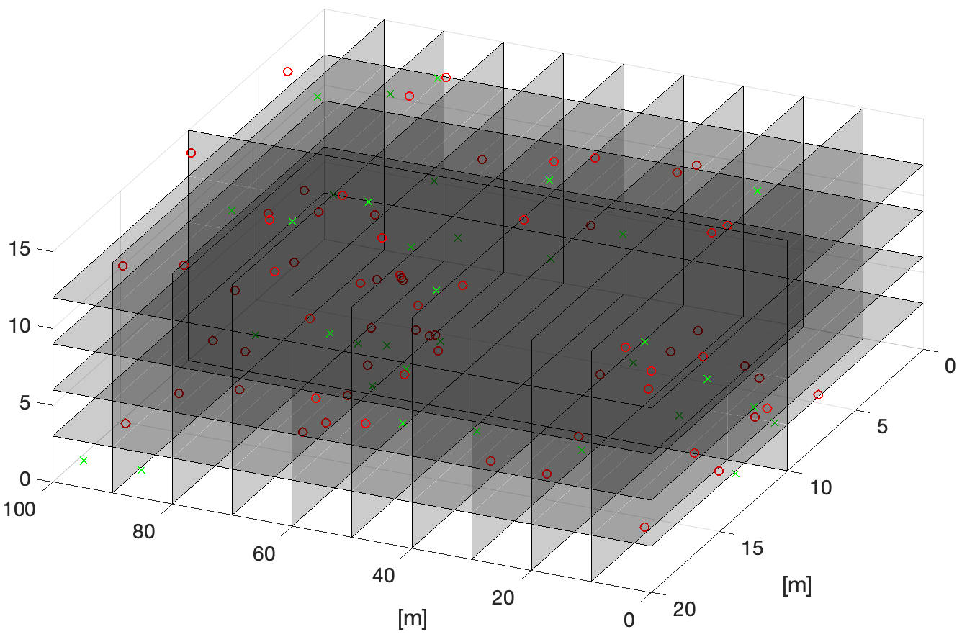
System Level Simulation
Reference scenario "Residential" from the TGax simulation scenarios [3]
  Apartment building with 10m×10m×3m apartments
    5 floors, 10 rows, 2 columns
    1 AP, 2 STAs in each apartment
  Assume 3 channels, random selection
    1/3 of all APs & associated STAs on the same channel
  Same traffic pattern for all apartments

Slide 7
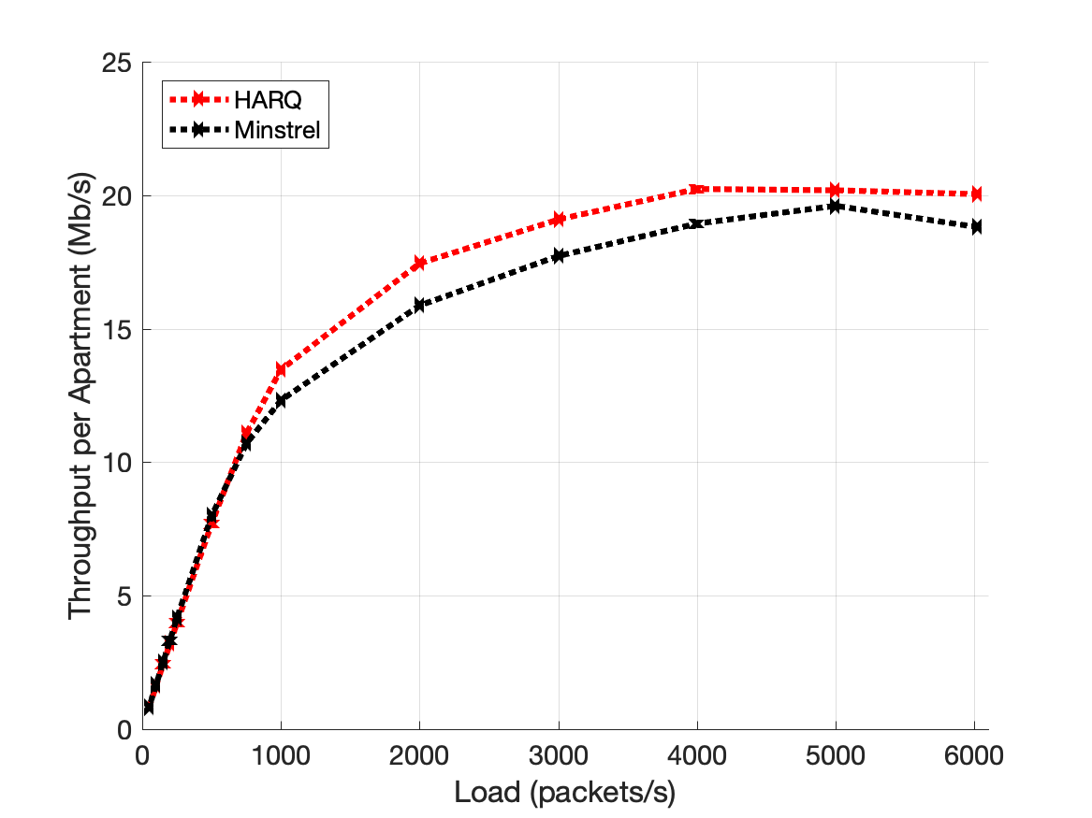
Results: Downlink Traffic Only
Same traffic pattern for all apartments
  Only downlink
  Constant bit rate, 1000B packets, x per second
  From AP to both associated STAs
HARQ has slightly higher capacity
  Although the rate adaptation algorithm is simpler / less adaptive: No adaptation for retransmissions

Slide 8
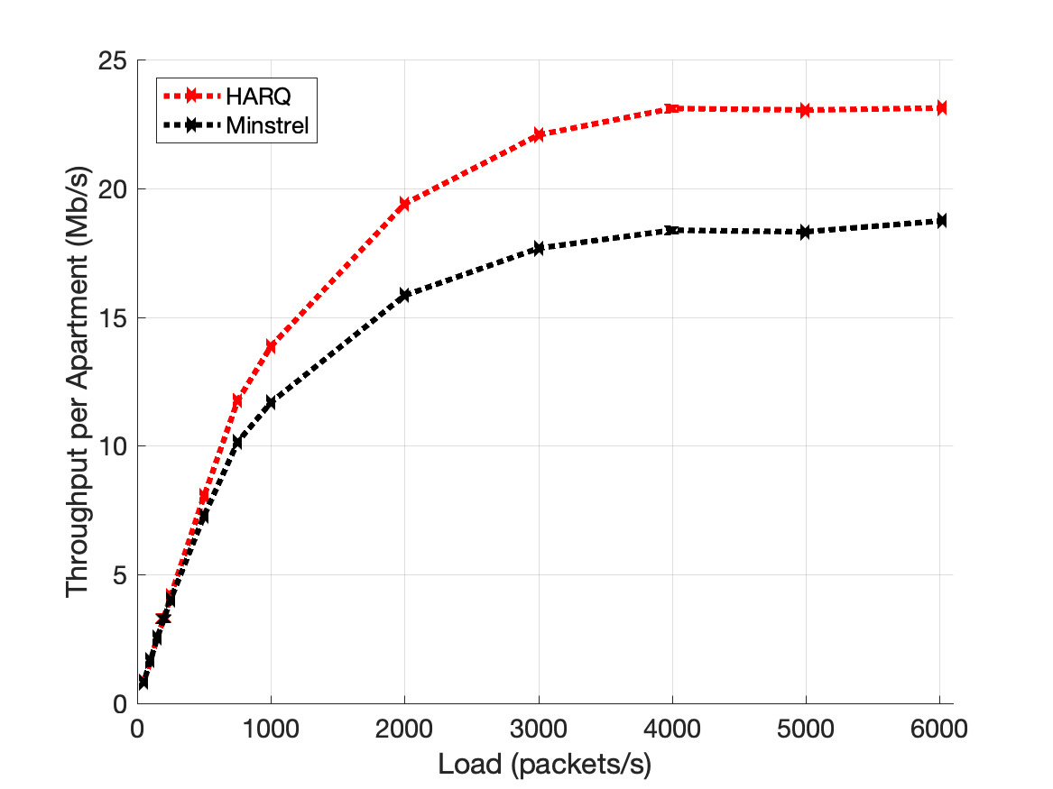
Results: Uplink & Downlink Traffic
Same traffic pattern for all apartments
  50% uplink, 50% downlink
  Constant bit rate, 1000B packets, x per second
  From AP to both associated STAs and from both STAs to AP
HARQ gain is significant
  STAs transmit & interfere with other BSSs
  Interference variance increases
  Throughput of Minstrel is slightly reduced
  HARQ has better opportunities for combining

Slide 9
Can We Do Better?
✅
retransmission
HARQ process
rate adaptation
initial transmission
✅
Idea: No rate adaptation, always use high MCS
  Good channel → Everything is fine
  Bad channel → HARQ process gets some information
    May require many retransmissions for success, high overhead
Idea 2: No rate adaptation, always use high MCS, but opportunistically
  Good channel → Same throughput as above
  Bad channel → Extract as much useful information as possible, apply HARQ for the rest

Slide 10
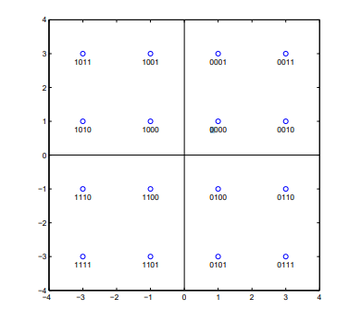












































Multi-Layer Modulation [4]
Sequential mapping of codewords to symbols
Parallel mapping of codewords to symbols
Data
Data
Preamble
OFDM Symbols
Preamble
OFDM Symbols
10
00
10
00
11
01
11
01

Slide 11
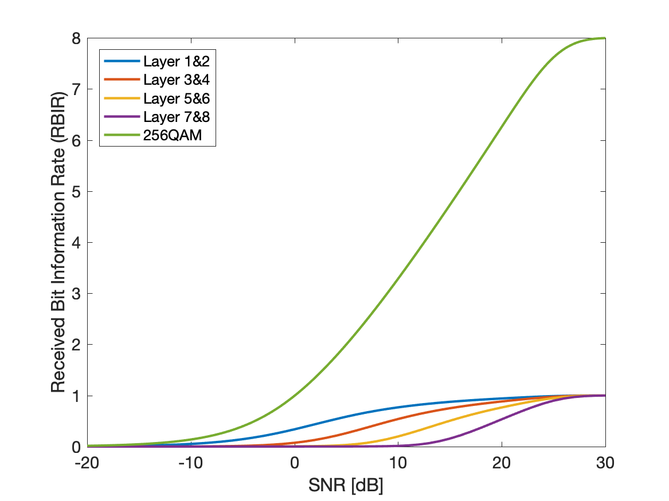
Multi-Layer Modulation: Error Statistics
SNR < 0dB
  All transmissions fail
SNR > 25dB
  All transmissions succeed
0dB < SNR < 25dB
  Robust layer(s) can be decoded successfully
  Other layers end up in HARQ processes and are assigned a more robust layer in the retransmission
    Implemented strategy: Top-to-bottom
    Simple, but not necessary optimal

Slide 12
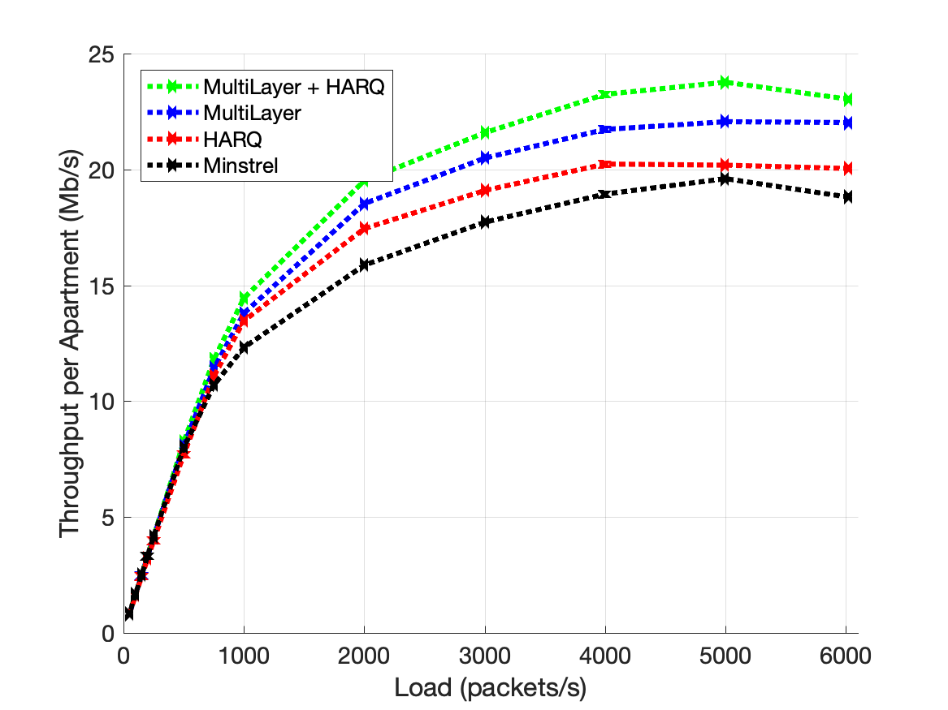
Results: Downlink Traffic Only
Same traffic pattern for all apartments
  Only downlink
  Constant bit rate, 1000B packets, x per second
  From AP to both associated STAs
Replacement of rate adaptation by Multi-Layer Modulation increases the system capacity compared to Minstrel & compared to HARQ
Combined MultiLayer + HARQ further increases system capacity

Slide 13
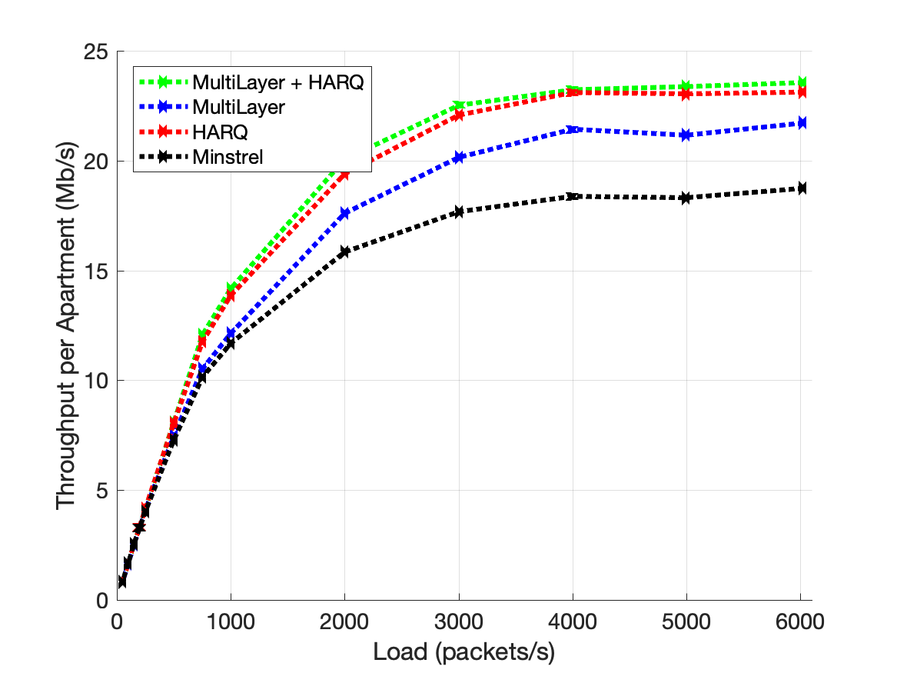
Results: Uplink & Downlink Traffic
Same traffic pattern for all apartments
  50% uplink, 50% downlink
  1000B packets, x per second
  From AP to both associated STAs and from both STAs to AP
Here, HARQ with rate adaption results in similar throughput as HARQ+Multi-Layer

Slide 14
Conclusion
We evaluated HARQ and Multi-Layer Modulation with the help of system level simulations for TGax reference scenario "Residential"
  Pre-transmission rate adaptation has to estimate the instantaneous SNR
    Not optimal in scenarios of varying interference
  HARQ helps in these scenarios
    Assures that at least some information can be used
    Still the problem of inaccurate pre-transmission link adaptation remains
  Multi-Layer Modulation solves the problem of the rate adaptation
    Opportunistic usage of the channel
    Instantaneous SNR information not required

Slide 15
References
[1] F. Fietkau, D. Smithies, "Linux Wireless Minstrel High Throughput", [online] Available: https://wireless.wiki.kernel.org/en/developers/documentation/mac80211/ratecontrol/minstrel
[2] S. Max et al., "Combined HARQ and Rate Adaptation", dcn 11-19-1196-01
[3] S. Merlin et al., "Simulation Scenarios", dcn 11-14-0980-16
[4] L. Wilhelmsson et al., "Some results on HARQ performance in dense deployments", dcn 11-19-1133-00

