Slide 1
Wi-Fi Sensing: Technical Feasibility, Standardization Gaps
Date: 2019-11-09
Authors:

Slide 2
Outline
Wi-Fi Sensing Definition
Wi-Fi Sensing Technical Feasibility
  Motion / Pet filtering
  Presence
  Standardization Gaps to Support Wi-Fi Sensing
  Conclusion and Next Steps
  References

Slide 3
Wi-Fi Sensing Definition
Wi-Fi Sensing: Ability of a system to detect changes in an environment where a transmitter and a receiver exchange signals accordingly to the IEEE 802.11 standard.
Similar definitions can be found in:
  [1] Wi-Fi sensing: Usages, requirements, technical feasibility and standards gaps IEEE 802.11-19/1293r0
  [2] 802.11 Sensing: Applications, Feasibility, Standardization, IEEE 802.11-19/1626r0

Slide 4
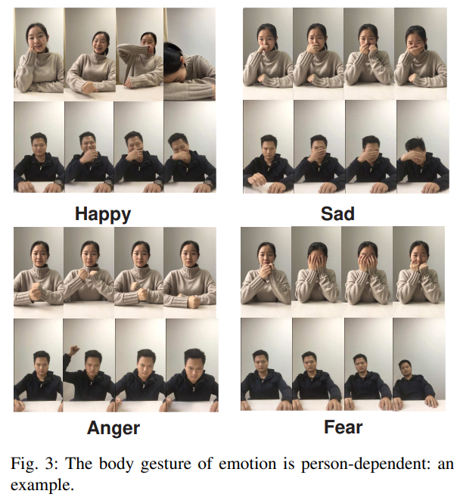
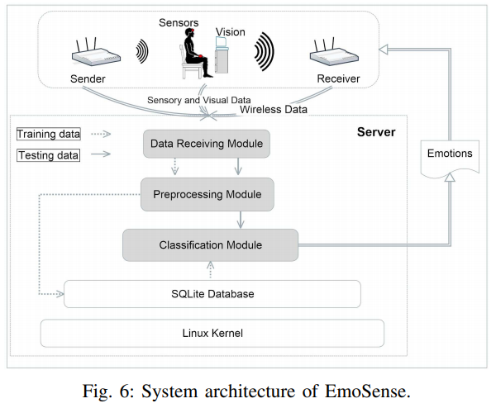
Wi-Fi Sensing Technical Feasibility
Scientific Publications
  Thousands of Scientific Publications
    Interesting example: [3] EmoSense: Computational Intelligence Driven Emotion Sensing via Wireless Channel Data,
Potential improvements:
  + breathing rate
  + heart rate

Slide 5

Wi-Fi Sensing Technical Feasibility
Scientific Publications
  Thousands of Scientific Publications
    Recent example: [3] EmoSense: Computational Intelligence Driven Emotion Sensing via Wireless Channel Data,
  State-of-the-art reviews, surveys [4], special issues

Slide 6
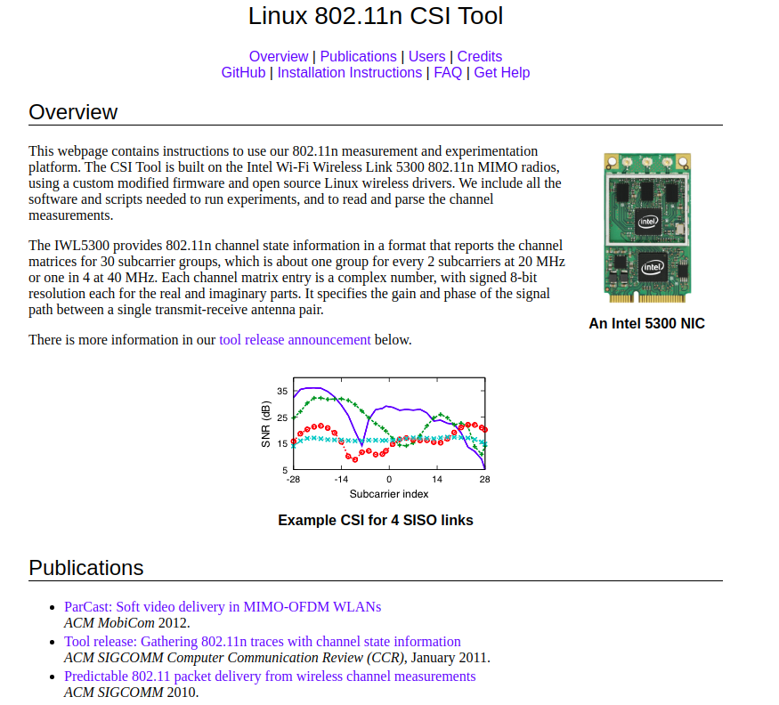
Wi-Fi Sensing Technical Feasibility
Scientific Publications
  Thousands of Scientific Publications
    Recent example: [3] EmoSense: Computational Intelligence Driven Emotion Sensing via Wireless Channel Data,
  State-of-the-art reviews, surveys, special issues
Forums
  https://dhalperi.github.io/linux-80211n-csitool/
    Long list of links to Scientific Publications
  https://wands.sg/research/wifi/AtherosCSI/

Slide 7
Wi-Fi Sensing Technical Feasibility
Scientific Publications
  Thousands of Scientific Publications
    Recent example: [3] EmoSense: Computational Intelligence Driven Emotion Sensing via Wireless Channel Data,
  State-of-the-art reviews, surveys, special issues
Forums
  https://dhalperi.github.io/linux-80211n-csitool/
    Long list of links to Scientific Publications
  https://wands.sg/research/wifi/AtherosCSI/
Several companies are focused on CSI-based sensing

Slide 8
Wi-Fi Sensing Technical Feasibility
Other Documents in this TIG have discussed use cases and have addressed technical feasibility on [1][2][5]:
  Motion
  Localization (device free, device oriented)
  Breathing rate estimation
  Proximity and Presence to a device with multiple sounding sources

Slide 9
Wi-Fi Sensing Technical Feasibility
In this presentation we would like to focus on:
  Motion / Pets Motion Filtering:
    Market application: Security Systems (a pet now can be within the sensing area)
  Presence:
    Market application: Remote Monitoring System (a person is there but has not moved for 10 hours)
  Fall Detection (video):
    Market application: Remote Monitoring System (a potential fall is detected in dwelling X)

Slide 10
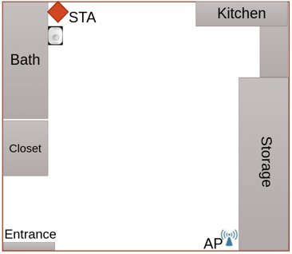
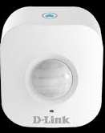
Wi-Fi Sensing Technical Feasibility
Motion / Pets Motion Filtering: Test Example
Test campaign conducted
Example:
  Pet Type: Cat
  Ground Truth using
    Motion Sensor (DLink DCH S150)
    Testimonial by Pet Tester
    Size of the studio – 450 sq ft

Slide 11
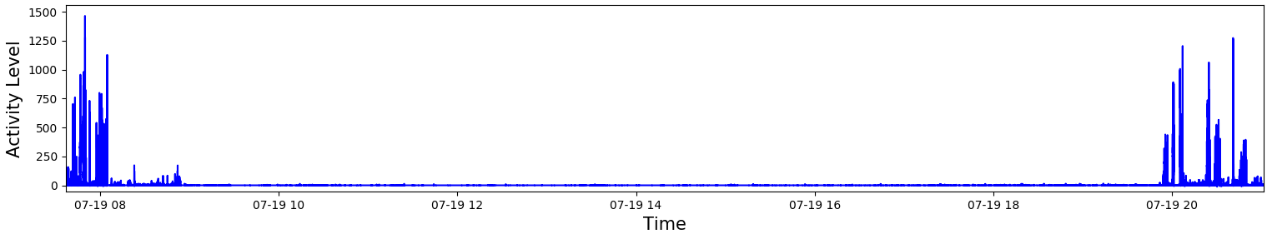
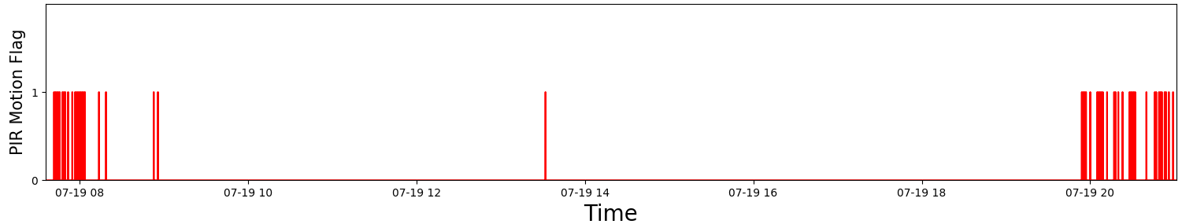
Wi-Fi Sensing Technical Feasibility
Motion / Pets Motion Filtering: Examples of Activity Level
Activity Level
PIR Motion Sensor
Human+ Pet Motion
Only Pet Motion
Human+ Pet Motion

Slide 12
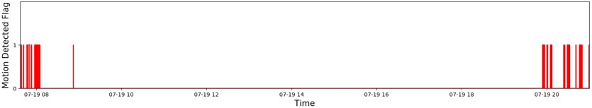
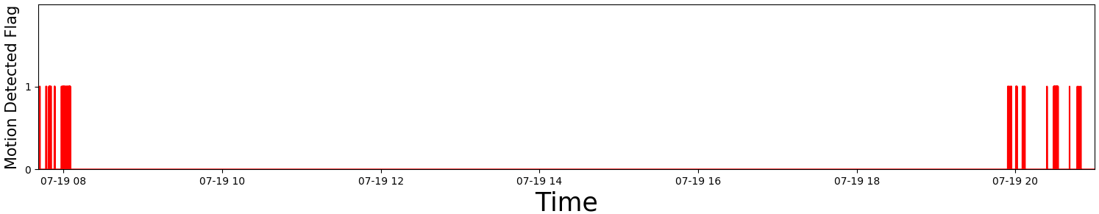
Wi-Fi Sensing Technical Feasibility
Motion / Pets Motion Filtering: Examples of Algorithm
Without Pet Filtering
With Pet Filtering v12
Human+ Pet Motion
Only Pet Motion
Human+ Pet Motion

Slide 13
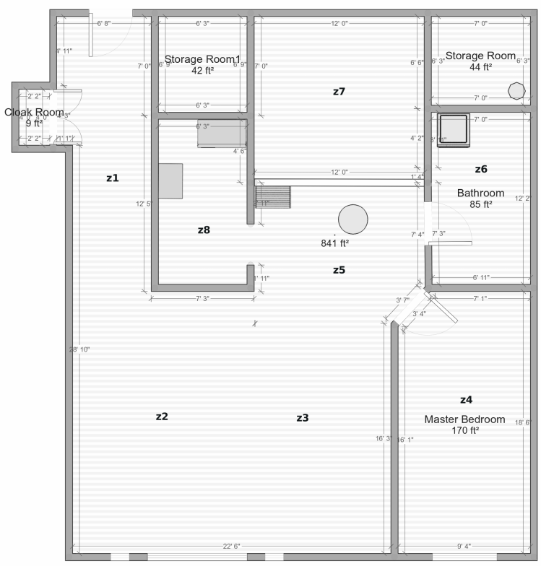


Wi-Fi Sensing Technical Feasibility
Motion / Pets Motion Filtering: Test Example
Entrance
Example:
  Pet Type: Dog (32 Kg)
  Ground Truth using
    Motion Sensor (D-Link DCH S150)
    NEST Camera
    Testimonial by Pet Tester
    Size of the apartment– 1,200 sq ft
Bedroom
STA
Kitchen
Living Room
AP

Slide 14
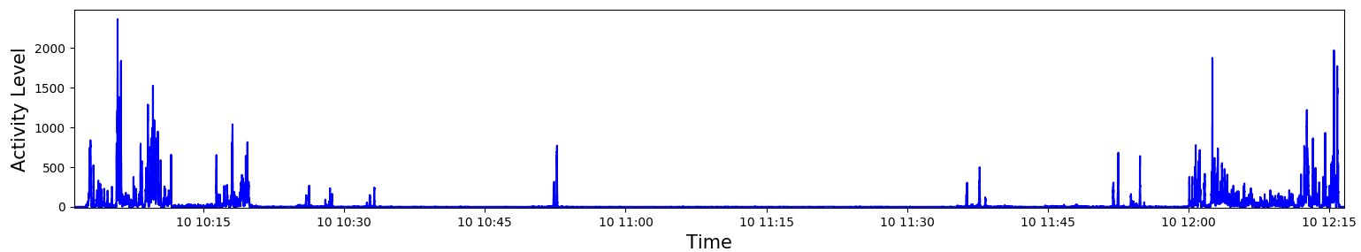
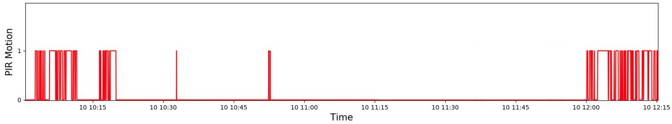
Wi-Fi Sensing Technical Feasibility
Motion / Pets Motion Filtering: Examples of Activity Level
Activity Level
PIR Motion Sensor
Human+ Pet Motion
Only Pet Motion
Human+ Pet Motion

Slide 15
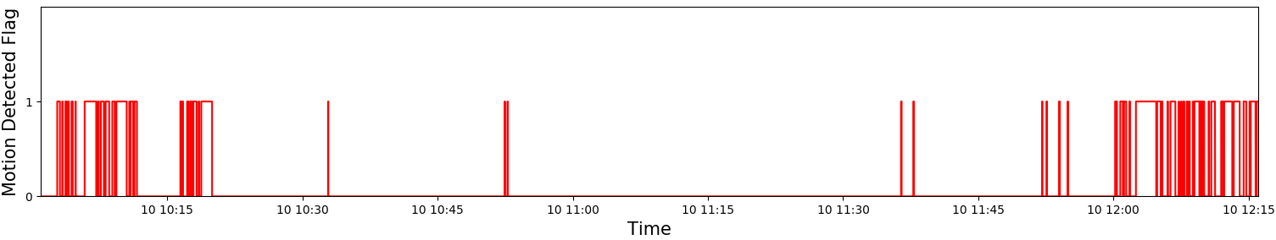
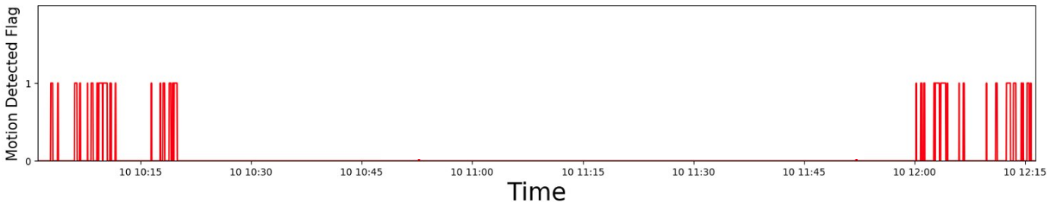
Wi-Fi Sensing Technical Feasibility
Motion / Pets Motion Filtering: Examples of Algorithm
Without Pet Filtering
With Pet Filtering
Human+ Pet Motion
Only Pet Motion
Human+ Pet Motion

Slide 16
Wi-Fi Sensing Technical Feasibility
Motion / Pets Motion Filtering: Test Summary
Type of Pet​ | Device placement ​ | Total No. Of Hours​ | Total No. Of Tests​ | Passed Tests Rate​
1 Cat​ | Ground level ​ | 47​ | 6​ | 100%​
2 Small Dogs​ | Ground level ​ | 161.5​ | 19​ | 94.74%​
 | Ground level ​ | 418.41​ | 44​ | 90.91%​
1 Cat​ | Socket level​ | 599.984​ | 80​ | 92.50%​
1 Cat​ | Socket level​ | 44.34​ | 9​ | 100%​
 | Socket level​ | 375.28​ | 36​ | 91.67%​
 | Socket level​ | 64​ | 7​ | 100%​
2 Cats​ | Socket level​ | 147.5​ | 17​ | 100%​
 | Socket level​ | 120​ | 16​ | 100%​
1 Small Dog​ | Socket level​ | 1172.2​ | 176​ | 89.20%​
2 Small Dogs​ | Socket level​ | 988.927​ | 129​ | 96.90%​
1 Large Dog​​ | Socket level​​ | 270.31​ | 41​ | 92.68%​
Summary​ | 2 levels​ | 4452.951​ | 580​ | 95.70%​

Slide 17
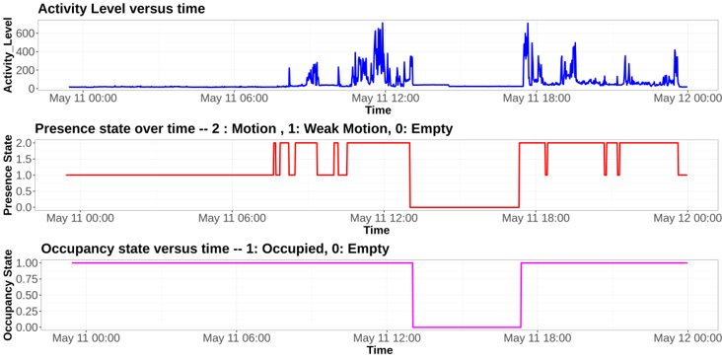
Wi-Fi Sensing Technical Feasibility
Presence
(a)
One particular Test Campaign
Locations: 9
Device positioning: 13
More than 3,000 hours
Global accuracy > 89.0%
(b)
(c)
Notes:
*Accuracy = (TP+TN)/(TP+TN+FP+FN)
**F-score = 2(Precision · Recall/Precision + Recall), Precision = TP/TP+FP and Recall = TP/TP+FN.

Slide 18
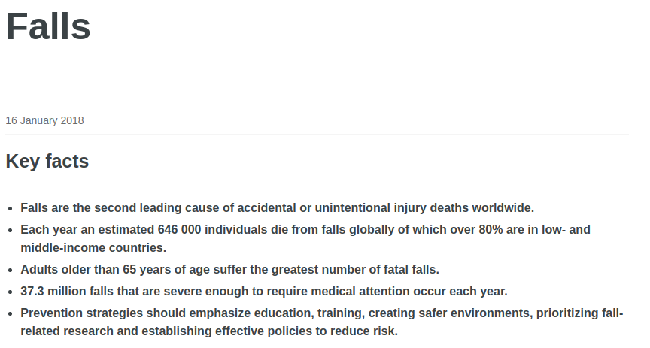

Wi-Fi Sensing Technical Feasibility
Fall Detection
Why Fall detection is important?
[6] https://www.who.int/news-room/fact-sheets/detail/falls
Notes:
*Accuracy = (TP+TN)/(TP+TN+FP+FN)
**F-score = 2(Precision · Recall/Precision + Recall), Precision = TP/TP+FP and Recall = TP/TP+FN.

Slide 19
Wi-Fi Sensing Technical Feasibility
Fall Detection
Can save a life by detecting a falling accident within seconds
Will help to achieve timely treatment and dramatically decrease medical expenses
Does not require wearables and does not invade user’s privacy
Notes:
*Accuracy = (TP+TN)/(TP+TN+FP+FN)
**F-score = 2(Precision · Recall/Precision + Recall), Precision = TP/TP+FP and Recall = TP/TP+FN.

Slide 20
Standardization Gaps to Support Wi-Fi Sensing
CSI is not accessible from the user space in all Wi-Fi chipsets
Common interface for exposing CSI to the user space:
  Data Interface
  Control Interface
  Socket interface, a web/REST API, or a stream interface

Slide 21
Standardization Gaps to Support Wi-Fi Sensing
CSI is not accessible from the user space in all Wi-Fi chipsets
Common interface for exposing CSI to the user space:
typedef struct{
uint64_t tstamp; /* h/w assigned time stamp */
uint16_t csiLen; /* csi data length (bytes) */
uint16_t channel; /* wireless channel (represented in Hz) */
int16_t noise; /* calculated hardware noise */
uint8_t mode; /* 11n(0) or 11ac(1) */
uint8_t phyerr; /* phy error code (set to 0 if correct)*/
uint8_t rate; /* transmission rate or MCS index */
uint8_t chanBW; /* channel bandwidth (0->20MHz,1->40MHz)*/
uint16_t numTones /* number of subcarriers for each stream */
uint8_t nRx; /* number of receiving antenna*/
uint8_t nTx; /* number of transmitting antenna*/
uint8_t ng; /* grouping parameter */
int16_t rssi[CSI_MAX_NRX]; /* rx frame RSSI [ctl, chain 0] */
uint8_t clientMAC[MAC_ADDRESS_BYTES]; /* MAC Address of CSI Client source */
}__attribute__((packed, aligned(1))) s_csi_status;

Slide 22
Standardization Gaps to Support Wi-Fi Sensing
CSI is not accessible from the user space in all Wi-Fi chipsets
Common interface for exposing CSI to the user space
Study on effective dimensions for the CSI reports (frequency, time, spatial streams: (f, t, ss)
  Compression rates for reporting CSI matrices:
      Is ng enough? This will help on reducing computing cycles in the chipsets
Typedef struct {
uint8 img;
uint8 real;
} __attribute__((packed, aligned(1))) t_complex;
t_complex Csi_matrix[ss][nrx][ntx]// where ss is the subcarrier index [1, N], nrx is the rx antenna and ntx is the tx antenna.

Slide 23
Standardization Gaps to Support Wi-Fi Sensing
Re-use of existing traffic for Wi-Fi Sensing
Do we need to involve upper layers to include functionalities such cooperation between nodes for motion services, and standardized measurements of motion detection services?
Design of figures of merit that indicate quality of CSI data from a sensing capability perspective
Lack of a histogram mask for deviation of nominal sampling rates

Slide 24
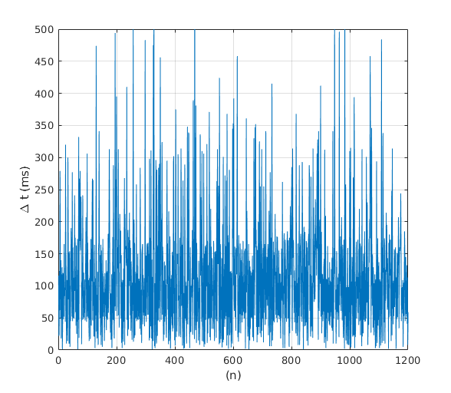
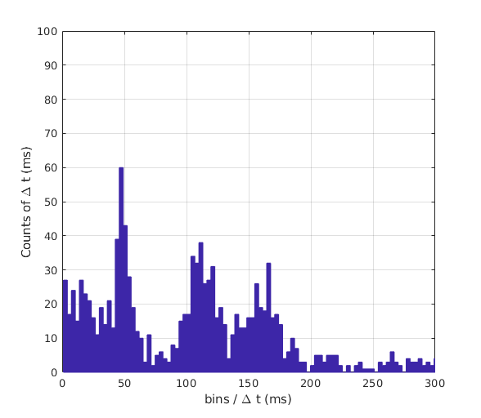
Standardization Gaps to Support Wi-Fi Sensing
Lack of a histogram mask for evaluating deviation from nominal sampling rate. Example of a driver's response to a Ts = 50ms

Slide 25
Standardization Gaps to Support Wi-Fi Sensing
Lack of a histogram mask for evaluating deviation from nominal sampling rate. Example of a driver's response to a Ts = 50ms
Mask

Slide 26
Conclusions and next steps
There is enough evidence to prove feasibility of human motion services through CSI
There are significant omissions in the current 802.11 specifications that if addressed will accelerate market adoption
Additional use cases will be covered in upcoming presentations
We will continue supporting the TIG SENS in the current study. In addition, we will support the creation of a Task Group for Wi-Fi Sensing

Slide 27
References
[1] Wi-Fi sensing: Usages, requirements, technical feasibility and standards gaps IEEE 802.11-19/1293r0
[2] 802.11 Sensing: Applications, Feasibility, Standardization, IEEE 802.11-19/1626r0
[3] Yu Gu, et al. "EmoSense: Computational Intelligence Driven Emotion Sensing via Wireless Channel Data", IEEE Transactions on Emerging Topics in Computational Intelligence, 2019.
[4] Z. Wang, et al., "A Survey on Human Behavior Recognition Using Channel State Information," in IEEE Access, vol. 7, pp. 155986-156024, 2019.
doi: 10.1109/ACCESS.2019.2949123
[5] Wi-Fi Sensing Application: Multipath Enhanced Device Free Localization, IEEE 802.11-19/1580r0
[6] https://www.who.int/news-room/fact-sheets/detail/falls

