Slide 1
Discussion on PHY/MAC Signaling for Adaptive Repetition of 11p PPDU in 11bd
Date: 2019-11-11
Authors:
Name | Affiliation | Address | Phone | Email
Insun Jang | LG Electronics | 19, Yangjae-daero 11gil, Seocho-gu, Seoul 137-130, Korea |  | insun.jang@lge.com
Dongguk Lim |  |  |  | dongguk.lim@lge.com
Jinsoo Choi |  |  |  | js.choi@lge.com
Jeongki Kim |  |  |  | jeongki.kim@lge.com
Eunsung Park |  |  |  | esung.park@lge.com
Suhwook Kim |  |  |  | suhwook.kim@lge.com

Slide 2
Introduction
TGbd decided to support the adaptive repetition of 11p PPDU when operating on OCB broadcast mode in 10MHz bandwidth [1], [2]
  In this contribution, we call the format including the adaptive repetition of 11p PPDU “repeated PPDU format”
  We haven’t resolved several issues, e.g., signaling and time gap
Especially, several signaling methods has been proposed in terms of MAC [3] and PHY [4]
In this contribution, we compare the proposed signaling methods in terms of gain of repeated format and issues and provide our proposal

Slide 3

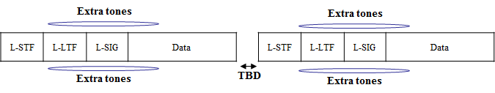
Signaling in MAC and PHY headers
Basically, Each PPDU in Repeated format shall be able to be received (decoded) by 11p STAs without any impact
Option 1: Existing fields MAC header can be reused
  For example, [3] proposed to indicate the signaling information in the Duration/ID field to reduce the redundancy of NGV capability indication
Option 2: Extra tones can be used [4]

Slide 4
MAC Signaling
Repeated format can provide the combining gain or the opportunistic gain
  Opportunistic gain means that it can provide an opportunity to successfully receive at least a packet, even though several packets are failed
To use the information from MAC header, successful PPDU decoding is necessary
  After successful decoding, the STA don’t need to combine the packets
  Opportunistic gain can be still obtained

Slide 5
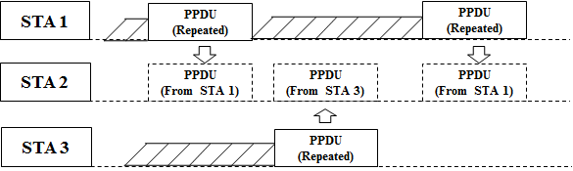
PHY Signaling
Using Extra tones at PHY header can obtain the combining gain
However, it requires that an 11bd STA always has to detect extra tones
Moreover, if SIFS is not applied as time gap, it is hard to differentiate transmitter STAs
  If several STAs transmit repeated PPDUs during a certain time, an 11bd STA doesn’t know which packet is transmitted by which STA, which cannot achieve the combining gain
  Also, Use of SIFS would be unfair to STAs in terms of channel access

Slide 6
Comparison between
MAC and PHY Signaling
To obtain the combining gain, PHY signaling can have the high complexity of implementation and the issues of identification and time gap
Even though MAC signaling doesn’t obtain combining gain, MAC signaling can be simply implemented while obtaining the opportunistic gain
Therefore, we propose MAC signaling
Factor | MAC | PHY (Extra tones)
Combining gain | X | O
Opportunistic gain | O | O
Identification of transmitters | O | X
Etc | - | Overhead for detection of extra tones

Slide 7
Recap: Proposed MAC Signaling [3]
We proposed to indicate the signaling information in the Duration/ID field
  The information means “Whether the following PPDU exists or not”
  It can be associated with the indication of NGV capability
  It removes the redundancy for indicating NGV capability
We can use two specific values in Duration/ID field, associating Repeated format with NGV capability

Slide 8
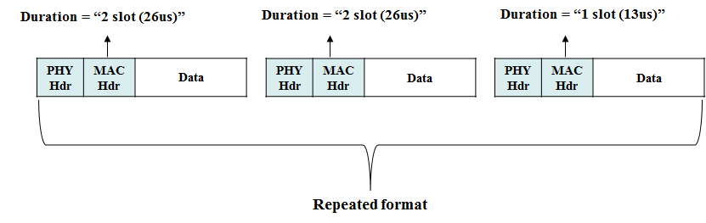
Recap: Example of Proposal [3]
Using Duration/ID field to indicate the repeated format
  Specific values, i.e., values of duration are TBD
Value of 2 slot means NGV capability while the following PPDU exists
Value of 1 slot means NGV capability while the following PPDU does not exist

Slide 9
Summary
We compared the proposed signaling methods in terms of gain of repeated format and issues
Because of complexity and identification issues of PHY signaling, we proposed MAC signaling
Specifically, we proposed to indicate “whether the following PPDU exists or not” as the signaling information, and indicate it in “Duration/ID field” as the signaling method

Slide 10
SP #1
Do you agree to add the following text into 11bd SFD?
  When an 11bd STA transmits repeated 11p PPDUs, each PPDU shall include the information to indicate whether the following PPDU exists or not
Y/N/A

Slide 11
SP #2
Do you agree to add the following text into 11bd SFD?
  When an 11bd STA transmits repeated 11p PPDUs, Duration/ID field of a frame in each PPDU indicates whether the following PPDU exists or not
Y/N/A

Slide 12
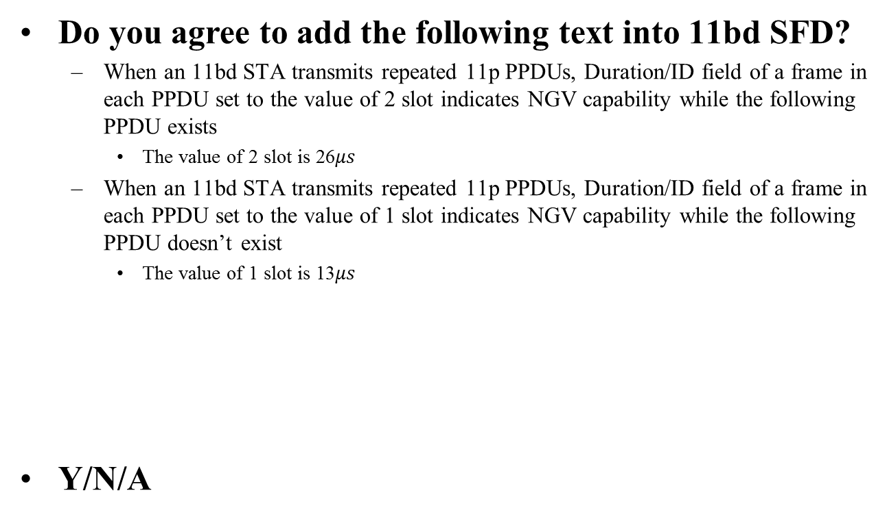
SP #3
Do you agree to add the following text into 11bd SFD?
  When an 11bd STA transmits repeated 11p PPDUs, Duration/ID field of a frame in each PPDU set to the value of 2 slot indicates NGV capability while the following PPDU exists
    The value of 2 slot is 26$μs$
  When an 11bd STA transmits repeated 11p PPDUs, Duration/ID field of a frame in each PPDU set to the value of 1 slot indicates NGV capability while the following PPDU doesn’t exist
    The value of 1 slot is 13$μs$
Y/N/A

Slide 13
References
[1] 802.11-19/1055r1 Adaptive Repetition
[2] 802.11-19/0497r1 802.11bd Specification Framework Document
[3] 802.11-19/1481r0 Signaling for Adaptive Repetition of 11p PPDU in 11bd
[4] 802.11-19/1596r1 PHY Signaling for Adaptive Repetition of 11p PPDU

