Slide 1
Studies on False Detection of WUR PPDU as L-STF
Date: 2019-11-7
Authors:

Slide 2
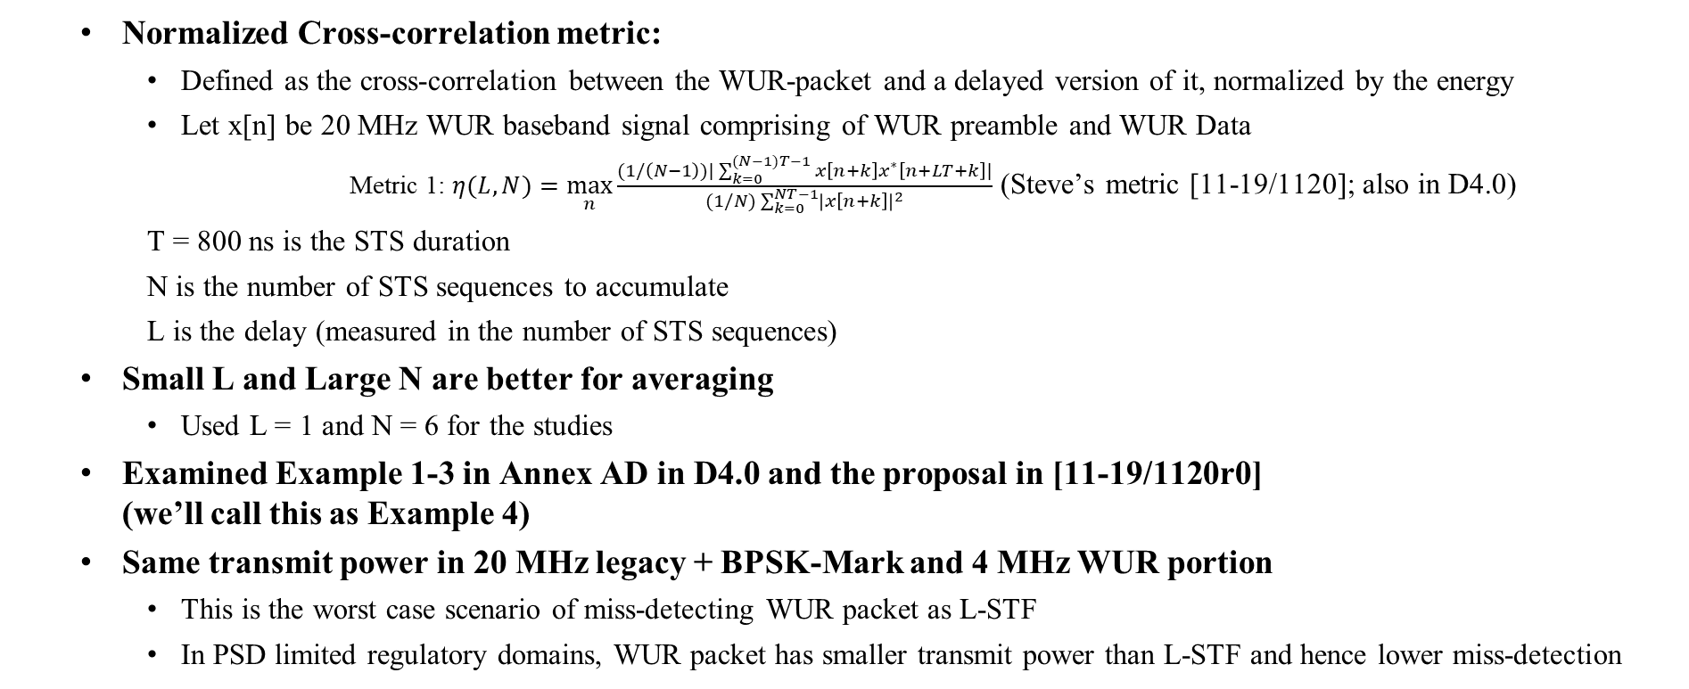
Introduction
  Normalized Cross-correlation metric:
    Defined as the cross-correlation between the WUR-packet and a delayed version of it, normalized by the energy
    Let x[n] be 20 MHz WUR baseband signal comprising of WUR preamble and WUR Data
    Metric 1: $η(L,N)=\max_{n}{\frac{(1/\left(N−1\right))|\sum_{k=0}^{(N−1)T−1}{x\left[n+k\right]x^{∗}\left[n+LT+k\right]}|}{(1/N)\sum_{k=0}^{NT−1}{{\left|x\left[n+k\right]\right|}^{2}}}}$ (Steve’s metric [11-19/1120]; also in D4.0)
    T = 800 ns is the STS duration
    N is the number of STS sequences to accumulate
    L is the delay (measured in the number of STS sequences)
  Small L and Large N are better for averaging
    Used L = 1 and N = 6 for the studies
  Examined Example 1-3 in Annex AD in D4.0 and the proposal in [11-19/1120r0]
  (we’ll call this as Example 4)
  Same transmit power in 20 MHz legacy + BPSK-Mark and 4 MHz WUR portion
    This is the worst case scenario of miss-detecting WUR packet as L-STF
    In PSD limited regulatory domains, WUR packet has smaller transmit power than L-STF and hence lower miss-detection

Slide 3
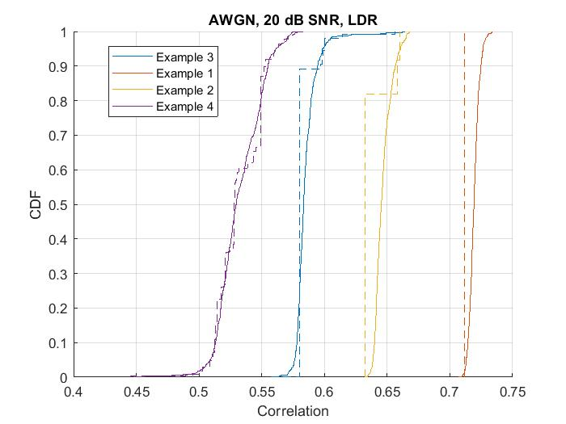
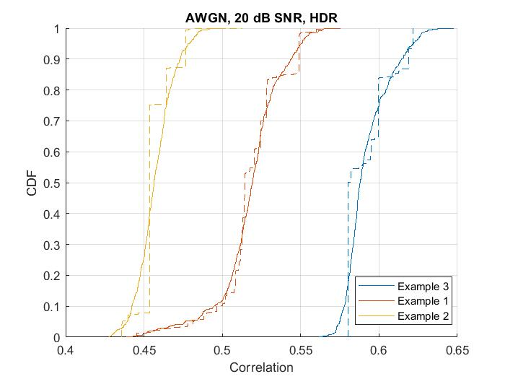
Cross-Correlation values in AWGN with 20 dB SNR
Tx side (no noise)
Legend
Dashed – Baseband Tx signal
Solid – Baseband Rx signal
4
3
2
1
2
1
3
Correlation test threshold in D4.0
Cross-correlation can be different across realizations due to symbol randomizer (random cyclic shifts) and random data
At a high SNR, cross-correlation values are much lower than the L-STF value (0.98-1)
  LDR: Example 4 (Steve proposal [11-19/1120r0]) has the lowest correlation, but exceeds 0.4
    Correlation threshold of 0.4 is not sufficient. The threshold should be increased to 0.65
      Examples 2, 3, and 4 meet this requirement in almost all cases (80 percentile)
  HDR: All examples can exceed the correlation of 0.4
    The threshold should be increased to 0.65. All three examples in Annex AD meet this requirement in almost all cases

Slide 4
Average Cross-Correlation values in AWGN with 20 dB SNR
LDR Examples | Metric 1
Example 1 | 0.71
Example 2 | 0.63
Example 3 | 0.58
Example 4 (Steve proposal [11-19/1120r0]) | 0.53
L-STF (reference) | 0.99
HDR Examples1 | Metric 1
Example 1 | 0.52
Example 2 | 0.45
Example 3 | 0.58
L-STF (reference) | 0.99
Table shows the average cross-correlation numbers, across different realizations
(computed using Tx signal, i.e. no noise)
  LDR: All examples have much lower correlation than L-STF
    Examples 1 has the highest cross-correlation
    Example 4 (Steve proposal [11-19/1120r0]) has lowest correlation of 0.53 but still above 0.4
  HDR: All examples have much lower correlation than L-STF
    Examples 1-3 have comparable correlation values between 0.45 and 0.58

Slide 5
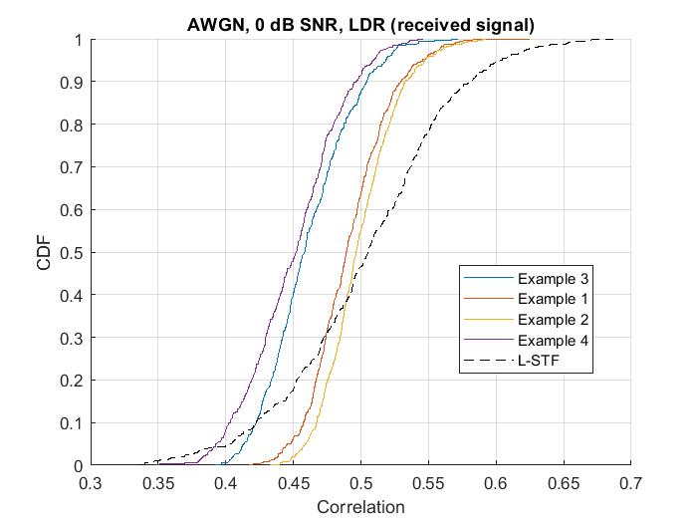
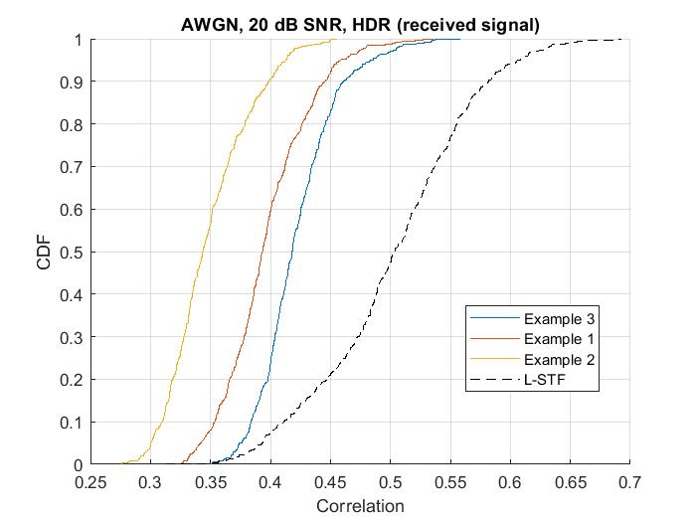
Cross-Correlation values in AWGN with 0 dB SNR
0
Only showing cross-correlation computed on received signal. Transmit signal same as in slide 3.
At low SNR, cross-correlation values are already low, and most of the times lower than the L-STF value
  All LDR examples and HDR examples have similar cross-correlation (+/- 0.05)

Slide 6
Cross-Correlation values in AWGN with 0 dB SNR
LDR Examples | Metric 1
Example 1 | 0.49
Example 2 | 0.50
Example 3 | 0.46
Example 4 (Steve proposal) | 0.45
L-STF (reference) | 0.51
HDR Examples | Metric 1
Example 1 | 0.40
Example 2 | 0.35
Example 3 | 0.42
L-STF (reference) | 0.50
Table shows the average cross-correlation numbers, across different realizations
(computed using Rx signal)
At low SNR, cross-correlation values are already low
  LDR: All 4 examples have similar correlation values (0.45-0.50)
  HDR: All 3 examples have lower correlation than L-STF (0.35-0.42)

Slide 7
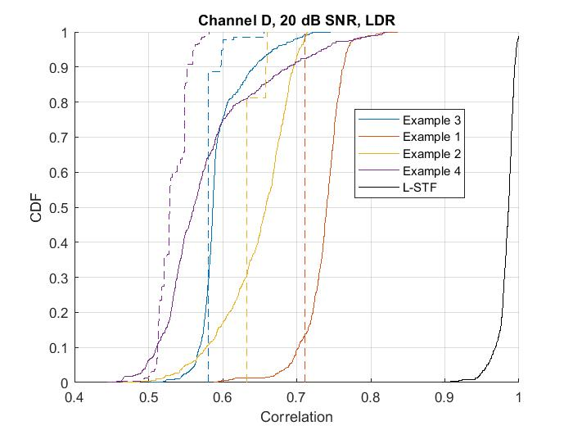
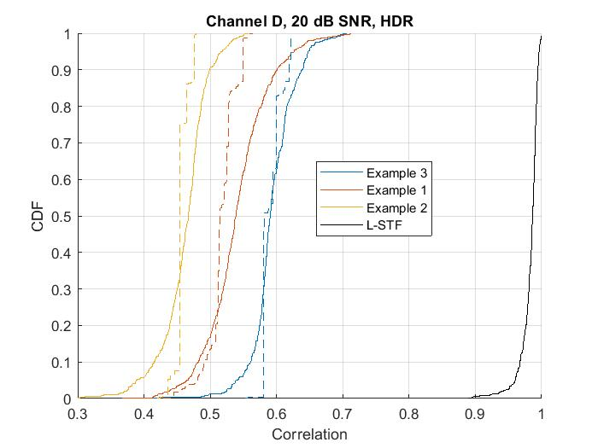
Cross-Correlation in Channel D with 20 dB SNR
4
Rx side
(with noise+multipath)
Tx side
(no noise)
Legend
Dashed – Baseband Tx signal
Solid – Baseband Rx signal
In Channel D, the multipaths changes the effective shape of received waveform, thereby resulting in different cross-correlation value (than compared to the one measured on transmit signal).
  The cross-correlation can vary significantly across channel realizations, as can be seen above
    For instance, LDR Example 4 no longer provides lowest cross-correlation in 30% of realizations
    However, all examples have significantly lower cross-correlation compared to STF (close to 1)

Slide 8
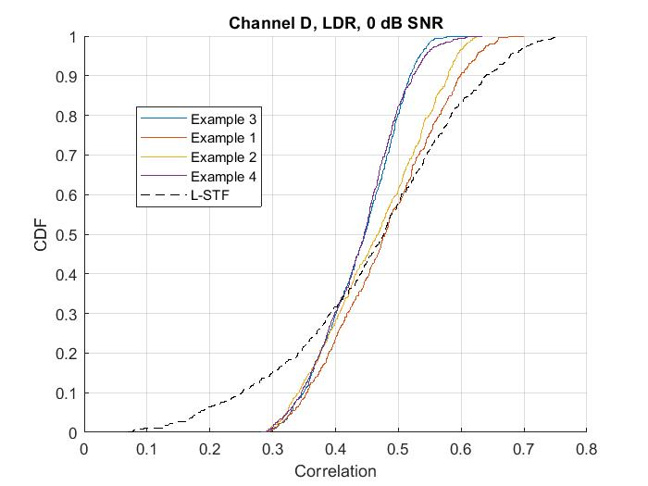
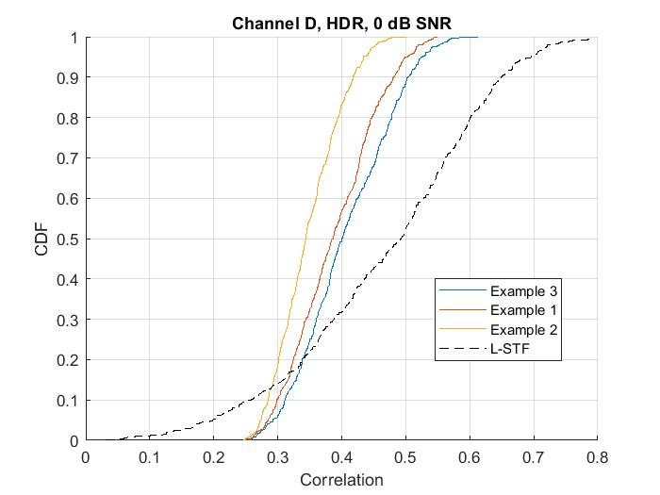
Cross-Correlation in Channel D with 0 dB SNR
Only showing cross-correlation computed on received signal. Transmit signal same as in slide 3.
At low SNR, cross-correlation values are already low, and most of the times lower than the L-STF value
  All LDR examples and HDR examples have similar cross-correlation (+/- 0.05)

Slide 9
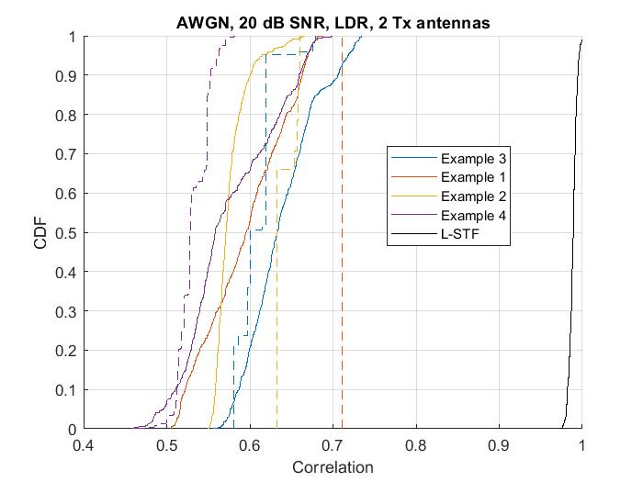
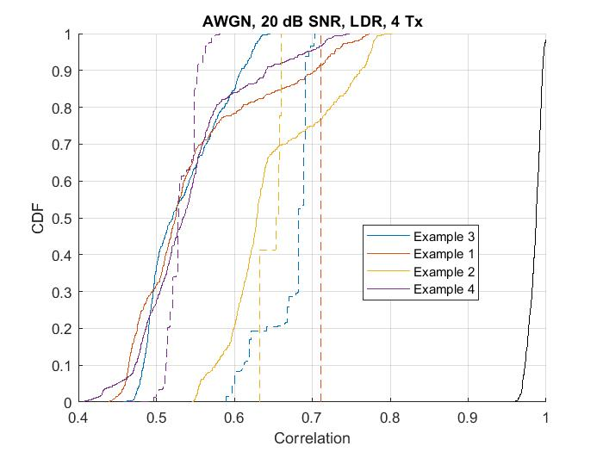
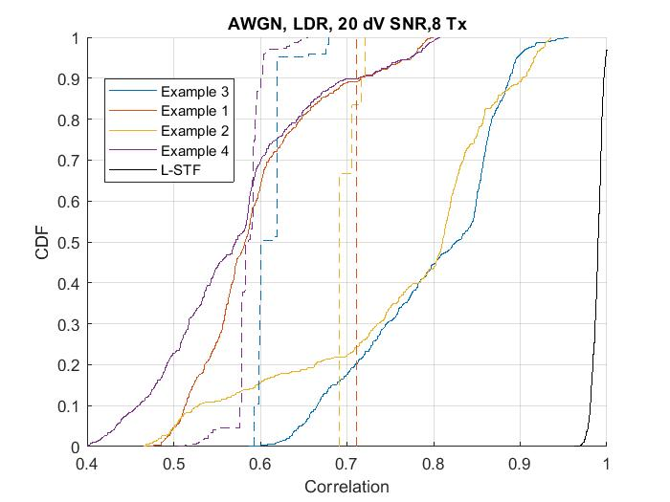
Cross-correlation in AWGN with multiple Tx antennas (LDR)
Legend
Dashed – Baseband Tx signal
Solid – Baseband Rx signal
L-STF
L-STF
L-STF
Cross-correlation can be different for the signal transmitted from different antennas/RF chains, due to per-antenna CSD
  Since we are interested in worst case scenario, for each realization, we picked the max of cross-correlation across different antennas
  Receiver gets the combined signal from the Tx antennas. The geometrical LOS angle is modeled randomly across realizations.
The cross-correlation with different examples is lower than L-STF
Even with Example 4, the cross-correlation can go up to 0.65 (with 8 Tx antennas)

Slide 10
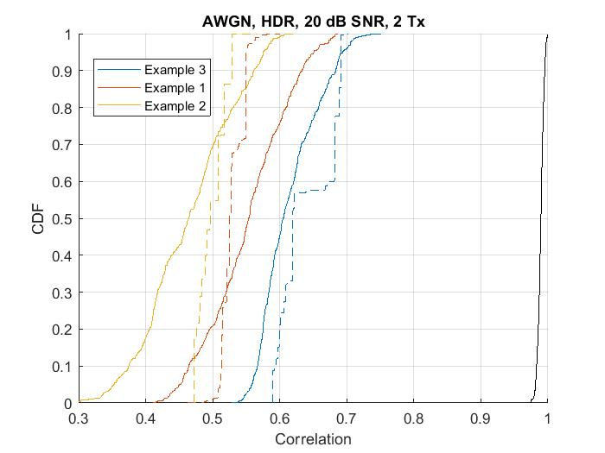
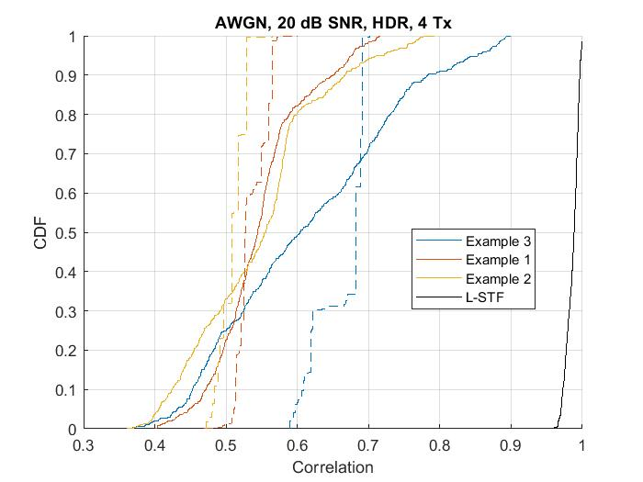
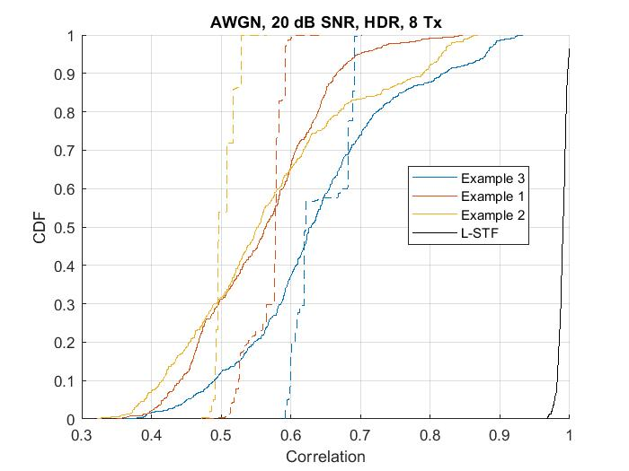
Cross-correlation in AWGN with multiple Tx antennas (HDR)
Legend
Dashed – Baseband Tx signal
Solid – Baseband Rx signal
Cross-correlation can be different for the signal transmitted from different antennas/RF chains, due to per-antenna CSD
  Since we are interested in worst case scenario, for each realization, we picked the max of cross-correlation across different antennas
  Receiver gets the combined signal from the Tx antennas. The geometrical LOS angle is modeled randomly across realizations.
The cross-correlation with different examples is lower than L-STF
All 3 examples exceed cross-correlation of 0.4. They are below 0.7

Slide 11
Observation
It seems to be a corner case for a legacy STA to start receiving a WUR PPDU from the WUR-Sync/WUR-Data field
When a WUR PPDU is received at high SNR (i.e. 20 dB), all three on-waveform examples in the spec D4.0 showed much lower correlation values compared to the L-STF (see slide 4)
  It is a correct behavior for a legacy STA to defer it’s transmission when a high-power WUR PPDU is detected because
    Transmitting on top of the strong WUR PPDU may cause collision
    Trying to receive another packet while the WUR PPDU is on the medium has little chance to succeed since the interference due to the WUR PPDU is already strong
    Even if another packet has much higher power than the WUR PPDU, this means the WUR PPDU transmitter, the legacy STA, and the STA that intends to transmit a PPDU to the legacy STA are all close to each other and therefore, there is high chance that the STA that intends to transmit to the legacy STA hears the WUR PPDU transmission and defers its transmission.
Our simulation shows that Example 4’s correlation output at the Tx side (no noise, no channel) exceeds the correlation threshold 0.4 defined in D4.0 (see Slide 14 in the backup)
When a WUR PPDU is received at low SNR (i.e. 0 dB), all three on-waveform examples in the spec showed low correlation outputs and was comparable to Example 4 [11-19/1120] on-waveform (ranging from 0.5 to 0.53 at 90%tile in slide 5)
When a WUR PPDU is received over Channel D, an on-waveform that showed low correlation value in AWGN showed wide variation of the correlation outputs (0.45 to 0.75) above 0.4
When a WUR PPDU is transmitted using multiple antennas, the correlation output increases and exceeds 0.4 (Slides 9 and 10)

Slide 12
Conclusions
A legacy STA detecting and deferring to a WUR PPDU received at a high SNR is a correct behavior
When a WUR PPDU is received at low SNR, the correlation output at a legacy STA is already low for all three examples in 802.11ba D4.0
The correlation output at the receiver side exceeds the correlation threshold 0.4 defined in D4.0 when noise, multipath channel, and multiple antennas are taken into account
The correlation test threshold 0.4 in D4.0 is too low
We recommend to increase the correlation test threshold to 0.65
  LDR: Example 3 and 4 meet the threshold 0.65 (Example 1 and 2 need to be replaced)
  HDR: Example 1, 2, and 3 meet the threshold 0.65 (no changes needed)

Slide 13
Straw Poll
Do you agree to increase the correlation test threshold to 0.65?
Y/N/A

Slide 14
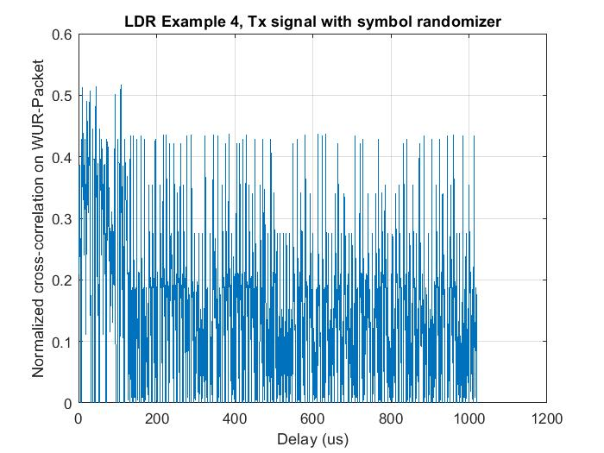
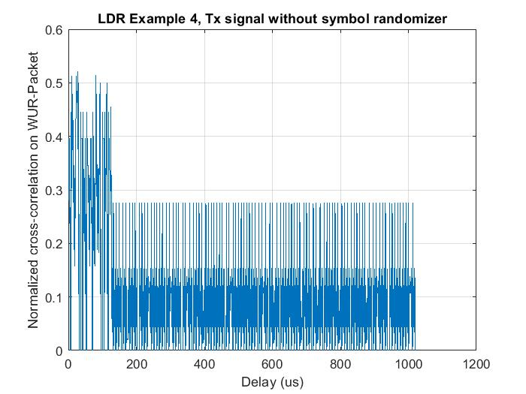
Discussion on LDR Example 4
Figure shows example cross-correlation for the WUR-sync and WUR-Data portion of the packet, for transmit signal (1 Tx)
  WUR-preamble (or 2us pulse) is the bottleneck in cross-correlation number
  LDR Example 4 has cross-correlation of 0.28 when measured on WUR-Data portion, without applying symbol randomization
    The corresponding number increased to 0.43 with symbol randomization

