Slide 1
Multi-link Channel Access Discussion Follow-up
Date: 2019-11-11
Authors:

Slide 2
Introduction
Multi-link Operation
  Candidate feature being discussed in TGbe group
  Several aspects
    Transmission of frames of a TID over multiple links
    Minimizing negotiation overhead for fast link switching
Multi-link Channel Access
  Several discussions on multi-link channel access, asynchronous and synchronous operations
  A few contributions have considered multi-link operation with single primary channel
    Similar to 80 + 80 operation in which all devices perform backoff only one link
In this presentation, we follow up on multi-link channel access discussion presented in October conference call [1,2]

Slide 3
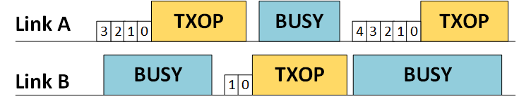
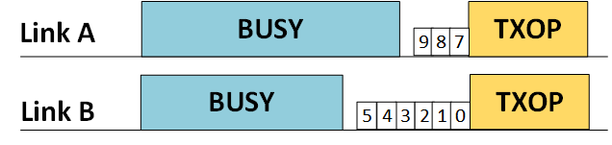
Asynchronous Operation
Asynchronous multi-link channel access
  Per-link backoff procedure with no synchronization of multi-link transmissions
  Single link STAs and legacy STAs can operate on any link
  Simultaneous transmit and receive operation (STR)
  Shall be the default multi-link access mode
Multi-link TXOP Aggregation
  Link with backoff countdown to 0 can aggregate second link if idle (e.g. for PIFS)
  Per-link PPDU provides more flexibility due to diverse link conditions
TXOP: ML STA’s TXOP
Busy: other traffic

Slide 4
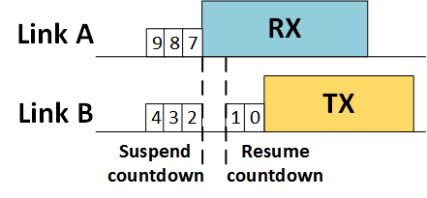
Previous Contributions’ Recap
11-19/1405
  MLD may not be capable to perform simultaneous transmit-receive (STR)
  Mechanisms to improve multi-link channel utilization of non-STR MLDs
  Opportunistic backoff recommencement (Appendix A)
  Multi-link busy status feedback indication (Appendix B)
11-19/1505
  Fairness considerations for multi-link TXOP aggregation (Appendix C)
Backoff countdown resumes with same value
link A
TXOP
TXOP
busy
ML
STA
3
2
1
0
9
8
7
6
5
4
3
link B
busy
TXOP
busy
5
4
3
2
1
0

Slide 5
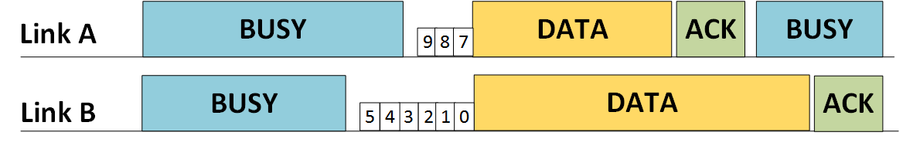
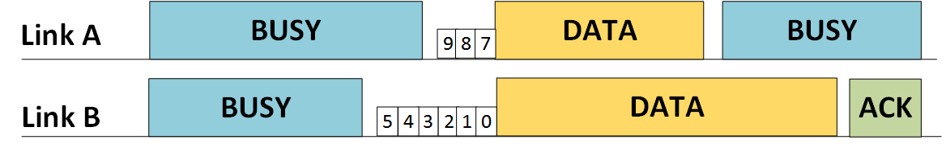
Multi-link TXOP Aggregation without TXOP alignment
Even though link is aggregated, TXOP need not be aligned on the multiple links
Padding to align TXOPs would lead to inefficient multi-link utilization
For efficient operation, TXOP utilized on aggregated link can be smaller than the main link on which backoff counter was 0
STR MLD to STR MLD case
  Per-link acknowledgement
  TXOP aggregation might be unfair in this scenario
Non-STR MLD to AP MLD/ AP MLD to non-STR MLD
  Unified acknowledgement (single Block ACK agreement [3]) on link with backoff counter zero
  Packet extension may be additionally utilized to account for processing overhead

Slide 6
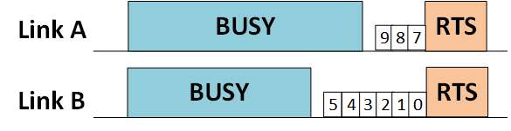
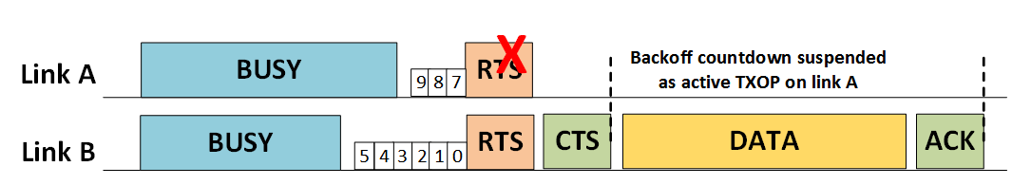
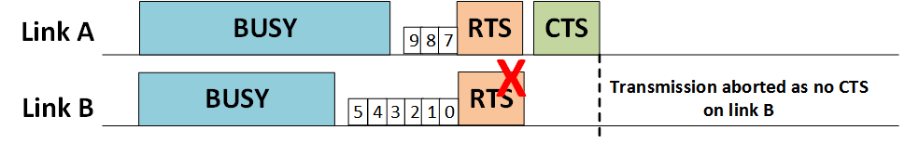
Proposal for Multi-link TXOP Aggregation Protection
Example snapshot at a non-STR MLD
Non-STR MLD transmits RTS on both links
Link A is the aggregated link in this example
Proposal
  If CTS is received on both links, transmission is performed on both links
  If CTS received only on the link with backoff counter 0 (link B), then transmission performed only on that link
  If CTS received only on aggregated link (link A), then no transmission is performed
    CF-End can be transmitted on aggregated link to reset NAV as data transmission will not be performed
    Regular backoff procedure applies on link B

Slide 7
Multi-link Operation Constraints at non-AP MLD
Simultaneous Transmit-Receive (STR)
  MLD may not be capable due to in-device power leakage from insufficient frequency separation
  Example: Link A operating in lower 5 GHz and link B operating in upper 5 GHz
Simultaneous Transmit-Transmit (STT)
  For some channel combinations, additionally MLD may not be capable of simultaneous transmission on those channels due to issues with intermodulation
  For some channel combinations, additionally MLD may not be capable of simultaneous transmission on those channels with a single antenna due to RF limitations
Simultaneous Receive-Receive (SRR)
  For some channel combinations, additionally MLD may not be capable with a single antenna due to RF limitations
  Fall back to operation with only a single active link at a time

Slide 8
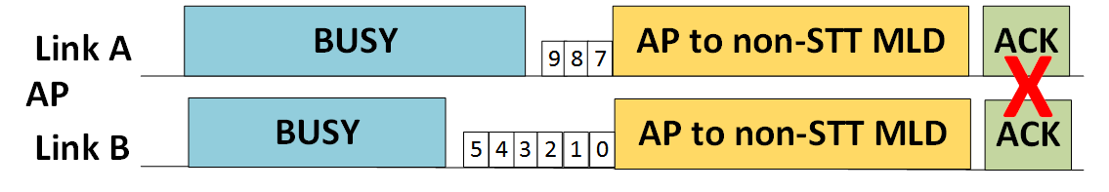
Downlink multi-link TXOP Aggregation with STT Constraint
Non-STT MLD: MLD with STT constraint
Non-STT MLD can still benefit from multi-link operation
  Downlink multi-TXOP aggregation still possible as non-STT MLD has simultaneous receive capability
  Multi-link gain observed from medium access on multiple channels even without STT capability
Per-link simultaneous acknowledgement is infeasible due to STT constraint

Slide 9
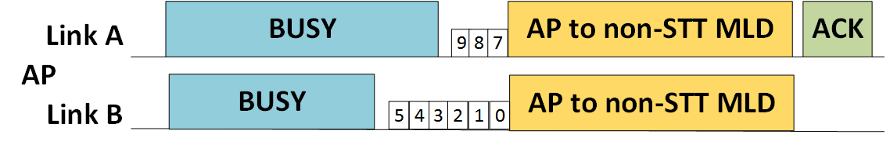
Multi-link immediate response from non-STT MLDs (1/2)
For high efficiency, immediate response is preferable
Due to STT constraint, feedback can be transmitted over a single link
Due to diverse link conditions, AP may explicitly recommend the link to be used for immediate response
Alternatively, non-STT MLD may be locked on to a particular link for the immediate response transmission
Non-STT MLD can decide which link to be used for the response transmission

Slide 10
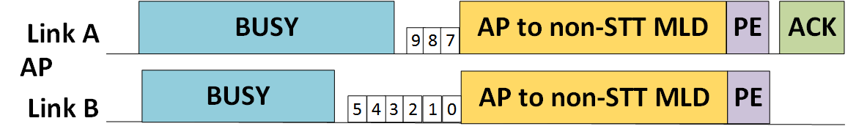
Multi-link immediate response from non-STT MLDs (2/2)
Additional time may be needed to account for processing overhead at non-STT MLD in constructing immediate acknowledgement for frames received over multiple links
Proposal: AP and non-STT MLD negotiate Packet Extension for downlink multi-link TXOP aggregation mode during multi-link setup and AP uses that Packet Extension for this mode
The same PE can be used for non-aligned TXOP aggregation shown in slide 5

Slide 11
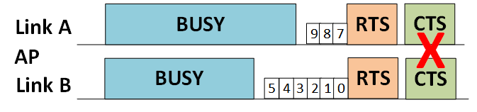
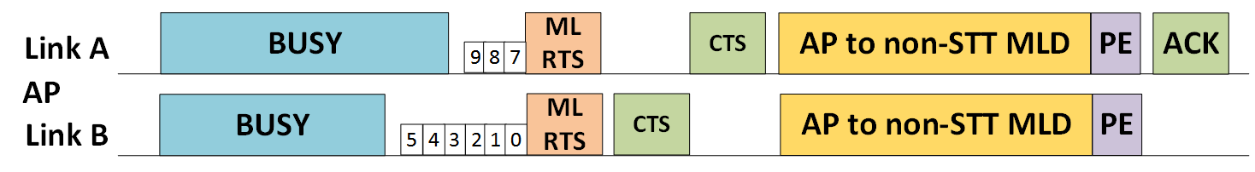
Multi-link Aggregation Protection for non-STT MLDs
Due to STT constraint, per-link CTS cannot be transmitted simultaneously
Proposal summary
  A new frame multi-link RTS (ML RTS) transmitted on both links
  Sequential CTS transmission over the multiple links
  Data transmission on none/one/both the links

Slide 12
Proposal Details
  AP transmits multi-link RTS (ML RTS) on all links
    ML RTS includes the link sequence of CTS feedback
    The first link in sequence shall be the link on which backoff counter reached zero
  Non-STT MLD transmits the CTS in the sequence provided by ML RTS
  Duration setting in ML RTS MAC header
    On link with backoff counter zero, duration set to TXOP duration as in regular procedure
    On aggregated link, duration set to end of corresponding CTS transmission on that link
  If CTS not transmitted on first link in sequence, then non-STT MLD shall not transmit CTS on second link
  If AP does not receive a CTS on the first link in sequence, AP does not perform transmission on any link
    NOTE: Non-STT MLD might transmit CTS on both links but AP might receive only on one link
  Backoff procedure can be resumed on both links after CTS timeout on first link in sequence

Slide 13
Summary
Mechanism for non-aligned multi-link TXOP aggregation
Mechanism for multi-link TXOP aggregation protection
Classification of multi-link operation constraints: STR, STT, SRR
Mechanism for downlink multi-link TXOP aggregation acknowledgement from non-STT MLDs
Mechanism for protection of downlink TXOP aggregation destined to non-STT MLDs
Packet extension can be utilized to enable construction of immediate acknowledgements that include information about successfully received frames on other links

Slide 14
Straw Poll #1
Do you support that the 802.11be amendment shall define the following mechanisms:
  During multi-link operation setup, AP MLD indicates to non-AP MLD the capability of its STAs to include in acknowledgement responses information about successfully received frames by other STAs of the same MLD
  During multi-link operation setup, non-AP MLD indicates to AP MLD the capability of its STAs to include in acknowledgement responses information about successfully received frames by other STAs of the same MLD

Slide 15
Straw Poll #2
Do you support that the 802.11be amendment shall define the following mechanisms:
  During multi-link operation setup, a AP MLD negotiates with a non-AP MLD packet extension to be added to frames, transmitted by a STA of the AP MLD to a STA of the non-AP MLD, that request for immediate response including information about successfully received frames by other STAs of the non-AP MLD.
  During multi-link operation setup, a non-AP MLD negotiates with a AP MLD packet extension to be added to frames, transmitted by a STA of the non-AP MLD to a STA of the AP MLD, that request for immediate response including information about successfully received frames by other STAs of the AP MLD.

Slide 16
Straw Poll #3
Do you agree that 802.11be shall allow a multi-link device that has constraints to simultaneously transmit on a pair of links to operate over this pair of links?
  Signaling of this constraints is TBD

Slide 17
References
[1] 11-19/1405, “Multi-link Operation Channel Access Discussion”
[2] 11-19/1505, “Multi-link TXOP Aggregation Considerations”
[3] 11-19-1262-06-00be-specification-framework-for-tgbe

Slide 18
Appendix A: Opportunistic Backoff Countdown Resume
For certain conditions, non-STR MLD resumes countdown on link B during busy state on link A
Similar to 802.11ax SRP-based spatial reuse backoff procedure
Inter-BSS PPDU (e.g. BSS Color)
  Backoff countdown can be resumed as frame not for non-STR MLD
Intra-BSS Uplink PPDU
  Backoff countdown can be resumed, similar to above
  UL/DL bit in HE-SIG-A for HE SU PPDU/ER SU PPDU
  UL MU identified by HE TB PPDU
Intra-BSS Downlink PPDU
  Backoff countdown can be resumed if PPDU identified to be not destined to itself
  STA ID in HE-SIG-B for HE MU PPDU or unable to decode HE-SIG-B of HE MU PPDU
  No STA ID info in PHY preamble for SU PPDU and MAC header decoding can take long
  Proposal: STA ID info in EHT PHY preamble for SU PPDU

Slide 19
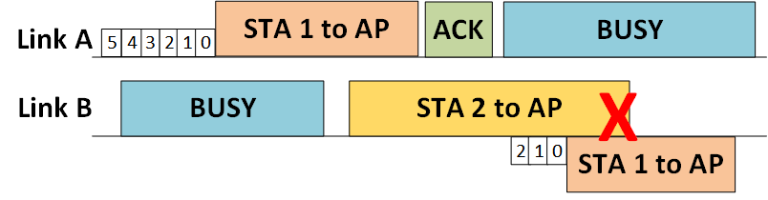
Appendix B: Multi-link Busy State Feedback
STA 1: Non-STR MLD,
STA 2: single link STA
STA 1
Non-STR MLD misses PHY preamble on link B during its TX on link A
Performs ED check on link B after its link A TXOP and cause collision at AP on link B
AP knows MLD’s non-STR constraint and AP’s current reception of intra-BSS PPDU
Proposal: When non-STR MLD completes transmission in link A, if AP is currently receiving intra-BSS PPDU on link B or if AP is transmitting on link B, then AP indicates Busy Status in feedback (ACK in figure) to non-STR MLD on link A. Accordingly, non-STR MLD suspends backoff procedure until the occurrence of an intra-BSS PPDU reception or aPPDUMaxTime countdown expiry

Slide 20
Appendix C: Aggregated link Backoff Procedure
In single link operation, CW resets to CW min upon successful transmission
Backoff counter did not reach zero on aggregated link prior to TXOP
Resetting CW to CW min on aggregated link can be unfair to single link STAs
Proposal: CW remains same as prior to TXOP on aggregated link and backoff counter resumes from value prior to TXOP
Failed transmission case can follow existing backoff procedure
Backoff countdown resumes with same value
link A
TXOP
TXOP
busy
ML
STA
3
2
1
0
9
8
7
6
5
4
3
TXOP: ML STA’s TXOP
Busy: other traffic
link B
busy
TXOP
busy
5
4
3
2
1
0

Slide 21
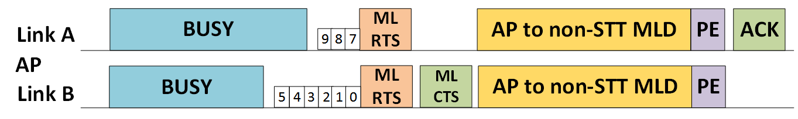
Alternative solution for non-STT MLD downlink TXOP Aggregation: Single Multi-link CTS over one link
  AP transmits multi-link RTS (ML RTS) on both links
  ML RTS includes the link ID of the link on which backoff counter was zero
    Non-STT MLD transmits ML CTS on the indicated link
  ML CTS includes channel status of aggregated link
    Packet extension may be additionally required to allow for ML CTS construction overhead
  If AP does not receive ML CTS, AP does not perform transmission on either link
  If ML CTS indicates busy state on aggregated link (link A) then AP can transmit only on the link on which backoff counter was 0 (link B)
  Backoff procedure can be resumed on both links after the ML CTS timeout

