Slide 1
Multi-link Channel Access Discussion Follow-up
Date: 2019-11-11
Authors:

Slide 2
Introduction
Multi-link Operation
  Candidate feature being discussed in TGbe group
  Several aspects
    Transmission of frames of a TID over multiple links
    Minimizing negotiation overhead for fast link switching
Multi-link Channel Access
  Several discussions on multi-link channel access, asynchronous and synchronous operations
  A few contributions have considered multi-link operation with single primary channel
    Similar to 80 + 80 operation in which all devices perform backoff only one link
In this presentation, we follow up on multi-link channel access discussion presented in October conference call [1,2]

Slide 3
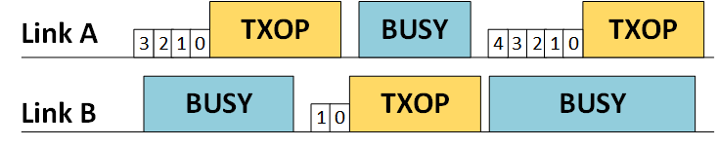
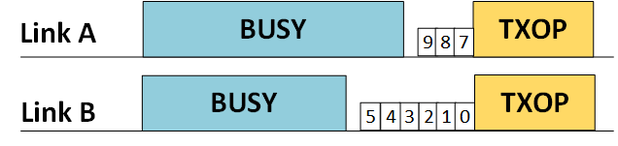
Asynchronous Operation
Asynchronous multi-link channel access
  Per-link backoff procedure with no synchronization of multi-link transmissions
  Single link STAs and legacy STAs can operate on any link
  Simultaneous transmit and receive operation (STR)
  Shall be the default multi-link access mode
Multi-link TXOP Aggregation
  Link with backoff countdown to 0 can aggregate second link if idle (e.g. for PIFS)
  Per-link PPDU provides more flexibility due to diverse link conditions

Slide 4
Multi-link Operation Constraints at non-AP STA
Simultaneous Transmit-Receive (STR) Constraint
  STA may not be capable due to in-device power leakage from insufficient frequency separation
  Example: Link A operating in lower 5 GHz and link B operating in upper 5 GHz
Simultaneous Transmit-Transmit (STT) Constraint
  For some channel combinations, STA may not be capable of simultaneous transmission on those channels due to issues with intermodulation
  For some channel combinations, STA may not be capable of simultaneous transmission on those channels with a single antenna due to RF limitations
Simultaneous Receive-Receive (SRR) Capability
  For some channel combinations, STA may not be capable with a single antenna due to RF limitations
  Fall back to single link operation without this capability

Slide 5
Non-AP STA Classification
Multi-link STAs indicate STR and STT capability to AP
  Dynamic indication by ML STA based on operating links
In this context, classification of non-AP STAs on a link pair
  STR STA
    ML STA capable of STR, STT and SRR on that link pair
  Non-STR STA
    ML STA not capable of STR but capable of STT and SRR on that link pair
  Non-STT STA
    ML STA not capable of STR, not capable of STT but capable of SRR on that link pair
  Single link STA
    STA operating only on one of the links of the link pair

Slide 6
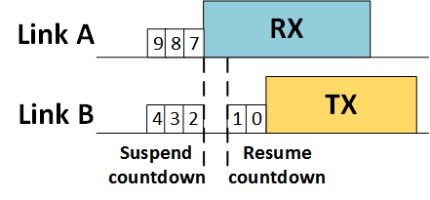
Recap: Opportunistic Backoff Countdown Resume at non-STR STA
For certain conditions, non-STR STA resumes countdown on link B during busy state on link A
Similar to 802.11ax SRP-based spatial reuse backoff procedure
Inter-BSS PPDU (e.g. BSS Color)
  Backoff countdown can be resumed as frame not for non-STR STA
Intra-BSS Uplink PPDU
  Backoff countdown can be resumed, similar to above
  UL/DL bit in HE-SIG-A for HE SU PPDU/ER SU PPDU
  UL MU identified by HE TB PPDU
Intra-BSS Downlink PPDU
  Backoff countdown can be resumed if PPDU identified to be not destined to itself
  STA ID in HE-SIG-B for HE MU PPDU or unable to decode HE-SIG-B of HE MU PPDU
  No STA ID info in PHY preamble for SU PPDU and MAC header decoding can take long
  Proposal: STA ID info in EHT PHY preamble for SU PPDU

Slide 7
Recap: Aggregated link Backoff Procedure
In single link operation, CW resets to CW min upon successful transmission
Backoff counter did not reach zero on aggregated link prior to TXOP
Resetting CW to CW min on aggregated link can be unfair to single link STAs
Proposal: CW remains same as prior to TXOP on aggregated link and backoff counter resumes from value prior to TXOP
Failed transmission case can follow existing backoff procedure
Backoff countdown resumes with same value
link A
TXOP
TXOP
busy
ML
STA
3
2
1
0
9
8
7
6
5
4
3
TXOP: ML STA’s TXOP
Busy: other traffic
link B
busy
TXOP
busy
5
4
3
2
1
0

Slide 8
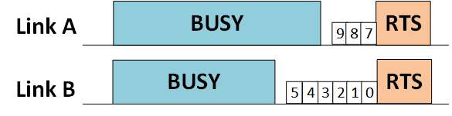
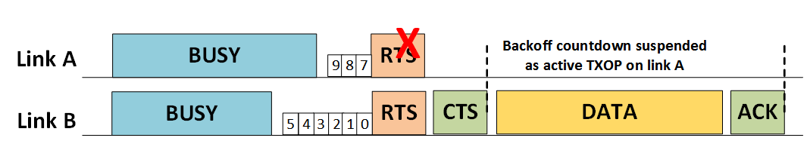
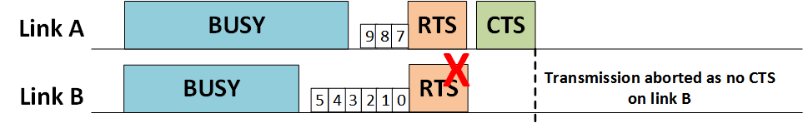
Proposal for Multi-link TXOP Aggregation Protection
Example snapshot at a non-STR STA
Non-STR STA transmits RTS on both links
Link A is the aggregated link in this example
Proposal
  If CTS is received on both links, transmission is performed on both links
  If CTS received only on the link on which backoff counter was 0 (link B), then transmission performed only on that link
  If CTS received only on aggregated link (link A), then no transmission is performed

Slide 9
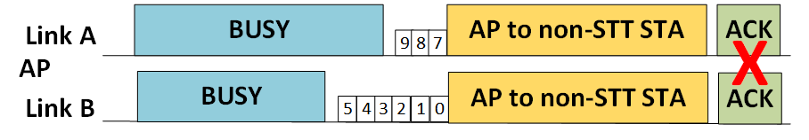
Downlink multi-link TXOP Aggregation with STT Constraint
Non-STT STA: Non-STR STA with STT constraint
Non-STT STA still benefits from multi-link operation
  Downlink multi-TXOP aggregation still possible as non-STT STA has simultaneous receive capability
  Multi-link gain observed from medium access on multiple channels even without STT capability
Per-link simultaneous acknowledgement is infeasible due to STT constraint

Slide 10
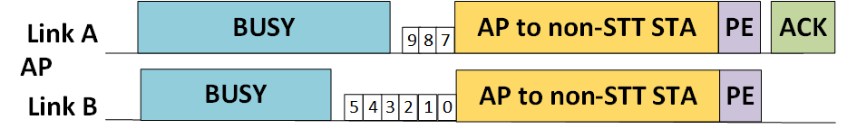
Proposal: Multi-link immediate response from non-STT STAs
For high efficiency, immediate response is preferable
Due to STT constraint, feedback can be transmitted over a single link
Due to diverse link conditions, AP explicitly indicates the link to be used for immediate response
  If explicitly informed, then non-STT STA shall use that link for response
Proposal: AP and non-STT STA negotiate Packet Extension for downlink multi-link TXOP aggregation mode during multi-link setup and AP uses that Packet Extension for this mode
  Motivation: To allow for processing overhead at non-STT STA in constructing immediate acknowledgement for frames received over multiple links
  Packet Extension concept was introduced in 802.11ax standard. We are using it for a special case in multi-link operation as described above.

Slide 11
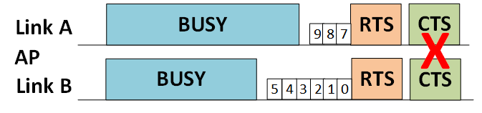
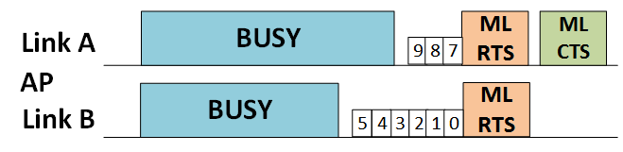
Proposal: Multi-link Aggregation Protection for non-STT STAs
Due to STT constraint, per-link CTS cannot be transmitted simultaneously
  AP transmits multi-link RTS (ML RTS) on all links
  ML CTS includes channel status of all links
  Packet extension may be additionally required to allow for ML CTS construction overhead
  Non-STT STA may use any link that is not busy for the ML CTS transmission
  If AP does not receive ML CTS, AP does not perform transmission on either link
  If ML CTS indicates busy status on the link on which backoff counter was zero (link B in example), then it will abandon transmission
  If ML CTS indicates busy state on aggregated link (link A) but not the link on which backoff counter was zero (link B) then AP can transmit only on the link on which backoff counter was 0 (link B)
  Backoff procedure can be resumed on both links after the ML CTS timeout

Slide 12
Summary
Non-AP STAs indicate STR capability and STT capability to AP
Proposal for multi-link TXOP aggregation protection
Proposal for downlink multi-link TXOP aggregation protection mechanism for non-STT STAs
Proposal for downlink multi-link TXOP aggregation acknowledgement from non-STT STAs

Slide 13
References
[1] 11-19/1405, “Multi-link Operation Channel Access Discussion”
[2] 11-19/1505, “Multi-link TXOP Aggregation Considerations”

