Slide 1
Multi-link Security Consideration
Date: 2019-11-5
Authors:
Name | Affiliations | Address | Phone | Email
Po-Kai Huang | Intel
Laurent Cariou
Ouzieli Ido
Bravo Daniel
Epstein Avner
Schreiber Ofer
Arik Klein
Robert Stacey
Carlos Cordeiro
Notes:
September 2012

Slide 2
Background
Multi-link framework and setup has been discussed [1,2]
We discuss the security consideration in this presentation
AP MLD
Non-AP MLD
AP1
AP1
STA1
AP2
STA2
Request frame for multi-link setup
Response frame for multi-link setup
AP3
STA3
Non-AP STA1

Slide 3
Scope of Multi-link Security Consideration
Expect that 4-way handshake or group key handshake will be reused
The discussion points are:
  GTK/IGTK/BIGTK
    Same key or different key for different links
    Key generation method
  PTK
    Same key or different key for different links
    Key generation method

Slide 4
Consideration of GTK/IGTK/BIGTK
We think that replay attack of group addressed data frame, group addressed management frame, or beacon frame across links shall be avoided
  Replaying group addressed data frame sent in one link in another link messes up the replay counter used by the legacy STAs to receive group addressed data frame
  Replaying group addressed management frame like disassociation frame sent in one link in another link messes up the BSS operation for legacy STAs
  Replaying Beacon frame sent in one link in another link may mess up the capability and TSF indication
Replay attack across links may happen if AP MLD uses same MAC addresses and same GTK/IGTK/BIGTK across links
AP MLD
Non
-
AP MLD
Non
-
AP
AP
1
Link
Disassociation
1
1
Non
-
AP
AP
2
Link
Disassociation
2
2
Replayed by the attacker

Slide 5
Consideration of GTK/IGTK/BIGTK
Even if AP MLD uses different MAC addresses across links, there are still benefits for using different GTK/IGTK/BIGTK across links
  Refreshing key in one link due to whatever reasons does not require key refreshing in other links => keep security domain separate
  Managing different key in different links does not require coordination of PN assignment => keep implementation simple
We propose that different GTK/IGTK/BIGTK across links shall be allowed for multi-link operations

Slide 6
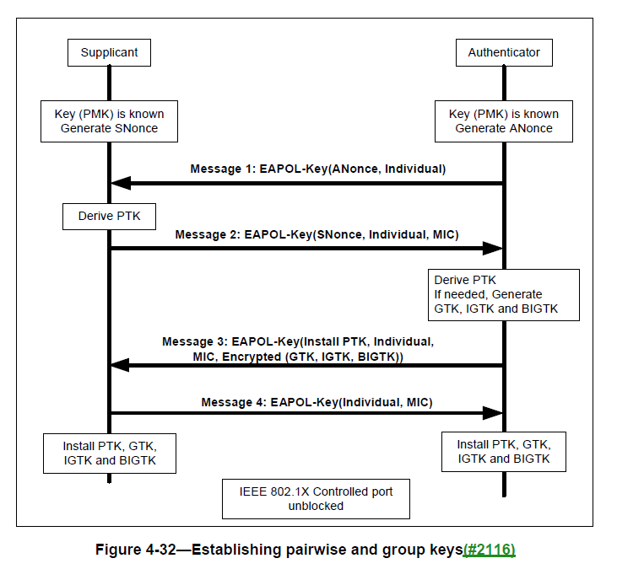
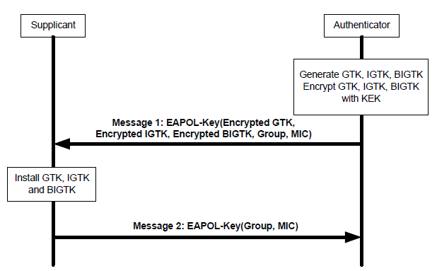
Delivery of GTK/IGTK/BIGTK across links
Current spec does not mandate generating method for GTK/IGTK/BIGTK, and AP MLD can just generate multiple random values for different keys across links
To avoid multiple 4-way handshakes or group key handshakes, we propose to deliver different GTK/IGTK/BIGTK in one 4-way handshake or group key handshake.
  Design multi-link GTK/IGTK/BIGTK KDE with link ID field
  Put the multi-link GTK/IGTK/BIGTK KDE in message 3 of 4-way handshake or message 1 of group key handshake

Slide 7
Consideration for PTK
The question of same or different PTK across links has to be considered together with the design of handling TID reordering across links
  The current spec mandates that replay attack check has to be done after reordering is done
Shared SN space across links has been agreed in the current SFD
One shared receive reordering buffer of a TID across links is the natural result when we have shared SN space

Slide 8
Consideration for PTK
The example below demonstrates that if we have different PN space, i.e., different PTK, across links, MPDU may be dropped based on the current replay detection
  To resolve the problem, coordination of PN assignment across links is required, and the benefits of simplifying implementation using different PTK vanishes

Slide 9
Proposal for Same PTK
To have same PTK under same/different MAC address across links, we need to have same PMKSA (i.e., same PMK) and same PTKSA
  PMKSA is created based on AS (EAP method) or PSK (SAE method)
  PTKSA is created based on 4-way handshake or FILS authentication
We think this can be achieved by
  For both methods, consider the negotiation between two MLDs rather than two STAs
    For EAP method, use the MLD address for calculation of PMKID (under EAP method),
    For SAE method, change <password, STA-A-MAC, STA-BMAC> tuple to <password, address of AP MLD, address of non-AP MLD> tuple
  For PTK calculation, replace AA as the address of AP MLD and replace SPA as the address of non-AP MLD
  For FILS authentication, replace AP-BSSID/STA-MAC with address of corresponding MLD address in the procedure
  Address of MLD needs to be conveyed in the air

Slide 10
Conclusion
We propose to have different GTK/IGTK/BIGTK across links to avoid replay attack across links, enable separate security domain, and simplify implementation
  Have one 4-way handshake or group key handshake to deliver the different keys across links
We propose to have PTK and PN space across links to accompany the design of having one receive reordering buffer across links
  Use the MLD address to compute the PMK and PTK

Slide 11
Straw Poll #1
After multi-link setup between two MLDs, do you support to use different GTK/IGTK/BIGTK in different links with different PN space?
  GTK/IGTK/BIGTK in different links are delivered in one 4-way handshake

Slide 12
Straw Poll #2
After multi-link setup between two MLDs, do you support to use same PMK and PTK across links with same PN space and use the MLD MAC addresses to compute PMK and PTK?

Slide 13
Reference
[1] 19/773r8 Multi-link Operation Framework
[2] 19/822r9 Extremely Efficient Multi-band Operation

Slide 14
Backup
pairwise master key security association (PMKSA): The context resulting from a successful IEEE 802.1X authentication exchange between the peer and Authentication Server (AS) or from a preshared key (PSK).
pairwise master key (PMK): The key derived from a key generated by an Extensible Authentication Protocol (EAP) method or obtained directly from a preshared key (PSK).
pairwise transient key security association (PTKSA): The context resulting from a successful 4-way handshake between a peer and Authenticator or from a successful fast initial link setup (FILS) authentication.
pairwise transient key (PTK): A concatenation of session keys derived from the pairwise master key (PMK) or from the PMK-R1. Its components are a key confirmation key (KCK), a key encryption key (KEK), and a temporal key (TK), which is used to protect information exchanged over the link.

Slide 15
Backup
12.5.3.3.7 CCM originator processing
The PN values sequentially number each MPDU. Each transmitter shall maintain a single PN (48-bit counter) for each PTKSA and GTKSA(#59).
12.5.5.3.6 GCM originator processing
The PN values sequentially number each MPDU. Each transmitter shall maintain a single PN (48-bit counter) for each PTKSA and GTKSA(#59).
12.6.1.1.6 PTKSA
The PTKSA consists of the following:
— PTK
— Pairwise cipher suite selector
— Supplicant MAC address or STA’s MAC address
— Authenticator MAC address or BSSID
— Key ID
— If FT key hierarchy is used,
— R1KH-ID
— S1KH-ID
— PTKName

