Slide 1
Presence and Proximity Detection Using WLAN Sensing
Date: 2019-10-24
Authors:

Slide 2
Introduction
Previous presentations on WLAN sensing given at WNG and at SENS TIG partially addressed usage models. For example,
  Proximity, gesture recognition, gaming control, liveness, facial/body recognition, area sensing/presence detection, robot 3D vision [1]
  Audio with user tracking, location in store [2]
In this presentation, we look into presence detection and proximity detection into more detail.
We also discuss performance requirements/metrics and the use of alternative (non-WLAN-based) technologies.

Slide 3
Presence Detection
Goal is to enable a WLAN device or WLAN network to, for example,
  Identify the presence of people (1 or more)
  Determine number of people
  Determine if subject is human
  Monitor well-being of each person
  Determine coarse location (passively)
in a given environment (home, enterprise, vehicle…).
WLAN is used for both data transfer and sensing.
  Important differentiator to other technologies. For example, could be used to network multiple “sensors” and/or to transfer data to the cloud.
Proprietary solutions already exist in the market.

Slide 4
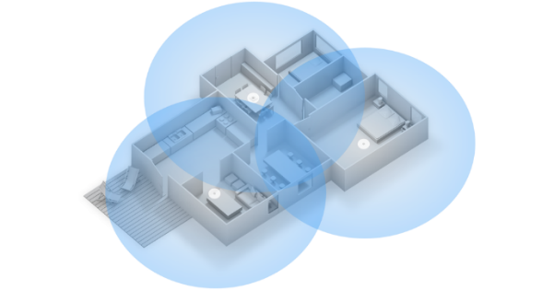
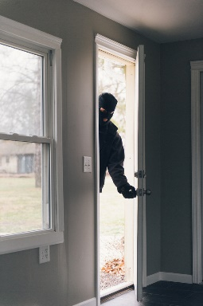
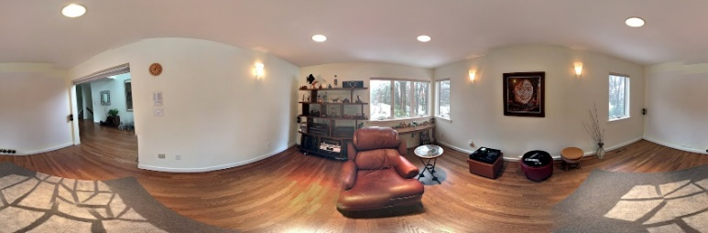
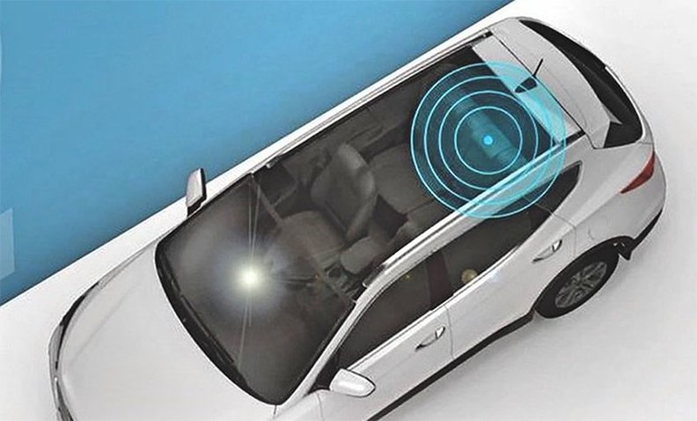
Presence Detection – Use Cases
Smart home, building monitoring
  Detection of presence of users within a house/room/etc., including number of users
  Air condition capacity controlled by number of people
  Activate light if there are people in the room
Security
  Identify intrusion in pre-defined areas
  Detect presence in the presence of smoke
Health care
  Fall detection
  Remote vital sign monitoring
Child presence detection

Slide 5
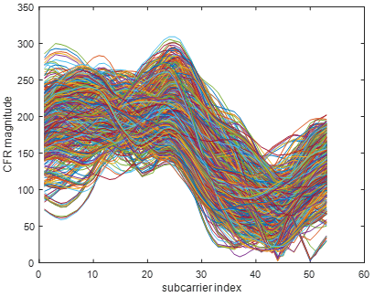

Presence Detection – Example [3]
Example: Detect motion and identify where (e.g., in which room) it happens.
Core algorithm makes use of eigen-decomposition of the covariance matrix of multiple channel estimates obtained over time to determine motion.
Relies on transmit/receive STA diversity.

Slide 6
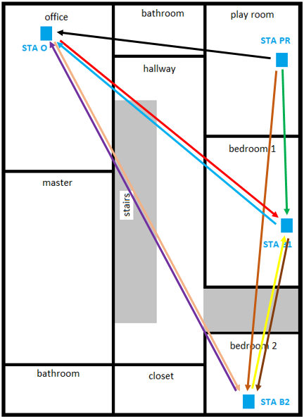
Presence Detection – Example [3]
 | No | O | PR | B1 | O + PR | O + B1 | PR + B1
No | 1 | 0 | 0 | 0 | 0 | 0 | 0
O | 0 | 1 | 0 | 0 | 0 | 0 | 0
PR | 0 | 0 | 1 | 0 | 0 | 0 | 0
B1 | 0 | 0 | 0 | 0.9895 | 0 | 0 | 0.0105
O + PR | 0 | 0 | 0 | 0 | 0.9999 | 0 | 0.0001
O + B1 | 0 | 0 | 0 | 0.0006 | 0.0016 | 0.9874 | 0.0103
PR + B1 | 0 | 0 | 0 | 0.0074 | 0.0001 | 0.0245 | 0.9680

Slide 7

Proximity Detection
Goal is to enable a WLAN device to detect the presence of a potential user in its vicinity.
Use cases
  Smart platforms
    Emerge/go to sleep mode (screen power save)
    Screen lock
  Security
    Screen privacy “screen”
  Smart home/building, home/building monitoring
    Automatically turn on lights, call elevator, when a person arrives
  Improved user experience
    Trigger other applications such as gesture and facial recognition
Proprietary solutions already exist in the market.

Slide 8
Proximity Detection – Example [4]
Relies on transmit STA diversity.
Ability to differentiate motion close to transmit points from motion close to sensing device.
Measure of channel variability – refer to [4].

Slide 9
Performance Metrics 1/2
  (Note: The material below and in the next slide builds upon definitions presented in [2].)
  Sensing range: Maximum distance from a sensing device to the subject.
  Example: <5m indicates that the maximum distance a sensing device would reliably detect/track a subject is 5m.
  Sensing coverage: Required coverage area of a sensing network.
  Example: <10m² indicates that the area in which a sensing network would reliably detect/track a subject is 10m².
  Detection/Classification Accuracy: Detection/classification accuracy is specified in terms of the average probability of correctly detecting/classifying one or more of the following： a) Presence, b) Gesture (among a pre-defined set of gestures), c) Specific body activity such as breathing rate, and d) Human vs animal vs object.
  Example: >95% indicates that a given sensing application satisfies its detection/classification requirements more than 95% on average.
  Number of subjects: Required number of subjects (people/objects…) the sensing device network is capable of detecting/tracking at the same time.
  Example: <5 indicates that a given WLAN sensing application is able to reliably track 5 subjects simultaneously.

Slide 10
Performance Metrics 2/2
  Latency: Maximum or average time necessary for a sensing device/network to produce an output after an event of interest happens.
  Example: 100ms indicates that a sensing device/network requires at most, or on average, 100ms to, for example, detect a person when entering a pre-specified area.
  Field of View: Angle through which a sensing device is sensitive to an event of interest.
  Example: ±50°indicates that a given sensing device reliably classifies gestures performed up to 50°from a given reference (plane perpendicular to the screen, for example).
  Refresh Rate: Maximum or average time necessary for a sensing device/network to update its sensing output.
  Example: 100ms indicates that a given sensing application updates its output on average, or at most, every 100ms.
  Expected Location Accuracy: Maximum difference between the actual and “sensed” location/position of a subject.
  Example: <1m indicates that a given sensing application using 2.4/5 GHz devices is able to reliably estimate the location of a subject with maximum error equal to 1m.

Slide 11
Performance Metrics - Examples
Presence detection
Usage model | Sensing range | FOV | Accuracy |  |  | Latency | Refresh rate | Exp. number of simultaneous subjects
 |  |  | Location accuracy | Velocity accuracy | Detection accuracy
Presence detection | <3m … <10m | TBD | < 50cm @ 90% | N/A | >95% | <1s | TBD | <= 5
AC Control | <10m | (room) | < 50cm @ 90% | N/A | >95% | <1s | TBD | <= 10
Light Control | <10m | (room) | < 50cm @ 90% | N/A | >95% | <1s | TBD | <= 10
Fall detection | <10m | (room) | < 50cm @ 90% | N/A | >95% | <1s | TBD | <= 10
Passengers in the car | <3m | (car) | < 30cm @ 90% | N/A | >95% | <1s | TBD | <= 5

Slide 12
Performance Metrics - Examples
Proximity detection
Usage mode | Sensing range | FOV | Accuracy |  |  | Latency | Refresh rate | Exp. number of simultaneous subjects
 |  |  | Location accuracy | Velocity accuracy | Detection accuracy
Phone screen | Few cm | ±50° | (R) <5mm | N/A | >99% | <100ms | 100msec | 1
Trigger gesture or other application | <0.5m | ±50° | (R) <10cm | N/A | >95% | <100ms | 100msec | 1
PC/TV screen | 1.5 m - 4m | ±60° | (R) < 50cm | N/A | >95% | Walk-in: 1000ms Walk-away: 2000ms | 100msec | 1

Slide 13
Advantages WLAN-based Sensing
If the application requires data transfer, such as to support
  The networking of multiple sensors
  Central/cloud processing
  Sensing application triggering an action/notification (e.g., phone app)
WLAN sensing has an advantage over other modes since data transfer and sensing are performed with the same hardware.
Most modern electronic platforms, such as smartphones, laptop computers, and even appliances, already include WLAN. Other sensors, such as radars or PIRs, require integration and occupy valuable area.
Excellent WLAN coverage in typical residential and enterprise environments. Number of WLAN devices in such environments is large and growing, enabling receive/transmit station diversity.
Improved performance by making use of other WLAN features.

Slide 14
Other Sensing Technologies
Proximity and presence detection can be implemented with other technologies, including
  Infrared and visible light sensors (e.g., PIR, LIDAR)
  Ultrasonic and microwave radars (e.g., FMCW)
  Acoustic sensors
  Cameras
  Accelerometer (e.g., vibration), magnetometer (e.g., for road traffic monitoring)
The right technology depends on the application and platform of interest. WLAN-based sensing is attractive because
  Good range, doesn’t require LoS, works through walls and smoke
  Does not require light, works in the dark
  Not computationally intensive (when compared to cameras, for example)
  No privacy concerns
Also useful for applications that make use of sensor fusion.

Slide 15
WLAN Sensing: Standard
To more efficiently support sensing and to enable more use cases, standards support is required.
  See WNG discussions: [1], [3]-[7].
WLAN sensing-related aspects that require standard support include
  Negotiation of sensing parameters and schedule
  Determine transmission characteristics of PPDUs used for sensing
  Power save (e.g., not rely on the opportunistic reception of packets)
  Enable transmit/receive station diversity
  Protocol flow that efficiently supports unique and fundamental characteristics of Wi-Fi sensing

Slide 16
Conclusions
WLAN-based sensing has multiple advantages over other sensing technologies
  Various conditions (light/no light, smoke…), relatively low computational complexity, long range, single-device and networked solutions…
  Common data transfer and sensing hardware
  Improved performance by relying on other 802.11 features
  Well established and widely adopted technology/protocol
A large number of use cases can be supported by WLAN sensing, each with possibly unique requirements.
We suggest for the group to start developing a usage model document.

Slide 17
References
[1] Wi-Fi sensing in 60GHz band, IEEE 802.11-19/1551r1.
[2] Usage models for WLAN sensing, IEEE 802.11-19/1725r0.
[3] Wi-Fi sensing: Cooperation and standard support, IEEE 802.11-19/1416r0.
[4] Wi-Fi sensing: Usages, requirements, technical feasibility and standards gaps, IEEE 802.11-19/1293r0.
[5] Wi-Fi sensing, IEEE 802.11-19/1164r0.
[6] Wi-Fi sensing - Follow up, IEEE 802.11-19/1293r0.
[7] 802.11 sensing: Applications, feasibility, standardization, IEEE 802.11-19/1626r1.

