Slide 1
CSI-based Wi-Fi Sensing: Results and Standardization Challenges
Date:10/30/2019
Authors:

Slide 2
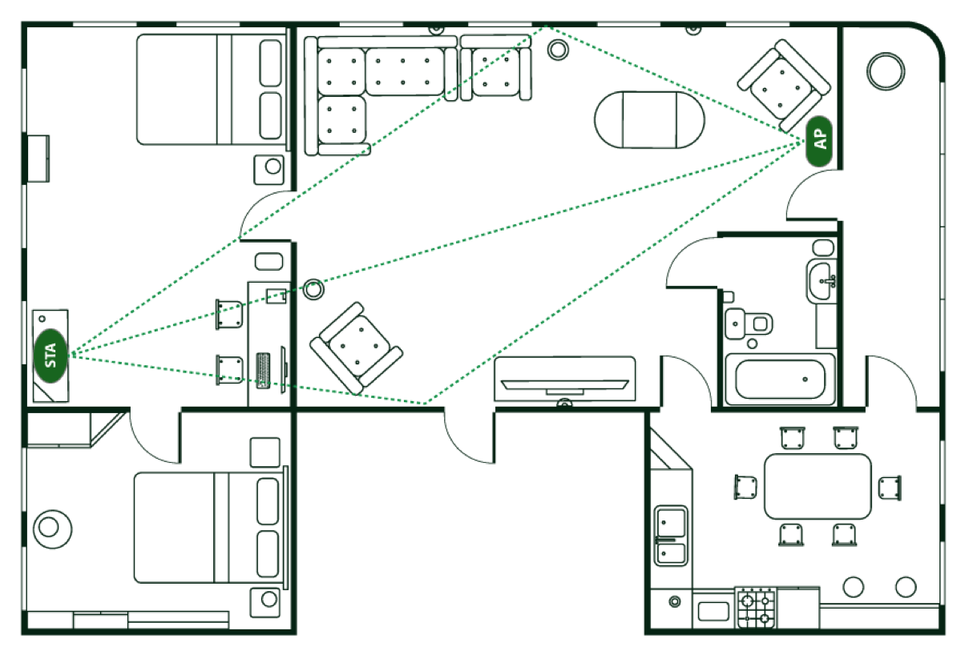
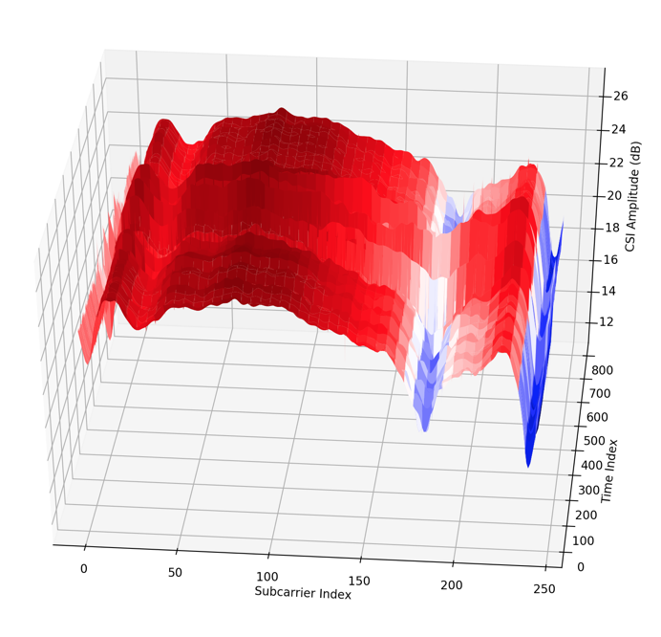
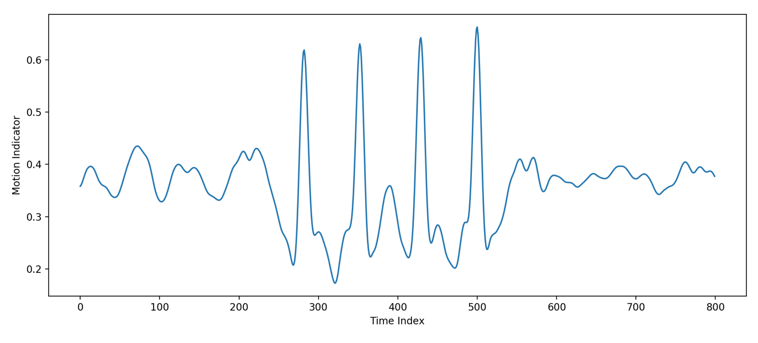
Wi-Fi Sensing
What is Wi-Fi Sensing? [1, 2]
Using existing standardized 802.11-based protocols to sense and track changes in the environment
Status
Interest in WNG July session
TIG created in September session to further explore Wi-Fi sensing
Why Wi-Fi?
Ubiquitous, re-use existing technology for new use cases
Device-free, extra sensor-free, privacy-friendly
Feasible for interesting sensing applications [3, 4, 6, etc.]
What is missing?
Reliability, consistency and availability of CSI
Interoperability

Slide 3
Use Cases*
Security
Home security – intrusion detection
Device security – personal electronics, vehicle unlocking
Automation
Smart home – automation, HVAC control
Gesture recognition – smart device control, gaming
Health care
Elderly care – fall detection
Recuperation – gait and presence detection
Localization
Indoor and reverse location
*Also discussed in [3-6]

Slide 4
Standard Compliant CSI Extraction
STA₁
STA₂
Explicit
CSI tracking based on CBF
Limited resolution due to compression
Implicit
CSI tracking based on LTF
Overhead without existing traffic
Channel direction not crucial
Typical use cases only track changes over time
NDPA
NDP
CSI (1->2)
CBF
STA₁
STA₂
CSI (2->1)
Data

Slide 5
CSI Parameters of Significance
Resolution
Many application require high resolution (without compression) CSI
Periodicity
Some use cases like fall detection might need a reliable periodicity of CSI
Coverage
Depending on the size of the monitoring location coverage is essential
Beamforming might affect isotropic coverage
Overhead
In order to keep airtime usage low more efficient protocol needed

Slide 6
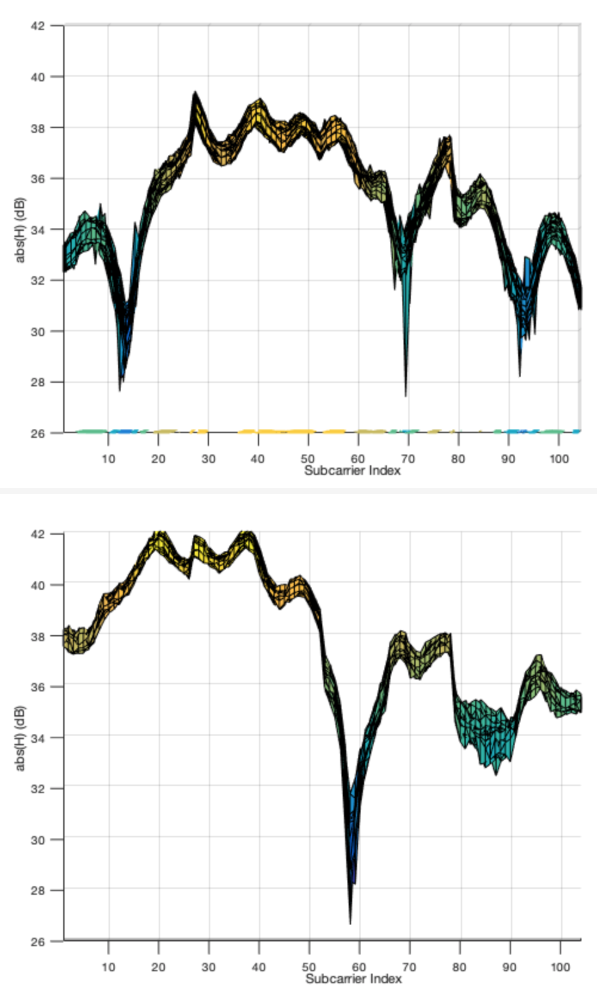
Standardization Challenges* (1)
CSI from Stationary Environment
TX-side Adaptations
Examples
BW adaptation
TX Power adaptation
Beamforming, Antenna selection
Power-save mode
Possible solution
Standardize indicator
Fix parameters for sensing
Parameter
Set 1
Parameter
Set 2
* Challenges that can be alleviated by standardization

Slide 7
Standardization Challenges (2)
Sounding Overhead [7, 8]
Examples
Explicit sounding – periodicity control of sounding frames
Implicit sounding – data overhead
Possible solution
Efficient, scheduled or solicited sounding
Interoperability
Availability and feature parity of CSI in current HW
Airtime comparison for explicit sounding [7]
STA₁
STA₂
Echo Request
Ack
Echo Response
Ack
Example implicit sounding
in absence of background traffic

Slide 8
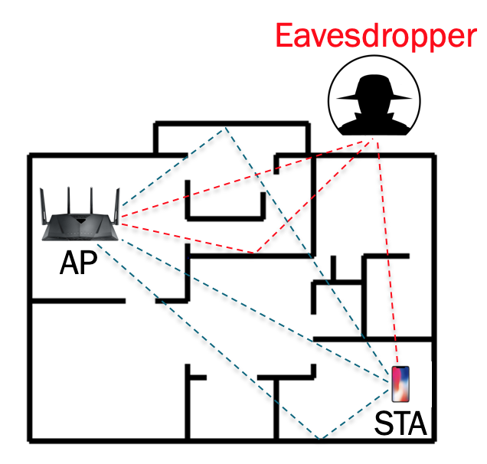
Standardization Challenges (3)
Privacy
Examples
Passive sensing – overhearing active links
Active sensing – new link based tracking
Possible solution
Standardized obfuscation or encryption
Problem – backward compatibility

Slide 9
Conclusions
Wi-Fi sensing is growing in demand with many implemented solutions indicating feasibility
Standard-compliant CSI is an existing feature that can enable numerous practical applications
Standardization can make the CSI extraction process private, efficient and improve interoperability

Slide 10
References
[1] Wi-Fi sensing, IEEE 802.11-19/1164
[2] Wi-Fi sensing: cooperation and standard support, IEEE 802.11-19/1416
[3] Wi-Fi sensing: Usages, requirements, technical feasibility and standards gaps, IEEE 802.11-19/1293
[4] 802.11 sensing: Applications, feasibility, standardization, IEEE 802.11-19/1626
[5] Usage models for WLAN sensing, IEEE 802.11-19/1725
[6] Discussion of market potential and technical feasibility about WLAN sensing, IEEE 802.11-19/1726
[7] MU sounding improvements, IEEE 802.11-18/1191
[8] Sounding-only support during ranging, IEEE 802.11-18/1630

