Slide 1
Wireless Sensing: Use cases, Feasibility, Standardization
Date: 2019-10-09
Authors:
–

Slide 2
Mandate of WLAN Sensing TIG (SENS TIG)
To investigate use cases, requirements, technical approaches and changes to 802.11 standard to support WLAN sensing.
The TIG is to bring a recommendation to the 802.11 WG at the November 2019 session to either
  Continue with the TIG until the next session; or
  Terminate the TIG with no further work; or
  Terminate the TIG and request formation of a SG to develop a PAR and CSD

Slide 3
Topics to be discussed in conference call on 2019-10-09
Usage models, use cases
Function requirements
Broad Market Potential
Technical feasibility
Measurement and evaluation results
Technology and standardization gaps to support WLAN sensing
Any other business

Slide 4
WLAN Sensing functions and use cases
Motion detection [2] (NLOS)* # – intruder detection, security, smart IoT
Breathing monitoring [3] (wearable-free)* # – sleep monitoring, well-being, caregiving
Locationing/tracking [4] (NLOS)* – smart factory, indoor GPS companion, traffic planning
Fall detection [5] (no video)* # – older adults, accident detection, caregiving
Child detection in hot cars * # – smart cars, accident prevention
Presence/proximity detection [6]* # – conference room, convenience, smart IoT
Human identification [7] * # – user identification, personalization, smart IoT
Gesture recognition [8] # – smart office
Activity recognition [9] # – user interface
* Demonstratable.
# Contactless/need no wearable.
N.B. See [1] for a comprehensive survey.

Slide 5
Broad Market Potential
Service providers:
  New sensing/sensor => new service/new device
  New wave of “802.11 sensing” services regarding daily living, safety, lifestyle, convenience, personalization, caregiving, digital health, etc.
  Traditional (e.g. broadband, mobile, streaming, cable) or new (e.g. smart device makers)
Device manufacturers (e.g. smart home/IoT devices, consumer electronics, computing devices, home appliance, lighting, accessories)
  New sensing=> new functionality of 802.11-enabled devices
  New wave of “802.11 sensing” devices - DIY or connected to “802.11 sensing” service
Component providers
  Backward compatibility => Expanded markets for existing components (firmware upgrade)
  New component opportunity for “802.11 sensing” services and devices

Slide 6
Technical feasibilities
WLAN sensing has been extensively studied in peer reviewed international journal papers and conference papers, even in text books!

Slide 7

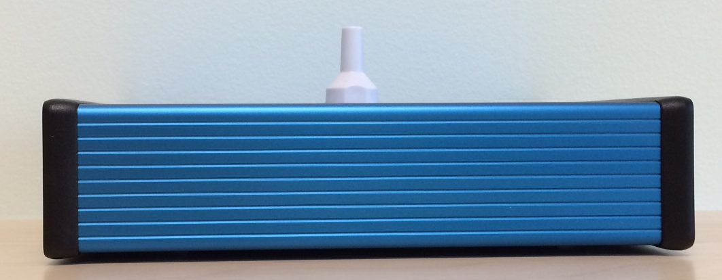
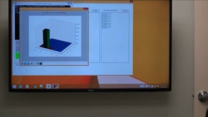
Feasibility of wireless sensing - Locationing
Two “blue boxes” (size:5cmx15cmx20cm)
First box (Tx) transmits wireless sounding signal to second box (Rx).
Rx extracts channel state information (CSI) from sounding signal
During training, Rx at fixed location while Tx moves around (LOS/NLOS). Rx records CSI “signature” associated with various locations
During operation, Tx is to be located. Rx obtains CSI and compares with stored CSI signatures in database. Location associated with matched stored CSI is location of Tx.
Average location error is approx. 2 cm.
Notes:
640x smaller!
Fit into a brief case

Slide 8
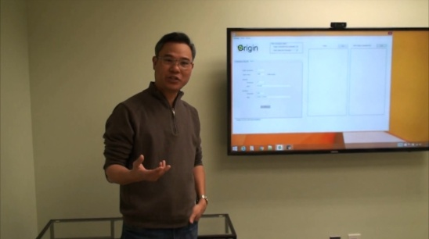
Feasibility of wireless sensing - Security
Same two “blue boxes” sensing prototypes
Tx and Rx placed at LOS/NLOS to guard an area. Tx transmits sounding signal to Rx. Rx extracts CSI from sounding signal
During training, Rx uses machine learning to learn “states” such as “empty house with all doors close” and “door close” based on CSI.
During operation, Rx detects “empty house with all door close” and any state change based on CSI.
Notes:
640x smaller!
Fit into a brief case

Slide 9
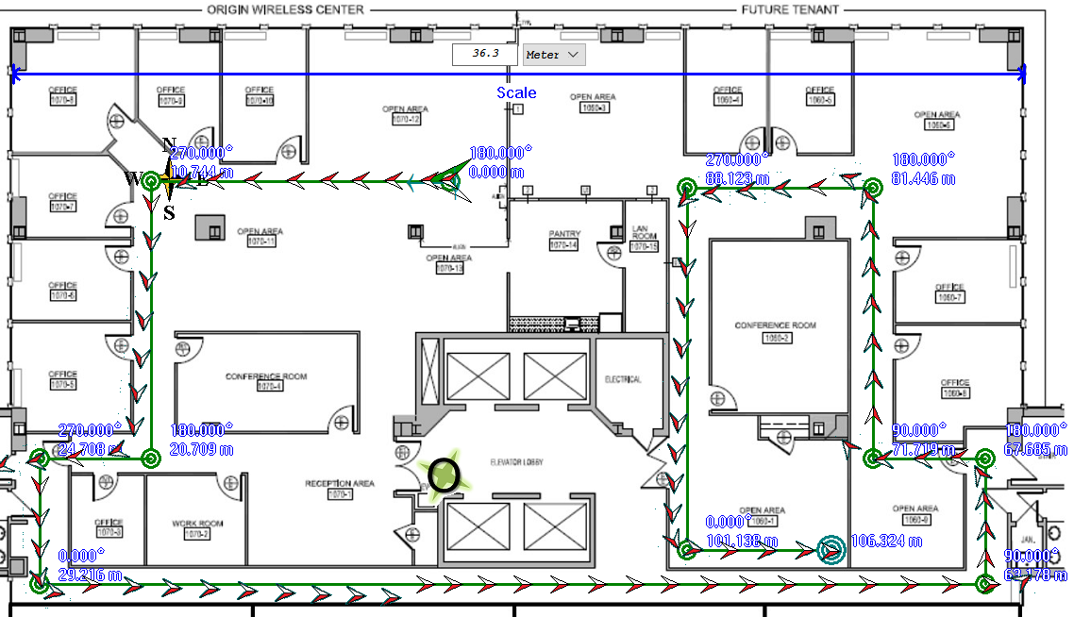
Feasibility of wireless sensing - Tracking
In walking experiments along paths in buildings, wireless tracking prototype shows high tracking accuracy.
Rx at fixed location while Tx moves around. Rx to be tracked.
NLOS operation. No training.
Average (abs) tracking error is less than 20-30 cm
Need map.
Tx
Rx
True path
802.11 tracking

Slide 10
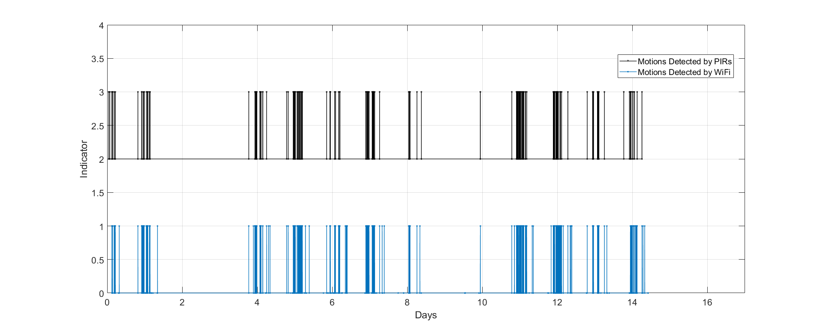
Feasibility of wireless sensing - Motion Detection
In a long-term side-by-side comparison with passive infra-red PIR sensor (a test house covered by 6 professionally installed PIRs and a pair of 802.11 Tx/Rx), wireless motion sensing prototype performs similar to, if not better than, the PIRs. Results verified by video recording.
Tx/Rx at fixed locations. NLOS or LOS. Detect motion based on 5GHz WiFi CSI.
Detection rate: 802=99.997%, PIR=97.5%
False alarm rate: 802=0.000%, PIR=0.000%
Missed detection by PIR
PIRx6
802.11
False alarm by PIR

Slide 11
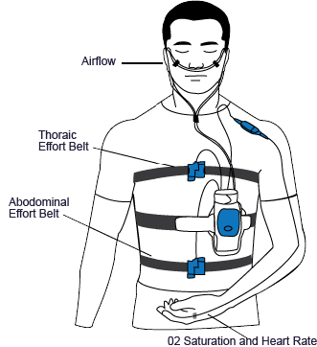
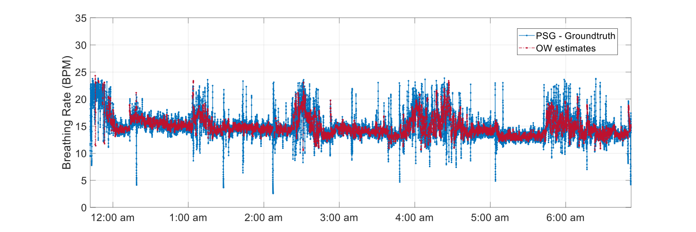
Feasibility of wireless sensing - Breathing Monitoring
In multi-night side-by-side comparison with other breathing sensors (pressure sensor, radar sensor, with polysomnography (PSG) being ground truth), 802.11 breathing monitoring prototype (contactless) outperforms pressure sensor and radar sensor.
Tx/Rx at fixed position around sleeping human. Detect breathing based on 5GHz WiFi CSI.
stage (awake/REM/NREM) detection rate: 802=0.87/0.87/0.89, pressure=0.77/0.46/0.75, radar=0.53/0.79/0.87
median (abs) error: 802=0.47/0.68/0.42bpm, pressure=0.86/1.28/0.80bpm
PSG
Tx
Rx
Airflow
ECG
EEG
EMG
O2 Saturation and Hear Rate

Slide 12
Need of standardization for 802.11 sensing
Some current challenges:
  CSI is not always available.
  CSI sufficient for data communication may not be sufficient for 802.11 sensing.
  CSI sufficient for a 802.11 sensing task may be insufficient for another.
  No standardized testing for CSI for 802.11 sensing: consistency, accuracy, precision. (WiFi Alliance? TBD.)
Need a protocol to control the generation of CSI, repetition rate, accuracy of timing, antenna selection and probing for 802.11 sensing.
    Some 802.11 sensing demos need periodic probing/CSI generation at 1/10/100/1000Hz?
CSI consistency, precision and format may be needed. (WiFi Alliance? TBD.)
2.4/5/6GHz sensing should be independent of 60GHz sensing as they operate in different principles.

Slide 13
Conclusion
Wireless sensing
Broad market potential - Yes
Distinct identity – Yes
Technical feasibility - Yes
Economic feasibility – Yes
Compatibility with existing 802 standards - Yes
Co-existence - Yes
We should form a Study Group to investigate WiFi sensing and prepare PAR for WiFi sensing

Slide 14
References
B.B Wang, Q.Y. Xu, C. Chen, F. Zhang, and K.J.R. Liu, "The Promise of Radio Analytics: A Future Paradigm for Wireless Positioning, Tracking, and Sensing", IEEE Signal Processing Magazine, Vol. 35, No. 3, pp.59-80, May 2018.
Yu Gu, et.al., “MoSense: An RF-based Motion Detection System via Off-the-Shelf WiFi Devices”, IEEE Internet of Things Journal, Vol. 4, No. 6, pp.2326-2341, Dec. 2017.
Xuefeng Liu, et.al., “Contactless respiration monitoring via off-the-shelf WiFi devices”, IEEE Trans. On Mobile Computing, Vol. 15, No. 10, pp.2466-2479, Oct. 2016.
Feng Zhang, et.al., “WiSpeed: A statistical electromagnetic approach for device-free indoor speed estimation”, IEEE Internet of things Journal, Vol.5, No. 3, pp.2163-2177, Jun. 2018.
Hao Wang, et.al., “RT-Fall: A real-time and contactless fall detection system with commodity WiFi devices”, IEEE Trans. On Mobile Computing, Vol. 16, No. 2, pp. 511-526, Feb. 2017.
Hai Zhu, et.al., “R-TTWD: Robust device-free through-the-wall detection of moving human with WiFi”, IEEE Journal on Selected Areas in Communications, Vol. 35, No. 5, pp. 1090-1103, May 2017.
Hongbo Liu, et.al., “Authenticating users through fine-grained channel information”, IEEE Trans. On Mobile Computing, Vol. 17, No. 2, pp. 251-264, Feb. 2018.
Kamran Ali, et.al., “Recognizing keystrokes using WiFi devices”, IEEE Journal on Selected Areas in Communications, Vol. 35, No. 5, pp. 1175-1190, May 2017.
Yi Wang, et.al., “Robust indoor human activity recognition using wireless signals”, Sensors, Vol. 15, No. 7, pp. 17195-17208, Jul. 2015.
IEEE Std 802.11-2016, Section 19.3.12, pp. 2392-2400.

Slide 15
Straw Poll
“We agree that 802.11 should form a Study Group (SG) on WiFi sensing.”
  YES
  NO
  NEED MORE INFORMATION/TIME
  ABSTAINED

Slide 16
Broad Market Potential
New way to sense.
New functionalities for 802.11-enabled devices (TV, speaker, router, IoT devices) and facilities (stadiums, halls, rooms, warehouse, factory).
New industry-wide business opportunities for all 802.11 related companies (components/ devices/services). See slide 7.
Performance advantages over existing sensors. (see next slide)
NLOS operation. No blind spot. Especially suitable for indoor.
Ubiquitous. 802.11-enabled devices popular in homes/office. Any device compliant with the 802.11 standard potentially could be used.
Need no dedicated hardware. Any 802.11-compliant device (including our demo devices) can potentially implement any 802.11 sensing functionalities using only software upgrade.

