Slide 1
Usage models for WLAN sensing
Date: 2019-10-09
Authors:
Name | Affiliation | Address | Phone | Email
Rui Du | Huawei Technologies Co. Ltd | F1, Huawei Base, Shenzhen, China |  | Ray.du@Huawei.com
Tony Xiao Han |  |  |  | Tony.hanxiao@huawei.com
Chenchen Liu
Meihong Zhang
Danny Tan Kai Pin
David Xun Yang

Slide 2
Abstract
Several contributions about WLAN sensing have been discussed in July and September IEEE 802.11 meeting [1-7], in which include some descriptions of usage models.
This document defines relevant terminologies to discuses the usage models for WLAN sensing.
In this initial version, only two usage models are included and additional usage models are expected to be added in the future.

Slide 3
Usage model terminology
Rui Du, et al. (Huawei)

Slide 4
Usage model terminology
Usage Model – A usage model is the combination of the following 4 items below and in the next slide; not to be confused with a use case which is the specific set of steps to accomplish a particular task.
Pre-Conditions – Initial conditions before the use case begins.
Environment – The type of place in which the network of the use case is deployed, such as home, outdoor, hot spot, enterprise, metropolitan area, etc.
Use case – A use case is task oriented. It describes the specific step-by-step actions performed by a user or device. One use case example is a user starting and stopping a video stream.
Rui Du, et al. (Huawei)

Slide 5
Usage model terminology
Requirement and attribute–
  Sensing range: the maximum distance from a sensing device to the target.
  E.g., < 5m would indicate that the distance from a sensing device to the target is within 5 meters.
  Expected Location Accuracy: Location can be specified using Cartesian (X,Y,Z) or Polar (R, theta, phi) coordinates. Location accuracy is specified in terms of distance from actual location measured in either Cartesian or Polar coordinates.
  E.g., <XYZ: 10cm@90% is a requirement that the computed location be within 10cm of the actual location 90% of the time using Cartesian coordinates.
  Expected Velocity Accuracy: Velocity can be specified using Cartesian (X,Y,Z) or Polar (R, theta, phi) coordinates. Velocity accuracy is specified in terms of difference from the actual velocity measured using either Cartesian or Polar coordinates.
  E.g., < XYZ: 0.2 m/sec@90% is a requirement that the computed velocity be within 0.2m/sec of the actual velocity 90% of the time using Cartesian coordinates.
  Detection Accuracy (DA): The detection accuracy is specified in terms of probability of correctness for one of the following：
  a) gesture detection where a pre-defined set of gestures and/or motions shall be identified
  b) presence detection
  c) a specific body activity detection like breathing
  d) real person detection distinguishing human from non-human or animal.
  E.g., >95% is a requirement that the percentage of accurate detection is more that 95%.
  Field of View (FOV): The angle through which the sensing device performs sensing and detection, i.e., the FOV indicates the coverage area of a sensing device.
  E.g., ±50°is a requirement that the coverage area of a sensing device is ±50°.
  Expected Latency: Expected time taken to complete the related WLAN sensing process.
  E.g., 10 ms latency would indicate that WLAN sensing process needs to be completed within 10 ms.
  Expected Refresh Rate: This defines how frequent the refresh takes place.
  E.g. a refresh rate of 10 Hz would indicate that WLAN sensing results need to be refreshed 10 times in a second.
  Expected number of simultaneous targets: This defines how many targets could be detected simultaneously within the sensing area.
  E.g. a simultaneous targets number of 5 would indicate that 5 targets could be detected/monitored/… simultaneously by WLAN sensing device within the sensing area.
Rui Du, et al. (Huawei)

Slide 6
List of usage models
Rui Du, et al. (Huawei)

Slide 7
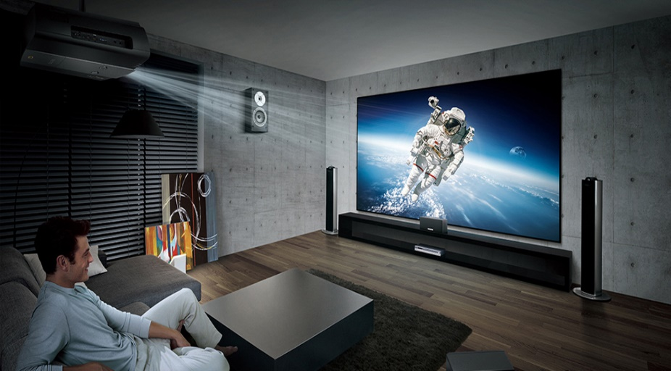
1. Audio with user tracking (Follow-me sound) (1/2)
Pre-Conditions
Smart home with WLAN based audio system including various WLAN speakers.
WLAN is employed for sensing/positioning, but may or may not be employed for sound transfer.
Audio system calibration is done, i.e., speaker placement and position is automatically determined, and audio system adjusts the speaker settings for best sound experience.
Environment
Smart home with 802.11 coverage.
Immersive gaming room with 802.11 coverage.
Use Case
  The user does not need to wear a WLAN device.
  The user’s position is continuously monitored.
  The audio system adjusts the speaker settings according to the user’s position and movement for immersive sound experience.
https://uppic-fd.zol-img.com.cn/g5/M00/0D/0A/ChMkJllWFZuIdf9SAAOoPtMQwRcAAdx4wF6HpAAA6hW306.jpg
Note: This usage model is modified based on the usage model No.2 for 11az [8], which require the user to wear a WLAN device.
Rui Du, et al. (Huawei)

Slide 8
1. Audio with user tracking (Follow-me sound) (2/2)
Requirement and attribute
Usage model # | Sensing range | FOV | Accuracy |  |  | Latency | Refresh rate | Exp. number of simultaneous targets
 |  |  | Location accuracy | Velocity accuracy | DA
1. Audio with user tracking | <3m … <10m | TBD | same room @ 99% (simple) < XYZ: 50cm @ 90% (typical) < XYZ: 10cm @ 90% (high fidelity) Note¹ | N/A | >90% | <10ms | >10Hz | <= 5
Note ¹: the head of the user should be detected.
Rui Du, et al. (Huawei)

Slide 9
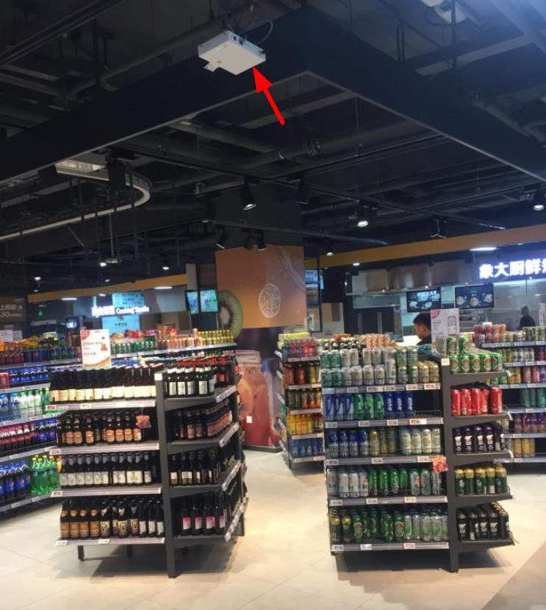
2. Location in store (1/2)
Pre-Conditions
Person does not need to carry a WLAN device
Environment
A store with 802.11 coverage.
A store has an WLAN device (AP/STA) on every few aisles.
Use Case
  The user is going around in the store, and does not need to carry a WLAN device
  WLAN sensing is used to indicate whether the user is moving, or whether he stopped in front of some products
  WLAN sensing is used to determine, e.g., the number of users facing a specific product, the time duration of the user stopped in front of a specific product
http://img.wezhan.cn/content/sitefiles/88646/images/12157659_%E8%B6%85%E5%B8%82%E5%AE%9A%E4%BD%8D3.jpeg
Note: This usage model is modified based on the usage model No.11 for 11az[8], which require the user to wear a WLAN device.
Rui Du, et al. (Huawei)

Slide 10
2. Location in store (2/2)
Requirement and attribute
Usage model # | Sensing range | FOV | Accuracy |  |  | Latency | Refresh rate | Exp. number of simultaneous targets
 |  |  | Location accuracy | Velocity accuracy | DA
2. Location in store | <3m … <10m | TBD | < XYZ: 50cm @ 90% (typical) < XYZ: 10cm @ 90% (high fidelity) | N/A | >90% | <10ms | >10Hz | <= 10……<= 50
Rui Du, et al. (Huawei)

Slide 11
Summary
Relevant terminologies to discuss the usage models for WLAN sensing have been defined.
Two usage models have been discussed and additional usage models are expected to be added in the future.

Slide 12
References
[1] 11-19-1164-00-0wng-wi-fi-sensing.pptx
[2] 11-19-1293-00-0wng-wi-fi-sensing-usages-requirements-technical-feasibility and standards gaps.pptx
[3] 11-19-1500-00-0wng-wi-fi-sensing-follow-up.pptx
[4] 11-19-1416-00-0wng-wi-fi-sensing-cooperation-and-standard-support.pptx
[5] 11-19-1551-00-0wng-wi-fi-sensing-in-60ghz-band.pptx
[6] 11-19-1626-01-0wng-802-11-sensing-applications-feasibility-standardization.pptx
[7] 11-19-1580-00-0wng-wi-fi-sensing-application-multipath-enhanced-device-free-localization.pptx
[8] 11-16-0137-04-00az-ngp-use-case-document.pptx
Rui Du, et al. (Huawei)

