Slide 1
Strongest Tap FTM for PEDMG
Date: 2019-10-02
Authors:

Slide 2
Abstract
The presentation covers comments open CIDs
  FTM measurement for strongest CIR tap for PEDMG
  excluding PDMG, due to limited use-cases (no first path AWV)
  CID #:
    1427: R2I / I2R ToA Type to distinguish b/w first vs. strongest tap FTM
    2349: option to include strongest tap FTM with new trigger field 5
This presentations shows the motivation behind these comments and proposes corresponding resolutions

Slide 3
Motivation
ToA and optionally AOA/AOD measurements of strongest arrival path (tap) of the CIR may be required for
  precise clock offset estimation in obstructed LOS (oLOS) scenarios, e.g., for sync of wireless speakers
    synchronization of multiple wireless speakers in oLOS scenario
    strongest tap FTM provides higher SNR → more precise synchronization
  enhanced positioning in oLOS scenario
    in addition to First Path measurements perform FTM based on strongest arrival path
    unknown reflector position, but additional AOA/AOD/ToA measurements
      solve overdetermined system of equations (see next slides)
      → ~ 25% accuracy improvement
  simple LOS/NLOS discrimination
reflector / scatterer
regular AWV
RSTA
first path AWV
obstacle
ISTA

Slide 4
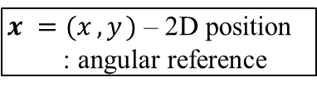


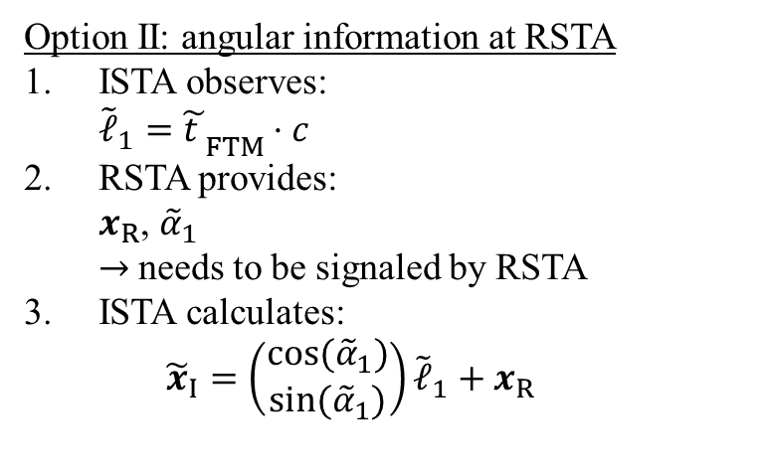
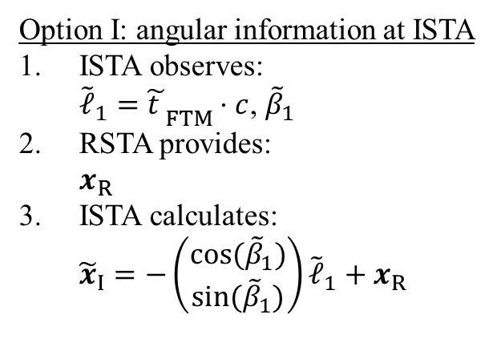
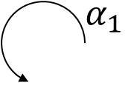
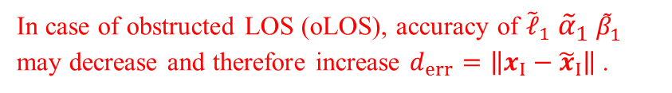


Current method in 11az: oLOS
$x_{ }=(x_{ }, y_{ })$ – 2D position
: angular reference
$α_{1}$
In case of obstructed LOS (oLOS), accuracy of ${\tilde{ℓ}}_{1}$ ${{\tilde{α}}_{1}}_{ }{\tilde{β}}_{1}$ may decrease and therefore increase ${d_{err}=\left\|x_{I}−{\tilde{x}}_{I}\right\|}_{ }$.
$$x_{R}$$
$ℓ_{1}$
$$β_{1}$$
$$x_{I}$$
Option I: angular information at ISTA
ISTA observes:
${\tilde{ℓ}}_{1}={\tilde{t_{ }}}_{FTM}⋅c$, ${\tilde{β}}_{1}$
RSTA provides:
$x_{R}$
ISTA calculates:
${\tilde{x}}_{I}=−\left(\begin{matrix}cos⁡({\tilde{β}}_{1}) \\ sin⁡({\tilde{β}}_{1})\end{matrix}\right){\tilde{ℓ}}_{1}+x_{R}$
Option II: angular information at RSTA
ISTA observes:
${\tilde{ℓ}}_{1}={\tilde{t_{ }}}_{FTM}⋅c$
RSTA provides:
$x_{R}$, ${\tilde{α}}_{1}$
$→$needs to be signaled by RSTA
ISTA calculates:
${\tilde{x}}_{I}=\left(\begin{matrix}cos⁡({\tilde{α}}_{1}) \\ sin⁡({\tilde{α}}_{1})\end{matrix}\right){\tilde{ℓ}}_{1}+x_{R}$

Slide 5


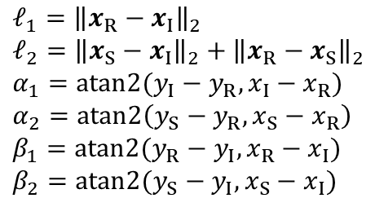


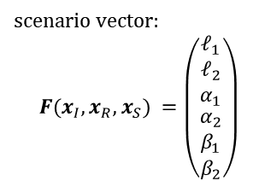
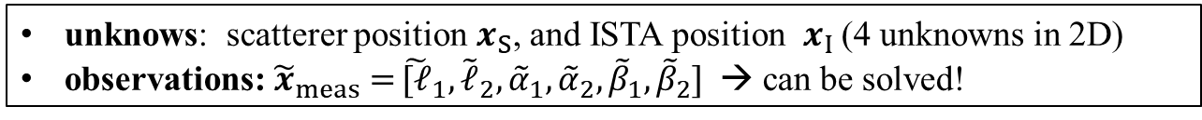

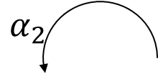
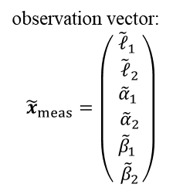
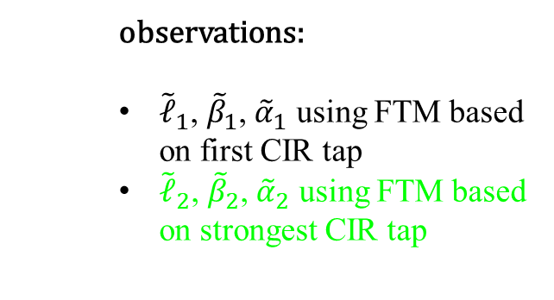
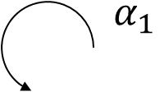



Proposed Extension for oLOS
Exploit both best and first path information
To localize ISTA, solve:
$α_{2}$
$α_{1}$
$${\tilde{x}}_{I}=\underset{x_{I} }{arg min}\left({\left|F\left(x_{I},x_{R},x_{S}\right)−{\tilde{x}}_{meas}\right|}^{2}\right) \left(1\right)$$
$$x_{R}$$
$$x_{S}$$
$ℓ_{2}$
scenario vector:
$${F(x_{I},x_{R},x_{S})}_{ }=\left(\begin{aligned}\begin{matrix}ℓ_{1} \\ \begin{aligned}ℓ_{2} \\ α_{1}\end{aligned}\end{matrix} \\ α_{2} \\ β_{1} \\ β_{2}\end{aligned}\right)$$
observation vector:
$${\tilde{x}}_{meas}=\left(\begin{aligned}{\tilde{ℓ}}_{1} \\ {\tilde{ℓ}}_{2} \\ {{\tilde{α}}_{1}}_{ } \\ {\tilde{α}}_{2} \\ {\tilde{β}}_{1} \\ {\tilde{β}}_{2}\end{aligned}\right)$$
$ℓ_{1}$
$$β_{2}$$
$$β_{1}$$
$$x_{I}$$
where:
$$ℓ_{1}={\left\|x_{R}−x_{I}\right\|}_{2}$$
$$ℓ_{2}={\left\|x_{S}−x_{I}\right\|}_{2}+{\left\|x_{R}−x_{S}\right\|}_{2}$$
$$α_{1}=atan2(y_{I}−y_{R},x_{I}−x_{R})$$
$$α_{2}=atan2\left(y_{S}−y_{R},x_{S}−x_{R}\right)$$
$$β_{1}=atan2(y_{R}−y_{I},x_{R}−x_{I})$$
$$β_{2}=atan2(y_{S}−y_{I},x_{S}−x_{I})$$
  observations:
  ${\tilde{ℓ}}_{1}$, ${\tilde{β}}_{1}$, ${\tilde{α}}_{1}$ using FTM based on first CIR tap
  ${\tilde{ℓ}}_{2}$, ${\tilde{β}}_{2}$, ${\tilde{α}}_{2}$ using FTM based on strongest CIR tap
proposed
extension
unknows: scatterer position $x_{S}$, and ISTA position $x_{I}$ (4 unknowns in 2D)
observations: ${\tilde{x}}_{meas}=$ ${\tilde{[ℓ}}_{1},{\tilde{ℓ}}_{2},{{\tilde{α}}_{1},{\tilde{α}}_{2},{\tilde{β}}_{1},{\tilde{β}}_{2}]}_{ }$ → can be solved!

Slide 6
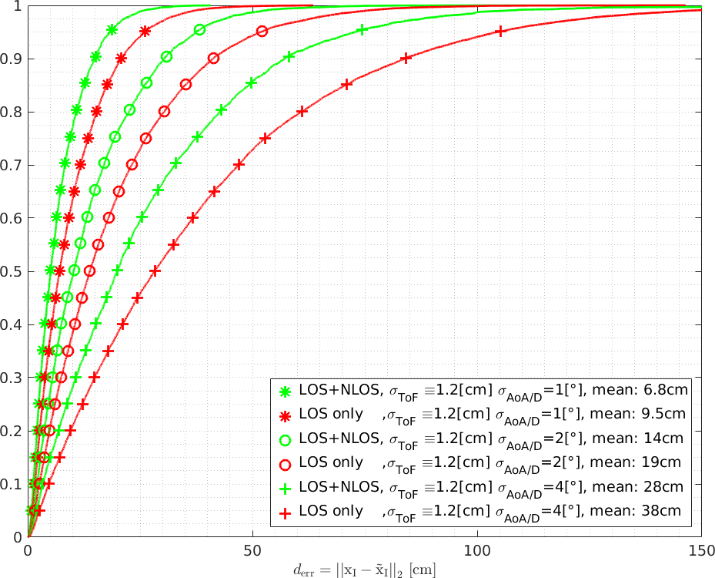
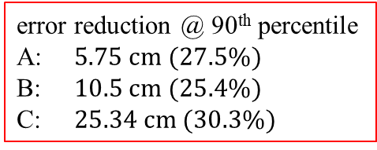

Simulation results
A
B
C
error reduction @ 90th percentile
A: $5.75 cm (27.5\%)$
B: $10.5 cm (25.4\%)$
C: $25.34 cm (30.3\%)$
Parameters:
see appendix
$${ccdf: P(ξ≤d}_{err})$$
A
different ToF/angular deviations
B
C
$${positioning error: ξ=\left\|x_{I}−{\tilde{x}}_{I}\right\|[cm]}_{ }$$
comparision between first path (LOS) only positioning vs. first + strongest path (LOS+NLOS): accuracy improvements $≈20…30\%$

Slide 7

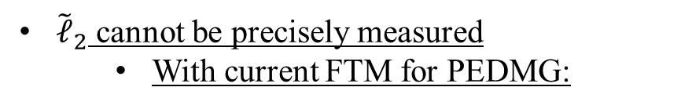
What is missing to allow extension
ISTA requires measurements:
${\tilde{x}}_{meas}=$ ${\tilde{[ℓ}}_{1},{\tilde{ℓ}}_{2},{{\tilde{α}}_{1},{\tilde{α}}_{2},{\tilde{β}}_{1},{\tilde{β}}_{2}]}_{ }$
${\tilde{ℓ}}_{2}$ cannot be precisely measured
  With current FTM for PEDMG:
|h(τ)|
cannot be used so far!
trigger field 1: using regular AWV
noise floor
τ
|h(τ)|
trigger field 2: using first path AWV
noise floor
first path propagation cluster
low SNR
→ToA/angular measurements may be inaccurate
best path propagation cluster
→ high SNR
τ

Slide 8
FTM for PEDMG in D1.0/1.4: Proposal
Enable ToA measurement and exchange based on strongest CIR tap
  allows estimation of TOF of strongest path, which may result from NLOS component in case of oLOS
|h(τ)|
trigger field 1: using regular AWV
→ first CIR tap
noise floor
τ
|h(τ)|
trigger field 1: using regular AWV
→ strongest CIR tap
noise floor
first path propagation cluster
→ low SNR
best path propagation cluster
→ high SNR
τ

Slide 9
Required Changes for FTM Request
In FTM Request to indicate w.r.t. which tap ToA/AoA/AoD is measured
  Option 1: R2I / I2R ToA type definition (CID 1427)
    in Ranging Parameters (9.4.2.279) as part of FTM Request (9.6.7.32)
    redefinition for PEDMG in SC mode (flag, if ToA timestamp shall be performed on the first or strongest arrival tap of the CIR)
    alternatively use reserved bit in Ranging Parameters field format (B22/23/46/47)
    drawbacks: ToA Type as in LMR not to be used for DMG/EDMG, re-definition
  Option 2: new trigger field definition for PEDMG (CID 2349)
    if trigger field 5 → regular AWV and ToA w.r.t. strongest CIR tap
    drawback: would need another trigger field for first path AWV
  Option 3: EDMG-Header-A Definition
    use reserved bit (next slide)
    preferred option

Slide 10

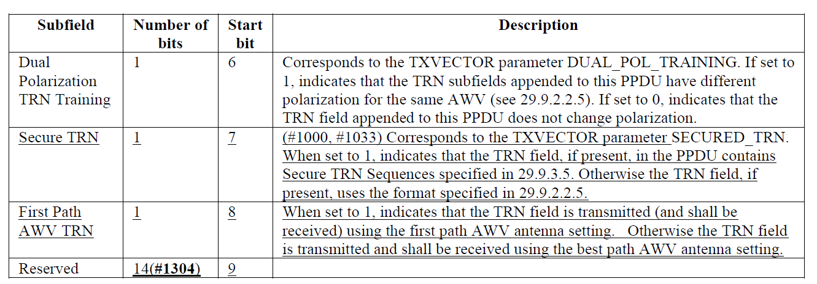


Request: Enabling Strongest Tap FTM for PEDMG – EDMG-Header-A Definition
see 29.3.3.3.2.3: Reserved bit in EDMG-Header-A for SC (EDMG-MCS field definition when Number of SS field is 0) to request first path vs. strongest path measurement: signal, if
  ToA timestamp shall be based on the strongest arrival path of the CIR or
  ToA timestamp shall be based on the first arrival path of the CIR
|h(τ)|
|h(τ)|
EDMG Header-A
flag = 0
EDMG Header-A
flag = 1
$_{0}$
τ
$_{0}$
τ
first path propagation cluster
best path propagation cluster
first path propagation cluster
best path propagation cluster

Slide 11
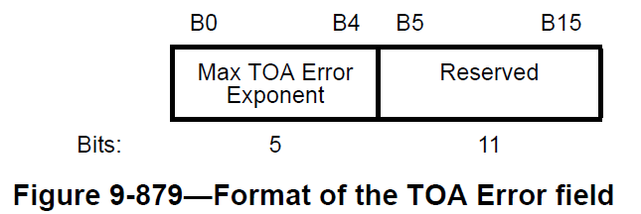
Report: ToA Error Field in FTM Frame
Feedback, which tap of the CIR was used
In FTM Frame / FTM Action field format (9.6.7.33)
  use reserved bit to indicate, if the ToA timestamp was calculated
    on the first tap of the CIR (if set to 0)
    or the strongest tap of the CIR (if set to 1)

Slide 12
References
[1] Draft P802.11az D1.0
[2] "First Path FTM SFD Text", IEEE 802.11-17/1884r1
[3] D. W. Marquardt, “An Algorithm for Least Square Estimation of Non-Linear Parameters,” Jun. 1963
[4] F. Fellhauer et al., "Non-Line-of-Sight Positioning for mmWave Communications," IEEE 19th International SPAWC Workshop, Kalamata, Greece, 2018.
[5] 11-19-1507-02-00az-clause-11-22-6-4-9-cids.docx

Slide 13
APPENDIX

Slide 14
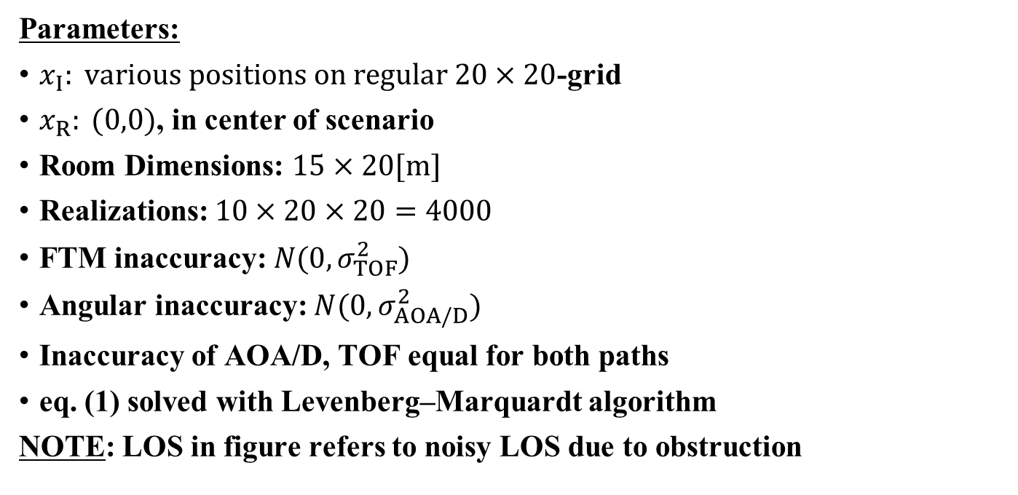
Simulation Parameters
Parameters:
$x_{I}: various positions on regular 20×20$-grid
$x_{R}: (0,0)$, in center of scenario
Room Dimensions: $15×20[m]$
Realizations: $10×20×20=4000$
FTM inaccuracy: $N(0,σ_{TOF}^{2})$
Angular inaccuracy: $N(0,σ_{AOA/D}^{2})$
Inaccuracy of AOA/D, TOF equal for both paths
eq. (1) solved with Levenberg–Marquardt algorithm
NOTE: LOS in figure refers to noisy LOS due to obstruction

