Slide 1
Strongest Tap FTM for PDMG/PEDMG
Date: 2019-10-02
Authors:

Slide 2
Abstract
The presentation covers comments open CIDs
FTM measurement for strongest CIR tap for PDMG/PEDMG
CID #:
1425: DMG capability for strongest path FTM
1427: R2I / I2R ToA Type to distinguish bw. first vs. strongest tap FTM
2349: option to include strongest tap FTM with new trigger field 5
This presentations shows the motivation behind these comments and proposes corresponding resolutions

Slide 3
Motivation
ToA and optionally AOA/AOD measurements of strongest arrival path (tap) of the CIR may be required for
precise clock offset estimation in obstructed LOS (oLOS) scenarios, e.g., for sync of wireless speakers
synchronization of multiple wireless speakers in oLOS scenario
strongest tap FTM provides higher SNR → more precise synchronization
enhanced positioning in oLOS scenario
in addition to First Path measurements perform FTM based on strongest arrival path
unknown reflector position, but additional AOA/AOD/ToA measurements
solve overdetermined system of equations (see appendix) → ~ 25% accuracy improvement
simple LOS/NLOS discrimination
reflector / scatterer
regular AWV
RSTA
first path AWV
obstacle
ISTA

Slide 4
FTM for PDMG/PEDMG in D1.0/1.4
FTM procedure with trigger field = 1
initiating FTM exchange
performing FTM with regular AWV acc. to 19/11-19-0666-01-00az-d3-0-bug-fixes.docx
In [2], it was motivated to select first path usage for FTM for oLOS cases to obtain correct location
introduced trigger field = 2 in the FTM Request Action field for first path AWV setting
reflector / scatterer
regular AWV
RSTA
first path AWV
obstacle
ISTA

Slide 5
FTM for PDMG/PEDMG in D1.0: Drawbacks
Trigger field = 2 in oLOS scenario:
due to weaker signal contributions on first arrival path, ToA/angular measurements may be inaccurate
Trigger field = 1 in oLOS scenario:
ToA measurement based on best CIR tap not possible
|h(τ)|
cannot be used so far!
trigger field 1: using regular AWV
noise floor
τ
|h(τ)|
trigger field 2: using first path AWV
noise floor
first path propagation cluster
→ low SNR
best path propagation cluster
→ high SNR
τ

Slide 6
FTM for PDMG/PEDMG in D1.0: Proposal
Enable ToA measurement and exchange based on strongest CIR tap
allows estimation of TOF of strongest path, which may result from NLOS component in case of oLOS
|h(τ)|
trigger field 1: using regular AWV → first CIR tap
noise floor
τ
|h(τ)|
new: can be used
trigger field 1: using regular AWV
→ strongest CIR tap
noise floor
first path propagation cluster
→ low SNR
best path propagation cluster
→ high SNR
τ

Slide 7
Strongest Tap FTM: Required Changes
In FTM Request:
indicate w.r.t. which tap ToA/AoA/AoD is measured
Option 1: ToA type definition
Option 2: new trigger field definition
Option 3: PPDU header flag
In FTM Report
feedback, which tap was used
ToA Error in LMR: not possible for PDMG / EPDMG STAs
→ ToA Error in FTM Frame / FTM Action Field format (9.6.7.33)

Slide 8
Option 1: Enabling Strongest Tap FTM for PDMG/PEDMG – ToA Definition
R2I / I2R ToA Type from Ranging Parameters (9.4.2.279) as part of FTM Request (9.6.7.32): CID 1427
original definition: distinguish bw. time or frequency domain ToA estimation
makes sense for OFDM mode
proposal: redefinition for PDMG/PEDMG in SC mode:
ToA Type subfield indicates, if the ToA timestamp shall be performed
on the first arrival tap of the CIR (if set to 0)
or the strongest tap of the CIR (if set to 1)
alternatively use reserved bit in Ranging Parameters field format (B22/23/46/47)
|h(τ)|
|h(τ)|
ToA Type = 0
ToA Type = 1
$_{0}$
τ
$_{0}$
τ
first path propagation cluster
best path propagation cluster
first path propagation cluster
best path propagation cluster

Slide 9
Option 2: Enabling Strongest Tap FTM for PDMG/PEDMG – New Trigger Field
Introduce new trigger field = 5 option for PDMG/PEDMG
using regular (best path) AWV
support AOA/AOD measurements
ToA timestamp shall be based on the strongest arrival path of the CIR
relates to comment 2349
|h(τ)|
|h(τ)|
Trigger field = 1
Trigger field = 5
$_{0}$
τ
$_{0}$
τ
first path propagation cluster
best path propagation cluster
first path propagation cluster
best path propagation cluster

Slide 10
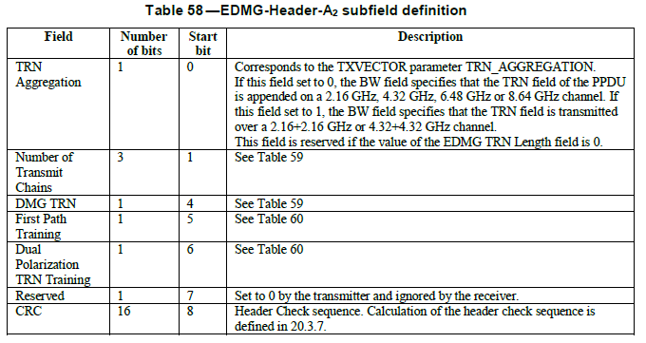
Option 3: Enabling Strongest Tap FTM for PDMG/PEDMG – PPDU Header Definition
Use reserved bit in PPDU Header to request first path vs. strongest path measurement: signal, if
ToA timestamp shall be based on the strongest arrival path of the CIR or
ToA timestamp shall be based on the first arrival path of the CIR
|h(τ)|
|h(τ)|
PPDU Header bit = 0
PPDU Header bit = 1
$_{0}$
τ
$_{0}$
τ
first path propagation cluster
best path propagation cluster
first path propagation cluster
best path propagation cluster

Slide 11
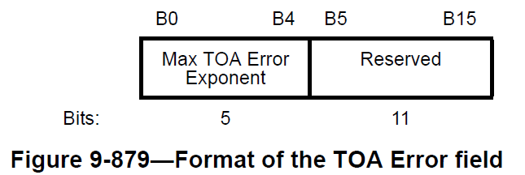
ToA Error Field in FTM Frame
Report after FTM measurement, how ToA was measured
In FTM Frame / FTM action field format (9.6.7.33)
use reserved bit to indicate, if the ToA timestamp was calculated
on the first tap of the CIR (if set to 0)
or the strongest tap of the CIR (if set to 1)

Slide 12
References
[1] Draft P802.11az D1.0
[2] "First Path FTM SFD Text", IEEE 802.11-17/1884r1
[3] D. W. Marquardt, “An Algorithm for Least Square Estimation of Non-Linear Parameters,” Jun. 1963
[4] F. Fellhauer et al., "Non-Line-of-Sight Positioning for mmWave Communications," IEEE 19th International SPAWC Workshop, Kalamata, Greece, 2018.
[5] 11-19-1507-02-00az-clause-11-22-6-4-9-cids.docx

Slide 13
APPENDIX

Slide 14
oLOS Scenario
Using preferably first path AWV and FTM measurement w.r.t. first arrival path of channel impulse response in case of obstructed LOS (oLOS)
Problem:
Unreliable ToA, AOA, AOD measurements
Solution:
Additionally measure ToA, AOA, AOD based on strongest arrival path of channel impulse response using regular (best) AWV
solve overdetermined system of equation (next pages)

Slide 15
Current method in 11az: oLOS
$x_{ }=(x_{ }, y_{ })$ – 2D position
: angular reference
$α_{1}$
In case of obstructed LOS (oLOS), accuracy of ${\tilde{ℓ}}_{1}$ ${{\tilde{α}}_{1}}_{ }{\tilde{β}}_{1}$ may decrease and therefore increase ${d_{err}=\left\|x_{I}−{\tilde{x}}_{I}\right\|}_{ }$.
$$x_{R}$$
$ℓ_{1}$
$$β_{1}$$
$$x_{I}$$
Option I:
ISTA observes: ${\tilde{ℓ}}_{1}={\tilde{t_{ }}}_{FTM}⋅c$, ${\tilde{β}}_{1}$
RSTA provides: $x_{R}$
ISTA calculates: ${\tilde{x}}_{I}=\left(\begin{matrix}cos⁡({\tilde{β}}_{1}) \\ sin⁡({\tilde{β}}_{1})\end{matrix}\right){\tilde{ℓ}}_{1}+x_{R}$
Option II:
ISTA observes: ${\tilde{ℓ}}_{1}={\tilde{t_{ }}}_{FTM}⋅c$
RSTA provides: $x_{R}$, ${\tilde{α}}_{1}$ $→$needs to be signaled by RSTA
ISTA calculates: ${\tilde{x}}_{I}=\left(\begin{matrix}cos⁡({\tilde{α}}_{1}) \\ sin⁡({\tilde{α}}_{1})\end{matrix}\right){\tilde{ℓ}}_{1}+x_{R}$

Slide 16
FTM with best path beamforming
$α_{2}$
$α_{1}$
$$x_{R}$$
In case of obstructed LOS (oLOS), accuracy of ${\tilde{ℓ}}_{1}$ ${{\tilde{α}}_{1}}_{ }{\tilde{β}}_{1}$ may decrease and therefore increase ${d_{err}=\left\|x_{I}−{\tilde{x}}_{I}\right\|}_{ }$.
$→$Use of reflected path can improve accuracy
$$x_{S}$$
$ℓ_{2}$
$ℓ_{1}$
To localize ISTA, (1) needs to be solved: ${\tilde{x}}_{I}=\underset{x_{I} }{arg min}\left({\left|F\left(x_{I},x_{R},x_{S}\right)−{\tilde{x}}_{meas}\right|}^{2}\right) (1)$
(i.e. by using iterative solving algorithms [3], [4])
Assume ISTA performs calculations:
current draft allows ISTA to acquire
$x_{R}$ provided by RSTA (LCI)
${\tilde{ℓ}}_{1}$ using FTM and first path beamforming training
${\tilde{β}}_{1}$, ${\tilde{α}}_{1}$ using AOA/AOD measurement
extension required to acquire
${\tilde{ℓ}}_{2}$ using FTM and best path beamforming training
${\tilde{β}}_{2}$, ${\tilde{α}}_{2}$ using AOA/AOD measurement
$$β_{2}$$
$$β_{1}$$
$$x_{I}$$
$$ℓ_{1}={\left\|x_{R}−x_{I}\right\|}_{2}$$
$$ℓ_{2}={\left\|x_{S}−x_{I}\right\|}_{2}+{\left\|x_{R}−x_{S}\right\|}_{2}$$
$$α_{1}=atan2(y_{I}−y_{R},x_{I}−x_{R})$$
$$α_{2}=atan2\left(y_{S}−y_{R},x_{S}−x_{R}\right)$$
$$β_{1}=atan2(y_{R}−y_{I},x_{R}−x_{I})$$
$$β_{2}=atan2(y_{S}−y_{I},x_{S}−x_{I})$$
scenario vector:
$${F(x_{I},x_{R},x_{S})}_{ }=\left(\begin{aligned}\begin{matrix}ℓ_{1} \\ \begin{aligned}ℓ_{2} \\ α_{1}\end{aligned}\end{matrix} \\ α_{2} \\ β_{1} \\ β_{2}\end{aligned}\right)$$
observation vector:
$${\tilde{x}}_{meas}=\left(\begin{aligned}{\tilde{ℓ}}_{1} \\ {\tilde{ℓ}}_{2} \\ {{\tilde{α}}_{1}}_{ } \\ {\tilde{α}}_{2} \\ {\tilde{β}}_{1} \\ {\tilde{β}}_{2}\end{aligned}\right)$$

Slide 17
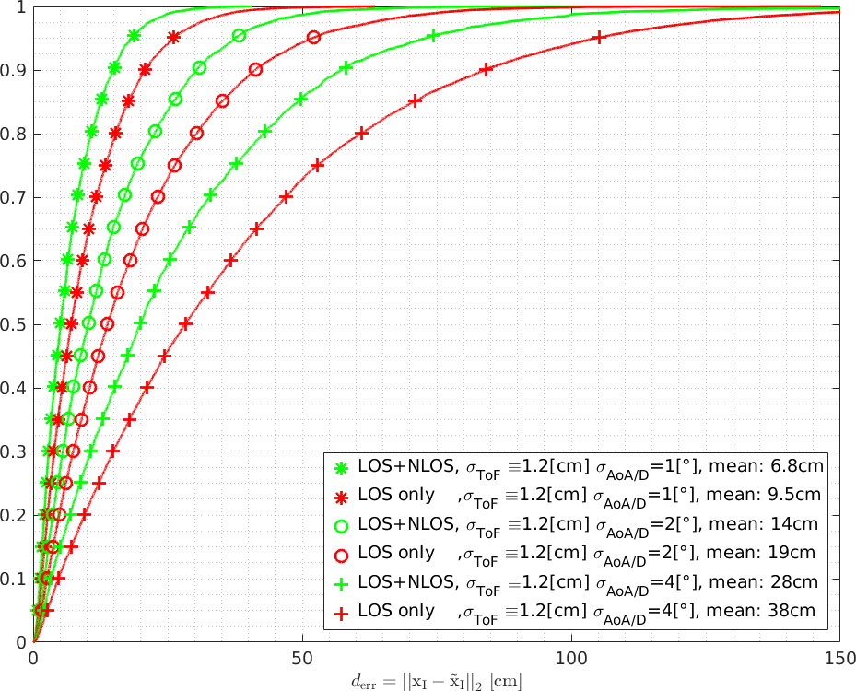
Simulation results
$α_{2}$
accuracy improvements $≈20…30\%$, when NLOS FTM is included in positioning process
$α_{1}$
$$x_{R}$$
$$x_{S}$$
$ℓ_{2}$
$ℓ_{1}$
A
B
C
$$β_{2}$$
$$β_{1}$$
$$x_{I}$$
$${P(ξ≤d}_{err})$$
error reduction @ 90th percentile
A: $5.75 cm (27.5\%)$
B: $10.5 cm (25.4\%)$
C: $25.34 cm (30.3\%)$
Parameters:
$x_{I}: various positions on regular 20×20$-grid
$x_{R}: (0,0)$, in center of scenario
Room Dimensions: $15×20[m]$
Realizations: $10×20×20=4000$
FTM inaccuracy: $N(0,σ_{TOF}^{2})$
Angular inaccuracy: $N(0,σ_{AOA/D}^{2})$
Inaccuracy of AOA/D, TOF equal for both paths
eq. (1) solved with Levenberg–Marquardt algorithm
NOTE: LOS in figure refers to noisy LOS due to obstruction
A
B
C
$${ξ=\left\|x_{I}−{\tilde{x}}_{I}\right\|[cm]}_{ }$$

Slide 18
Strongest Tap FTM for PDMG/PEDMG
reflector / scatterer
regular AWV
RSTA
There are cases, where ToA and AOA/AOD measurements of reflected path using strongest CIR tap are of interest
for devices not capable of first path BF
unambiguous LOS vs. NLOS TOF
simple LOS/NLOS discrimination
TOF measurements of reflected paths (precise clock offset estimation)
TOF and AOA/AOD measurements for enhanced oLOS positioning (see appendix)
using measurements based on both regular and best path FTM exchange
first path AWV
obstacle
ISTA
→ need to allow for ToA based on strongest arrival path of CIR

