Slide 1
EN 301 893 Spectrum Mask Interpretations
Date: 2019-09-17
Authors:
Name | Affiliations | Address | Phone | email
David Boldy | Broadcom |  |  | david.boldy@broadcom.com

Slide 2
Abstract
TC BRAN received a Liaison Statement from 3GPP RAN4 (document BRAN(19)102009r1) questioning interpretations of the spectrum mask in EN 301 893 for NR-U.

Slide 3
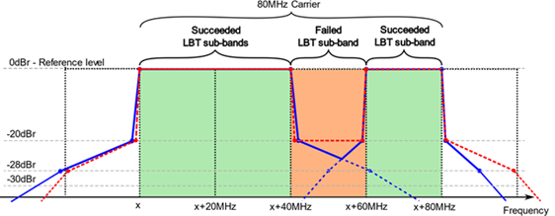
Questions
Q1:RAN4 would kindly request ETSI TC BRAN understanding whether preamble punctured mask for a wide band carrier larger than 20MHz having a relaxed mask requirement with a constant reference level of -20dBr in the punctured region(s) is compliant to ETSI mask?
Q2: RAN4 respectfully asks ETSI TC BRAN to confirm this understanding and explain the reasoning of the ETSI transmit spectral mask widening with increased bandwidth configurations, particularly at the -20dBr limit.

Slide 4
GoTo Meeting Contributions – Proposed response to LS
BRAN-Spectrum Mask: proposed answers to questions on the ETSI spectrum mask asked by 3GPP RAN4 Ericsson proposed response to LS | BRAN(19)000025r1
Interpretations of EN 301 893 for NR-U Nokia proposed response to LS | BRAN(19)000026
History of the Spectrum Mask in EN 301 893 BRAN Chair/EN 301893 rapporteur explaining the history of the spectrum mask and why the current requirements need updating to address this question. Proposed response in BRAN(19)000033. | BRAN(19)000028
Interpretation of EN 301 893 Mask - NR-U Intel proposed response to LS | BRAN(19)000032
DRAFT TC BRAN Response to 3GPP on the Spectrum Mask in EN 301 893 BRAN Chair/EN 3019 893 rapporteur draft proposed LS | BRAN(19)000033

Slide 5
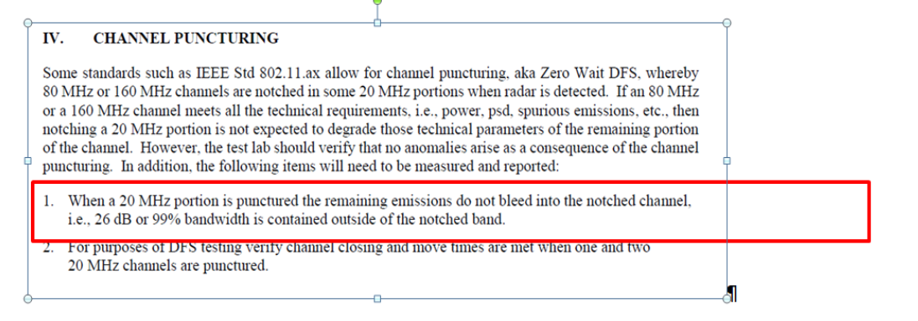
GoTo Meeting Contributions – Proposal to update standard
Channel puncturing EN 301 893 Proposal Broadcom proposal to address both issues based upon the 99% OBW test requirement already defined in the ETSI standard which also aligns with the FCC requirements that protect DFS channels. | BRAN(19)000029

Slide 6
GoTo Meeting Outcome
No agreement on proposed LS to RAN4.
No agreement how to address this in the standard.
The following was agreed:
“Rather than providing a formal feedback to 3GPP RAN4 as proposed in document BRAN(19)000033, the meeting agreed that more discussions are needed in TC BRAN and no formal feedback should be given at this moment. It was agreed that the chairman will only write an email (not LS) saying that TC BRAN will continue discussion and communicate their outcome to 3GPP when available”.
Note: Minutes from the GotoMeeting are included in BRAN(19)000035

Slide 7
Next Steps – 99% OBW
Generally good feedback and support on the Broadcom proposal
One negative comment:
Adoption of 99% criterion may still lead to interference.
Additional validations in progress to further support the 99% OBW proposal.
99% OBW is sufficient to protect radar in punctured channels in DFS bands for FCC.
Equivalent to -20dBr in IEEE standard.
Straw polls??
LS to BRAN??
Further discussion at BRAN103, 7-10 Oct, 2019

