Slide 1
Overview of proposed LC-optimized PHY
Authors:
Date: 2019-09-17

Slide 2

Abstract
This contribution presents a summary of new features of the proposed LC-optimized PHY for TGbb.
Introduction
Adaptive bitloading
Distributed MIMO
Higher bandwidth
Easy implementation
Integration of 11ax with LC-optimized PHY

Slide 3
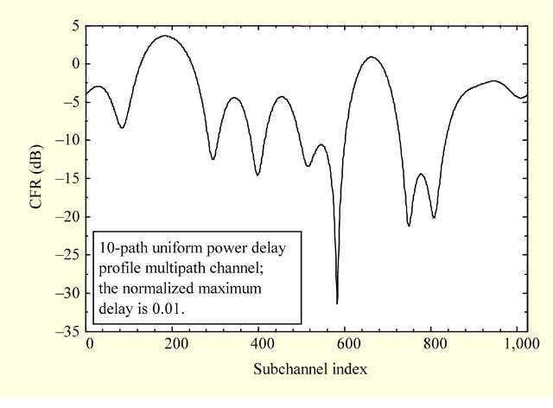
1. Introduction: How 802.11 RF PHYs work
Bit-interleaved coded modulation (BICM) is the concept behind all existing 802.11 PHYs.
In RF channels, BICM works well.
BICM creates redundancy. Then it permutes bits randomly over all the subcarriers.
In a rare fading event, lost bits can be repaired by the soft-decision FEC.
RF

Slide 4
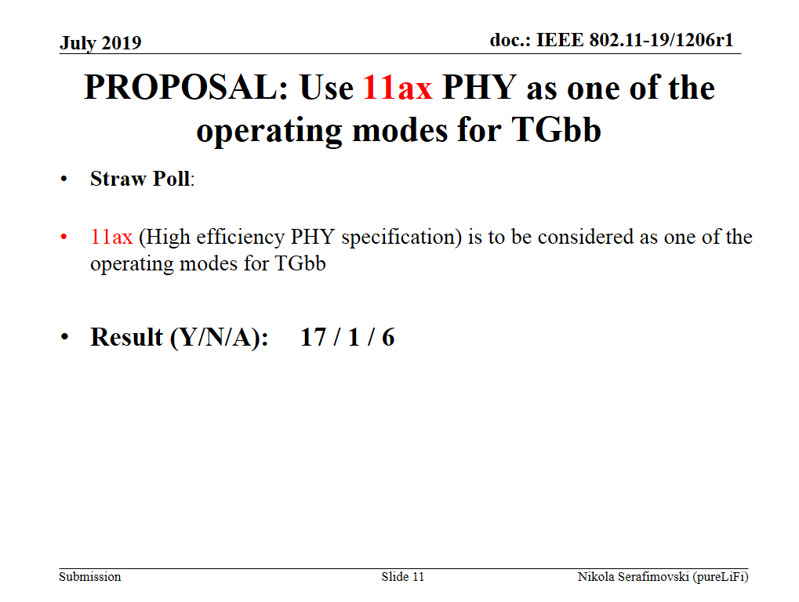

Slide 5
Limitations of 11ax for LC
Limitations of 11ax for LC
  Adaptive bitloading is not supported
  Bandwidth is limited to 160 MHz
  MIMO is limited to 8x8
  New interface to LC frontend is needed
LC should not be limited by 802.11 PHY developed for RF
Light is a new wireless medium
  Short-range, more directive, bidirectional, networked, less interfered
LC needs a dedicated PHY to overcome the limitations of 11ax.

Slide 6
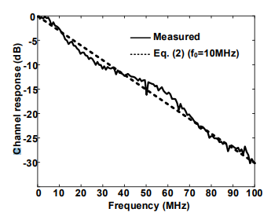
2. Why adaptive bitloading?
LC channel may be 1st order low-pass, due to
  NLOS propagation [1]
  Low-power LED driver characteristics [13]
Assume 100 MHz baseband and 20 MHz cut-off due to LED driver or channel
80% of the bits fall in a fade.
BICM operation will basically fail.
→ Replace BICM by adaptive bitloading.
LC
doc. 19-1208r0

Slide 7
Results
See simulation results for adaptive bitloading in 11-19/1566r2.
11-19-1566-02-00bb-simulation-results-with-bit-loading-for-the-lc-optimized-phy.pptx

Slide 8
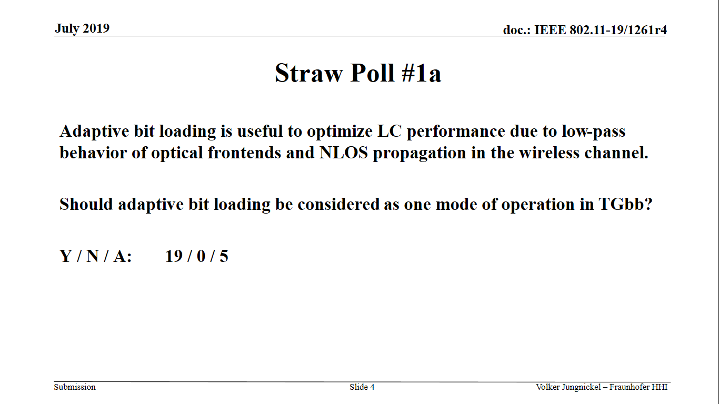

Slide 9
3. Why distributed MIMO?
LC is envisioned as a dense network
One LC frontend covers few meters spot area
Classical handover concepts are obsolete, taking realistic mobility into account
Centralized AP, distributed LC frontends serve LC Non-AP STAs
Large distributed multiuser MIMO
STAs communicate with a subset of frontends
LC and RF APs could be co-located
RF to provide coverage, LC to add capacity
LC AP
Fronthaul
LC frontend
LC Non-AP STA

Slide 10
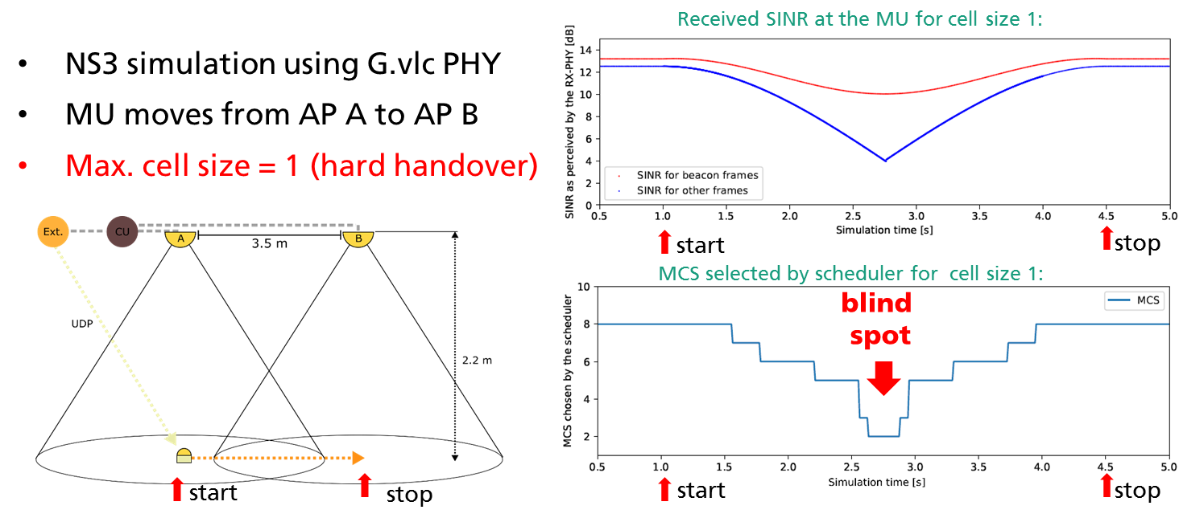
[2]
[2] Kai Lennert Bober, „Performance Evaluation of a Coordinated Visible Light Communication Network“, Master Thesis, TU Berlin, Germany, 2018

Slide 11
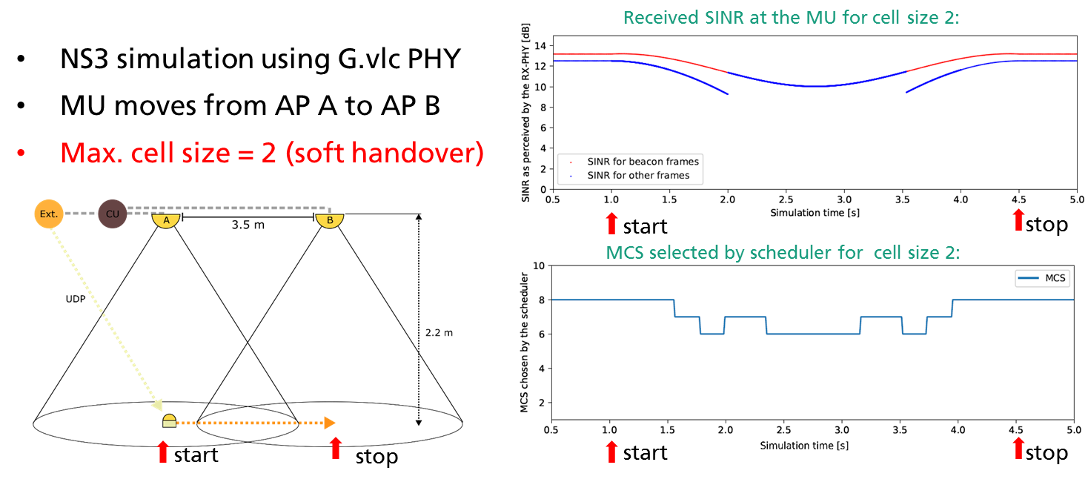
With distributed MIMO, blind spots for communication almost disappear!
Distributed MIMO enables consistent system-level performance for LC, similar to what is intuitively expected from the illumination level.

Slide 12
How LC-optimized PHY supports distributed MIMO?
LC-optimized PHY adds frequency-multiplexed pilot symbols in optional fields, see doc. 11-19-1053-02-00bb-lc-optimized-phy-proposal-for-tgbb.pptx
SISO
optional MIMO
SISO = single-input single-output
MIMO = multiple-input multiple-output
SHR = Synchronization header
CE = Channel estimation
PHR = Physical layer header
HCS = Header check sequence
PSDU = PLCP Service Data Unit
PLCP = Physical layer convergence protocol
Preamble
CE
symbols
PHY header
HCS
MIMO CE symbols
PSDU
SHR
PHR
PHY payload

Slide 13
Frequency-time multiplexed MIMO RS
MIMO RS use a comb of equally-spaced subcarriers.
A cyclic shift in the frequency domain identifies each LED. One comb is reserved for noise estimation.
The channel is interpolated between non-zero subcarriers, see [11] in doc. 11-19/1053r2.
Classical frequency reuse schemes can be applied for pilot assignments to LEDs.

Slide 14
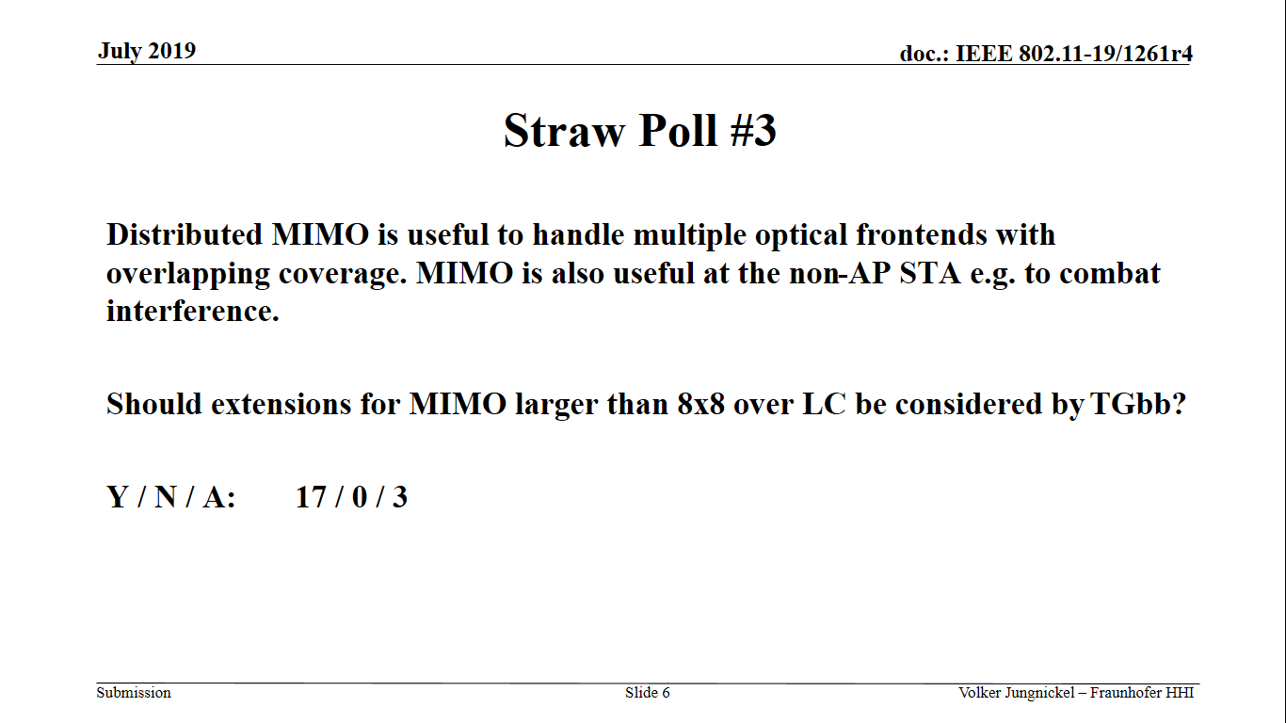

Slide 15
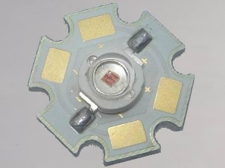
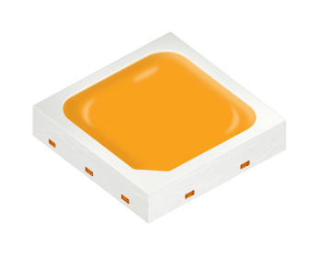
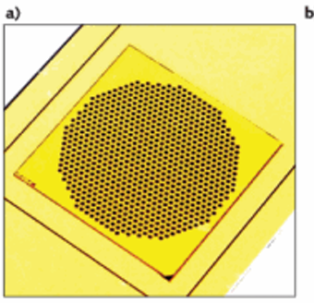
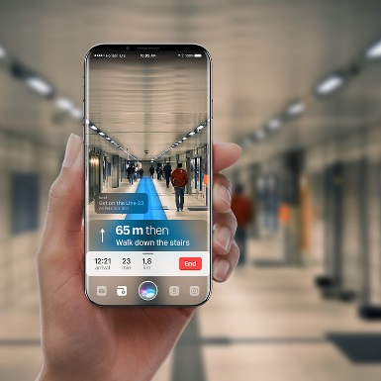
4. Why higher bandwidth?
SoA LC uses high-power LEDs
1-10 MHz bandwidth, due to large area
LED bandwidth can be improved by
  Using infrared as opposed to white LEDs
  Sophisticated LED driver designs: High bandwidth needs more energy
Vertical cavity lasers (VCSELs) are widely used in cell phones.
VCSELs have higher bandwidth due to stimulated emission: 1 GHz and more
VCSEL arrays offer it altogether: High power, high bandwidth and low power
doc. 11-19/0916r1

Slide 16
How LC-optimized PHY enables higher bandwidth?
LC-optimized PHY is based on the home networking standard G.hn.
G.hn uses one silicon for multiple media: Powerline, phoneline, coax and plastic optical fiber (POF).
For the new LC standard G.9991 the coax profile in G.9960 has been selected..
The coax profile makes scaling to higher bandwidth straight forward, through the use of carrier aggregation. The concept is under discussion in G.hn2 project.
200 MHz
200 MHz
200 MHz
200 MHz
200 MHz
frequency

Slide 17
5. Why implementation is so easy?
LC modulation starts at DC up to some maximum frequency.
LC needs a real-valued baseband signal.
Fixed (incl. home) networking media are very similar.
Baseband chips can be easily reused for LC.
data
Reusing baseband signals from RF is much more difficult, see e.g. 802.11ax.
RF has complex-valued baseband up-converted in the same chip to an RF carrier.
New external interface is needed for reusing RF baseband signals for LC.
LED/VCSEL
LC-optimized baseband chip
AFE
chip
LC frontend
PD

Slide 18
Easy implementation
Feasibility is proven by several products from at least 3 independent vendors in current market using the LC-optimized PHY.
For example, see
  doc. 11-19-1208-00-00bb
  https://www.youtube.com/watch?v=066jgai1Fbc

Slide 19
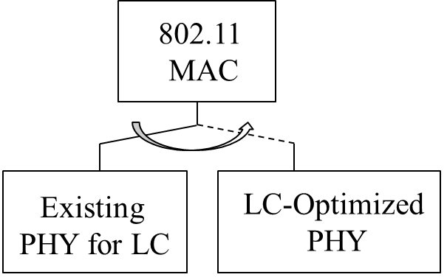
6. Integration with 11ax
Switching between PHY modes is common practice in 802.11 MAC
It needs a simple common-mode PHY, should support low complexity&energy
This way we can do all the signaling to switch to any more complex PHY

Slide 20
Ressources and references
References and resources for LC-optimized PHY are outlined in doc.11-19-1359-01-00bb-lc-optimized-phy-resources.pptx

