Slide 1
Spectral Flatness Test of the TGbb’s Reference Channel Models with HE Waveform
Date: 2019-09-17
Authors:

Slide 2
Abstract
This presentation aims to discuss the spectral flatness measurement of the TGbb’s reference channel models (IEEE 802.11-18/1582r4).

Slide 3
Background (1)
LC-optimized PHY has been proposed in IEEE 802.11-19/1053r2.
The main argument of the LC-optimized PHY is that due to the 1st order low-pass characteristics of LC channel, BICM might be suboptimal, and adaptive bit loading might be more advantageous.
The question is:
“How often will the adaptive bit loading significantly benefit the LC?”

Slide 4
Background (2)
“How often will the adaptive bit loading significantly benefit the LC?”
To answer the above question in a definitive way, it requires thorough and comprehensive comparisons.
Our first approach is to observe the flatness of the LC channel within a limited electrical channel bandwidth.
As far as the flatness test’s concern, we can have the following intuitions:
If the channel is flat, then the adaptive bit loading might not significantly benefit LC, and
if the channel is NOT flat, then the adaptive bit loading might significantly benefit LC

Slide 5
Clarification
This presentation aims to discuss the flatness in terms of the deviation of received powers at each subcarrier compared to other subcarriers.
Flatness test:
flat: if all powers are within deviation limits
not-flat: if any power exceeds deviation limits

Slide 6
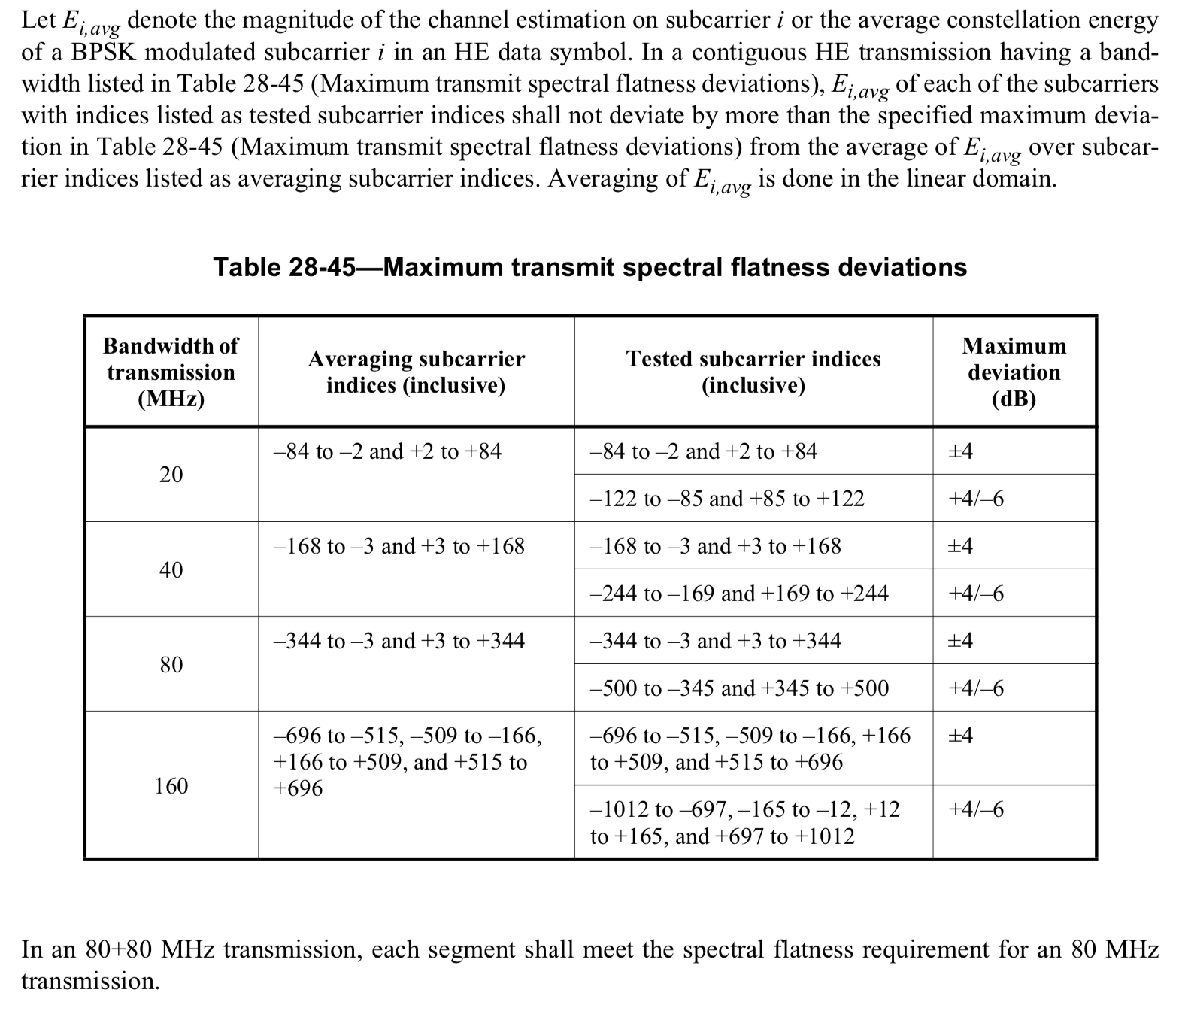
Spectral Flatness Measurement in 802.11ax (D3.0)
Magnitude of the channel estimation at each subcarrier
Deviation limit at each subcarrier

Slide 7
System Model
HE waveform
(IEEE P802.11ax™/D3)
TGbb Tx FE
(IEEE 802.11-18/1574r5)
CIR
(IEEE 802.11-18/1582r4)
TGbb Rx FE
(IEEE 802.11-18/1574r5)
Flatness test
(Table 24-45 in IEEE P802.11ax™/D3)
AWGN
(IEEE 802.11-18/1423r8),
NF = -174 dBm/Hz
Is flat?
HE
demodulate
Channel estimation

Slide 8
This is the structure of the folders in the dataset (IEEE 802.11-18/1582r4)
./simulation\ scenario\ empty\ room
└── overall\ cirs
├── effective\ cirs
└── optical\ cirs
./simulation\ scenario\ enterprise-conference\ room
├── individual\ cirs
│ ├── effective\ cirs
│ └── optical\ cirs
└── overall\ cirs
├── effective\ cirs
└── optical\ cirs
./simulation\ scenario\ enterprise-office\ with\ secondary\ light
├── Optical\ CIRs
│ ├── Ceiling\ Light\ (S)\ to\ Desk\ Light\ (R)\ Receiver
│ ├── Ceiling\ Light\ (S)\ to\ Destination\ (D)
│ └── Desk\ Light\ (R)\ Transmitter\ to\ Destination\ (D)
└── effective\ cirs
├── Ceiling\ Light\ (S)\ to\ Desk\ Light\ (R)\ Receiver
├── Ceiling\ Light\ (S)\ to\ Destination\ (D)
└── Desk\ Light\ (R)\ Transmitter\ to\ Destination\ (D)
./simulation\ scenario\ hospital\ ward
├── individual\ cirs
│ ├── effective\ cirs
│ └── optical\ cirs
└── overall\ cirs
├── effective\ cirs
└── optical\ cirs
./simulation\ scenario\ industrial\ wireless
├── individual\ cirs
│ ├── effective\ cirs
│ └── optical\ cirs
└── overall\ cirs
├── Optical\ CIRs
└── effective\ cirs
./simulation\ scenario\ residential
├── individual\ cirs
│ ├── effective\ cirs
│ └── optical\ cirs
└── overall\ cirs
├── effective\ cirs
└── optical\ cirs

Slide 9
Results (1)
BW = 20 MHz
fc: center freq.
Scenario | Flat percentage with fc=10.5 MHz | Flat percentage with fc=20 MHz
enterprise-conference | 70 of 100 = 70% | 62 of 100 = 62%
hospital | 233 of 256 = 91% | 191 of 256 = 74.6%
industrial | 36 of 48 = 75% | 14 of 48 = 29%
residential | 50 of 72 = 69.4% | 36 of 72 = 50%

Slide 10
Results (2)
BW = 40 MHz
fc: center freq.
Scenario | Flat percentage with fc=20.5 MHz
enterprise-conference | 65 of 100 = 65%
hospital | 195 of 256 = 76.17%
industrial | 30 of 48 = 62.5%
residential | 33 of 72 = 45.83%

Slide 11
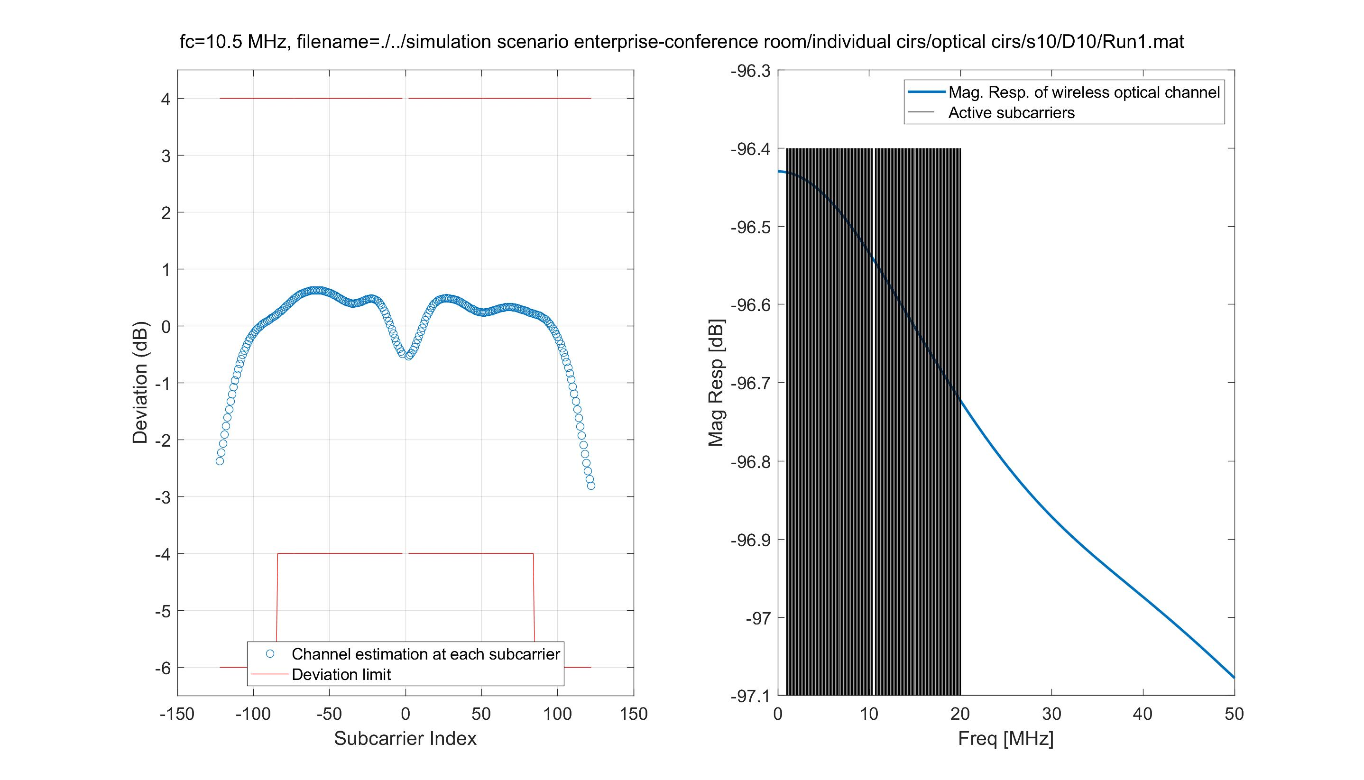
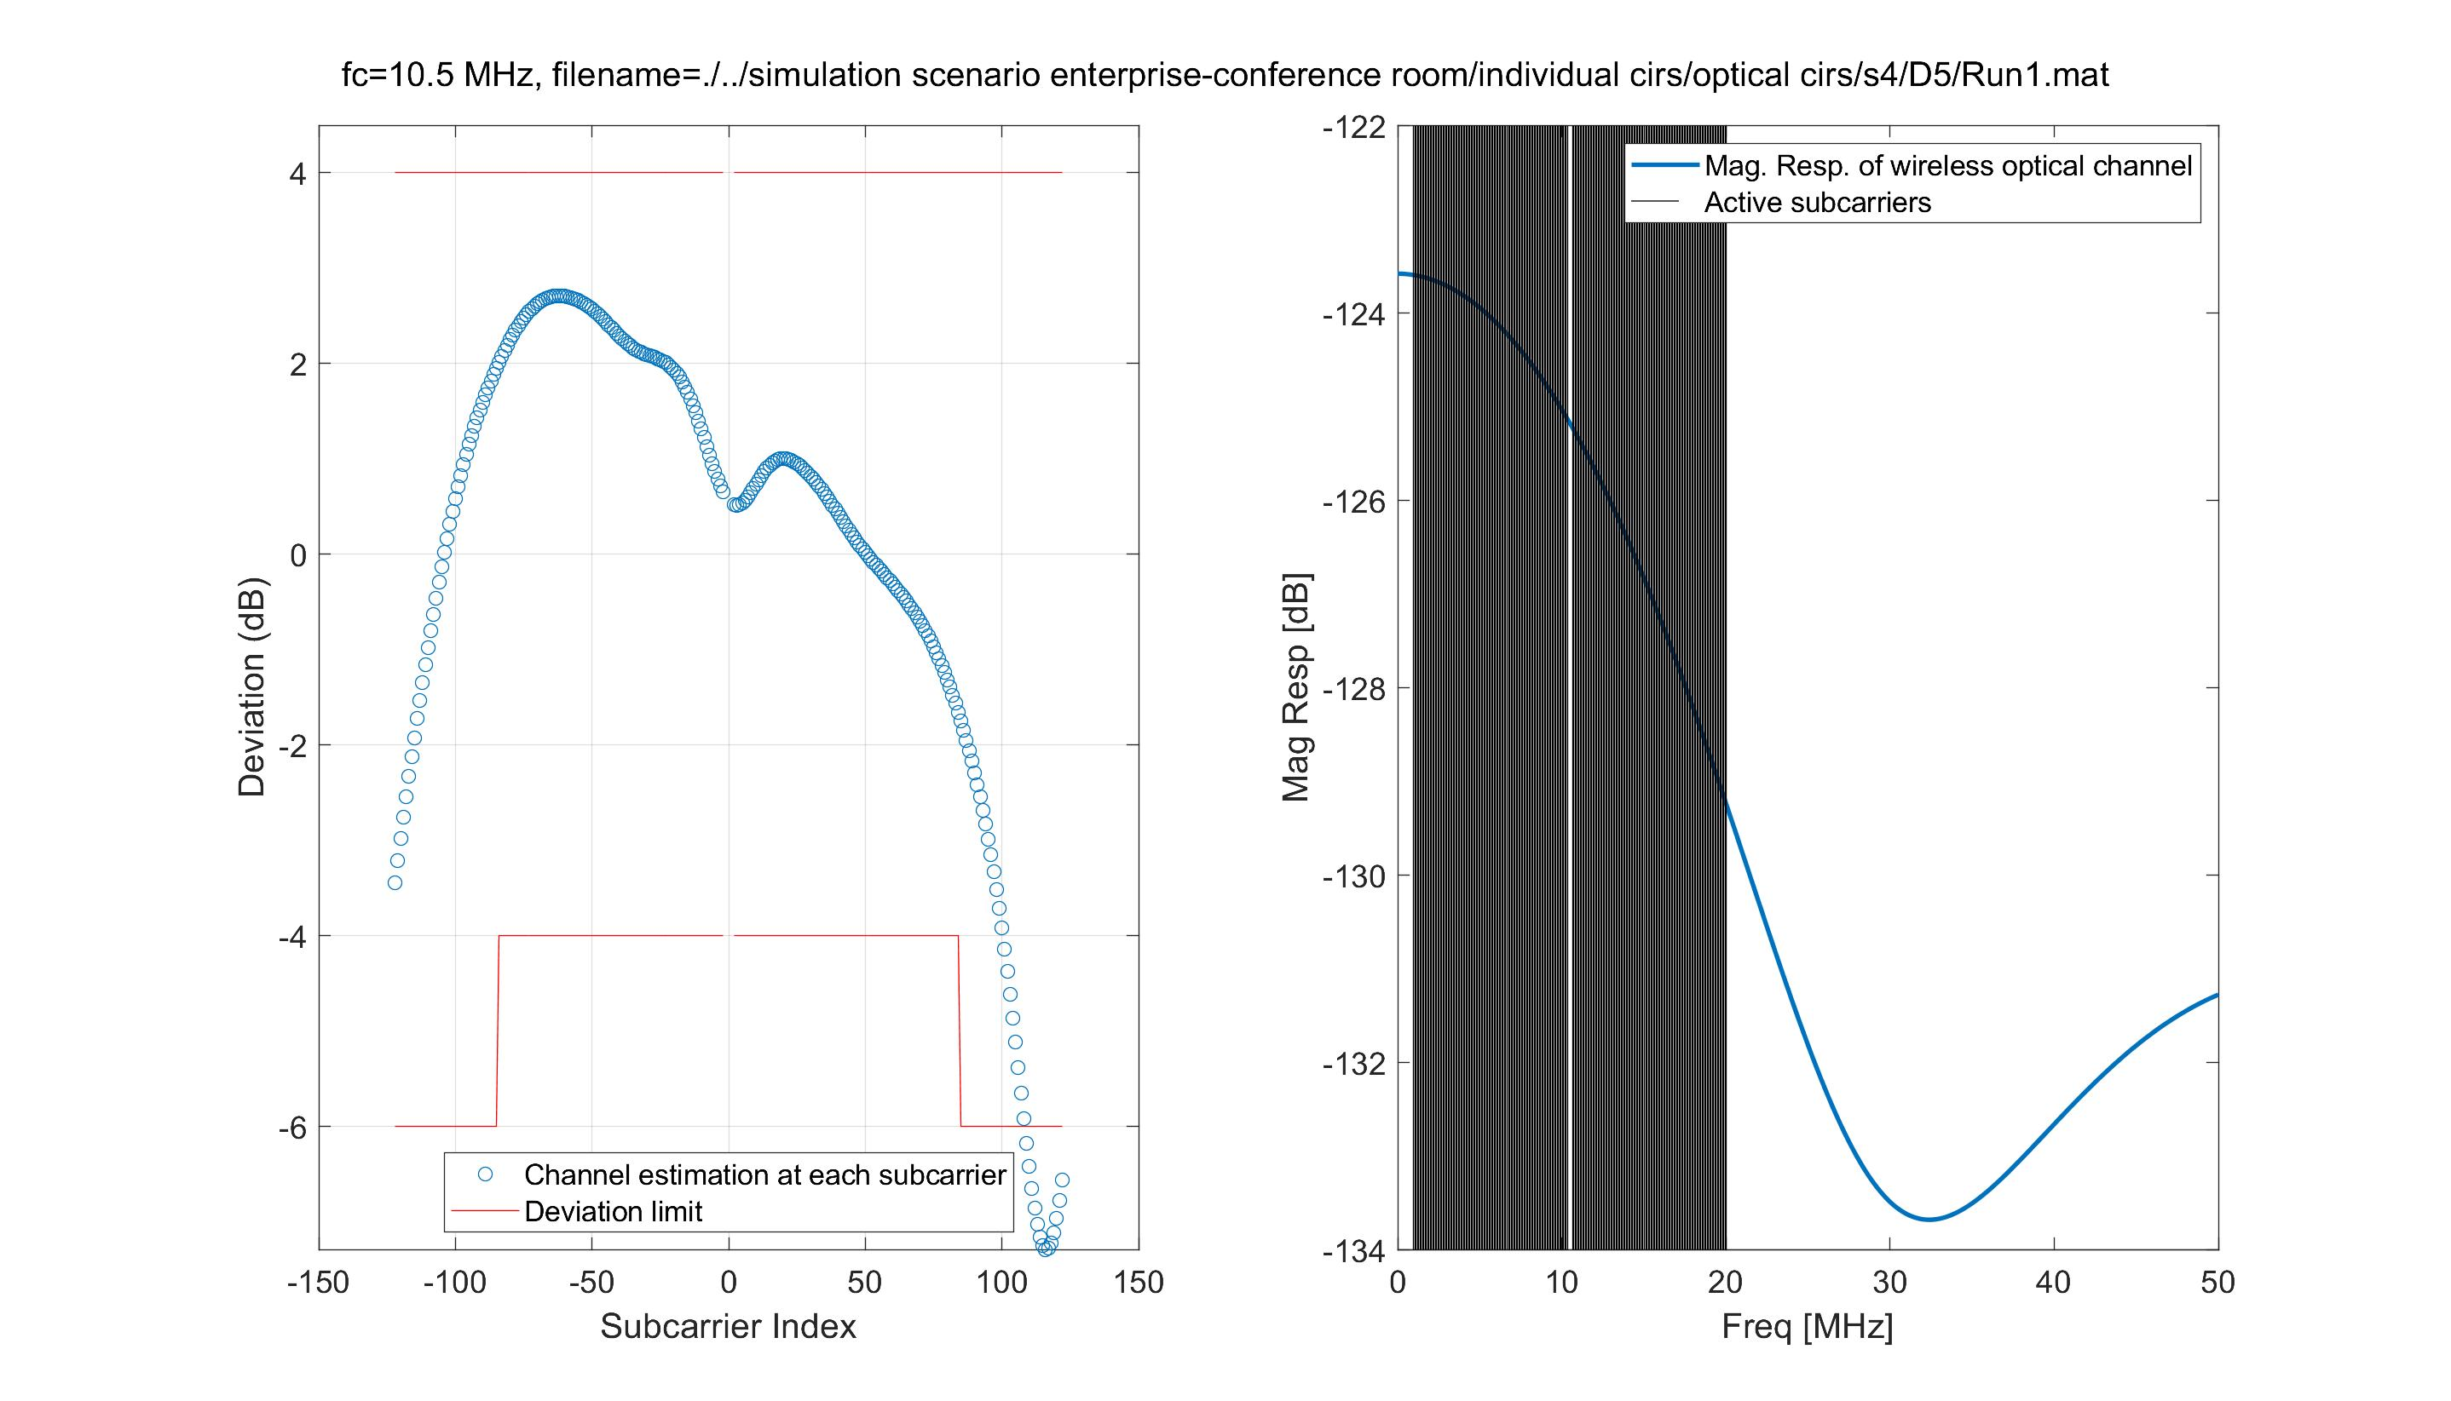
Scenario: enterprise-conference, BW=20MHz, fc=10.5 MHz
Minimum of max dev (best sample)
Maximum of max dev (worst sample)

Slide 12
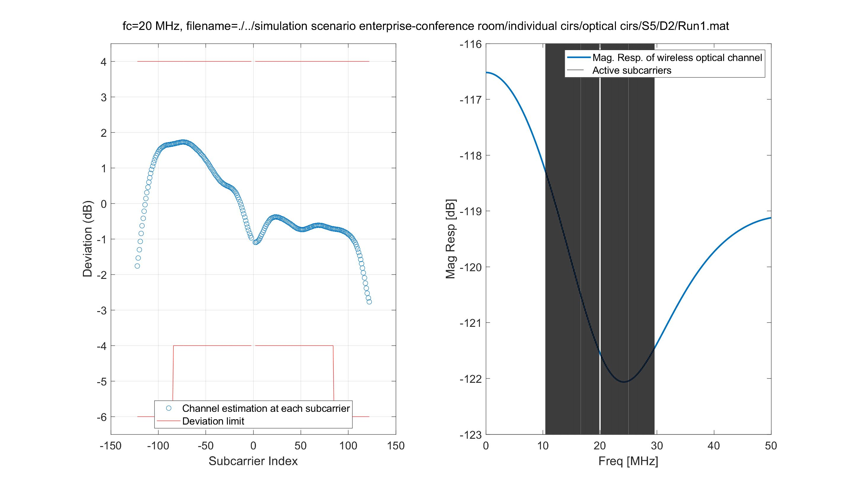
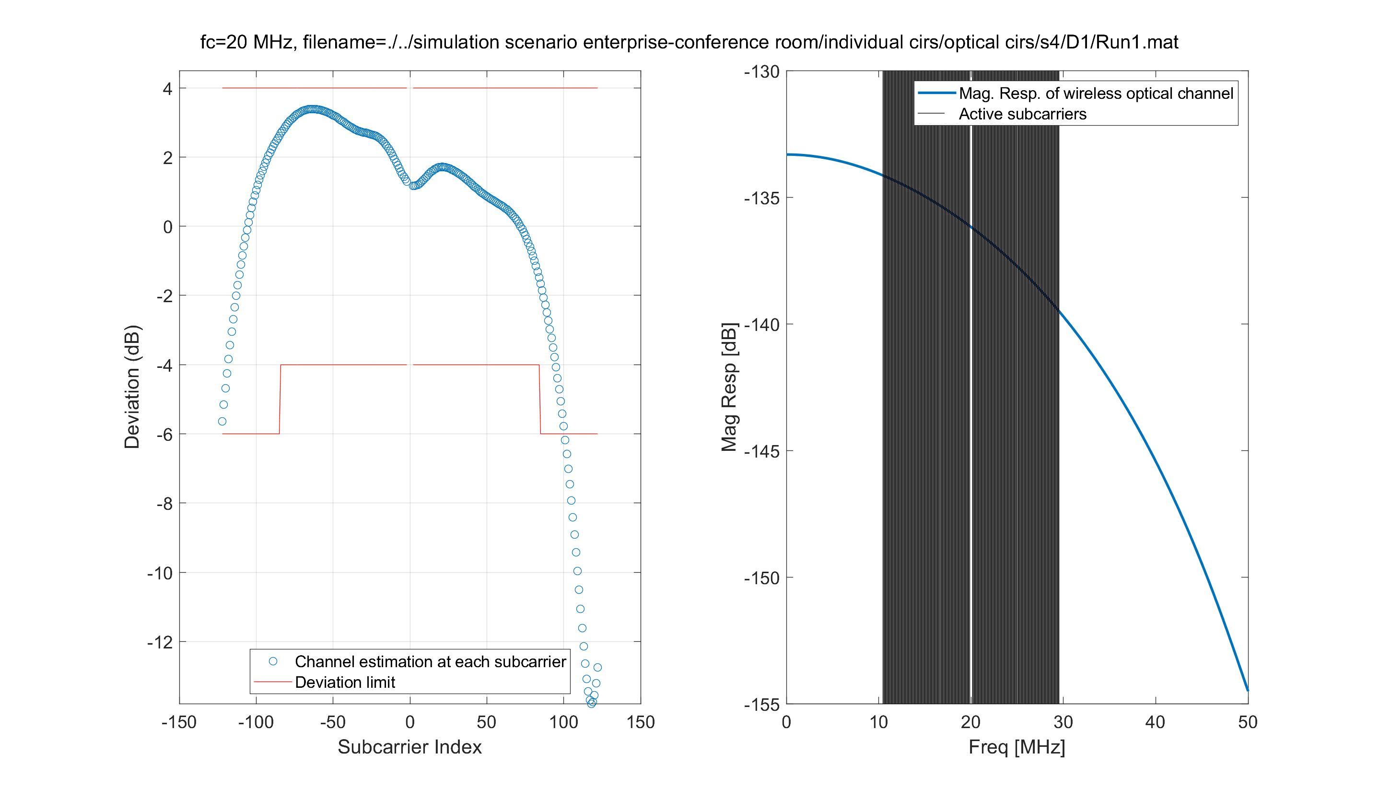
Scenario: enterprise-conference, BW=20MHz, fc=20 MHz
Minimum of max dev (best sample)
Maximum of max dev (worst sample)

Slide 13
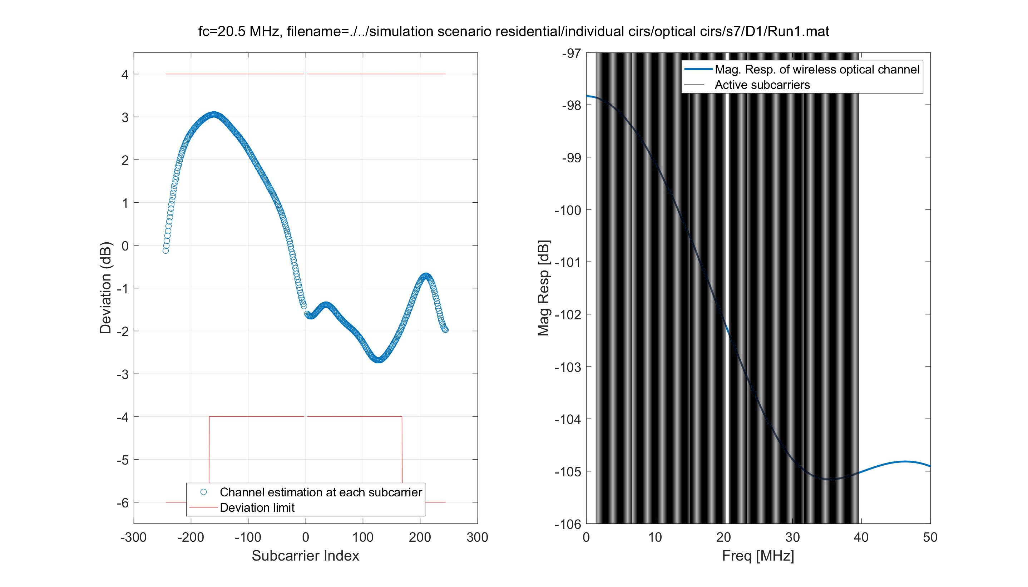
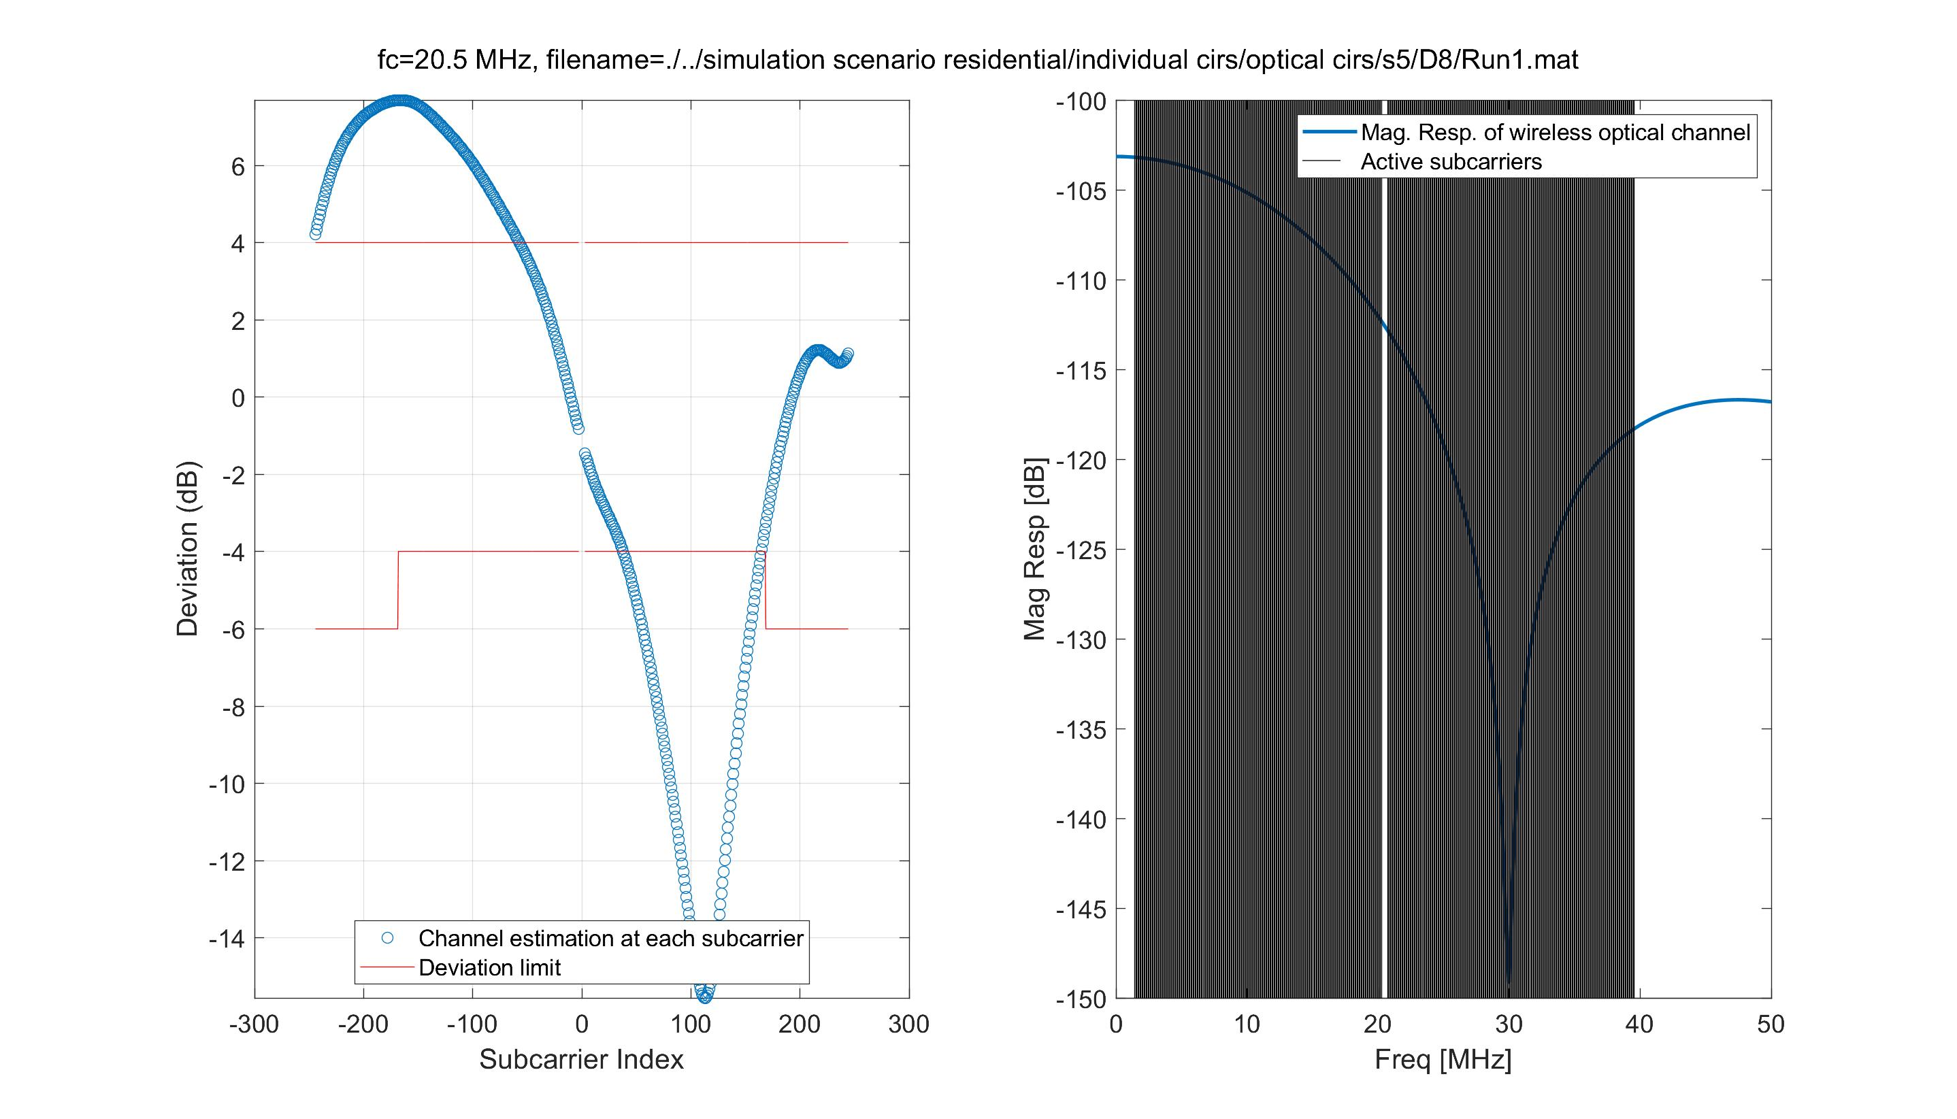
Scenario: residential, BW=40MHz, fc=20.5 MHz
Minimum of max dev (best sample)
Maximum of max dev (worst sample)

Slide 14
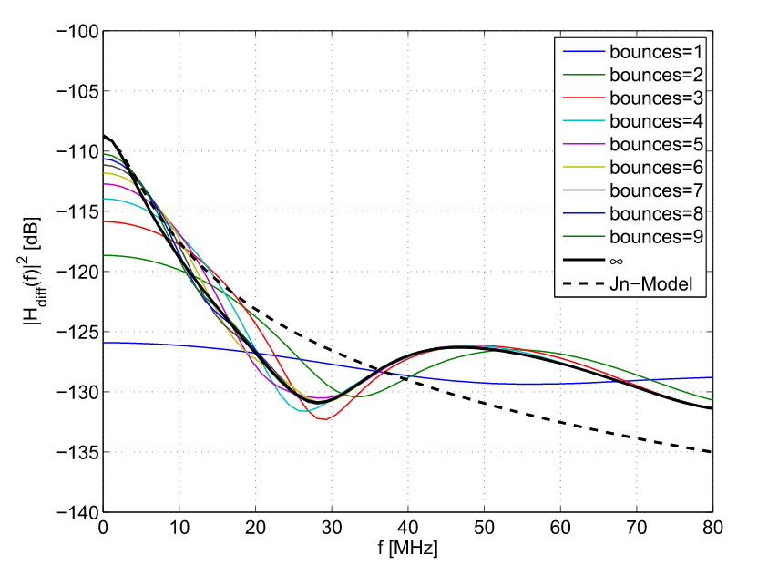
Discussions (1): related works
J. B. Carruthers and P. Kannan, "Iterative site-based modeling for wireless
infrared channels," in IEEE Trans. Antennas Propag., 2002.
H. Schulze, "Frequency-Domain Simulation of the Indoor
Wireless Optical Communication Channel," in IEEE TCOM, 2016.
V. Jungnickel, V. Pohl, S. Nonnig and C. von Helmolt, "A physical model of the wireless infrared communication channel," in IEEE JSAC, 2002.
Summary: More reflections means less flat

Slide 15
Discussions (2): how do CIRs that give the best and the worst samples look like?
CIRs samples with the best flatness
CIRs samples with the worst flatness

Slide 16
Discussions (4)
The question is now:
“Can we detect high-order reflections in practice?”
Based on the experiment carried out in [1], the high-order reflections will be submerged under the detectors’ noise floor.
[1] C. Chen, D. A. Basnayaka, X. Wu and H. Haas, "Efficient Analytical Calculation of Non-Line-of-Sight Channel Impulse Response in Visible
Light Communications," in JLT, 2018.

Slide 17
Conclusions
We discussed the flatness test on the dataset (IEEE 802.11-18/1582r4)
We showed that in most cases, the wireless optical channels are flat with BW = 20 MHz and 40 MHz. Further investigation will be done for higher BW.
We also argued that due to the limitations of the PDs, the high-order reflections cannot be detected. Hence, in practice we will most likely encounter flat wireless optical channels.
Further studies are needed to quantify the gain of the adaptive bit loading in flat and non-flat cases, respectively.

Slide 18
Appendix: All Samples
Go to the next slides

Slide 19
Scenario: enterprise-conference, BW=20MHz, fc=10.5 MHz
Minimum of max dev (best sample)
Maximum of max dev (worst sample)

Slide 20
Scenario: enterprise-conference, BW=20MHz, fc=20 MHz
Minimum of max dev (best sample)
Maximum of max dev (worst sample)

Slide 21
Scenario: hospital, BW=20MHz, fc=10.5 MHz
Minimum of max dev (best sample)
Maximum of max dev (worst sample)

Slide 22
Scenario: hospital, BW=20MHz, fc=20 MHz
Minimum of max dev (best sample)
Maximum of max dev (worst sample)

Slide 23
Scenario: industrial, BW=20MHz, fc=10.5 MHz
Minimum of max dev (best sample)
Maximum of max dev (worst sample)

Slide 24
Scenario: industrial, BW=20MHz, fc=20 MHz
Minimum of max dev (best sample)
Maximum of max dev (worst sample)

Slide 25
Scenario: residential, BW=20MHz, fc=10.5 MHz
Minimum of max dev (best sample)
Maximum of max dev (worst sample)

Slide 26
Scenario: residential, BW=20MHz, fc=20 MHz
Minimum of max dev (best sample)
Maximum of max dev (worst sample)

Slide 27
Scenario: enterprise-conference, BW=40MHz, fc=20.5 MHz
Minimum of max dev (best sample)
Maximum of max dev (worst sample)

Slide 28
Scenario: hospital, BW=40MHz, fc=20.5 MHz
Minimum of max dev (best sample)
Maximum of max dev (worst sample)

Slide 29
Scenario: industrial, BW=40MHz, fc=20.5 MHz
Minimum of max dev (best sample)
Maximum of max dev (worst sample)

Slide 30
Scenario: residential, BW=40MHz, fc=20.5 MHz
Minimum of max dev (best sample)
Maximum of max dev (worst sample)

