Slide 1
Performance and Fairness of
Multi-link Operation
Date: 2019-11-09
Name | Affiliation | Address | Phone | Email
Wisnu Murti | Seoul Nat’l Univ. of Science and Technology | 232 Gongneung-ro, Nowon-gu, Seoul 01811, Korea | +82-2-970-6455 | shk0787@seoultech.ac.kr
Sanghyun Kim |  |  |  | wisnumurti@seoultech.ac.kr
Ji-Hoon Yun |  |  |  | jhyun@seoultech.ac.kr
John (Ju-Hyung) Son | WILUS, Inc. | 216 Hwangsaeul-ro, Seongnam-si, Gyeonggi-do, Korea | +82-31-712-0524 | john.son@wilusgroup.com
Geonjung Ko |  |  |  | greg.ko@wilusgroup.com
Jin Sam Kwak |  |  |  | jinsam.kwak@wilusgroup.com

Slide 2
Introduction
EHT STAs are expected to support multi-link aggregation
Benefits of multi-link aggregation are
  Increased peak throughput
  Reduced latency and jitter
Power leakages between links may or may not be present
  If power leakage is present, it affects the clear channel assessments of other links
The following channel access operations have been discussed [1][2][3]:
  Synchronous operation
  Asynchronous operation
  Semi-asynchronous operation (aka synchronous without primary link [2], mixed synchronous and asynchronous [3])
The performance of these channel access operations may be affected by (1) existence of power leakage; (2) coexistence with legacy system; and (3) coexistence with EHT BSSs using different channel-access operation
Notes:
Write introduction as conclusion

Slide 3
Multi-link and Power Leakage
Link 1
4 | 3 | 2 | 1 | 0
TXOP
2 | 1 | 0
TXOP
No Power Leakage Case
Link 2
8 | 7 | 6 | 5 | 4 | 3 | 2 | 1 | 0
TXOP
4 | 3 | 2 | 1 | 0
Link 1
4 | 3 | 2 | 1 | 0
TXOP
2 | 1 | 0
TXOP
Power Leakage
Case
Link 2
8 | 7 | 6 | 5 | 4
LEAKAGE
3 | 2 | 1
LEAKAGE
BUSY due to power leakage
from Link 1
Link with power leakage
  Other link will sense its medium as BUSY if a neighboring link is transmitting
Link with no power leakage
  Other link will NOT sense a neighboring link's transmission, thus still can sense its medium as IDLE

Slide 4
Synchronous Operation
Link 1
4 | 3 | 2 | 1 | 0
TXOP
2 | 1 | 0
TXOP
Link 2
TXOP
BUSY
Perform back off procedure only on a primary link
Perform short CCA on secondary link(s) just before the backoff completion of a primary link
  IDLE – transmit on this secondary link too
  BUSY – does not transmit on this secondary link
Ideal to be used in links with power leakage

Slide 5
Asynchronous Operation
Link 1
4 | 3 | 2 | 1 | 0
TXOP
2 | 1 | 0
TXOP
No Power Leakage Case
Link 2
2 | 1 | 0
TXOP
8 | 7 | 6 | 5 | 4 | 3 | 2 | 1 | 0
TXOP
Link 1
4 | 3 | 2
LEAKAGE
1 | 0
TXOP
7 | 6 | 5 | 4
Power Leakage Case
Link 2
2 | 1 | 0
TXOP
8 | 7
LEAKAGE
6 | 5 | 4 | 3
Perform contention independently on individual links
Perform transmission independently on individual links
Ideal to be used in links without power leakage

Slide 6
Semi-asynchronous Operation
Link 1
4
BUSY
3 | 2 | 1 | 0
TXOP
7 | 6 | 5 | 4
TXOP
No Power Leakage Case
Link 2
2 | 1 | 0
TXOP
5 | 4
TXOP
3 | 2 | 1 | 0
TXOP
LEAKAGE
Link 1
4
BUSY
3 | 2 | 1 | 0
TXOP
7 | 6
TXOP
Power Leakage Case
Link 2
2 | 1 | 0
TXOP
5 | 4 | 3 | 2
TXOP
1 | 0
TXOP
Perform contention independently on individual links
Perform short CCA on the other link(s) just before completion of its backoff
  IDLE – transmit on other link too
  BUSY – does not transmit on other link
Can be be used in links with or without power leakage

Slide 7
Semi-asynchronous Operation
– fairness issues
Free-riding link’s resumed backoff procedure after transmission impacts fairness with legacy stations
Need to design semi-asynchronous operation to support coexistence
  We discuss different options for a free-riding link's backoff procedure after transmission
    Default: Resume backoff without changing its backoff count
    Option 1: Repick a new backoff count number
    Option 2: Switch to another CW set for a predetermined time period [similar to MU EDCA operation in 11ax]

Slide 8
Semi-asynchronous Operation – Option 1
Link 1
4
BUSY
3 | 2 | 1 | 0
TXOP
7 | 6 | 5 | 4 | 3
No Power Leakage Case
Link 2
2 | 1 | 0
TXOP
5 | 4
TXOP
9 | 8 | 7 | 6 | 5
LEAKAGE
repick backoff number
Link 1
4
BUSY
3 | 2 | 1 | 0
TXOP
7 | 6 | 5 | 4
Power Leakage Case
Link 2
2 | 1 | 0
TXOP
5 | 4 | 3 | 2
TXOP
9 | 8 | 7 | 6
repick backoff number
Fairness Option 1
  After transmission on multiple links, each ‘free-riding’ link (Link 2) repicks a new backoff counter

Slide 9
Semi-asynchronous Operation – Option 2
Link 1
4
BUSY
3 | 2 | 1 | 0
TXOP
7 | 6 | 5
BUSY
No Power Leakage Case
Link 2
2 | 1 | 0
TXOP
5 | 4
TXOP
3 | 2 | 1 | 0
TXOP
18 | 17
LEAKAGE
timeout
repick from CW Set B
Link 1
4
BUSY
3 | 2 | 1 | 0
TXOP
7
BUSY
6 | 5
Power Leakage Case
Link 2
2 | 1 | 0
TXOP
5 | 4 | 3 | 2
TXOP
1 | 0
TXOP
18 | 17
timeout
Fairness Option 2
  After transmission on multiple links, each ‘free-riding’ link (Link 2) switches from CW Set A to CW Set B for a predetermined time period
    CW Set A – default set (e.g. [16 .. 1024])
    CW Set B – higher CWmin and/or CWmax than Set A (e.g. [32 .. 2048])
  Switch back to CW Set A after the time period expires
repick from CW Set B

Slide 10
Simulation Setup
BSS Setup
  1 EHT BSS with 1 AP and 1 non-AP STA, both are multi-link aggregation enabled
  0~10 legacy OBSSs, each consists of 1 AP and 1 non-AP STA (single link) in each band
TX Setup
  Transmission with A-MPDU (up to 64 MPDUs), 1 MPDU = 1500 Bytes
  Both EHT BSS and legacy OBSSs are in full-buffer DL operation
  Using MCS 9 and 80 MHz bandwidth for each band
  Setup for semi-asynchronous operation Option 2
    CW Set A – [16 .. 1024]
    CW Set B – [32 .. 2048]
    Timeout time – 1ms
Notes:
Change base to 1 ms
Change variation to 1-3 ms

Slide 11
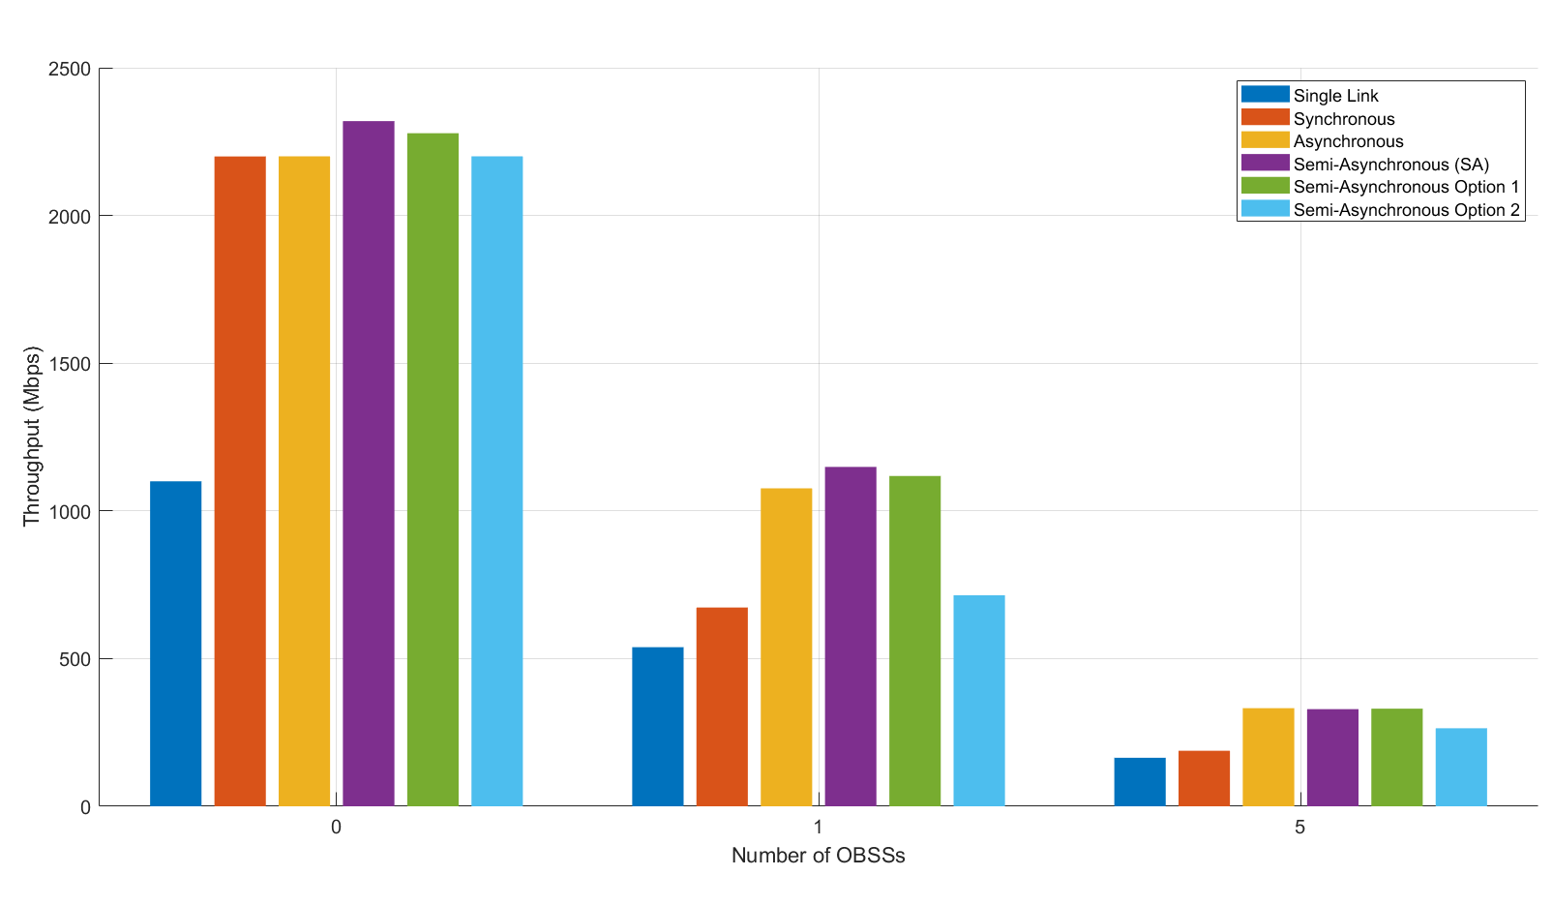
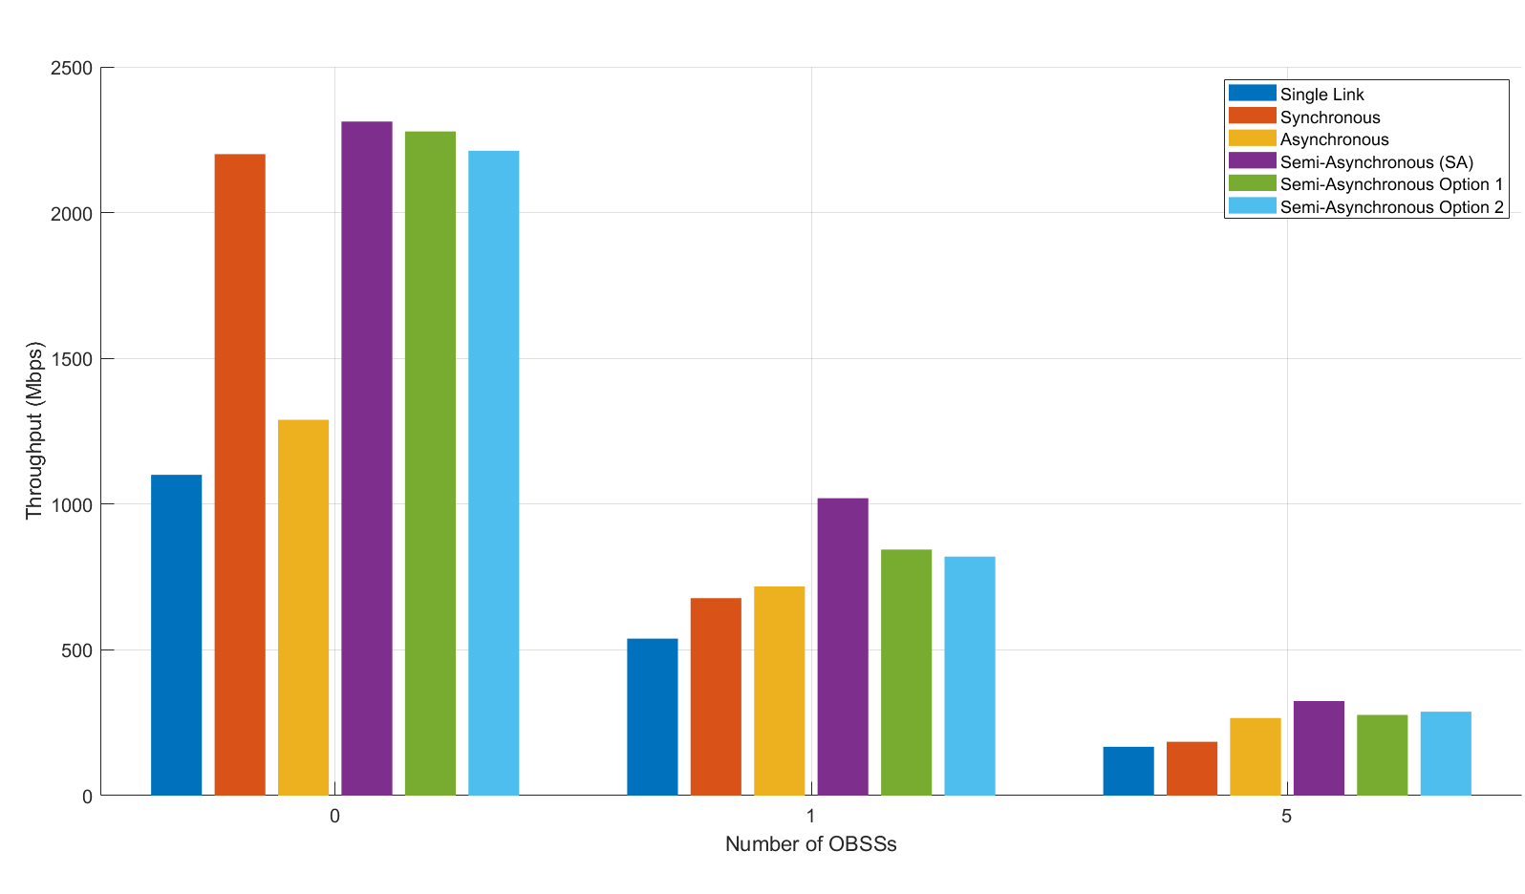
Throughput Comparison
without power leakage
with power leakage
Synchronous operation (SYNC)
  Not heavily affected by power leakage
  Performs worst in OBSS scenarios
Asynchronous operation (ASYNC)
  Highly affected by power leakages, better performance without power leakage
Semi-asynchronous operation (SA)
  Highest throughput with and without power leakage
  Performs best in crowded conditions with many legacy OBSSs
Notes:
Write the explanation on each graph

Slide 12
Coexistence Simulation Scenario
Fairness with Legacy
Legacy
Legacy
EHT
Legacy
Link 1
Band 1
Link 1
Link 1
Band 1
Link 1
Link 2
Band 2
Link 2
Link 2
Band 2
Link 2
Legacy
Legacy
Legacy
(Legacy only)
(EHT vs. Legacy)
Fairness with legacy
  Legacy only: 2 legacy BSSs in each band (each BSS is 1 AP + 1 non-AP STA)
  EHT and legacy: 1 EHT BSS using both bands and 1 legacy BSS in each band (2 legacy BSSs in total)
Coexistence between different EHT multi-link channel access operations
  2 EHT BSSs (1 AP and 1 non-AP STA), each using its own channel access operation
Coexistence bet’n different EHT multi-link channel access
EHT 1
EHT 2
Link 1
Band 1
Link 1
Link 2
Band 2
Link 2
(EHT vs. EHT)
Notes:
Change base to 1 ms
Change variation to 1-3 ms

Slide 13
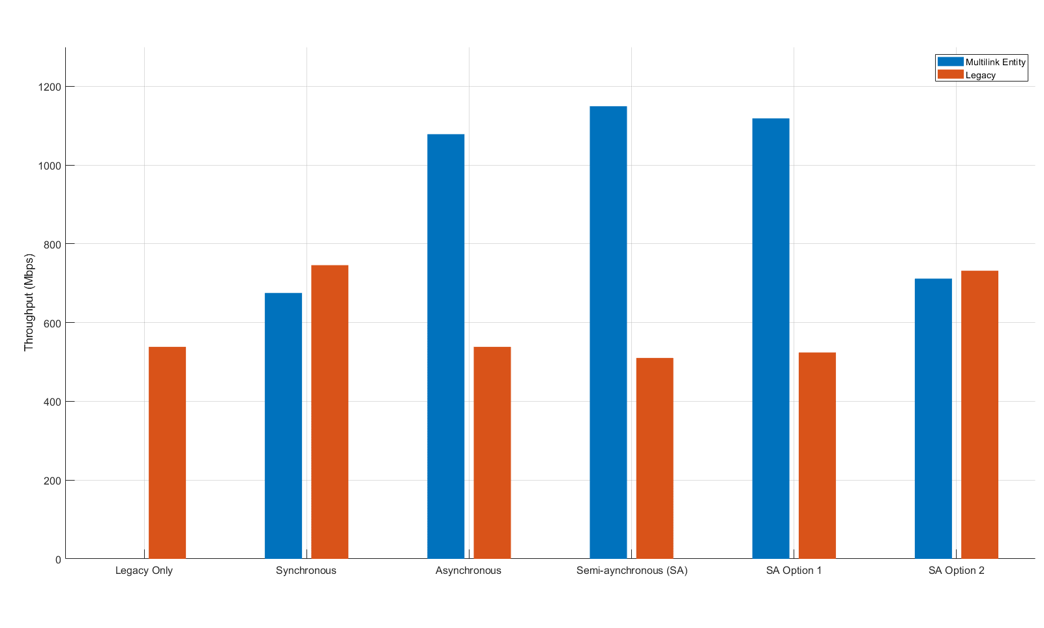
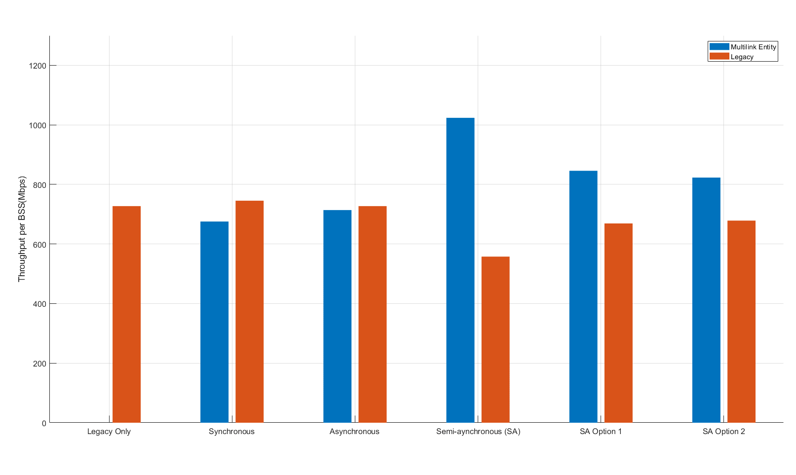
Fairness with Legacy System
without power leakage
with power leakage
EHT BSS using SA is more aggressive against legacy BSS compared to SYNC and ASYNC
Both fairness options of SA (Option 1 and 2) can be used to alleviate the fairness problem with legacy system

Slide 14
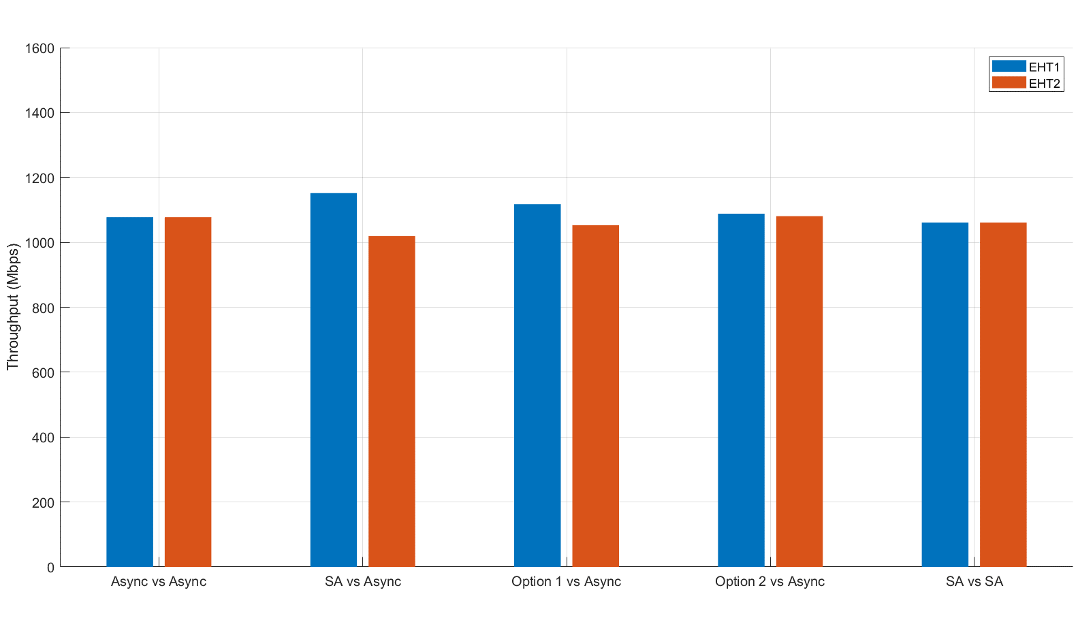
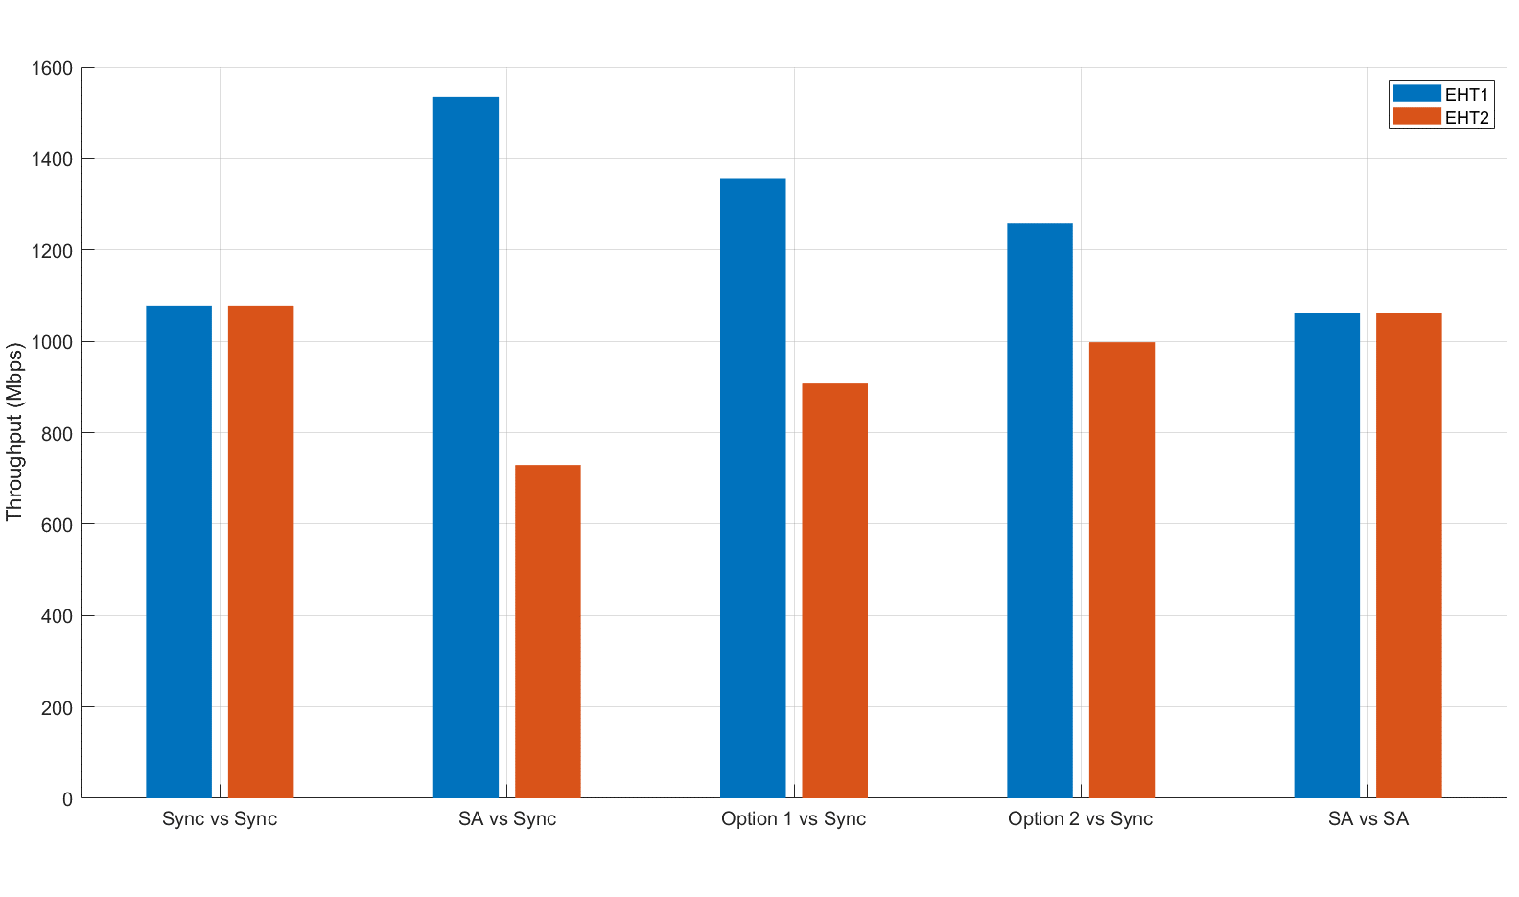
Coexistence between Different
EHT Channel Access Operations
without power leakage
with power leakage
SA is more aggressive than SYNC and ASYNC
Both fairness options of SA (Option 1 and 2) can alleviate the fairness problem with other channel access operations
Notes:
Write the explanation on each graph

Slide 15
Conclusions
The performance of the channel access operations for multi-link aggregation is affected by
  (1) with/without power leakage between links; (2) coexistence with legacy system; and (3) coexistence with EHT BSSs using different multi-link channel-access operation
Semi-asynchronous operation performs better than synchronous and asynchronous operations with and without power leakage for a wide range of OBSS crowdedness
Semi-asynchronous operation is more aggressive in channel access than synchronous and asynchronous operations, thus having a coexistence problem with legacy BSSs as well as with EHT BSSs using other channel access operation
Semi-asynchronous operation with the proposed backoff procedure modification can alleviate the coexistence problem

Slide 16
References
[1] 11-19-1291 Performance aspects of Multi-link operations
[2] 11-19-1116 Channel Access in Multi-band operation
[3] 11-19-1678 Multiple Link Asynchronous and Synchronous Transmission

Slide 17
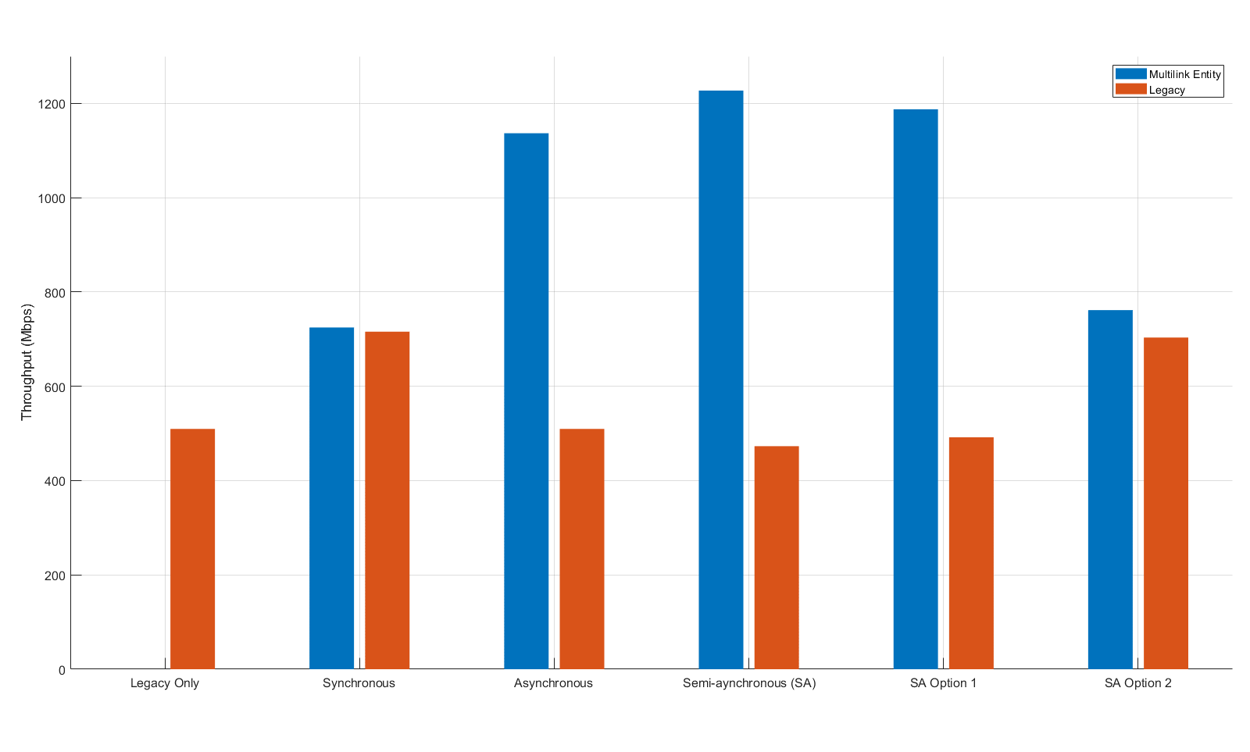
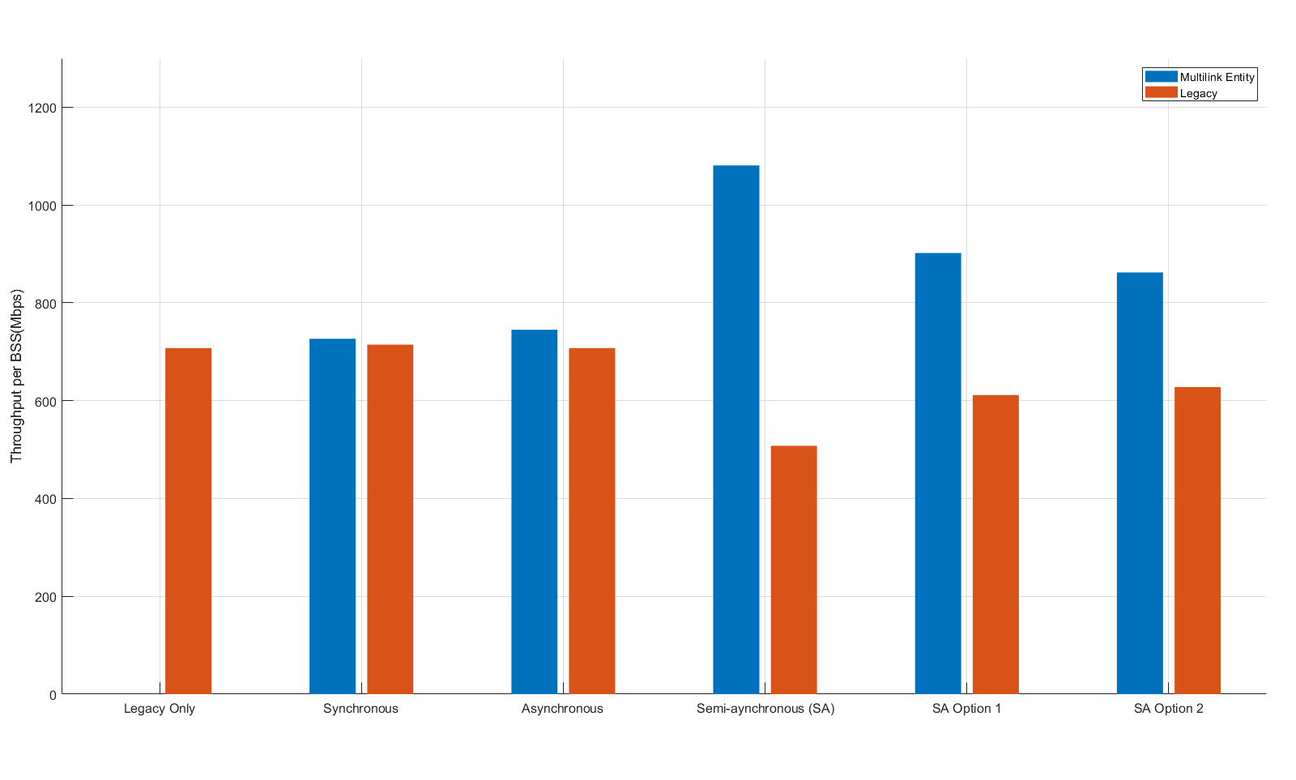
Appendix : Fairness with Legacy System
25% load on legacy STAs
without power leakage
with power leakage

Slide 18


Appendix : Fairness with Legacy System
50% load on legacy STAs
without power leakage
with power leakage

Slide 19

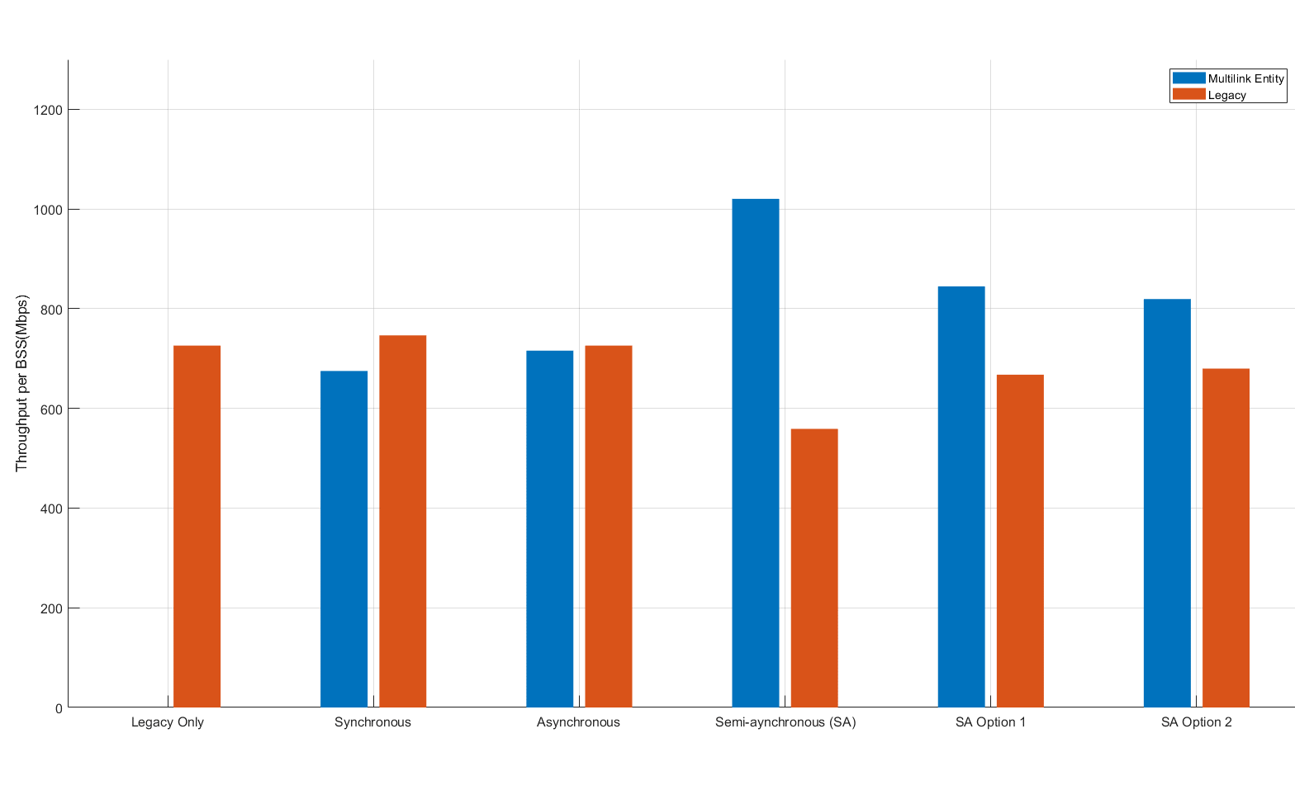
Appendix : Fairness with Legacy System
75% load on legacy STAs
without power leakage
with power leakage

