Slide 1
802.11 Sensing: Applications, Feasibility, Standardization
Date: 2019-09-17
Authors:
–

Slide 2
Outline
An Introduction to 802.11 sensing
Why 802.11 sensing?
Advantages of 802.11 sensing over some common sensors
Functionality and applications of 802.11 sensing
Business opportunities of 802.11 sensing
Feasibility of 802.11 sensing: motion detection, breathing monitoring, tracking
Need of standardization for 802.11 sensing
Conclusion
References

Slide 3
Introduction to 802.11 sensing (WiFi sensing)
802.11 sensing, or WiFi sensing, [1] is the use of 802.11 signals to sense (e.g. detect) events/changes in the environment. Often with signal processing and machine learning.
A STA (Tx) transmits 802.11 signal to a STA (Rx) in a multipath-rich venue.
802.11 signal bounces back and forth in the venue generating lots of multipaths.
Although undesirable to communications, the bouncing of the 802.11 signal effectively “scan” or “sense” the venue. By monitoring the multipaths (e.g. through CSI [10], see slide 11), it is possible to detect target events and changes in the venue. Example in next slides.
Line-of-sight (LOS) not required. Work in both LOS and Non-LOS (NLOS).
Wearable not required in most applications.

Slide 4
Why 802.11 sensing?
New way to sense.
New functionalities for 802.11-enabled devices (TV, speaker, router, IoT devices) and facilities (stadiums, halls, rooms, warehouse, factory).
New industry-wide business opportunities for all 802.11 related companies (components/ devices/services). See slide 7.
Performance advantages over existing sensors. (see next slide)
NLOS operation. No blind spot. Especially suitable for indoor.
Ubiquitous. 802.11-enabled devices popular in homes/office. Any device compliant with the 802.11 standard potentially could be used.
Need no dedicated hardware. Any 802.11-compliant device (including our demo devices) can potentially implement any 802.11 sensing functionalities using only software upgrade.

Slide 5
Advantages of 802.11 sensing over some common sensors
Passive infra-red (PIR) motion sensor
  LOS only
  Need many (e.g. 6) to cover a house
  no learning
Video camera:
  video intrude privacy
  LOS only
  memory intensive
  computation intensive
802.11 sensing
  both LOS/NLOS
  Need 1 Tx/Rx pair to cover a house
  learning
  no video to intrude privacy
  both LOS/NLOS
  much lower storage requirement
  much lower computation requirement

Slide 6
Functionalities/applications of 802.11 sensing
Motion detection [2] (NLOS)* # – intruder detection, security, smart IoT
Breathing monitoring [3] (wearable-free)* # – sleep monitoring, well-being, caregiving
Locationing/tracking [4] (NLOS)* – smart factory, indoor GPS companion, traffic planning
Fall detection [5] (no video)* # – older adults, accident detection, caregiving
Child detection in hot cars * # – smart cars, accident prevention
Presence/proximity detection [6]* # – conference room, convenience, smart IoT
Human identification [7]* # – user identification, personalization, smart IoT
Gesture recognition [8] # – smart office
Activity recognition [9] # – user interface
* Demonstratable.
# Contactless/need no wearable.
N.B. See [1] for a comprehensive survey.

Slide 7
Business opportunities of 802.11 sensing
Service providers:
  New sensing/sensor => new service/new device
  New wave of “802.11 sensing” services regarding daily living, safety, lifestyle, convenience, personalization, caregiving, digital health, etc.
  Traditional (e.g. broadband, mobile, streaming, cable) or new (e.g. smart device makers)
Device manufacturers (e.g. smart home/IoT devices, consumer electronics, computing devices, home appliance, lighting, accessories)
  New sensing=> new functionality of 802.11-enabled devices
  New wave of “802.11 sensing” devices - DIY or connected to “802.11 sensing” service
Component providers
  Backward compatibility => Expanded markets for existing components (firmware upgrade)
  New component opportunity for “802.11 sensing” services and devices

Slide 8
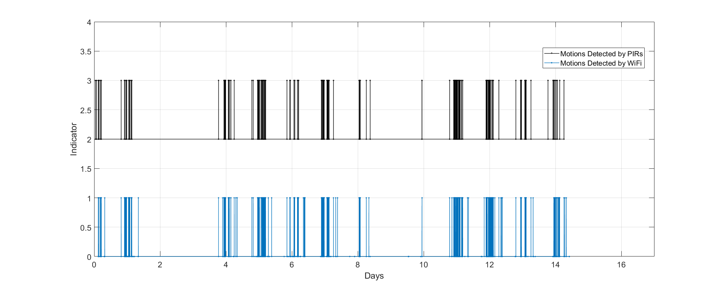
Feasibility of 802.11 - Motion Detection
In a long-term side-by-side comparison with PIR (a test house covered by 6 professionally installed PIRs and a pair of 802.11 Tx/Rx), 802.11 motion sensing prototype performs similar to, if not better than, the PIRs. Results verified by video recording.
Detection rate: 802=99.997%, PIR=97.5%
False alarm rate: 802=0.000%, PIR=0.000%
Missed detection by PIR
PIRx6
802.11
Missed detection by 802

Slide 9
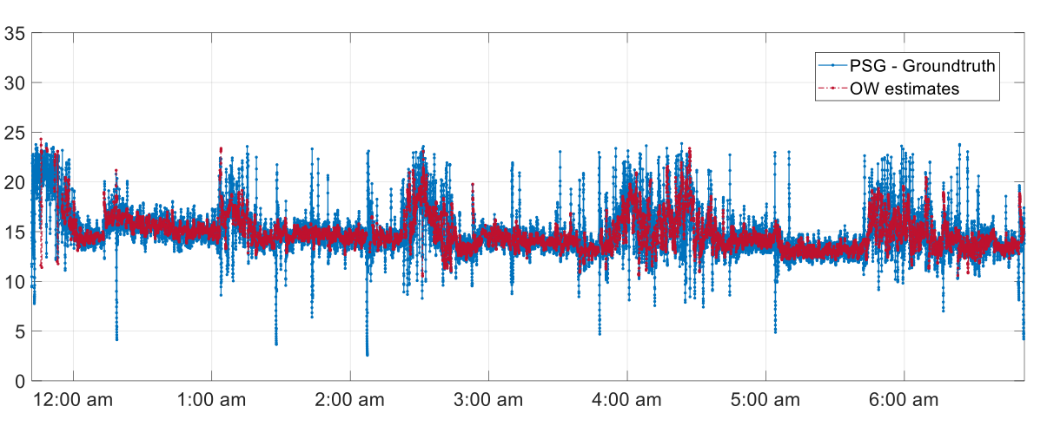
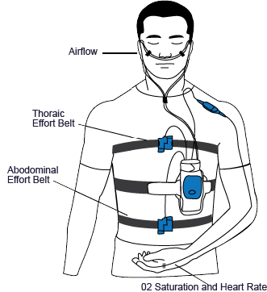
Feasibility of 802.11 - Breathing Monitoring
In multi-night side-by-side comparison with other breathing sensors (pressure sensor, radar sensor, with polysomnography (PSG) being ground truth), 802.11 breathing monitoring prototype (contactless) outperforms pressure sensor and radar sensor.
stage (awake/REM/NREM) detection rate: 802=0.87/0.87/0.89, pressure=0.77/0.46/0.75, radar=0.53/0.79/0.87
median (abs) error: 802=0.47/0.68/0.42bpm, pressure=0.86/1.28/0.80bpm
PSG
Tx
Rx
Airflow
ECG
EEG
EMG
O2 Saturation and Hear Rate

Slide 10
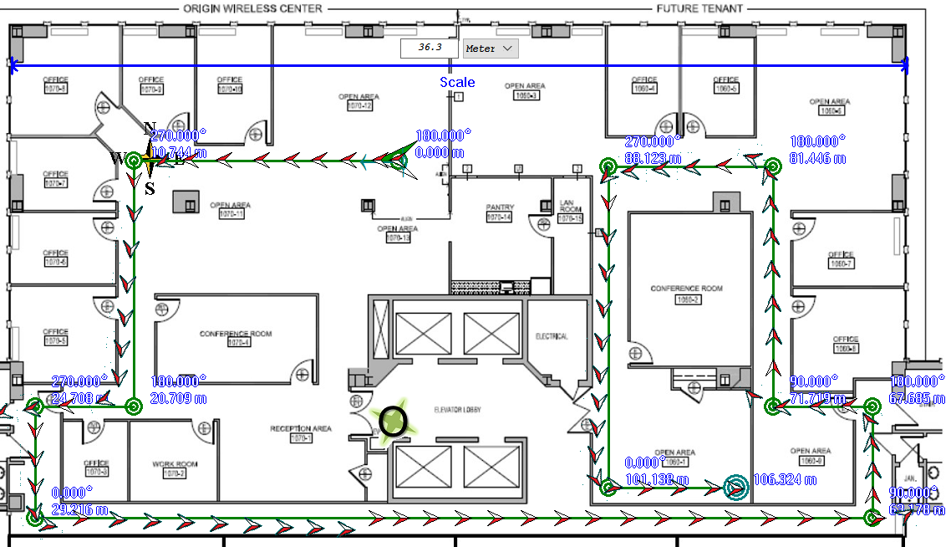
Feasibility of 802.11 Locationing/Tracking
In walking experiment along paths in buildings, 802.11 tracking prototype shows high tracking accuracy.
Average (abs) tracking error is less than 20-30 cm
NLOS operation. Need map.
Tx
Rx
True path
802.11 tracking

Slide 11
Need of standardization for 802.11 sensing
As said before, the bouncing of 802.11 signals creates multipaths which effectively scan or sense the environment - including any object motions, events and changes. The multipaths are captured in channel state information (CSI) [10].
In 802.11 sensing, various signal processing/machine learning algorithms and systems are applied to obtain and analyze CSI to achieve various tasks, regarding motions/events/changes.
  E.g. Motion detection by detecting change in CSI
  E.g. Breathing detection by detecting cyclic behavior of CSI
  E.g. Locationing by CSI recognition.
While standardization of the algorithms may not be needed, standardization may be needed for the systems regarding CSI generation, timing, accuracy, consistency, protocol, etc.
Interface may need to be standardized. (WiFi Alliance?? TBD.)
  Some 802.11 sensing demos need periodic probing/CSI generation at 1/10/100/1000Hz?

Slide 12
Need of standardization for 802.11 sensing
Need a protocol to control the generation of CSI, repetition rate, accuracy of timing, antenna selection and probing for 802.11 sensing.
CSI consistency, precision and format may be needed. (WiFi Alliance? TBD.)
Some current challenges:
  CSI is not always available.
  CSI sufficient for data communication may not be sufficient for 802.11 sensing.
  CSI sufficient for a 802.11 sensing task may be insufficient for another.
  No standardized testing for CSI for 802.11 sensing: consistency, accuracy, precision. (WiFi Alliance? TBD.)

Slide 13
Conclusion
A checklist of criteria for standard development
  Broad market potential - Yes
  Distinct identity – Yes
  Technical feasibility - Yes
  Economic feasibility – Yes
  Compatibility with existing 802 standards - Yes
  Co-existence - Yes
Recommendation: 802.11 to form Study Group on 802.11 sensing.

Slide 14
References
B.B Wang, Q.Y. Xu, C. Chen, F. Zhang, and K.J.R. Liu, "The Promise of Radio Analytics: A Future Paradigm for Wireless Positioning, Tracking, and Sensing", IEEE Signal Processing Magazine, Vol. 35, No. 3, pp.59-80, May 2018.
Yu Gu, et.al., “MoSense: An RF-based Motion Detection System via Off-the-Shelf WiFi Devices”, IEEE Internet of Things Journal, Vol. 4, No. 6, pp.2326-2341, Dec. 2017.
Xuefeng Liu, et.al., “Contactless respiration monitoring via off-the-shelf WiFi devices”, IEEE Trans. On Mobile Computing, Vol. 15, No. 10, pp.2466-2479, Oct. 2016.
Feng Zhang, et.al., “WiSpeed: A statistical electromagnetic approach for device-free indoor speed estimation”, IEEE Internet of things Journal, Vol.5, No. 3, pp.2163-2177, Jun. 2018.
Hao Wang, et.al., “RT-Fall: A real-time and contactless fall detection system with commodity WiFi devices”, IEEE Trans. On Mobile Computing, Vol. 16, No. 2, pp. 511-526, Feb. 2017.
Hai Zhu, et.al., “R-TTWD: Robust device-free through-the-wall detection of moving human with WiFi”, IEEE Journal on Selected Areas in Communications, Vol. 35, No. 5, pp. 1090-1103, May 2017.
Hongbo Liu, et.al., “Authenticating users through fine-grained channel information”, IEEE Trans. On Mobile Computing, Vol. 17, No. 2, pp. 251-264, Feb. 2018.
Kamran Ali, et.al., “Recognizing keystrokes using WiFi devices”, IEEE Journal on Selected Areas in Communications, Vol. 35, No. 5, pp. 1175-1190, May 2017.
Yi Wang, et.al., “Robust indoor human activity recognition using wireless signals”, Sensors, Vol. 15, No. 7, pp. 17195-17208, Jul. 2015.
IEEE Std 802.11-2016, Section 19.3.12, pp. 2392-2400.

Slide 15
Straw Poll
“We agree that 802.11 should form a Study Group (SG) on 802.11 sensing.”
  YES
  NO
  NEED MORE INFORMATION/TIME
  ABSTAINED

