Slide 1
Common-mode mandatory PHY
Date: 2019-09-14
Authors:

Slide 2
Abstract
This presentation highlights key LC features and studies that show the relevance and applicability of existing the 11ax PHY to LC. Specifically, we detail:
Circuit diagram showing the ease of converting existing RF solutions to operate for LC
Consequences of good and poor front-end, optical antenna, design on the responsivity of the system
Relevance of NLoS scenarios for LC
Considerations for the common-mode wavelength and a proposal for TGbb
Simulation results showing the performance of 11ax PHY in LC
That show how an 11ax PHY is a suitable basis for a common-mode mandatory PHY for 11bb.

Slide 3
LC base-band interface circuit is very simple to implement enabling 11ax baseband chips to be used for LC
PA _EN
RF (fc=5.25 GHz)
Up/down-converting mixer
IF (TBD, e.g., 90MHz)
LiFi TX
LiFi RX
Device 1
WiFi/LiFi
TBD, e.g., 5.16 GHz
PA _EN
RF (fc=5.25 GHz)
Up/down-converting mixer
IF (TBD, e.g., 90MHz)
LiFi TX
LiFi RX
Device 2
WiFi/LiFi
TBD, e.g., 5.16 GHz

Slide 4
LC front-end responses can vary and can be designed to easily operate with 11ax PHYs
As with all RF communications, LC front-ends can also vary in performance depending on the design.
All front-end designs will have a low-pass characteristic
Good front-end designs will have relatively broad and flat responses, as shown and agreed in doc. 11-18/1574r5

Slide 5
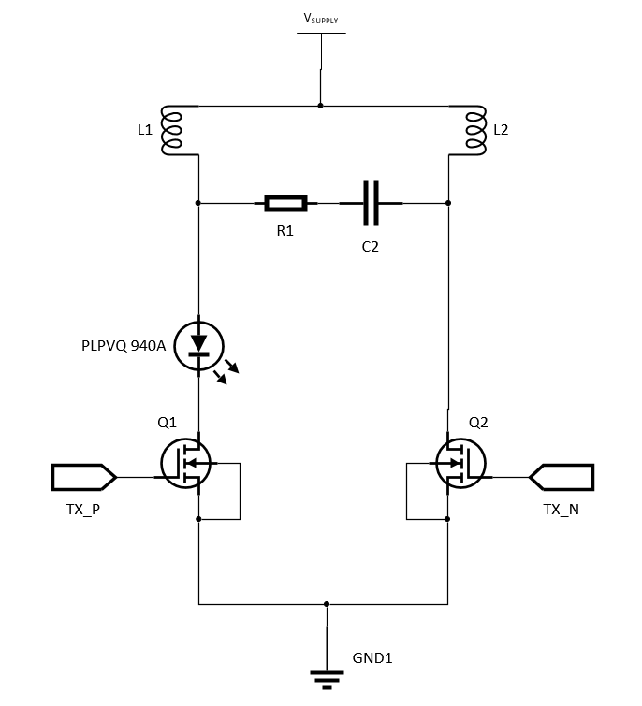
High-bandwidth transmitter front-end designs are well understood to enable even channel bandwidths of 160 MHz or more
VCSEL used (940 nm center wavelength)
Circuit can be tuned further for flatter response
Detector used was Newport 1601FS-AC
  Optical Receiver, 320-1000 nm Silicon Detector, 30 kHz to 1 GHz Bandwidth
Transmission distance was on the order of 10 cm

Slide 6
Achieving over 400 MHz of -3dB channel with a 940nm VCSEL is well understood – suitable for even a 320 MHz 11ax PHY
Simple Front-end design shows relatively flat response with
over 400 MHz -3dB bandwidth

Slide 7
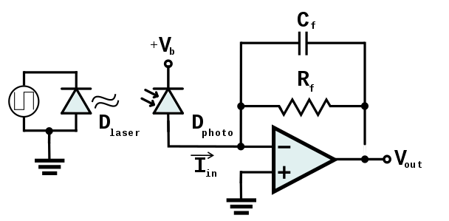
High-bandwidth receiver front-end designs are well understood suitable for 11ax PHY use
Basic avalanche photodiote (APD) connected to a standard trans-impedence amplifier (TIA) tuned for wider bandwidth.

Slide 8
Combined front-end frequency response can easily be designed to achieve multiple 100s MHz
Tx+Rx measured
Combined frequency response has flat response within 180 MHz
Combined frequency response has 3 dB bandwidth of 250 MHz
Bandwidth can be further extended by optimizing detector bias
Device used was LaserComponents SAR1500H4 Si APD+TIA

Slide 9
Non-Line-of-Sight scenarios occur but are much less frequent than LoS for most use-cases of interest in LC with a generally flat channel
Percentage distribution of use-cases that are LoS vs NLoS environments
Majority of use-cases are LoS only
Scenarios | LoS | NLoS
Empty Room | 85.7% | 14.3%
Enterprise-Conference Room | 58% | 42%
Hospital Ward | 87.5% | 12.5%
Residential | 100% | 0%
Industrial Wireless | 16.7% | 83.3%
Doc. 11-18/1582r4, IEEE 802.11bb Reference Channel Models for Indoor Environments.

Slide 10
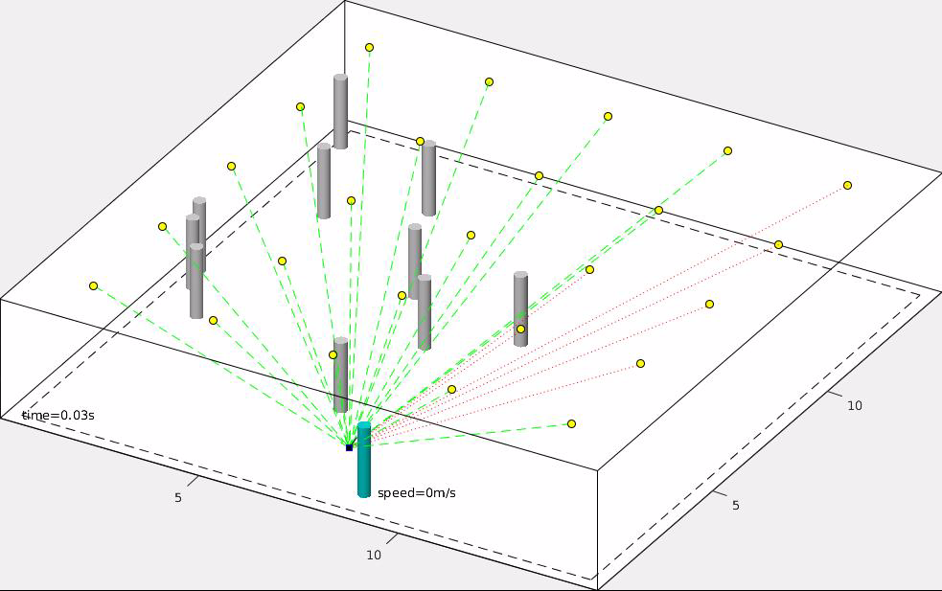
Appropriate system design can avoid nLoS scenarios, making 11ax suitable to be a common-mode PHY basis
https://ieeexplore.ieee.org/document/8756852

Slide 11
There are a several key areas to consider for the wavelength of interest of LC, leading to the conclusion that 900nm - 950nm is the best candidate for a common-mode mandatory wavelength
Silicon based detectors have peak responsivity typically between 800 and 1000nm. The peak value can be adjusted by changing the doping in the epitaxy of the detector
Standard NIR sources operate at wavelengths of 808, 850 or 940nm
Criteria to determine which wavelength should be chosen include:
  Eye safety limits
  Impact on detector responsivity if just wavelength is changed
  Availability of sources

Slide 12
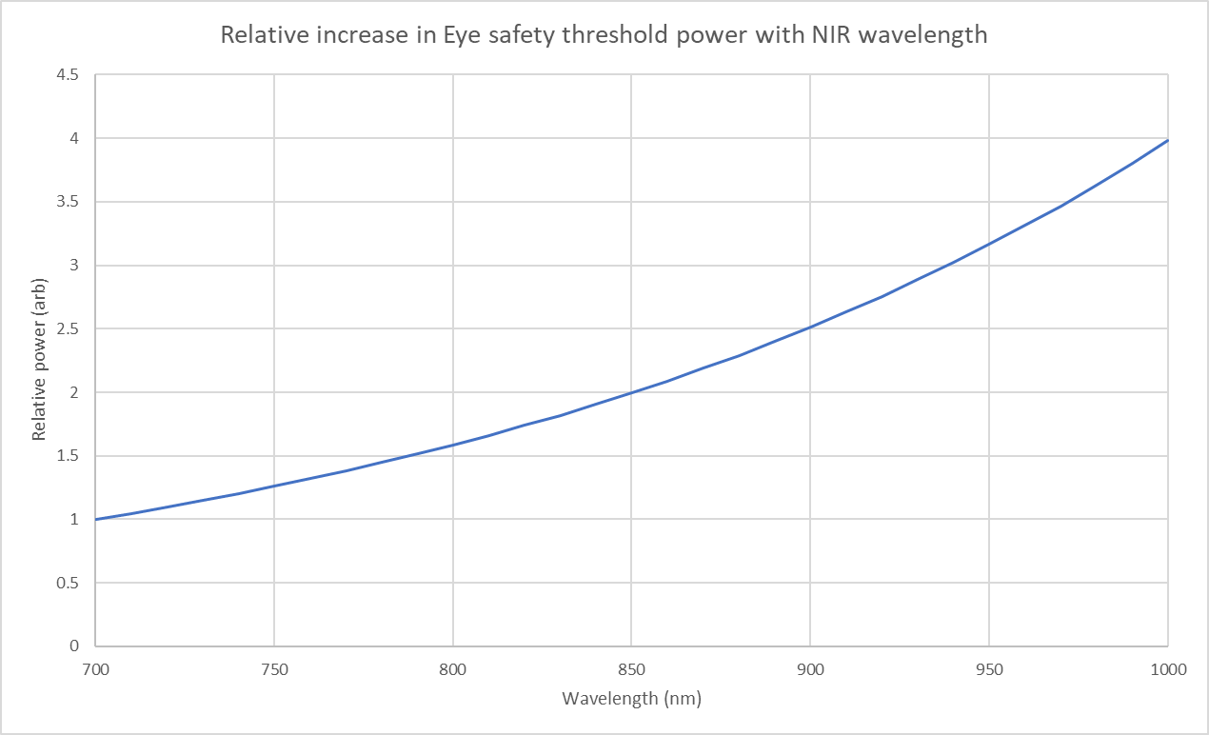
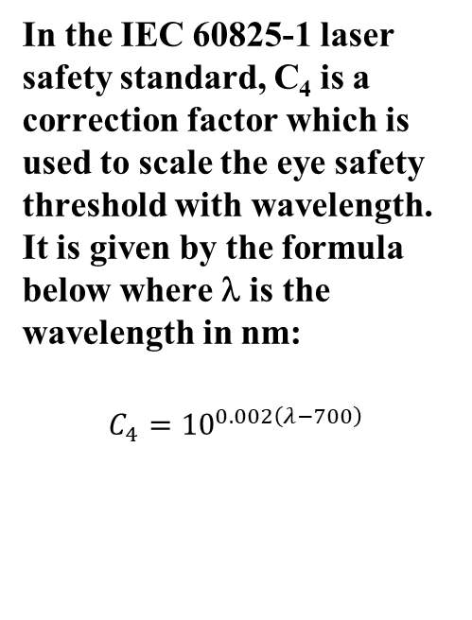
Eye safety limits the total amount of power that a single source can emit
In the IEC 60825-1 laser safety standard, C₄ is a correction factor which is used to scale the eye safety threshold with wavelength. It is given by the formula below where λ is the wavelength in nm:
$$C_{4}={10}^{0.002\left(λ−700\right)}$$

Slide 13
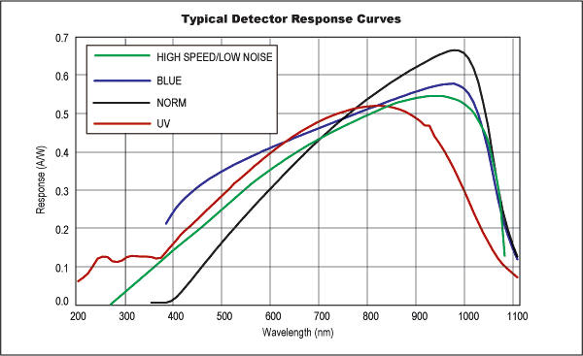
Silicon detector responsivity impacts the available electrical bandwidth of an LC front-end
The figure shows typical responsivity curves with wavelength of silicon based photodetectors. The green curve with high speed and low noise is the one most applicable to a LiFi system and shows very little change in responsivity with wavelength between 850nm and 950nm
https://www.edmundoptics.com/resources/application-notes/testing-and-detection/basic-principles-of-silicon-detectors/

Slide 14
The values of the wavelength dependent parameters are shown in the table below
Wavelength /nm | 808 | 850 | 940
Eye safety wavelength correction factor (C4)* | 1.64 | 2 | 3
Detector Responsivity** | 0.5 | 0.53 | 0.55
* Reference IEC 60825-1 Table 9
** This is for a generic green Silicon photodiode as shown in the Edmund Optics graph. The exact peak position can be varied by adjusting the epitaxy and it may be possible to achieve the same responsivity in all cases

Slide 15
Operating at 940nm offer an the possibility to have an additional 2.7 dB of SNR relative to 808nm while maintaining eye-safe operation
Table below shows how the change in maximum source power with wavelength would affect SNR assuming that all other factors (Detector size, position, orientation and responsivity) remained the same. The reference is a source at 808nm.
Emissions at 940nm allows more optical power to be transmitted and provide higher SNR
Wavelength /nm | 808 | 850 | 940
Maximum source power | 1 | 1.22 | 1.83
SNR change (dB) | 0 | +0.9 | +2.7

Slide 16
Operating at 940nm offer an the possibility to have an additional 0.5 dB of SNR relative to 808nm with the same detector size
Table below shows how the change in detector responsivity with wavelength would affect SNR assuming that all other factors (Detector size, position, orientation and Source power) remained the same. The reference is 808nm.
Better detector responsivity leads to 0.5 dB improvement in the SNR at 940nm.
Wavelength /nm | 808 | 850 | 940
Detector responsivity | 0.5 | 0.53 | 0.55
SNR change (dB) | 0 | +0.3 | +0.5

Slide 17
Technical and commercial reasons indicate that a 940nm source and detector are the best choice for a common-mode wavelength
There is expected to be little change in detector responsivity with wavelength within the region of interest (800nm – 950nm) if the detectors are doped to match.
However, the source power can be increased by 85% with a source operating at 940nm when compared to a source operating at 808nm and so with all other factors being equal that would lead to about a 2.7 dB increase in SNR.
In addition, currently there are more emitting sources available at 940nm, making them more cost effective for mass market introduction.

Slide 18
PROPOSAL: Common-mode mandatory wavelength
Straw Poll: Should TGbb make 900nm – 950nm the common-mode mandatory wavelength for all TGbb STAs?
Y / N / A

Slide 19
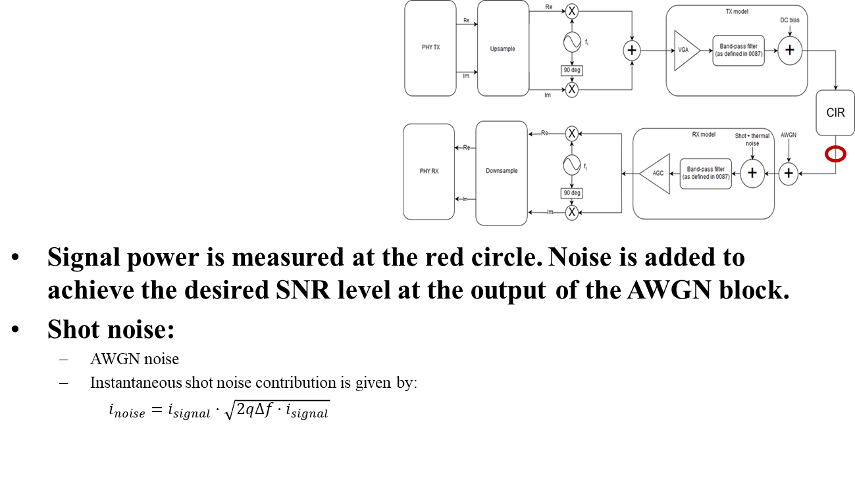
Simulation set-up for 11ax PHY in LC scenarios
Simulations show the performance of 11a PHY in LC scenarios as a basis and compare it to 11ax PHY in the same environments, where 11ax performs better than an 11a.
Simulation set-up:
Preamble: 100,000 repetitions
Header: 10,000 repetitions
Payload: 1,000 repetitions
Signal bandwidth: 20MHz

Slide 20
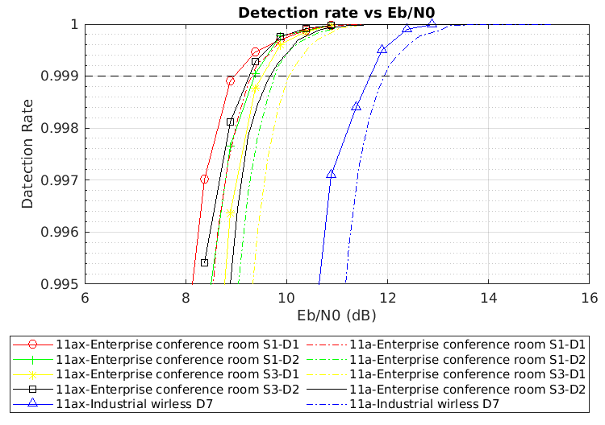
Preamble simulation results show that 11ax has better performance than 11a in an LC channel
Min. SNR for detection rate > 0.999:
Scenario | Min SNR
Enterprise conf. room S1-D1 | 4.6 dB
Enterprise conf. room S1-D2 | 5.0 dB
Enterprise conf. room S3-D1 | 5.2 dB
Enterprise conf. room S3-D2 | 4.8 dB
Industrial wireless | 7.5 dB

Slide 21
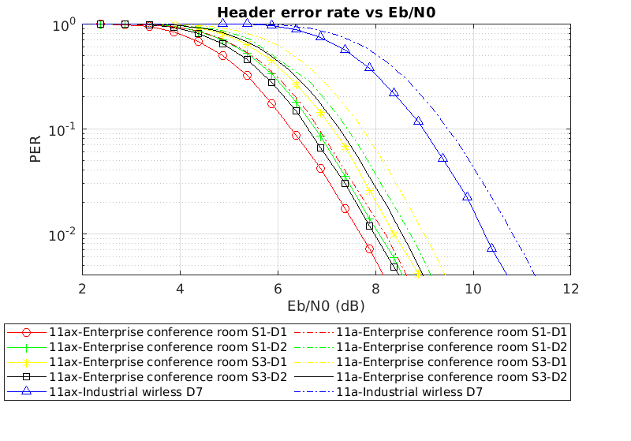
Hearer simulation results show that 11ax has better performance than 11a in an LC channel
802.11a:
  MCS0: BPSK, ½ coding rate
  PHY rate: 6 Mbps
  BW = 20 MHz
  Eb/N0 = SNR + 5.23dB
  10,000 packets
802.11ax:
  MCS0: BPSK, ½ coding rate
  PHY rate: 7.3 Mbps
  BW = 20 MHz
  Eb/N0 = SNR + 4.38dB
  10,000 packets

Slide 22
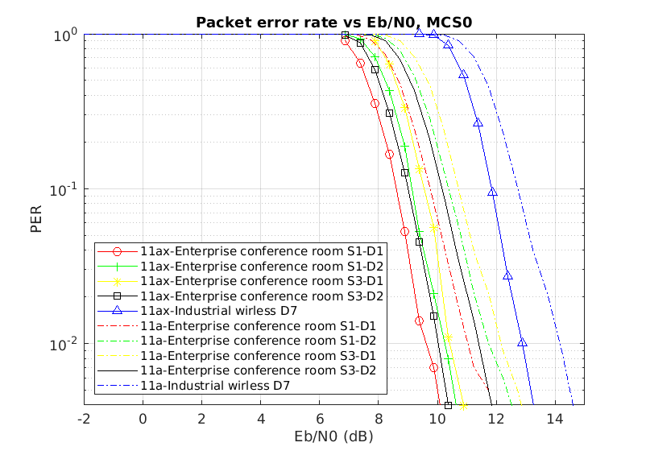
Payload simulation results – MCS0
802.11a:
  MCS0: BPSK, ½ coding rate
  PHY rate: 6 Mbps
  Eb/N0 = SNR + 5.23dB
  1,000 packets
802.11ax:
  MCS0: BPSK, ½ coding rate
  PHY rate: 7.3 Mbps
  Eb/N0 = SNR + 4.38dB
  1,000 packets
The use of LDPC codes improves performance

Slide 23
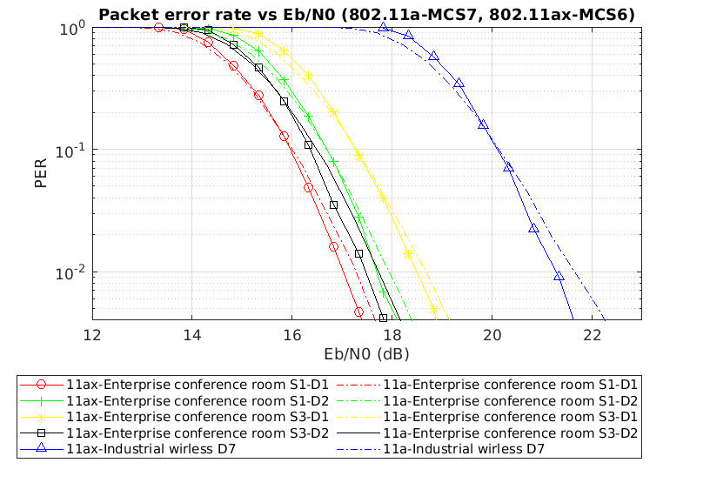
Payload simulation results – MCS7/9
802.11a:
  MCS7: 64QAM, 3/4 coding rate
  PHY rate: 54 Mbps
  Eb/N0 = SNR – 4.31dB
  10,000 packets
802.11ax:
  MCS6: 64QAM, 3/4 coding rate
  PHY rate: 65.8 Mbps
  Eb/N0 = SNR – 5.17dB
  1,000 packets

