Slide 1
Multi-link setup procedure
Date: 2019-xx-xx
Authors:

Slide 2
Introduction
In PAR[1], the multi-link operation is included to enhance the throughput
There are many discussions on framework and operation of multi-link procedure
  The entity for multi-link operation [2], [3]
  BSS configuration of multi-link [4]
  The negotiation procedure of multi-link operation [5]
This presentation continue to discuss the negotiation procedure considering the BSS configuration in multi-link

Slide 3
Recap: multi-link operation and channel access
The use of multi-link may include the transmission of data with same TID in multi-band
  The access procedure of multiple links may be performed by simultaneous and independent access

Slide 4
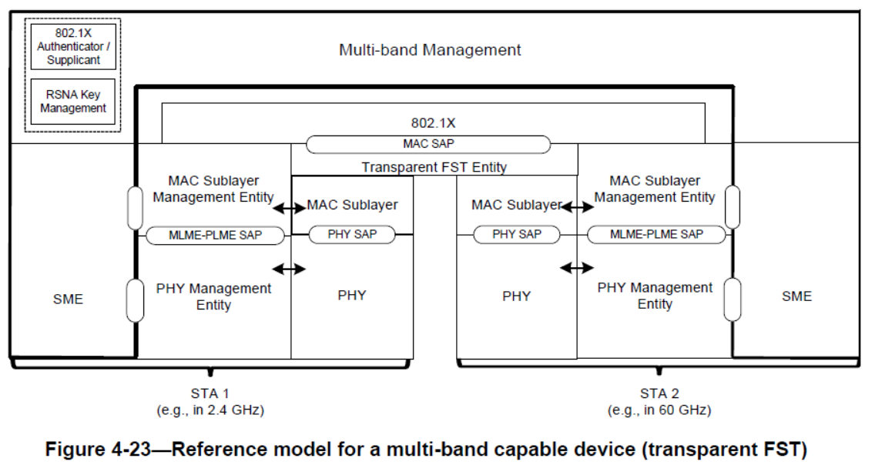
Multi-band reference model
The reference model for multi-band
  Supported transparent/non-transparent FST(Fast Session Transfer)
  Transmission of MSDUs with same TID is generally not allowed

Slide 5
The BSS configuration in baseline
In the baseline, the BSS is configured in each band/primary link
  The primary channel is defined as the common channel used by all STA associated to AP
  The beacon frame transmission is performed on primary channel
With the addition of multi-link concept, the BSS concept may be re-defined
  Decision is needed whether the BSS is configured in each link

Slide 6
BSS definition in multi-link environment: BSS in each link
Each BSS in each link: the multi-link operation is defined as the aggregation between BSS[4]
  Each AID space in each link
  Legacy STA may associate to the corresponding link

Slide 7
Setup procedure for BSS in each link
The setup procedure for multi-link
  The association of each BSS for multi-link is not preferable
  May be set to association for one link and negotiation of using other supplementary links
  Primary link change needs the transfer of association status to the new link
    As in transparent FST of multi-band operation
    May need reassociation/AID reallocation

Slide 8
BSS definition in multi-link environment: BSS in each link
Combined BSS for multiple links
  Same AID space for all links (may need AID space efficient method)
  May need change to the baseline BSS concept
  May need to change the content or transmission operation of Beacon frame
    Supports association with legacy STA in each link (primary channel)
    Supports association with multi-link capable device

Slide 9
Setup procedure for BSS in each link
The setup procedure for multi-link
  STA may listen all possible links in scanning process
  STA may select one link to perform association
  Primary link change does not need transferring the parameter regarding association state
    No need for reassociation/AID reallocation

Slide 10
The negotiation process of multi-link
Link addition concept of supplementary links
  Setting one primary link in association
  Adding process of supplementary links by negotiation

Slide 11
The negotiation process of multi-link
On-off switching of candidate links
  AP broadcasts the supplied link information in Beacon frame or Association response frame
  STA select one link in association
  Additional link is activated by the negotiation process

Slide 12
Conclusion
In this presentation, the BSS configuration and negotiation procedure is discussed
In multi-link scenario, BSS may be configured in two ways
  BSS in each link
  One BSS for all links
The two types of negotiation procedure may be performed
  Association in one link + addition of supplementary links
  Turning on-off switch for each link

Slide 13
Straw poll
Which type of negotiation procedure do you prefer?
  Link addition concept
  On-off switching concept
  Other methods

Slide 14
Reference
[1] 18/1231r6 EHT Draft Proposed PAR, Laurent Cariou (Intel)
[2] 19/773 Multi-link Operation Framework, Po-Kai Huang (Intel)
[3] 19/823 Multi-Link Aggregation, Abhishek Patil (Qualcomm)
[4] 19/1095 Multi-Link Architecture and Requirement Discussion, Yonggang Fang (ZTE)
[5] 19/822 Extremely Efficient Multi-band Operation, Po-Kai Huang (Intel)

