Slide 1
Multi-Band Operation in LC and Hybrid LC/RF Networks
Date: 2019-09-18
Authors:

Slide 2
Abstract
The objective of this contribution is to motivate the need and use of hybrid RF and LC network.
In particular, we promote the existing multi-band operation and Fast Session Transfer (FST) Setup protocol of [1] as way forward for forming hybrid LC and RF networks in the framework of the future 802.11bb.
In addition, it is shown that the existing multi-band operation and Fast Session Transfer (FST) Setup protocol of [1] can be used in the optical band in a straightforward way.

Slide 3
Outline
Why Hybrid LC and RF Networks
Way Forward in 802.11bb
Multi-Band Operation
Fast Session Transfer
Transparent and Non-Transparent FST
Example of the FST Setup Protocol
Use Cases of FST in the Optical and RF Spectrum

Slide 4
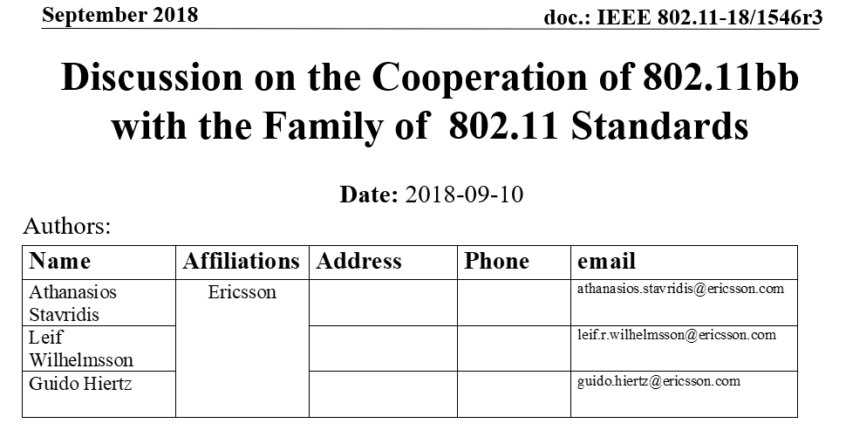
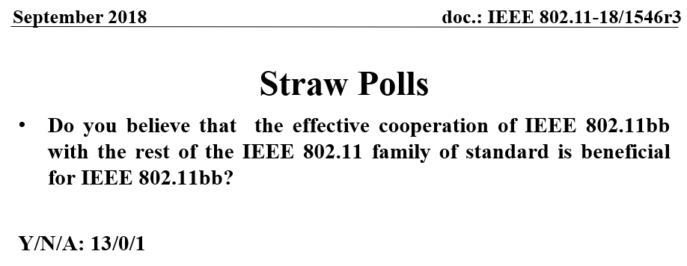
Hybrid LC and RF Networks in 802.11bb

Slide 5
Why Hybrid LC and RF Networks
Difficulties encountered by LC systems:
Low receive SINR (poor communication) in non-favourable geometric setups of the transceiver
Connectivity problems due to the physical signal blockages
Solutions
Optical domain (densification of the optical transmitters and receivers)
Undesirable optical interference
Additional backhauling
Applicable only in static scenarios
Hybrid LC and RF domain
On-the-fly increased connectivity and communication robustness
Indirect support for high mobility
Coverage extension
Cross-room connectivity

Slide 6
Way Forward in 802.11bb
Preferences:
Minimal standardization overhead
Reuse existing 802.11 mechanisms
Suggested solution from IEEE STD 802.11-2016 [3]:
Multi-band operation and the Fast Session Transfer Mechanism (FST)
FST is introduced in IEEE STD 802.11-2016
Mainly motivated by the needs of 802.11ad (60 GHz)
Accommodation of the growing trend of multiband devices (different flavours of 802.11 in different frequency bands)
Efficient utilization of the available spectrum (both RF and LC)

Slide 7
Multi-Band Operation
Based on IEEE STD 802.11-2016 [3], a multi-band capable device is able to:
manage operations in more than one band/channel in a simultaneous manner or not.
support multiple MAC sublayers.
Multi-band procedures enable two multi-band capable devices to:
Discover
Synchronize
(de) Authenticate
(re) Associate
Disassociate
Manage resources with each other in any common band

Slide 8
Fast Session Transfer
A session, in the context of FST, refers to the non-PHY state information that is stored in the two communicating STAs and is available before and after a session transition.
The FST session transition is managed by the FST session setup protocol.
FST session setup protocol:
A multi-band device participates either as a initiator or as a responder.
Includes fours states and rules how to move from one state to another
States:
Initial (the FST session is in operational in one or both bands)
Setup Complete (initiator and responder are ready to change their current bands)
Transition Done (initiator and responder are enabled to operate in the other band if the LLT field is 0)
Transition Confirmed (initiator and responder )
More details about the previous four states can be found in [1, Section 11.33.2]
* Link Loss Timeout (LLT) field is a field in the FST Setup Request frame format

Slide 9
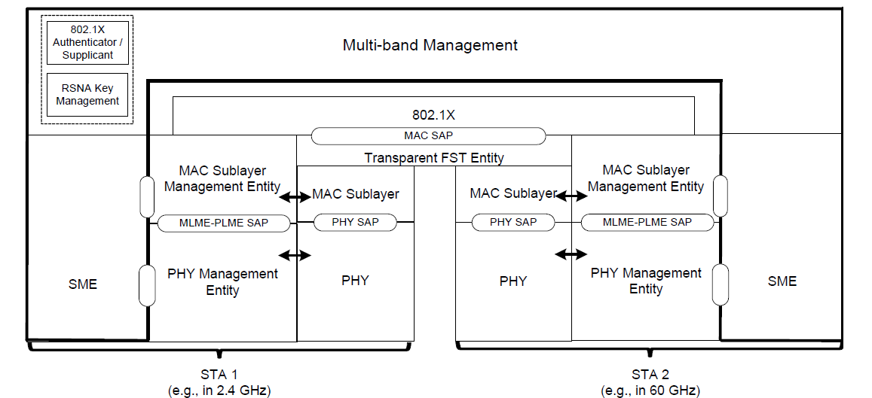
Transparent FST
[1, Section 4.9.4]: Reference model for a multiband capable device and transparent FST.
The layers above 802.11 are not participating in the multi-band operation

Slide 10
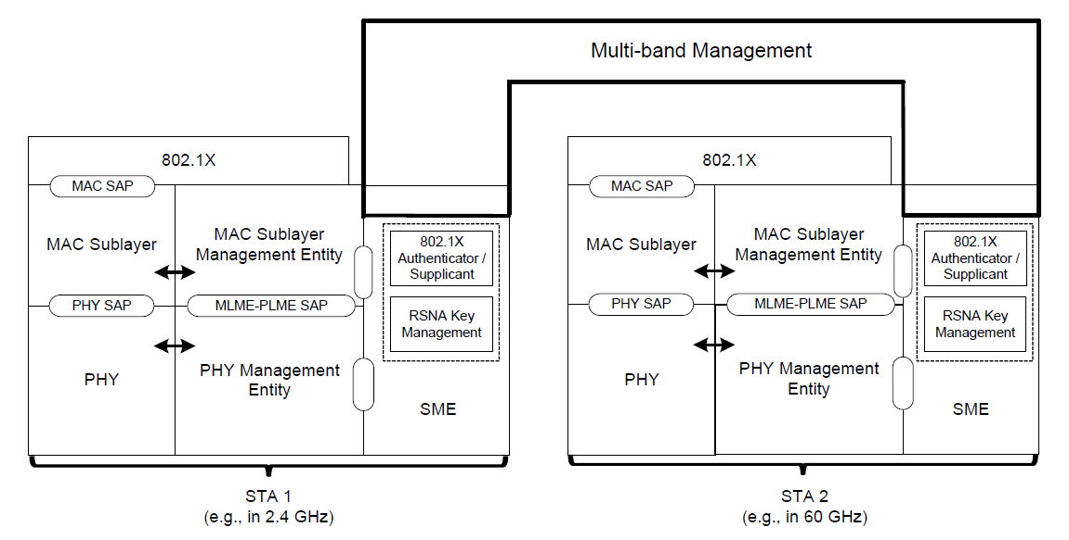
Non-Transparent FST
[1, Section 4.9.4]: Reference model for a multiband capable device and non-transparent FST
The layers above 802.11 are involved of the multi-band operation

Slide 11
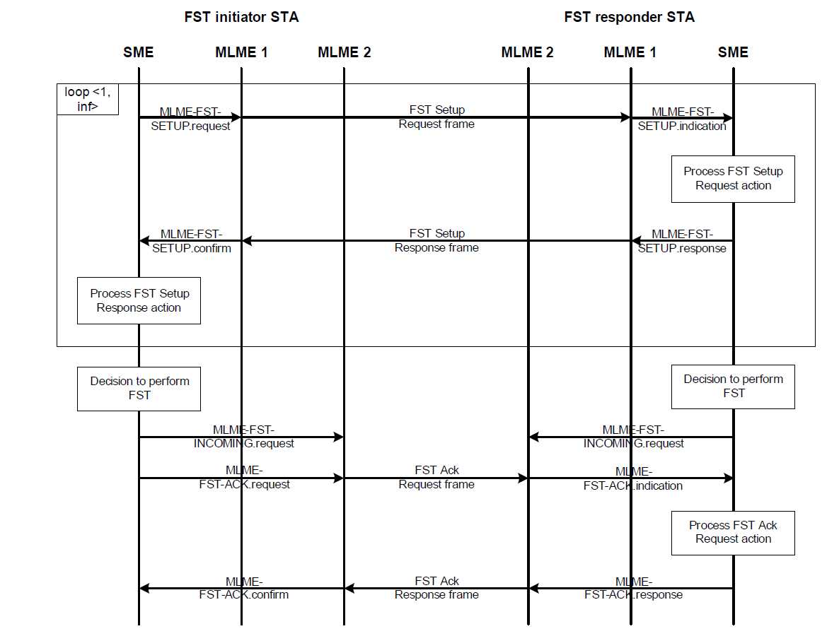
An Example of the FST Setup Protocol
Source: [1]
New band
Old band

Slide 12
FST Setup Protocol Between LC Bands
: LC bands
Source: [1]

Slide 13
FST Setup Protocol Between RF Bands
: RF bands
Source: [1]

Slide 14
FST Setup Protocol Between RF and LC Bands
: LC bands
: RF bands
Source: [1]

Slide 15
FST Setup Protocol Between LC and RF Bands
: LC bands
: RF bands
Source: [1]

Slide 16
Use Cases of FST in the Optical and RF Spectrum
Concurrent use of LC and RF bands
Switch from a LC band to another LC band
Switch from an RF band to a LC band
Switch from a LC band to an RF band
Switch from an RF band to an RF band
A switch from an old band to a new band is not possible using the FST mechanism if there is:
a communication loss in the old band during the FST Setup phase
a communication loss in the new band during the FST Ack phase
Solution: follow the same approach as AD or AY.

Slide 17
Straw Poll
Should the 802.11bb amendment support multi-band operation between any band in the available RF and optical spectrum?
Y/N/A: -/-/-

Slide 18
Motion
Instruct the editor to add the following sentence to clause 4 of IEEE 802.11bb draft:
“4.X.Y Light Communication (LC) STA
The main MAC features in a 802.11bb STA are the following:
Mandatory support for fast session transfer (FST)“
Y/N/A: -/-/-

Slide 19
References
[1] IEEE Standard for Information technology--Telecommunications and information exchange between systems Local and metropolitan area networks--Specific requirements - Part 11: Wireless LAN Medium Access Control (MAC) and Physical Layer (PHY) Specifications," in IEEE Std 802.11-2016 (Revision of IEEE Std 802.11-2012) , vol., no., pp.1-3534, 14 Dec. 2016.

