Slide 1
Triggered P2P
Date: 2019-08-23
Authors:

Slide 2
Abstract
Benefits of Trigger based Direct Link transmission.
Challenges with Direct Link transmission.

Slide 3
Introduction
Direct Link transmission => A Direct Link Scheduled (“DLS”) STA communicates directly with another Direct Link Peer STA (“DLP”).
Benefits of Direct Link (“DiL”) transmission [1] :
high throughput because lower number of transmissions
low latency due to one hop communication.
This presentation discusses an AP initiated DiL transmission mode where an AP transmits a DiL Announcement (DiL-A) frame with TBD format that triggers DiL transmission from one or more STAs.
AP
DiL-A
TXOP
DLS STA
SIFS
Data
DLP STA
SIFS
Ack
Slide 3
Dibakar Das, Intel

Slide 4
Trigger based DiL sequence benefits
A DiL transmission sequence initiated by a TF transmission has following benefits.
Increases the chances of either AP or the DiL STA wins a TXOP for DiL transmissions when both contend simultaneously.
Better medium management at AP as it can serve more than just one DiL STA in a TXOP.

Slide 5
Possible Topologies
Case 1
Case 2
Case 3
DLP
STA
DLS
STA
DLS STA
DLS STA
Both STAs associated
to same AP.
DLP STA
DLP STA
Only one STA associated
to the Triggering AP.
None of the STAs are associated
To Triggering AP.
: AP
: Non-AP STA
Notes:
Case 3 is same as general Multi-AP.

Slide 6
Relationship with Multi-AP techniques
Both Multi-AP and AP initiated DiL transmission sequence are similar in the sense that a (Coordinator) AP allocates resources to another (Coordinated) AP and a STA respectively.
Note: for DiL transmission, negotiation is required as the non-AP STA is not likely to be part of same Mgt domain as triggering AP.
For standardization simplicity, the signaling of resource requests and the general procedure for triggering needs to be harmonized.
Coordinator AP 0
COA frame
Coordinated AP 1
AP 1 transmits to associated STAs
UL frame to AP1
Allocated resource in Multi-AP
AP
DiL-A
frame
DiL STA
DiL STA transmits to its peer
Frame to DiL STA
Allocated resource in Direct Link
Notes:
I am assuming here that Coordinator AP is the one transmitting TF.

Slide 7
What needs to be defined ?
Direct Link Service Discovery and setup
Discovery of EHT TB Direct Link capability.
EHT Direct Link setup between AP and non-AP STAs (associated or non-associated).
Data transmission procedure
Specify signaling inside DiL-A and behavior of STAs participating in the Direct Link transmission.
Ways for DLS STA to report resource allocation request to AP.
Incl. both periodic and aperiodic allocations (e.g., airtime request).
Support for Cascaded Direct Link transmission: DLS STA may solicit transmission from DLP STA for bidirectional traffic within allocated time.
Typical use-case: VR to console communication [2]
Notes:
Discovery of EHT TDL capability:
1. Inform AP that TD peer STA wants to do P2p
2. Between the two P2P STAs they can use a new setup or TDLS or some proprietary setup (e.g., NAN).

Slide 8
Error Recovery
AP only initiates recovery if not detected transmission within SIFS from the DiL-A frame.
Otherwise, AP does not regain control of TXOP until either the end of the allocated time to the DLS STA or receipt of a frame from that STA.
TBD signaling.
TXOP
AP
Frame to another STA
DiL-A frame to DLS STA
SIFS
SIFS
DLS STA
…
Data to DLP STA
SIFS
Trigger P2P
End
SIFS
DLP STA
Ack + Data to DLS STA

Slide 9
Summary
Discussed challenges with Triggered P2P operation.

Slide 10
References
11-18-1481-01-0eht-technology-for-EHT
11-18-2009-06-0rta-rta-report-draft

Slide 11
Straw Poll 1
Do you agree to add the following to SFD:
Do you support that 11be defines a procedure for an AP to share its time resource obtained in a TXOP for peer-to-peer (STA-to-STA) frame exchanges ?
Notes:
Direct Link transmission sequence : transmission from one STA to another.

Slide 12
Backup slides

Slide 13
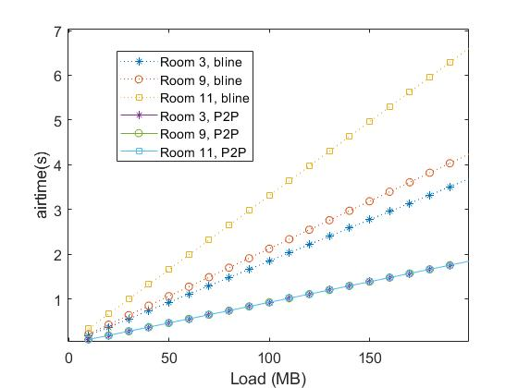
Motivation
P2P communication can significantly reduce the load on the BSS and simultaneously the latency by a one-hop communication.
About 70% reduction in
latency/airtime possible in
the two floor home scenario
by using P2P communication among users in the same room.

Slide 14
Pre-data phase negotiation
STA requests an AP to be scheduled for periodic or aperiodic operation.
For periodic operation, a version of TWT can be negotiated.
For aperiodic operation,
Associated STA can use a QoS Data/Null frame with special signaling in A-Ctrl field containing requested duration of service.
Unassociated STAs can use a Mgt frame containing above signaling.
Multi-AP: An STA can setup a schedule with multiple APs.
Unicast frame in a Multi-AP set.
Broadcast frame for APs that are not part of same Multi-AP set.

