Slide 1
Cumulative impact of multiple impairments on JT performance
Date: 2019-09-15
Authors:
Name | Affiliations | Address | Phone | email
Ron Porat | Broadcom |  |  | ron.porat@broadcom.com
Srinath Puducheri | Broadcom

Slide 2
Abstract
In this contribution we update the our JT results from [1] (simulation configuration r1) to include the impact of additional impairments

Slide 3
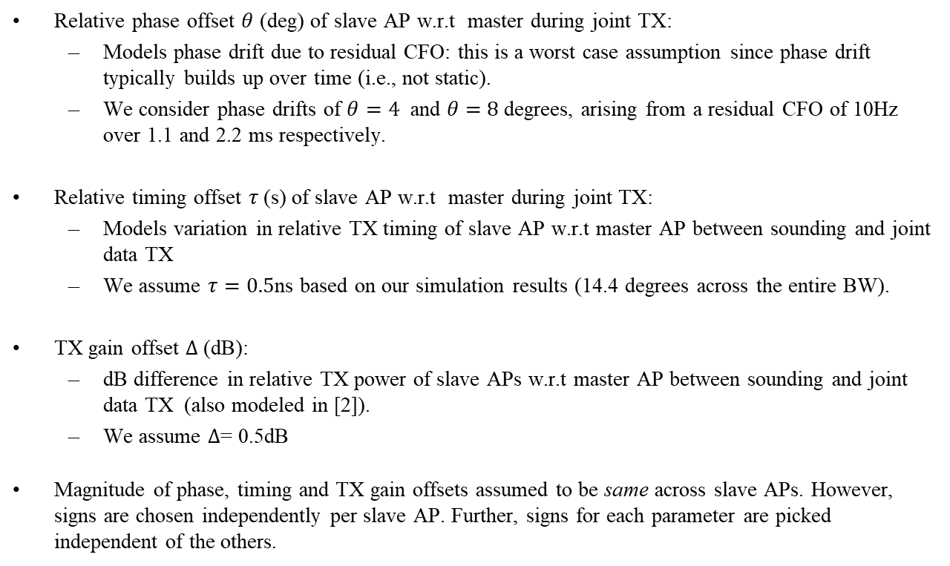
Impairments (1)
Relative phase offset $θ$ (deg) of slave AP w.r.t master during joint TX:
  Models phase drift due to residual CFO: this is a worst case assumption since phase drift typically builds up over time (i.e., not static).
  We consider phase drifts of $θ=4$ and $θ=$ $8$degrees, arising from a residual CFO of 10Hz over 1.1 and 2.2 ms respectively.
Relative timing offset $τ$(s) of slave AP w.r.t master during joint TX:
  Models variation in relative TX timing of slave AP w.r.t master AP between sounding and joint data TX
  We assume $τ=0.5$ns based on our simulation results (14.4 degrees across the entire BW).
TX gain offset $Δ$(dB):
  dB difference in relative TX power of slave APs w.r.t master AP between sounding and joint data TX (also modeled in [2]).
  We assume $Δ$= 0.5dB
  Magnitude of phase, timing and TX gain offsets assumed to be same across slave APs. However, signs are chosen independently per slave AP. Further, signs for each parameter are picked independent of the others.

Slide 4
Impairments (2)
STA channel drift with common-phase tracking on pilots:
  Phase drift (of slave APs relative to master) during joint TX, results in the channel seen by STA during payload changing versus the initial estimate (from preamble) as explained in [3].
  Modeled as static channel error at STA (worst-case assumption), with “common phase” estimation and removal done using pilots.
Joint NDP [4] channel estimation error:
  SNR for NDP assumed to be same as for joint TX; no channel-smoothing assumed.
Tx EVM on master and slave APs: assumed at a level needed for 256QAM

Slide 5
Other Assumptions as in [1]
Channel: 11nD, 80MHz, -30dBc channel aging
Baseline : TDMA across different BSS, each with AP =4 ant., STA = [2 2] ant., Nss = [2 1], DL MU-MIMO per BSS
Path-loss matrix (common to baseline and JT): each STA sees 0dB from own-BSS AP and X dB from remaining APs; X = 10, 20dB
  AP-STA SNR in all plots (x-axis) refers to own-BSS SNR
Joint TX (JT):
  Per-AP tx power = 1.0;
  2AP: AP = [4 4] ant., STA = [2 2 2 2] ant., Nss = [2 1 2 1]
    Total tx power boosted by 3dB
  4AP: AP = [4 4 4 4] ant., STA = [2 2 2 2 2 2 2 2] ant., Nss = [2 1 2 1 2 1 2 1]
    Total tx power boosted by 6dB
Metrics:
  Ideal gain: Gain of ideal JT over ideal baseline (i.e., no impairments for either)
  Impaired gain: Gain of JT with specified impairments over baseline.
  Channel aging present for both cases

Slide 6
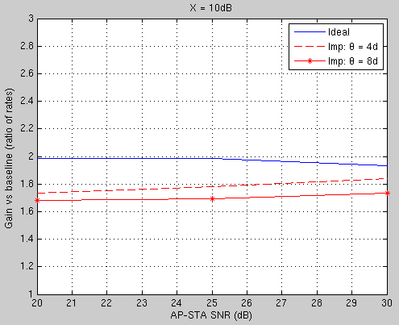
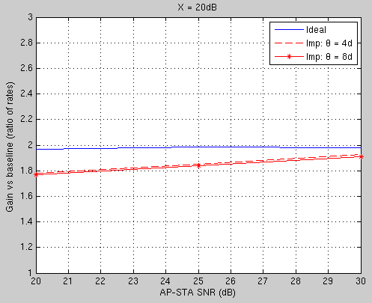
Simulation results: 2AP

Slide 7
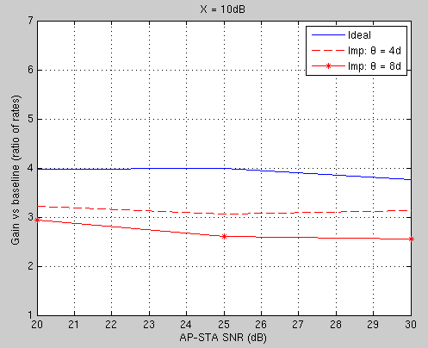
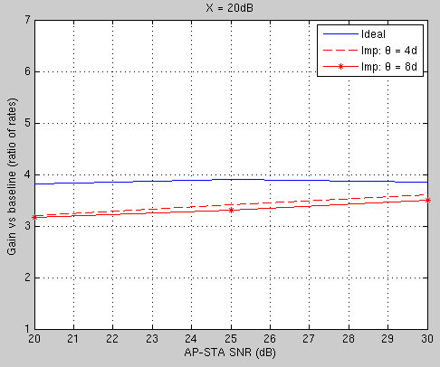
Simulation results: 4AP

Slide 8
Conclusions
As observed in [1], X=20 is insensitive to phase/timing impairments. Gains are:
  2AP: 1.9
  4AP: 3.5
X=10 shows an impact of 8d on performance. Gains @ 30dB SNR:
  2AP: 1.85 for 4d, 1.75 for 8d
  4AP: 3.15 for 4d, 2.6 for 8d
Overall even with higher phase drift and all other impairments included substantial gains with JT are still possible.

Slide 9
References
“Comparison of CBF and JT,” IEEE 802.11-19/0799
“Joint Transmissions: Backhaul and Gain State Issues,” IEEE 802.11-19/1089
“Joint Beamforming Simulations,” IEEE 802.11-19/1094
“Joint Sounding for Multi-AP Systems” IEEE 802.11-19/1593

