Slide 1
Consideration on Joint Transmission
Date: 2019-09
Authors:
Name | Affiliations | Address | email
Bo (Boyce) Yang | Huawei | Nanjing, China
Yunping (Lily) Lv |  | Nanjing, China | lvyunping@huawei.com
Peng (Paul) Chen

Slide 2
Introduction
Joint transmission (JT) as one candidate scheme in multi AP has been discussed in TGbe.
In general, the gain of JT is very attractive， while on the other hand, JT has stringent requirement as well.
Following challenges have been mentioned in TGbe till now.
  Heavy load on backhaul
  Stringent synchronization requirement
In this presentation, we analyze the feasibility to exploit JT in scenarios with wired backhaul, such as enterprise market, and some residential market.

Slide 3
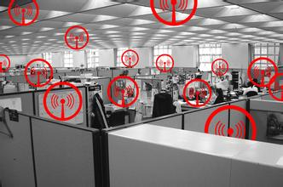
Enterprise Scenario
In enterprise, such as campus, schools, subway\railway\airport stations, malls\hotels\stadiums, hospital, warehouse, it is common that AP backhaul is wired Ethernet network.
A typical office WLAN consists of APs, switch(es)
  APs are connected to switch(es) exchanging Ethernet packets.
Switch
AP
AP
STA
STA

Slide 4
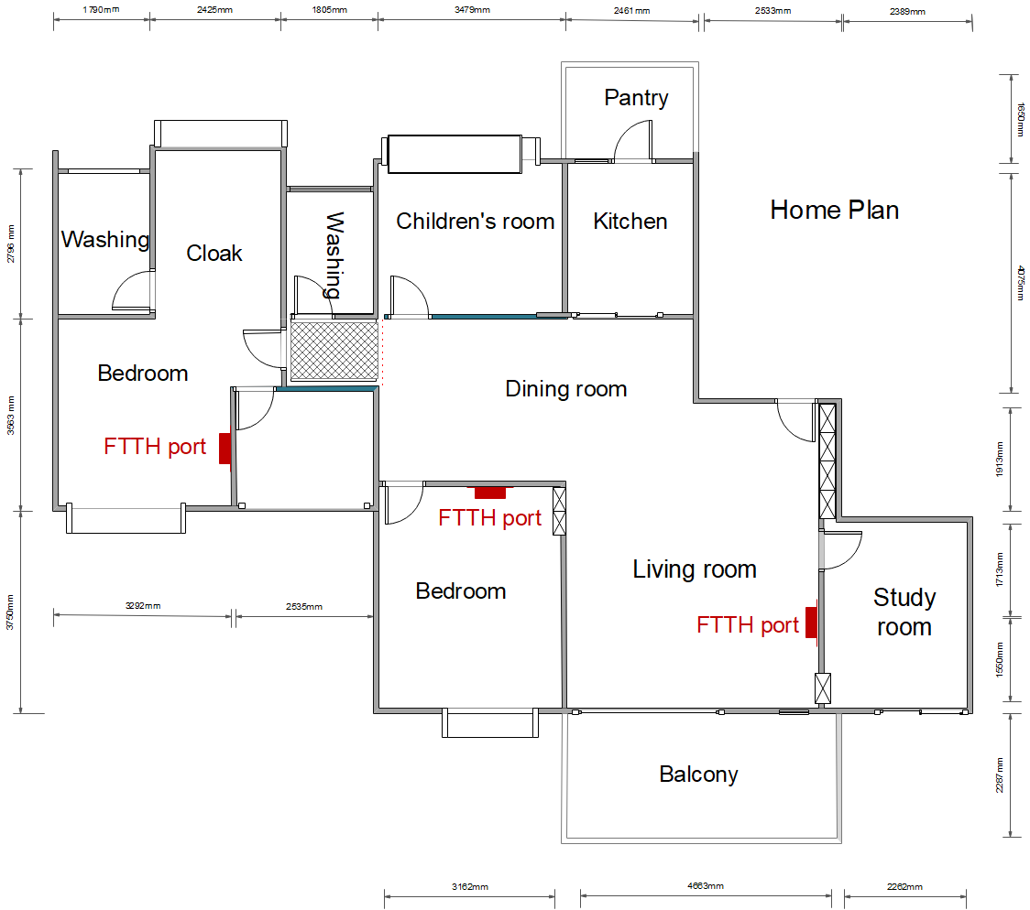
Residual Houses with wired backhaul
Many houses in china have more than one wired port
APs could connected to each other with wired link
AP(master)
AP(slave)
STA
STA

Slide 5
Possible Architecture of JT in Enterprise
Scheduled by AP Coordinator
  Coordinator is a logical entity
Data distributed over Ethernet network
  i.e. joint processing data
Freq sync is achieved by, e.g., Synchronous Ethernet
  Coordinator is the reference
Phase sync and time sync are over the air before each joint transmission
Coordinator
Switch
AP
AP
STA
STA

Slide 6
Backhaul
Exchanging data and control packets over wired backhaul does not degrade the spectral efficiency of air interface.
Refer to [1], JT backhaul bandwidth requirement at 80MHz
  Function of sum PHY data rates being supported over front-haul
    About 3.27 Gbps if using MCS5 (for 12ss total across APs)
    About 3.68 Gbps if using MCS6 (for 12ss total across APs)
    About 4.08 Gbps if using MCS7 (for 12ss total across APs)
Ethernet bandwidth capability is good enough for JT backhaul bandwidth requirement
  Today’s CAT5E cable can transmit at a rate of 5Gbps.
  CAT6 or higher grade copper can provide much more bandwidth, let alone fiber cables.

Slide 7
Synchronization
APs sync their own RF clock with the same clock reference on coordinator through wired backhaul.
  SyncE(synchronization over ethenet) supports 50 ppb or better frequency accuracy[2], which is 300Hz or less in 6G band.
  In our lab test, the equivalent CFO is around 5Hz, taken jitter and wander into account. See next slide test result.
Phase/Timing sync is achieved over the air
  Phase / Time offset could be achieved using trigger frame before JT with very small residual error[3][5].
Trigger
SIFS
Data
AP1
AP2
Trigger
SIFS
Data

Slide 8
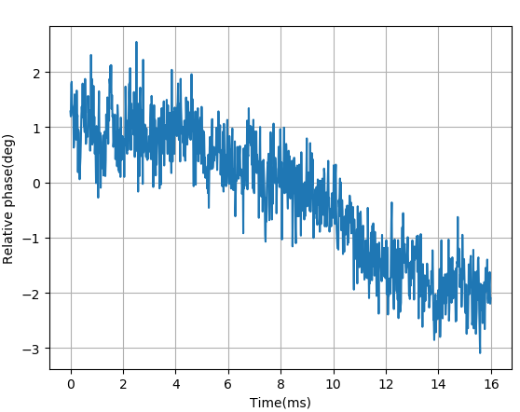
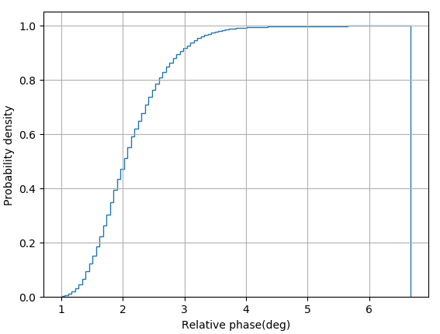
Frequency Sync Test
Test set up:
2 APs synchronize with same clock reference via wired backhaul.
Record phase offset between the 2 APs every 16us.
Test result:
Phase offset in 16ms
CDF: maximum phase offset in 2ms window
Conclusion:
The equivalent CFO (Phase variation) is very small.
The accuracy is independent of SNR of air interface.

Slide 9
Summary
Enterprise scenario should be considered in TGbe.
A candidate architecture is proposed for JT in enterprise scenarios.
Leveraging wired backhaul in enterprise architecture, bandwidth issue and sync issue in JT could be mitigated.
In addition to Freq sync on wired backhaul, phase/time sync over the air is needed.

Slide 10
References
[1] 11-19-1089-00-00be-joint-transmissions-backhaul-and-gain-state-issues
[2] ITU-T G.8261-Timing and synchronization aspects in packet networks
[3] 11-19-1092-01-00be-evaluation-of-joint-transmission
[4] 11-19-0800-00-00be-joint-processing-mu-mimo-update
[5] 11-19-0094-00-0eht-joint-processing-mu-mimo

Slide 11
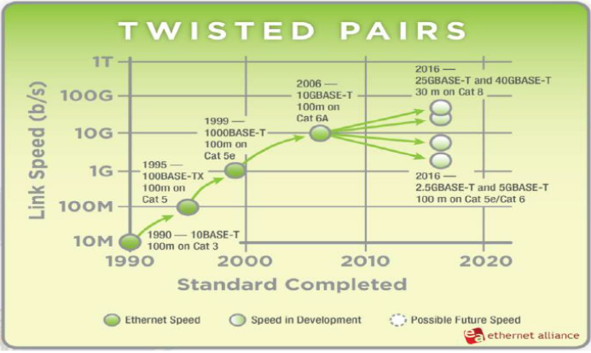
Backup

Slide 12
Backup
Backhual bandwidth requirement of another architecture
APs are connected with a central processor which process the precoded data.
I/Q data is exchanged between central processor and AP.
Central processor
I/Q
I/Q
AP
AP
Assume 80MHz, four 4 Tx APs scenario, I/Q size 8bit
8*2*(242*4)/16us * 4 = 3.87Gbps
STA
STA

