Slide 1
BA Setup for Multi-Link Aggregation
Date: 2019-08-23
Authors:
Name | Affiliations | Address | Phone | email
Jason Yuchen Guo | Huawei Technologies |  |  | guoyuchen@huawei.com
Yunbo Li
Guogang Huang
Ming Gan
Yifan Zhou

Slide 2
Introduction
There have been many discussions on transmitting frames of the same TID across multiple links[1-3].
It is also called multi-link aggregation (MLA), which is critical to improve the peak throughput, and to reduce latency for a particular application [3-4].
The BA setup protocol has been defined in the baseline spec, which should be done before the aggregated data transmission. However, it only allows frames of a particular TID to be transmitted on a single link.
Moreover, the following motion has been passed in the previous F2F meeting:
A single block ack agreement is negotiated between two MLDs for a TID that may be transmitted over one or more links.
NOTE – The format of the setup frames is TBD.
In this contribution, we propose a simple BA setup scheme for multi-link transmission based on the current the BA setup procedure.

Slide 3
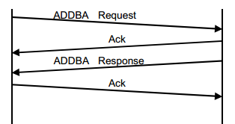
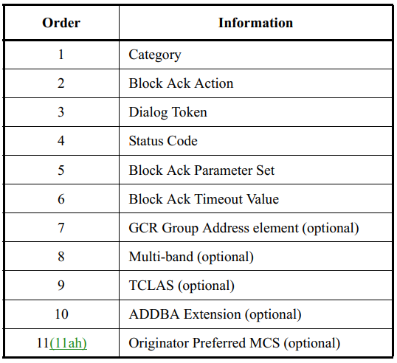
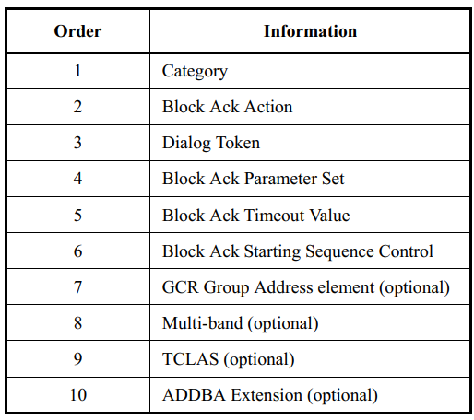
Recap – BA setup
The BA setup procedure between an originator and a recipient in the Spec:
It is an ADDBA request and ADDBA response frame exchange
The ADDBA request and response frames carry the following information:
ADDBA request
ADDBA response

Slide 4
Recap – BA setup
However, in the current standard, the BA agreement can only be established on a single link
The ADDBA request/response frames can optionally carry a multi-band element, if so, the BA agreement is established on the link indicated by the multi-band element
If the multi-band element is not carried in the ADDBA request/response frames, the BA agreement is established on the transmitting link (the link that the ADDBA request/response frames are transmitted)

Slide 5
BA setup for multi-link aggregation
In order to setup a BA agreement for multi-link transmission, we propose to carry multiple multi-band elements in the ADDBA request/response frames
Order | Information
1 | Category
2 | Block ACK Action
3 | Dialog Token
4 | Status Code
5 | Block Ack Parameter Set
6 | Block Ack Timeout Value
7 | GCR Group Address element (optional)
8 | Multi-band (optional)
9 | Multi-band (optional)
10 | TCLAS (optional)
11 | ADDBA Extension (optional)
12 | Originator Preferred MCS (optional)
Order | Information
1 | Category
2 | Block ACK Action
3 | Dialog Token
4 | Block Ack Parameter Set
5 | Block Ack Timeout Value
6 | Block Ack Starting Sequence Control
7 | GCR Group Address element (optional)
8 | Multi-band (optional)
9 | Multi-band (optional)
10 | TCLAS (optional)
11 | ADDBA Extension (optional)
ADDBA request
ADDBA response

Slide 6
BA setup for multi-link aggregation
The RA/TA of the ADDBA request/response frames shall be set to the multi-link device address of the originator and the recipient.
When carried in the ADDBA request frame, the multiple multi-band elements indicate the links that the originator intends to operate on
If the recipient STA replies an ADDBA response frame with the value of the Status Code field set to SUCCESS, then a BA agreement has been established for multi-link aggregation across the indicated links
Note that the multi-band elements in the ADDBA response frame can be a subset of the multi-band elements in the ADDBA request frame
Once the BA agreement for MLA is established, the frames of the same TID indicated in the Block Ack Parameter Set can be transmitted on the multiple links, and the same sequence number space is shared for the frames.
The recipient STA can send a single BA to acknowledge the data frames on all links, or send a BA for each link.
Link 1
SN=1
SN=2
SN=3
SN=4
BA
Link 2
SN=5
SN=6
SN=7
SN=8
BA

Slide 7
Conclusion
We propose a simple BA setup scheme for multi-link transmission based on the current the BA setup procedure
Multiple multi-band element can be put in the ADDBA request and response frames to setup a BA agreement for multi-link aggregation

Slide 8
Straw Poll 1
Do you support setup a BA agreement for multi-link operation by modifying ADDBA request and ADDBA response frames?
Y/N/A =

Slide 9
Straw Poll 2
Do you support to allow ADDBA request and ADDBA response frames to carry multiple multi-band elements to setup a BA agreement for multi-link operation?

Slide 10
Motion 1
Move to add the following text into IEEE 802.11be SFD:
Setup a BA agreement for multi-link operation by using ADDBA request and ADDBA response frames.
Move: Yunbo Li Second:
Discussion:
Result:

Slide 11
References
[1] 11-19-0823-00-00be-multi-link-aggregation
[2] 11-19-0979-00-00be-multi-link-operation-follow-up
[3] 11-19-0821-02-00be-multiple-band-discussion
[4] 11-19-1081-00-00be-multi-link-aggregation-gain-analysis-latency

