Slide 1
BA Setup for Multi-Link Aggregation
Date: 2019-08-23
Authors:
Name | Affiliations | Address | Phone | email
Jason Yuchen Guo | Huawei Technologies |  |  | guoyuchen@huawei.com
Yunbo Li
Guogang Huang
Ming Gan
Yifan Zhou

Slide 2
Introduction
There have been many discussions on transmitting frames of the same TID across multiple links.
  [1] proposes to have a common BA session across all STAs within the MLO entity
  [2] proposes to define a TID-to-Link mapping, which allows a single TID to be mapped to one or more links. The frames belonging to the single TID are sent on the mapped link(s)
  [3] mentions dynamic band switch, which allows the frames for single TID to be transmitted in any band, and BA negotiation in one band apply to all bands
It is also called multi-link aggregation (MLA), which is critical to improve the peak throughput, and to reduce latency for a particular application [3-4].
The BA setup protocol has been defined in the baseline spec, which should be done before the aggregated data transmission. However, it only allows frames of a particular TID to be transmitted on a single link.
In this contribution, we propose a simple BA setup scheme for multi-link transmission based on the current the BA setup procedure.

Slide 3
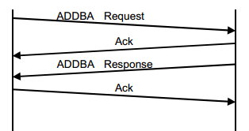
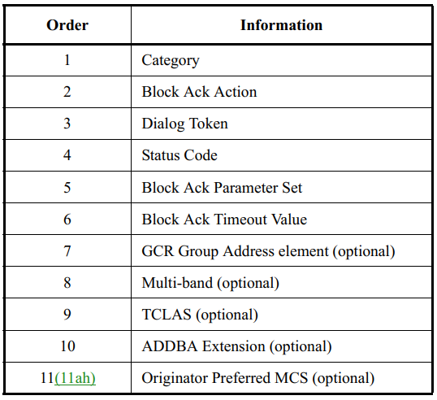
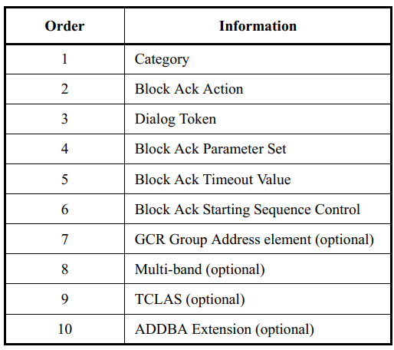
Recap – BA setup
The BA setup procedure between an originator and a recipient in the Spec:
It is an ADDBA request and ADDBA response frame exchange
The ADDBA request and response frames carry the following information:
ADDBA request
ADDBA response

Slide 4
Recap – BA setup
However, in the current standard, the BA agreement can only be established on a single link
  If the multi-band element is not carried in the ADDBA request/response frames, the BA agreement is established on the transmitting link (the link that the ADDBA request/response frames are transmitted)
  If the multi-band element is carried in the ADDBA request/response frames, the BA agreement is established on the link indicated by the multi-band element

Slide 5
BA setup for multi-link aggregation
In order to setup a BA agreement for multi-link transmission, we propose to carry multiple multi-band elements in the ADDBA request/response frames
Order | Information
1 | Category
2 | Block ACK Action
3 | Dialog Token
4 | Status Code
5 | Block Ack Parameter Set
6 | Block Ack Timeout Value
7 | GCR Group Address element (optional)
8 | Multi-band (optional)
9 | Multi-band (optional)
10 | TCLAS (optional)
11 | ADDBA Extension (optional)
12 | Originator Preferred MCS (optional)
Order | Information
1 | Category
2 | Block ACK Action
3 | Dialog Token
4 | Block Ack Parameter Set
5 | Block Ack Timeout Value
6 | Block Ack Starting Sequence Control
7 | GCR Group Address element (optional)
8 | Multi-band (optional)
9 | Multi-band (optional)
10 | TCLAS (optional)
11 | ADDBA Extension (optional)
ADDBA request
ADDBA response

Slide 6
BA setup for multi-link aggregation
The RA/TA of the ADDBA request/response frames shall be set to the MLO entity address of the originator and the recipient.
When carried in the ADDBA request frame, the multiple multi-band elements indicate the links that the originator intends to operate on
When multiple multi-band elements are carried in the ADDBA response frame with the value of the Status Code field set to SUCCESS, then a BA agreement has been established for multi-link aggregation across the indicated links
  The multi-band elements in the ADDBA response frame is a subset of the multi-band elements in the ADDBA request frame
Once the BA agreement for MLA is established, the frames of the same TID indicated in the Block Ack Parameter Set can be transmitted on the multiple links, and the same sequence number space is shared for the frames.
The recipient can use a single BA to acknowledge the data frames on all links
Link 1
SN=1
SN=2
SN=3
SN=4
BA
Carrying bitmap for 2 links
Link 2
SN=5
SN=6
SN=7
SN=8

Slide 7
Conclusion
  We propose a simple BA setup scheme for multi-link transmission based on the current the BA setup procedure
  Multiple multi-band element can be put in the ADDBA request and response frames to setup a BA agreement for multi-link aggregation

Slide 8
Straw Poll
  Do you support allowing ADDBA request and response frames to carry multiple multi-band elements to setup a BA agreement for multi-link aggregation?

Slide 9
References
  [1] 11-19-0823-00-00be-multi-link-aggregation
  [2] 11-19-0979-00-00be-multi-link-operation-follow-up
  [3] 11-19-0821-02-00be-multiple-band-discussion
  [4] 11-19-1081-00-00be-multi-link-aggregation-gain-analysis-latency

