Slide 1
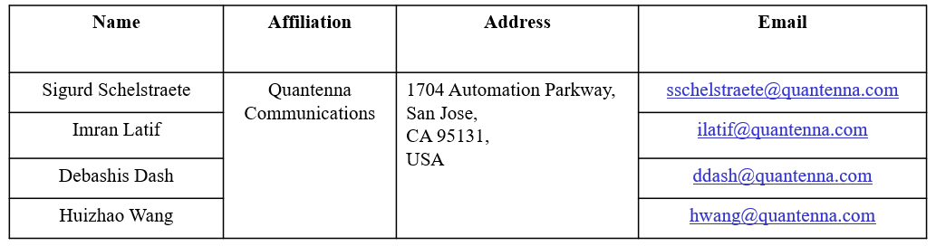
Multi-AP backhaul analysis
Date: 2019-09-13
Authors:

Slide 2
Introduction
Joint transmission (JT) has been extensively discussed as a candidate technology for 11be
  Gains from shared antenna resources
  Gains from independent maximum power limits in each of the APs
Joint operation consists of two main phases
  Information sharing: data to be sent jointly is sent from master AP to slave APs
  Joint transmission: all APs simultaneously send (shared) data to the target STAs
The performance gains of joint transmission have been simulated in numerous submissions [2-9]
The effect of information sharing (a.k.a. backhaul) has only received limited attention [1, 10]

Slide 3
Observations on backhaul
Information sharing (backhaul) needs to provide a rate at least as high as the combined MU rate
  Amount of data exchanged during information sharing is equal to amount of data sent during joint transmission
  [1] establishes backhaul rates for certain example MU configurations
    It does not analyze how actual backhaul rate affects effective data rates
Backhaul rate is a function of distances/link quality between master AP and slave APs
  Independent of joint transmission
  Worst Master-slave link determines possible rate

Slide 4
Goals of this submission
Provide quantitative analysis of impact of backhaul rate
Discuss in-channel vs. off-channel backhaul
Establish expectations for backhaul rates

Slide 5
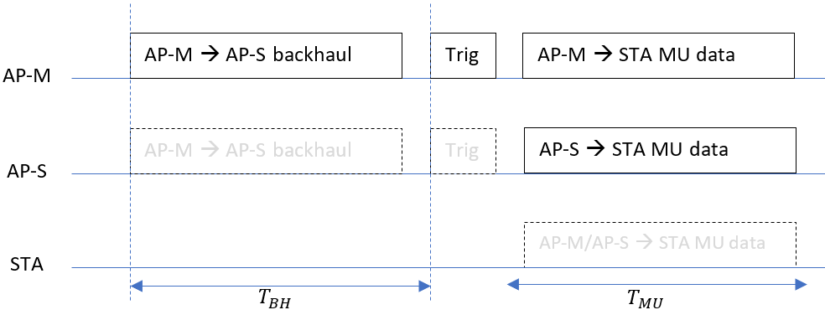
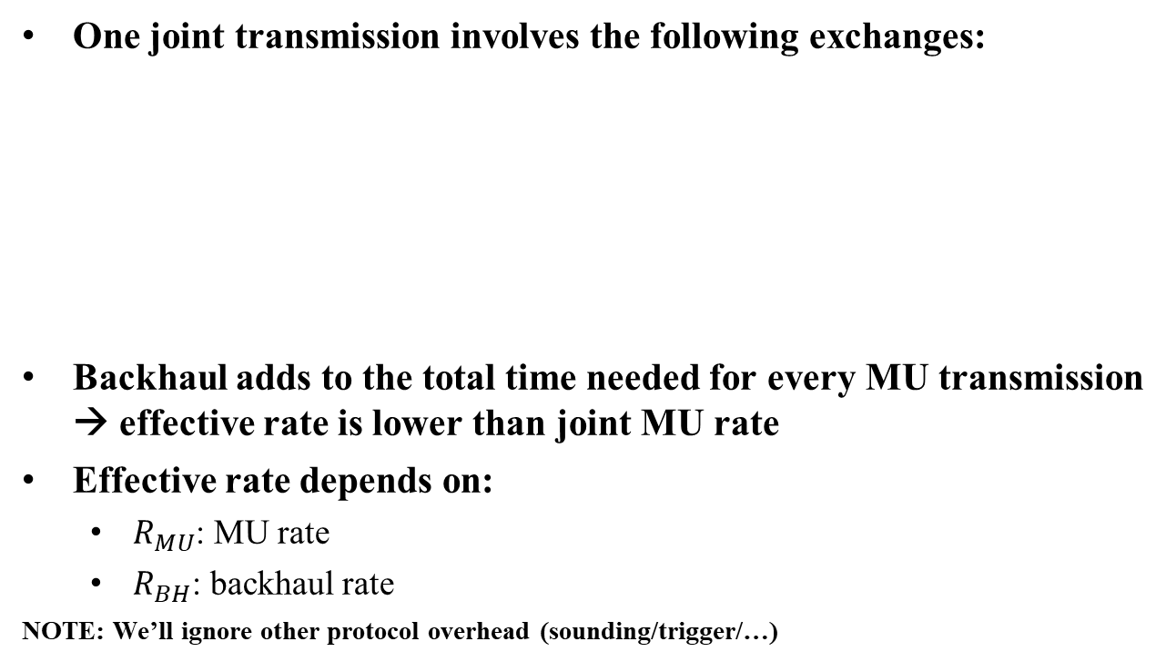
Impact of in-channel backhaul on effective throughput
One joint transmission involves the following exchanges:
Backhaul adds to the total time needed for every MU transmission → effective rate is lower than joint MU rate
Effective rate depends on:
  $R_{MU}$: MU rate
  $R_{BH}$: backhaul rate
NOTE: We’ll ignore other protocol overhead (sounding/trigger/…)

Slide 6
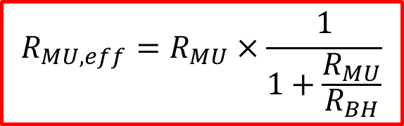
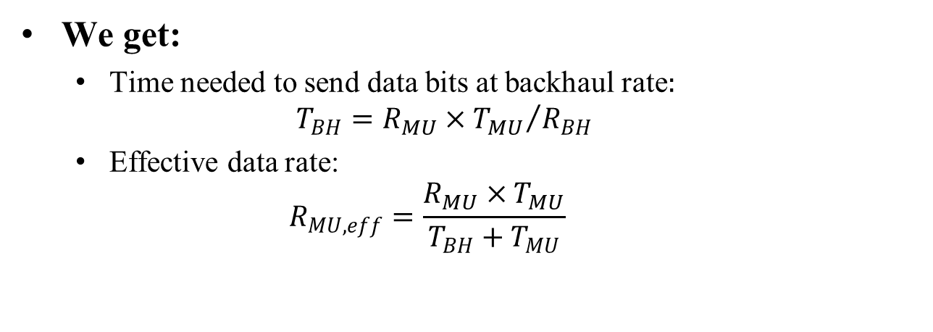
Impact of in-channel backhaul on effective throughput (2)
We get:
  Time needed to send data bits at backhaul rate$:$
  $T_{BH}={R_{MU}×T_{MU}}/{R_{BH}}$
  Effective data rate:
  $R_{MU,eff}=\frac{R_{MU}×T_{MU}}{T_{BH}+T_{MU}}$
$${R_{MU,eff}=R}_{MU}×\frac{1}{1+\frac{R_{MU}}{R_{BH}}}$$

Slide 7
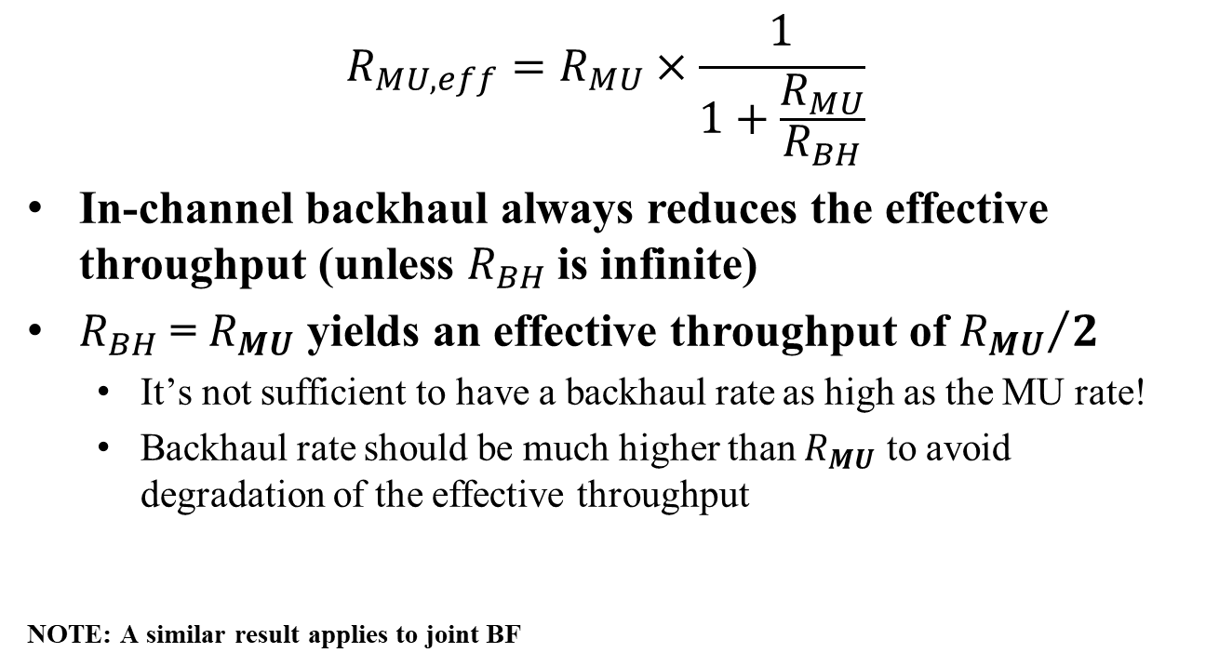
Effective Throughput
$${R_{MU,eff}=R}_{MU}×\frac{1}{1+\frac{R_{MU}}{R_{BH}}}$$
In-channel backhaul always reduces the effective throughput (unless $R_{BH}$is infinite)
$R_{BH}$ = $R_{MU}$ yields an effective throughput of ${R_{MU}}/2$
  It’s not sufficient to have a backhaul rate as high as the MU rate!
  Backhaul rate should be much higher than $R_{MU}$ to avoid degradation of the effective throughput
NOTE: A similar result applies to joint BF

Slide 8
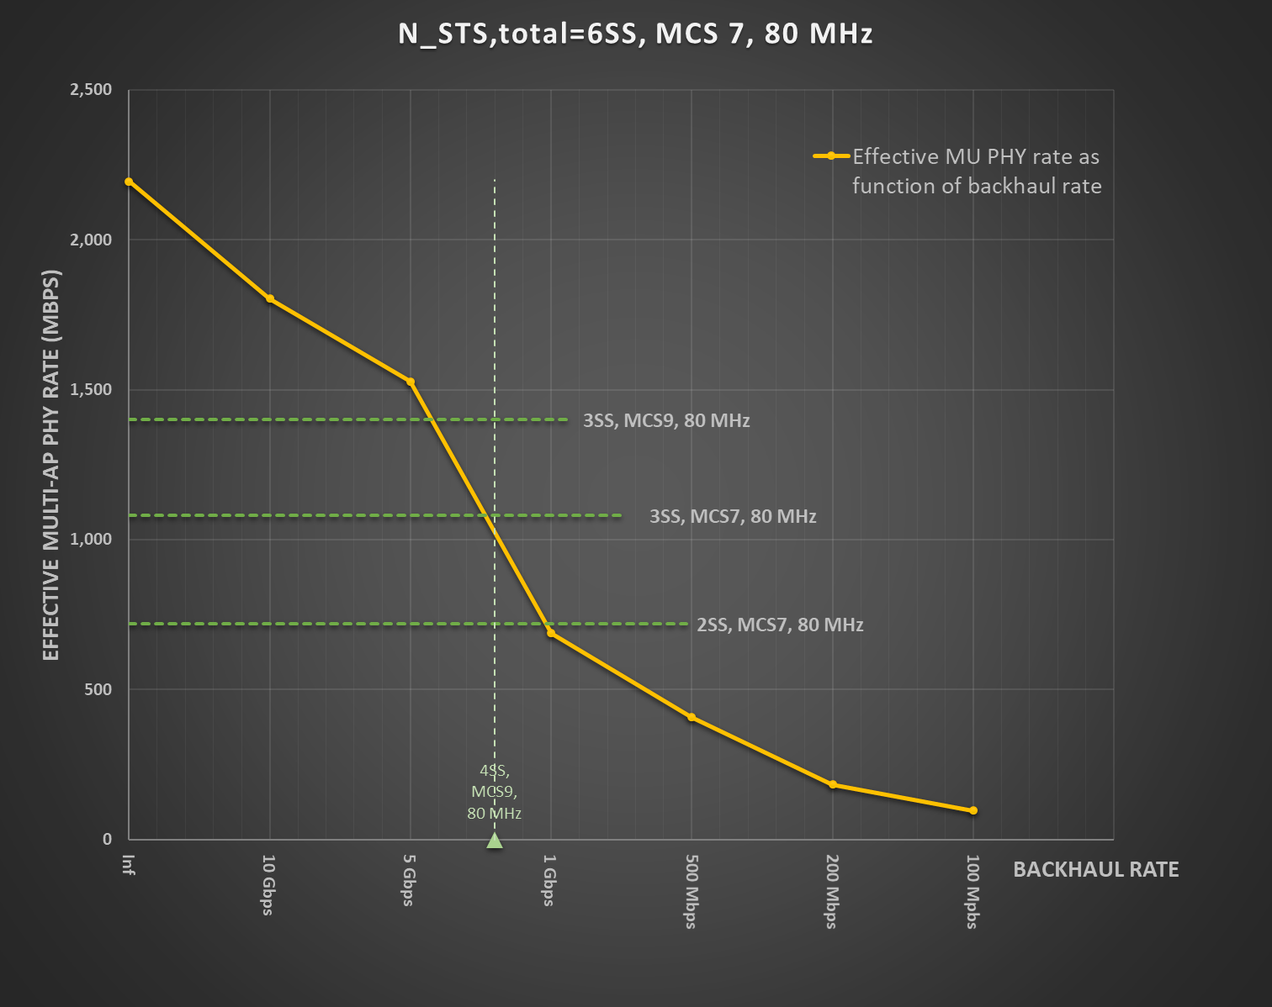
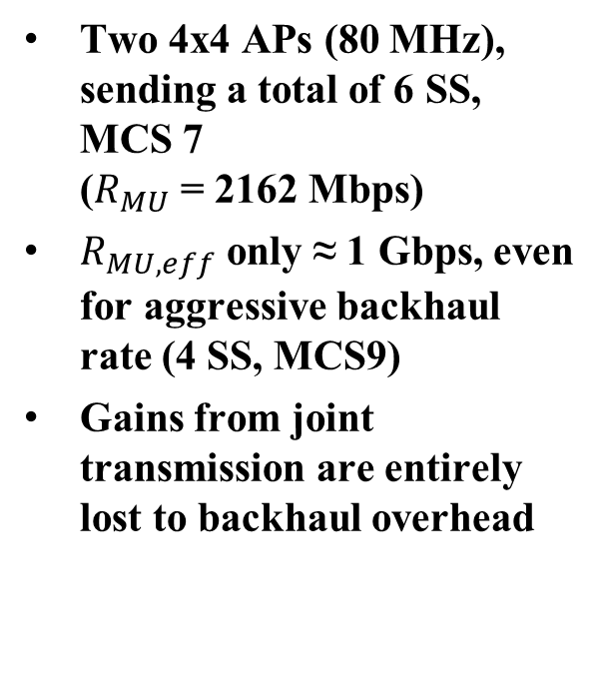
Example (1)
Two 4x4 APs (80 MHz), sending a total of 6 SS, MCS 7
($R_{MU}$ = 2162 Mbps)
$R_{MU,eff}$ only ≈ 1 Gbps, even for aggressive backhaul rate (4 SS, MCS9)
Gains from joint transmission are entirely lost to backhaul overhead

Slide 9
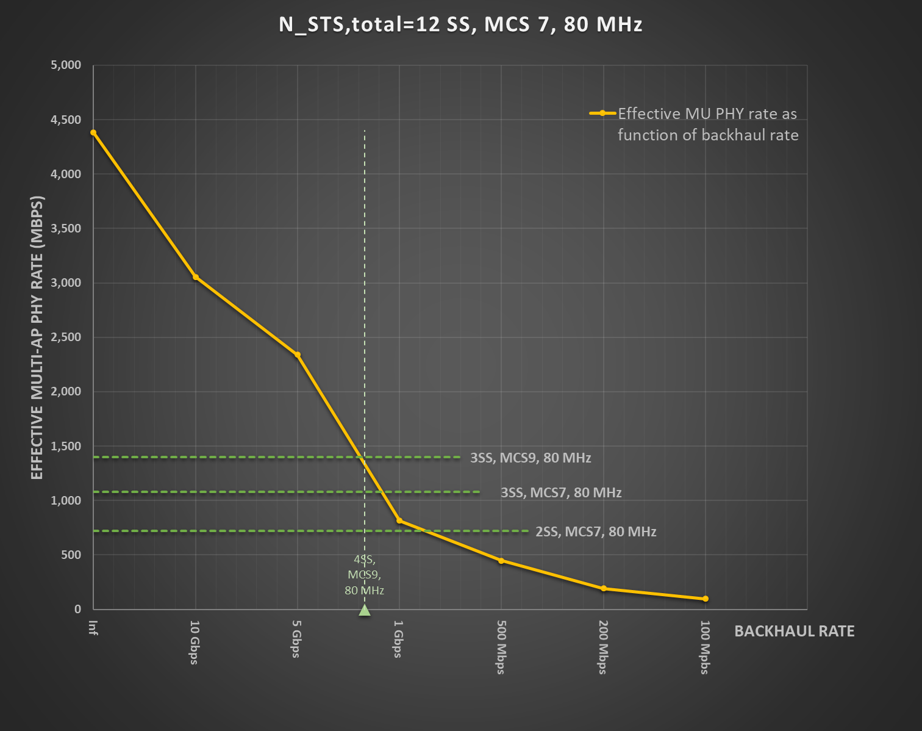
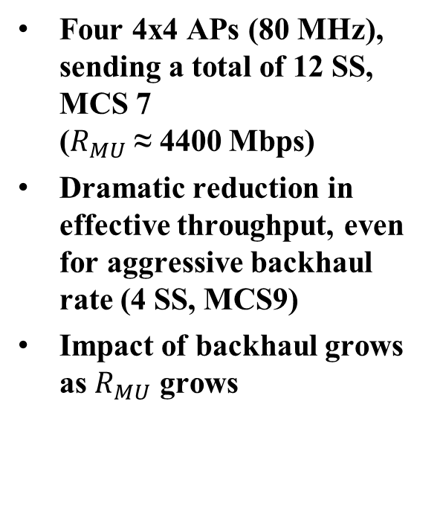
Example (2)
Four 4x4 APs (80 MHz), sending a total of 12 SS, MCS 7
($R_{MU}$ ≈ 4400 Mbps)
Dramatic reduction in effective throughput, even for aggressive backhaul rate (4 SS, MCS9)
Impact of backhaul grows as $R_{MU}$ grows

Slide 10
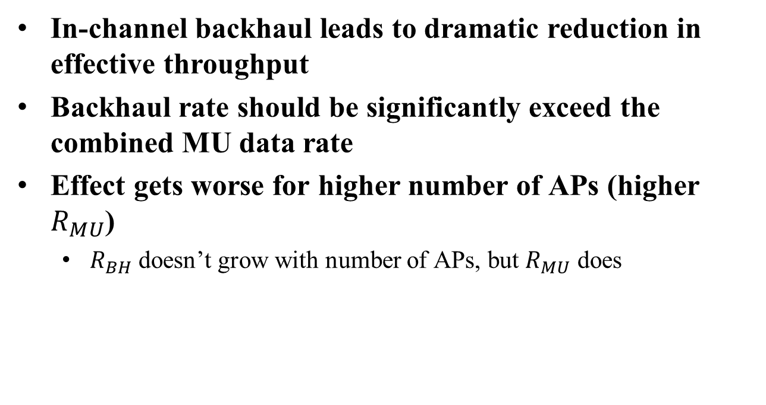
Notes on in-channel backhaul
In-channel backhaul leads to dramatic reduction in effective throughput
Backhaul rate should be significantly exceed the combined MU data rate
Effect gets worse for higher number of APs (higher $R_{MU}$)
  $R_{BH}$ doesn’t grow with number of APs, but $R_{MU}$ does

Slide 11
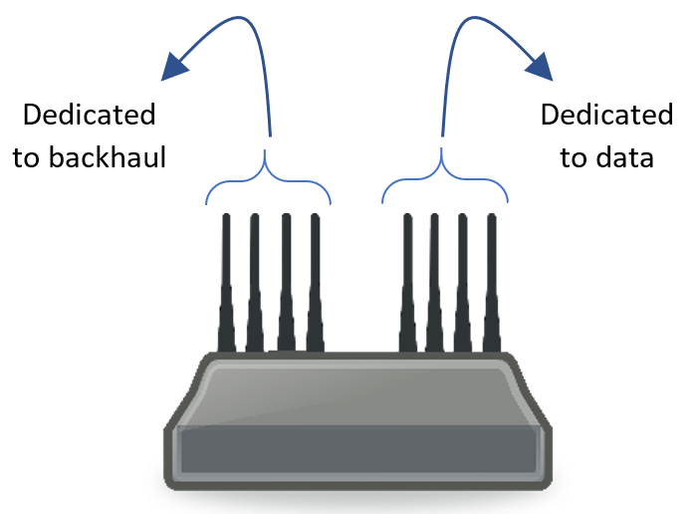
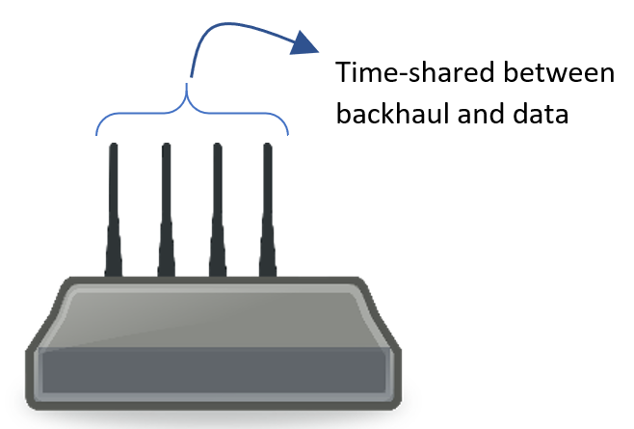
Off-channel backhaul
Data and backhaul in different Wi-Fi channels
  Could be different BW
Two scenarios
  Reuse antennas, i.e.: same antennas are used to do backhaul in off-channel as are used for in-channel MU transmission
  Separate set of dedicated antennas for backhaul

Slide 12
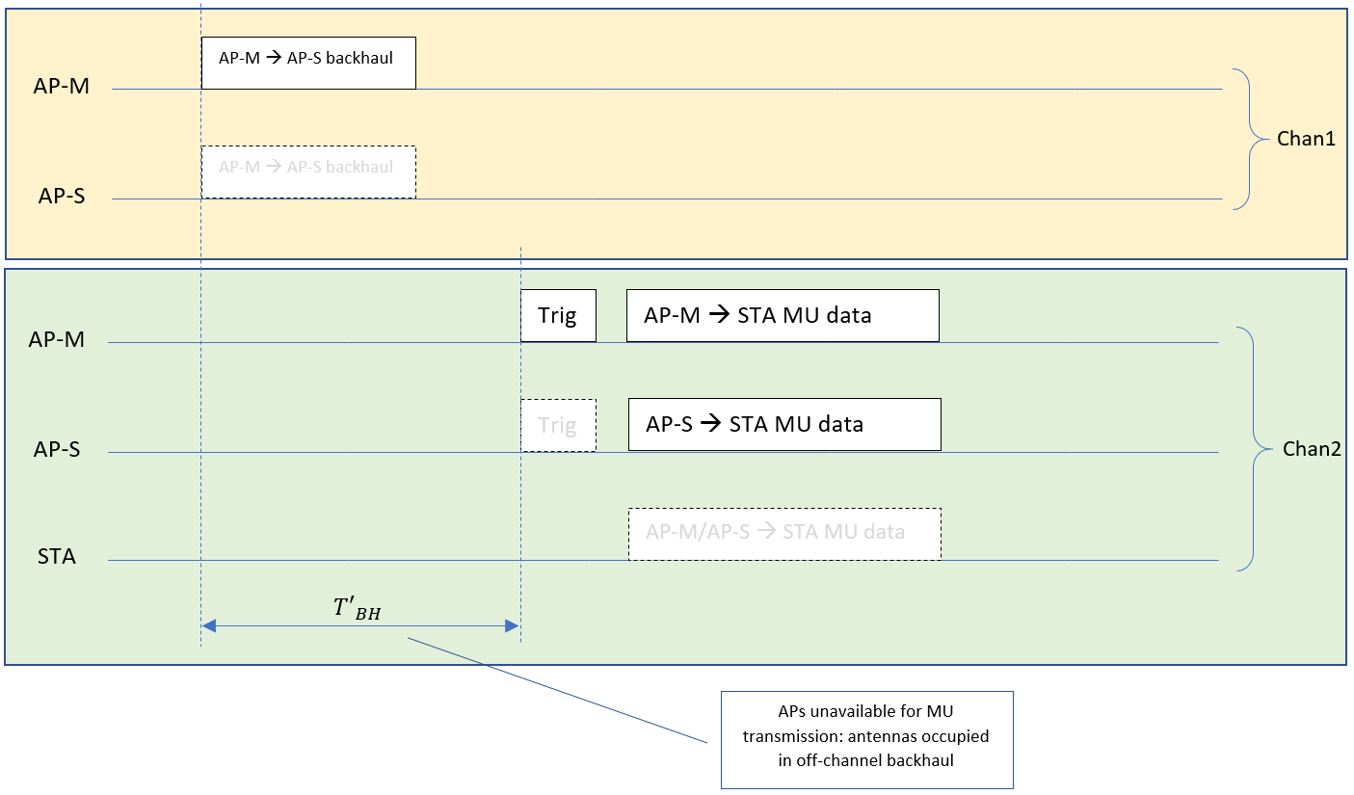
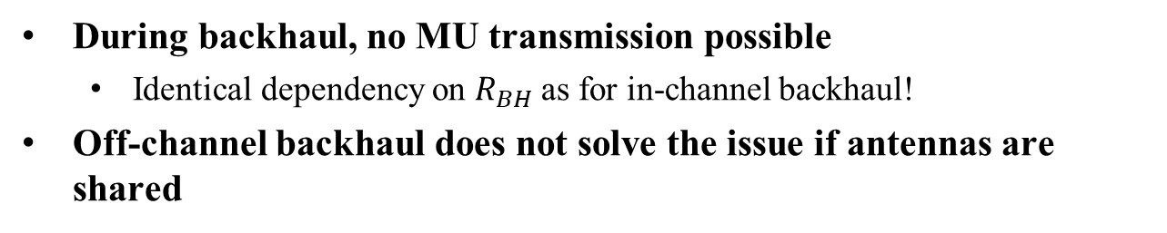
Off-channel backhaul with antenna reuse
During backhaul, no MU transmission possible
  Identical dependency on $R_{BH}$as for in-channel backhaul!
Off-channel backhaul does not solve the issue if antennas are shared

Slide 13
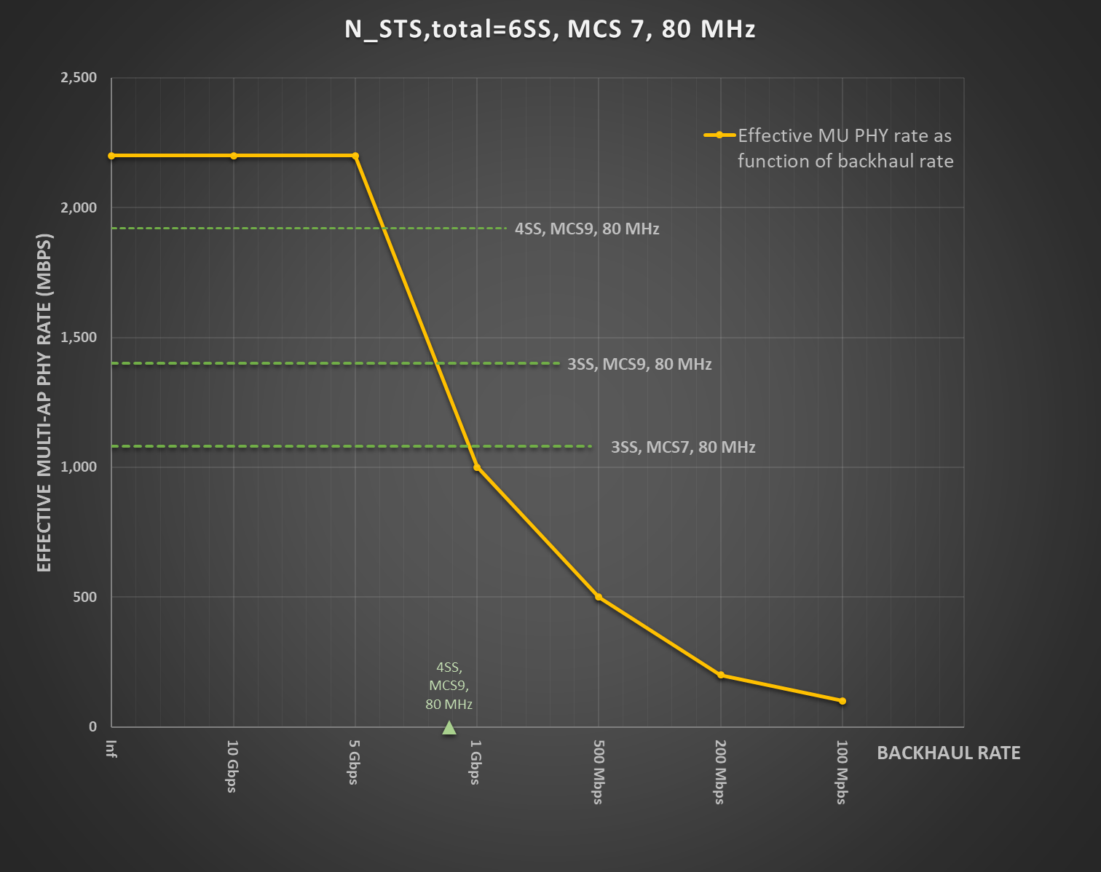
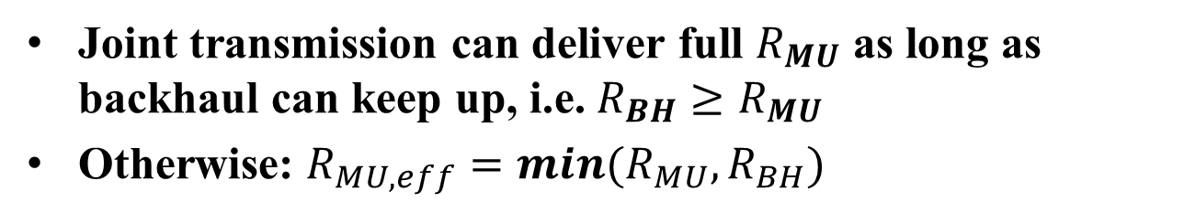
Off-channel backhaul with dedicated antennas
Joint transmission can deliver full $R_{MU}$ as long as backhaul can keep up, i.e. $R_{BH}≥R_{MU}$
Otherwise: ${R_{MU,eff}=min(R}_{MU},R_{BH})$
Significant reduction in effective throughput even at “realistic” backhaul rates (e.g. 4SS, MCS 9)

Slide 14
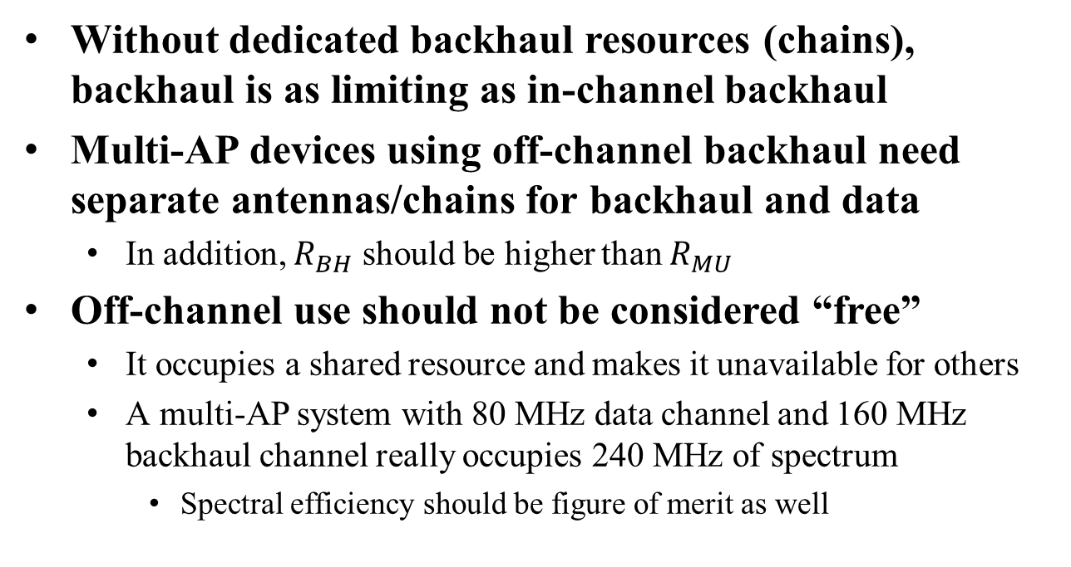
Notes on off-channel backhaul
Without dedicated backhaul resources (chains), backhaul is as limiting as in-channel backhaul
Multi-AP devices using off-channel backhaul need separate antennas/chains for backhaul and data
  In addition, $R_{BH}$ should be higher than $R_{MU}$
Off-channel use should not be considered “free”
  It occupies a shared resource and makes it unavailable for others
  A multi-AP system with 80 MHz data channel and 160 MHz backhaul channel really occupies 240 MHz of spectrum
    Spectral efficiency should be figure of merit as well

Slide 15
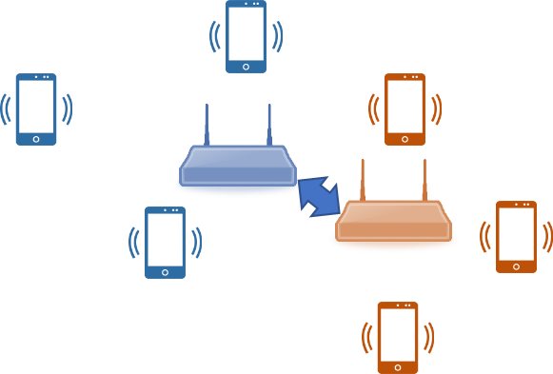
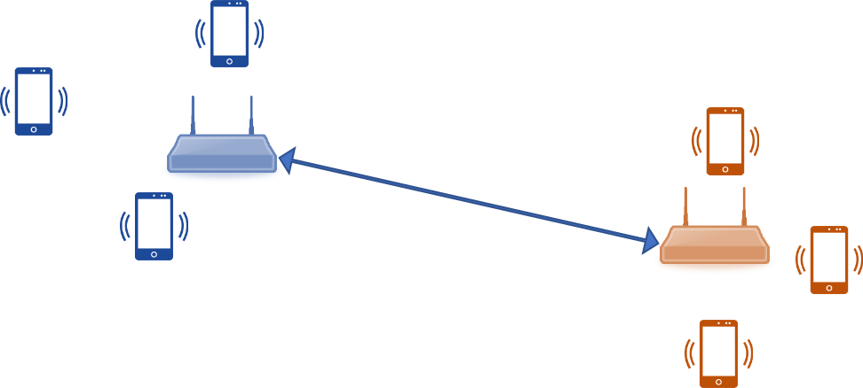
What is expected backhaul rate?
Joint Multi-AP operation assumes that APs are neither too close together nor too far apart
  Too close: mesh solution doesn’t make sense
  Too far: information sharing becomes severe bottleneck
Achievable rate depends on minimum rate across all AP-M/AP-S links
Optimistic Mid-range MCS ≈ 1-2 Gbps (160 MHz, 3SS)
  Higher is not realistic with wireless backhaul

Slide 16
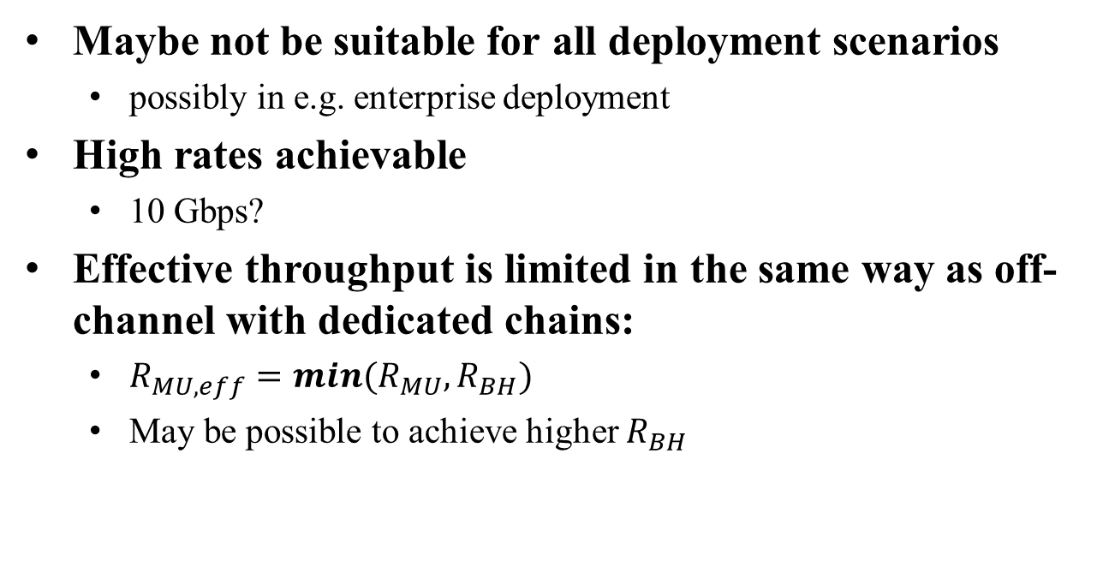
Wired backhaul
Maybe not be suitable for all deployment scenarios
  possibly in e.g. enterprise deployment
High rates achievable
  10 Gbps?
Effective throughput is limited in the same way as off-channel with dedicated chains:
  ${R_{MU,eff}=min(R}_{MU},R_{BH})$
  May be possible to achieve higher $R_{BH}$

Slide 17
Conclusion
Backhaul in joint operation can have significant impact
  In-channel backhaul doesn’t appear practical
  Off-channel backhaul with antenna sharing doesn’t appear practical
  Best solution is an independently operating backhaul
    Off-channel wireless or wired
    Dedicated antennas/wired interface
Impact of backhaul should not be ignored
  More work is needed to address this issue
  Specifically, simulation results should include assumptions and impact of backhaul

Slide 18
References
[1] Joint Transmissions, Backhaul and Gain State Issue, IEEE 802.11-19/1089
[2] Performance of Coordinated Null Steering in 802.11be, IEEE 802.11-19/1212
[3] Evaluation of joint transmission, IEEE 802.11-19/1092
[4] Joint BF Simulations, IEEE 802.11-19/1094
[5] Performance Investigation on Multi-AP Transmission, IEEE 802.11-19/779
[6] Multi-AP Collaborative BF in IEEE 802.11, IEEE 802.11-19/772
[7] Performance on Multi-band Operation, IEEE 802.11-19/777
[8] Joint Processing MU-MIMO Update, IEEE 802.11-19/800
[9] Comparison of CBF and JT, IEEE 802.11-19/799
[10] Joint Beamforming protocol simulation, IEEE 802.11-19/92

